Slide 1
Chapter 8 Operating System Support
Resource management
Providing support
Scheduling
Maximizing use of resources
Memory management
Partitioning
Paging
Virtual memory
Segmentation

Slide 2
What is an Operating System?
An Operating System is a program or collection of
programs that makes it easier for us to use a computer.
An Operating System provides simpler abstraction of the
underlying hardware.
An Operating System is resource manager.
Examples:
• DOS, OS/2, Windows XP, Windows 2000
• Ubuntu, FreeBSD, Fedora, Solaris, Mac OS
• iOS, Android, Symbian OS, Lynx OS

Slide 3
Objectives of Operating System
Convenience
Making the computer easier to use
Efficiency
Allowing better use of computer resources
Functions:
Managing Resources
Scheduling Processes (or tasks)
Managing Memory

Slide 4
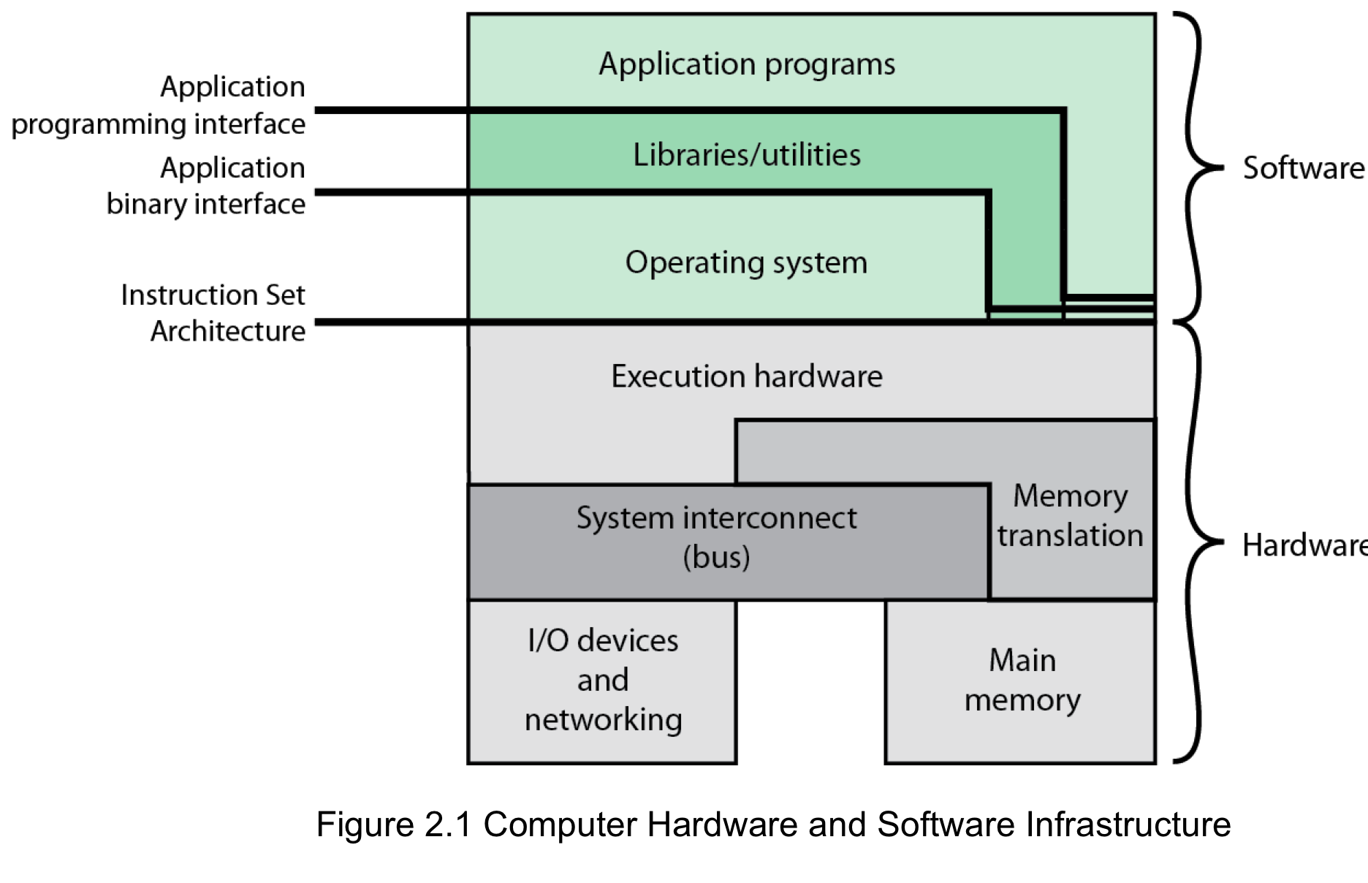
COMPUTER HARDWARE AND
SOFTWARE INFRASTRUCTURE

Slide 5
Operating System Services include
Program creation
Program execution
I/O Operation
Resource Management
File system manipulation
System access/protection
Error detection
Accounting

Slide 6
KEY INTERFACES
1. Instruction Set Architecture (ISA)
2. Application Binary Interface (ABI)
3. Application Programming Interface
(API)

Slide 7
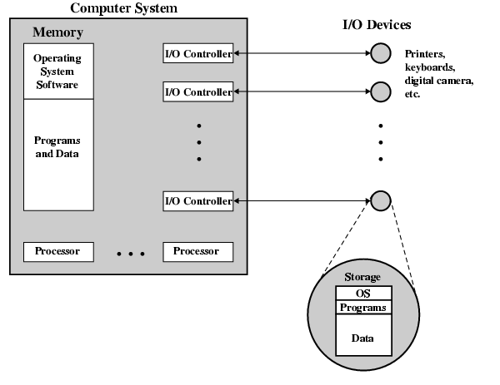
O/S as a Resource Manager

Slide 10
THE ROLE OF AN OS
A computer is a set of resources for the
movement, storage, and processing of data
and for the control of these functions.
The OS is responsible for managing these
resources

Slide 11
Types of Operating System
Interactive
Batch
Single program (Uni-programming)
Multi-programming (Multi-tasking)
Real-Time

Slide 12
Simple Batch Systems
Resident Monitor program
Users submit jobs to operator
Operator batches jobs
Monitor controls sequence of events to process batch
When one job is finished, control returns to Monitor which reads next job
Monitor handles scheduling

Slide 13
Memory Layout for Resident Monitor

Slide 14
Job Control Language
Instructions to Monitor
May be denoted by $
e.g.
$JOB
$FTN
... High Level Language Program
(Fortran, COBOL, . . . )
$LOAD
$RUN
... Application Data for program
$END

Slide 15
Desirable Hardware Features
Memory protection
To protect the Monitor
Timer
To prevent a job monopolizing the system
Privileged instructions
Only executed by Monitor
e.g. I/O
Interrupts
Allows for relinquishing and regaining control

Slide 16
Multi-programmed Batch Systems
I/O devices are very slow
➔ Waiting is inefficient use of computer
When one program is waiting for I/O, another can use the CPU

Slide 17
Uni-programmed System

Slide 18
Multi-Programming with Three Programs

Slide 19
Sample Program Mix

Slide 20
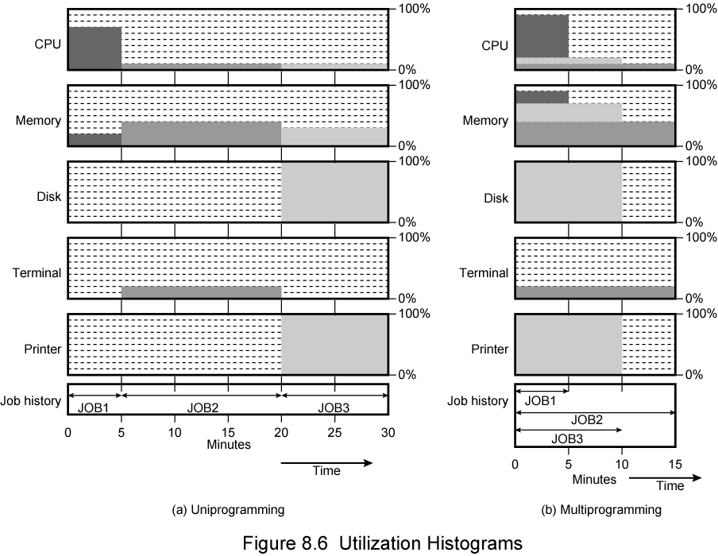
Utilization: Uni-programmed vs Multi-programmed

Slide 21
Multiprogramming Resource Utilization

Slide 22
Some Types of Systems
Uniprogramming - One user at a time uses the computer
Time Sharing - Allow users to interact directly with the computer
i.e. Interactive
Multi-programming - Allows a number of users to interact with the computer

Slide 23
Types of Scheduling

Slide 24
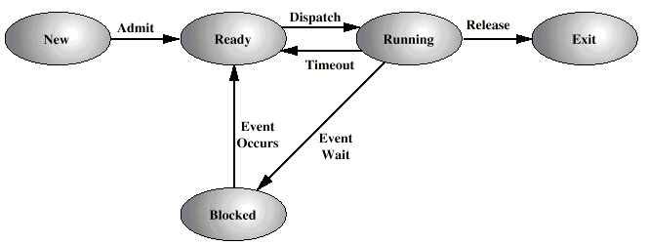
Five State Process Model

Slide 25
Process Control Block

Slide 26
Key Elements of O/S

Slide 27
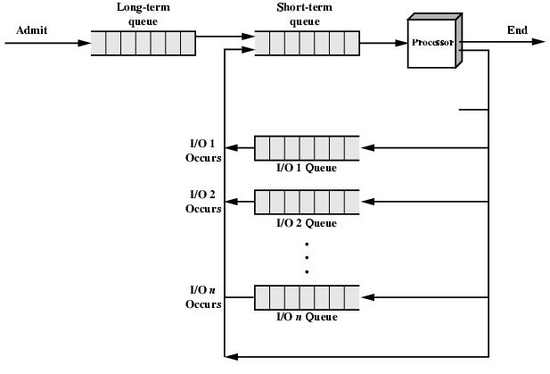
Process Scheduling

Slide 28
Memory Management
Uni-programming
Memory split into two
One for Operating System (monitor)
One for currently executing program
Multi-programming
“User” part is sub-divided and shared among active processes
Note: Memory size
- 16 bits ➔ 64K memory addresses
- 24 bits ➔ 16M memory addresses
- 32 bits ➔ 4G memory addresses

Slide 29
Swapping
Problem: I/O is so slow compared with CPU that even in multi-programming system, CPU can be idle most of the time
Solutions:
Increase main memory
Expensive
Swapping

Slide 30
What is Swapping?
Long term queue of processes stored on disk
Processes “swapped” in as space becomes available
As a process completes it is moved out of main memory
If none of the processes in memory are ready (i.e. all I/O blocked)
Swap out a blocked process to intermediate queue
Swap in a ready process or a new process
But swapping is an I/O process…
Isn’t I/O slow?
So why does swapping make sense ?

Slide 31
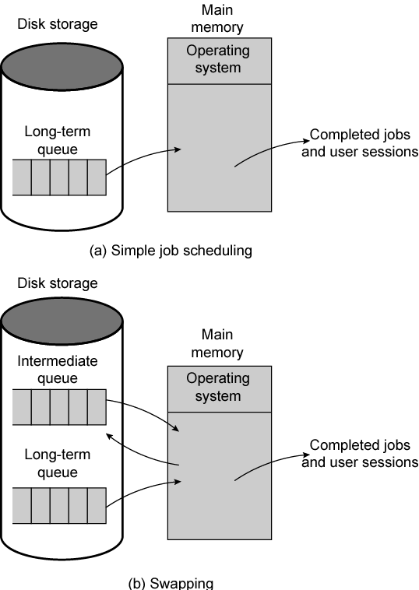
Use of Swapping

Slide 32
Partitioning
Partitioning:
May not be equal size Splitting memory into
sections to allocate to processes
(including Operating System!)
Fixed-sized partitions
Potentially a lot of wasted memory
Variable-sized partitions
Process is fitted into smallest hole that it will fit in
Dynamic partitions
no room for additional memory allocation
memory leak – need periodic coalescing, or
– need periodic compaction

Slide 33
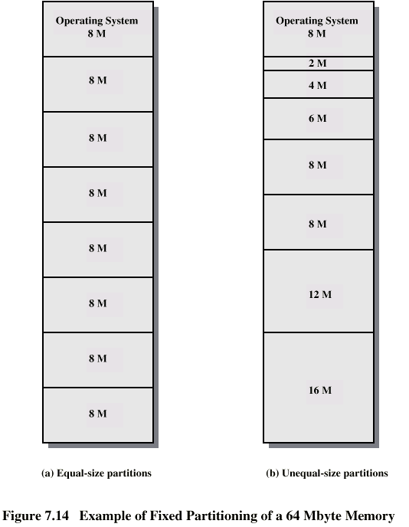
Fixed Partitioning

Slide 34
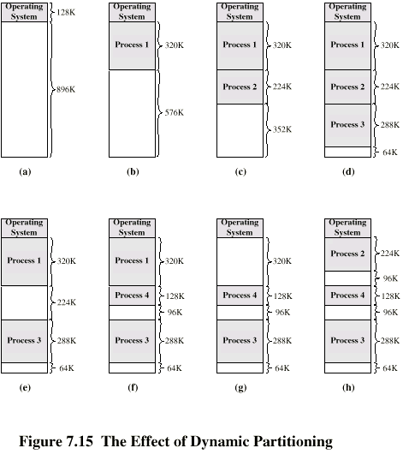
Effect of Dynamic Partitioning

Slide 35
Relocation Challenges
Can’t expect that process will load into the same place in memory
Instructions contain addresses
Locations of data
Addresses for instructions (branching)
Logical address - relative to beginning of program
Physical address - actual location in memory (this time)
Solution:
Use Base Address & Automatic (hardware) conversion

