Slide 1
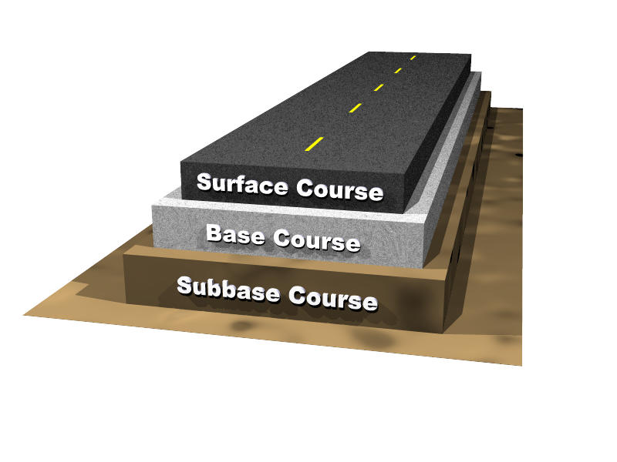
Typical Layers of a Pavement

Slide 2
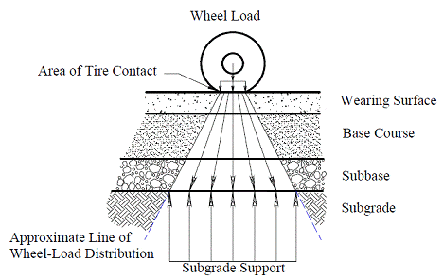
Flexible Pavement

Slide 3
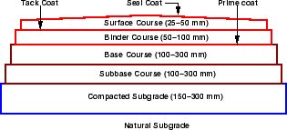
Flexible Pavement
Typical layers of a conventional flexible pavement includes
seal coat,
surface course,
tack coat,
binder course,
prime coat,
base course,
sub-base course,
compacted sub-grade, and natural sub-grade

Slide 4
Sealcoat
Sealcoat or pavement sealer is liquid coating mixture that is applied to asphalt based pavement.
Why Seal Coating is Done
Seal coats provide a waterproof surface and prevent moisture from entering, then weakening the roadbed.
Seal coats reduce deterioration and cracking of the asphalt surface and prolong the life of the pavement.
Seal coating prevents failures on pavements and is used where failure has already started.
Seal coats provide an improved non-skid surface in wet or icy conditions.
Seal coats provide an anti-glare and increased reflective surface for night and wet weather driving.
Seal coats provide a dust free surface on low volume roads.
Seal coating defers expensive repaving. Seal coats generally last three to five years.

Slide 5
Seal Coating Process
Prior to application the surface must be completely clean and dry using sweeping methods and/or blowers. If the surface is not clean and dry, then poor adhesion will result.
Pavement sealers are applied with either pressurized spray equipment, or self-propelled squeegee machines or by hand with a squeegee. Equipment must have continuous agitation to maintain consistency of the sealcoat mix.
The process is typically a two-coat application which requires 24 to 48 hours of curing before vehicles can be allowed back on the surface. Once the surface is properly prepared, then properly mixed sealer will be applied at about 60 square feet per gallon per coat.

Slide 6
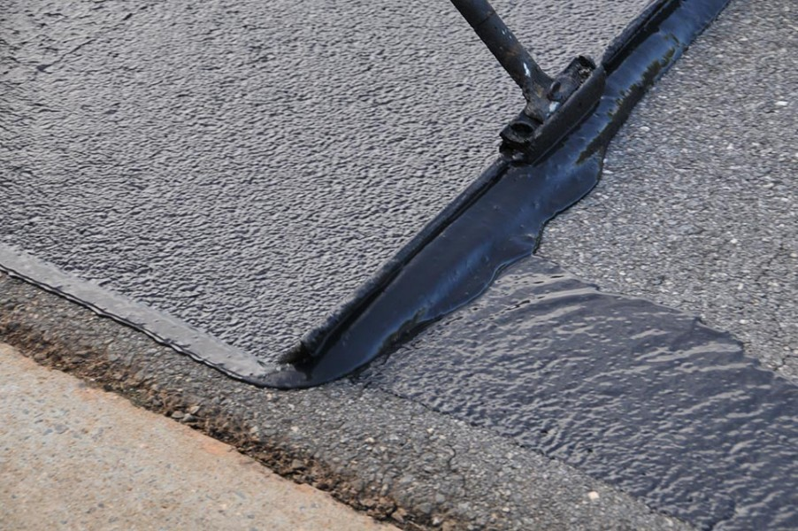
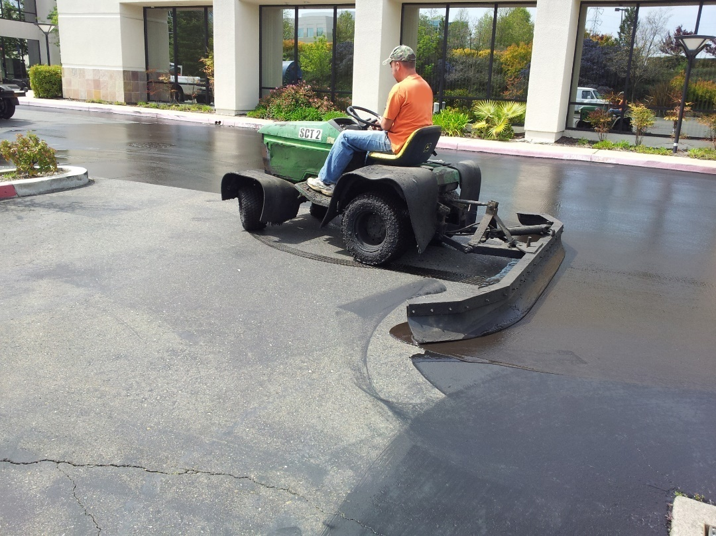
Seal Coating Process

Slide 7
Types of Sealcoat
There are primarily three types of pavement sealers. They are commonly known as
refined tar-based (coal tar based),
asphalt-based, and
petroleum-based
All three have their advantages but are typically chosen by the contractors’ preference unless otherwise specified.

Slide 8
Detriments to Sealcoat
Refined tar-based sealer offers the best protecting against water penetration and chemical resistance.
Asphalt-based sealer typically offers poor protection against environmental chemical and harsher climates (salt water).
Petroleum-based sealer offer protection against water and chemicals somewhere between the other two sealers.
Another difference between coatings is in terms of wear. Again, refined tar-based sealer offers the best wear characteristics (typically 3–5 years) while asphalt-based sealer may last 1–3 years. Petroleum-based sealer falls between refined tar and asphalt.

Slide 9
Health Risks with Tar Sealants
Some studies that suggest that refined tar sealants are a significant contributor to polycyclic aromatic hydrocarbon (PAH)levels in streams and creek beds and that the continual application of sealcoats may be a significant factor. As a result, a few municipalities in the United States have banned this material.
Cancer is a primary human health risk of exposure to PAHs. Exposure to PAHs has also been linked with cardiovascular disease and poor fetal development.

Slide 10
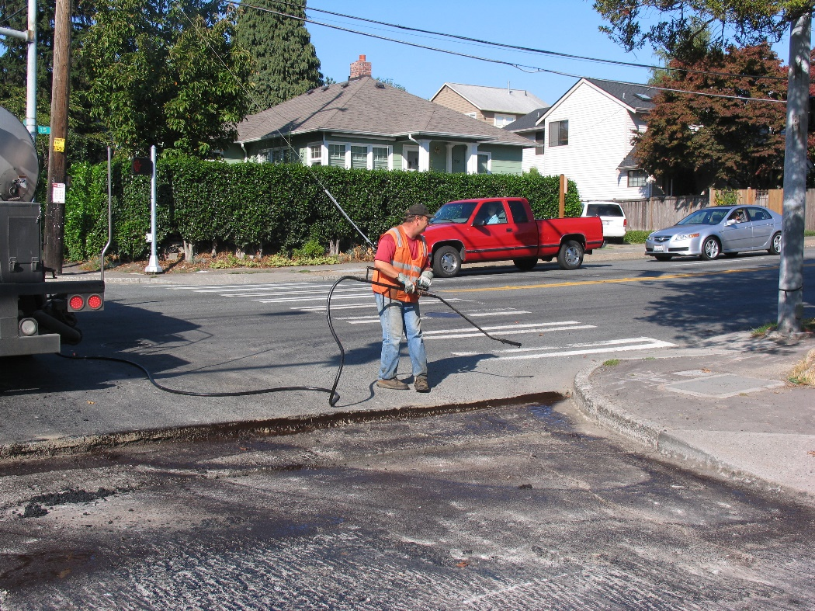
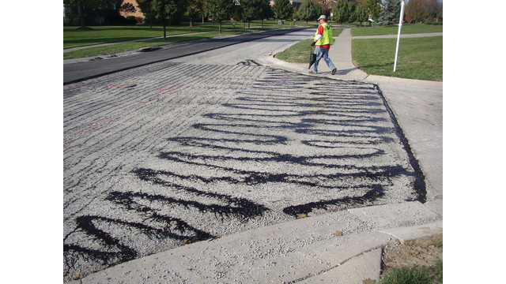
Tack Coat
Tack coat is a very light application of asphalt, usually asphalt emulsion diluted with water. It provides proper bonding between two layer of binder course and must be thin, uniformly cover the entire surface, and set very fast.

Slide 11
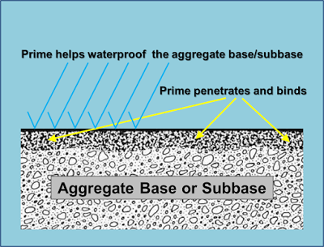
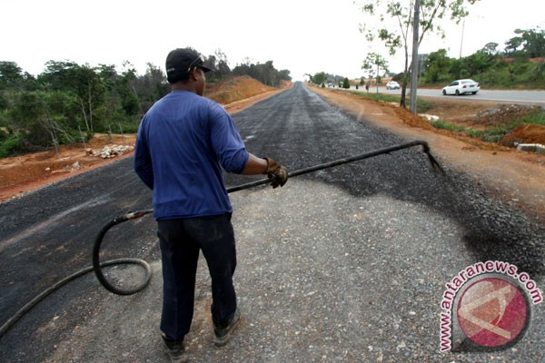
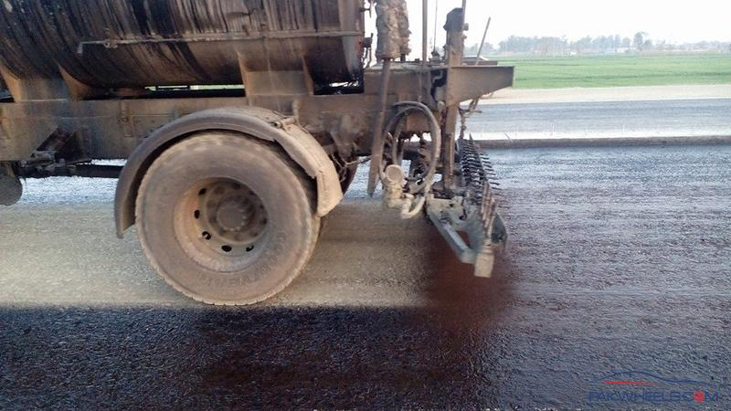
Prime Coat
Prime coat is an application of low viscous cutback bitumen to an absorbent surface like granular bases on which binder layer is placed. It provides bonding between two layers. Unlike tack coat, prime coat penetrates into the layer below, plugs the voids, and forms a water tight surface.

Slide 12
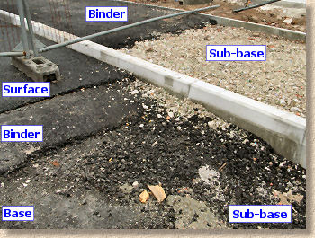
Surface course
Surface course is the layer directly in contact with traffic loads and generally contains superior quality materials. They are usually constructed with dense graded asphalt concrete(AC). The functions and requirements of this layer are:It provides characteristics such as friction, smoothness, drainage, etc. Also it will prevent the entrance of excessive quantities of surface water into the underlying base, sub-base and sub-grade,
It must be tough to resist the distortion under traffic and provide a smooth and skid- resistant riding surface,
It must be water proof to protect the entire base and sub-grade from the weakening effect of water.

Slide 13
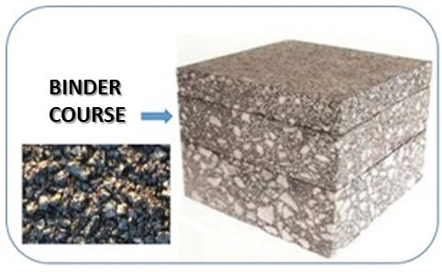
Binder course
This layer provides the bulk of the asphalt concrete structure. It's chief purpose is to distribute load to the base course The binder course generally consists of aggregates having less asphalt and doesn't require quality as high as the surface course, so replacing a part of the surface course by the binder course results in more economical design.

Slide 14
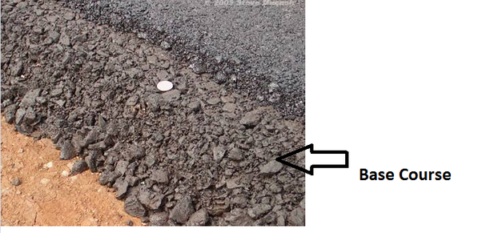
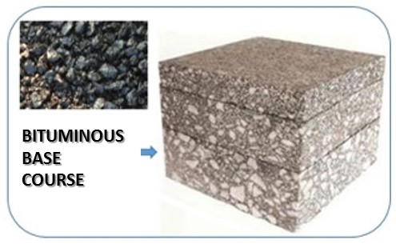
Base course
The base course is the layer of material immediately beneath the surface of binder course and it provides additional load distribution and contributes to the sub-surface drainage. It may be composed of crushed stone, crushed slag, and other untreated or stabilized materials.

Slide 15
Sub-Base course
The sub-base course is the layer of material beneath the base course and the primary functions are to provide structural support, improve drainage, and reduce the intrusion of fines from the sub-grade in the pavement structure. If the base course is open graded, then the sub-base course with more fines can serve as a filler between sub-grade and the base course.
A sub-base course is not always needed or used. For example, a pavement constructed over a high quality, stiff sub-grade may not need the additional features offered by a sub-base course. In such situations, sub-base course may not be provided.

Slide 16
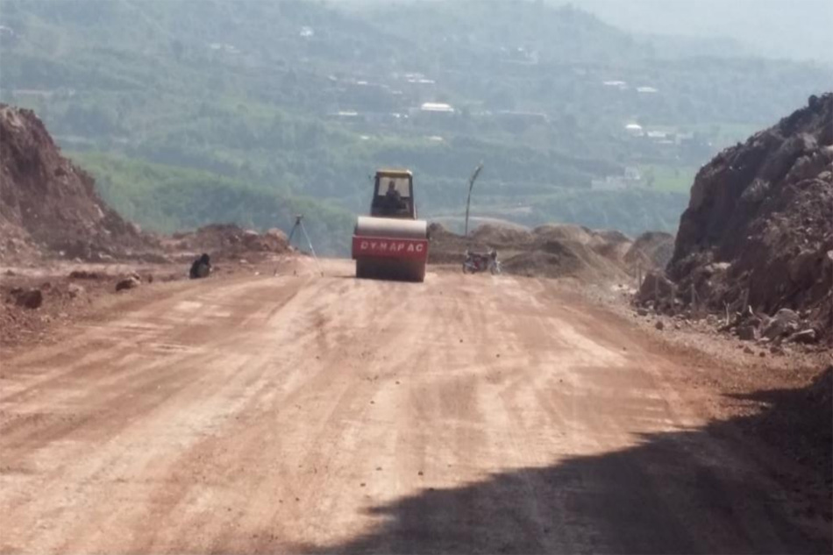
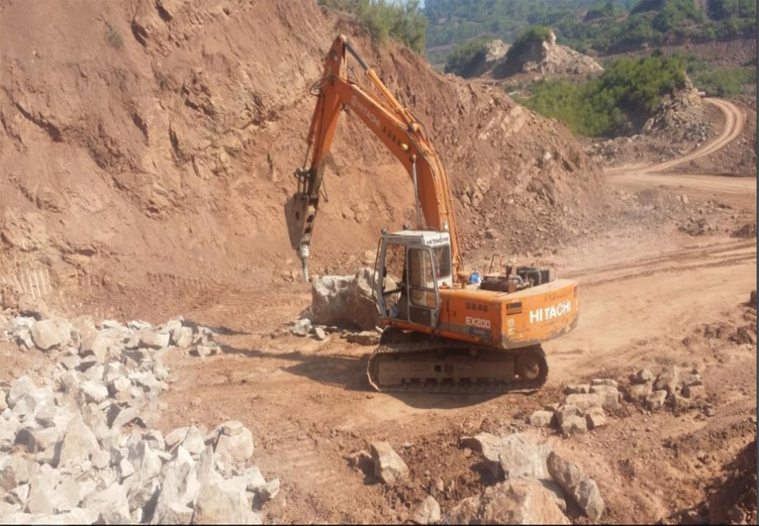
Sub-grade
The top soil or sub-grade is a layer of natural soil prepared to receive the stresses from the layers above. It is essential that at no time soil sub-grade is overstressed. It should be compacted to the desirable density, near the optimum moisture content.

Slide 17
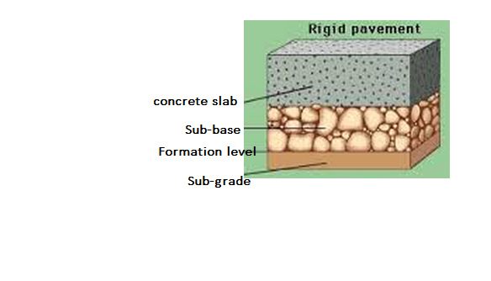
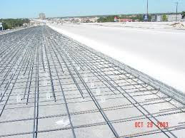
RIGID PAVEMENT
Rigid pavements normally use Portland cement concrete as the prime structural element.
Depending on conditions, engineers may design the pavement slab with plain, lightly reinforced, continuously reinforced, prestressed, or fibrous concrete.
The concrete slab usually lies on a compacted granular or treated subbase, which is supported, in turn, by a compacted subgrade.
The subbase provides uniform stable support and may provide subsurface drainage. The concrete slab has considerable flexural strength and spreads the applied loads over a large area.

Slide 18
Typical Rigid Pavement Structure

Slide 19
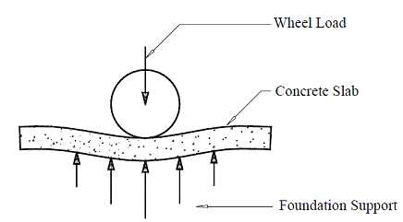
Transfer of wheel load to foundation in rigid pavement structure

Slide 20
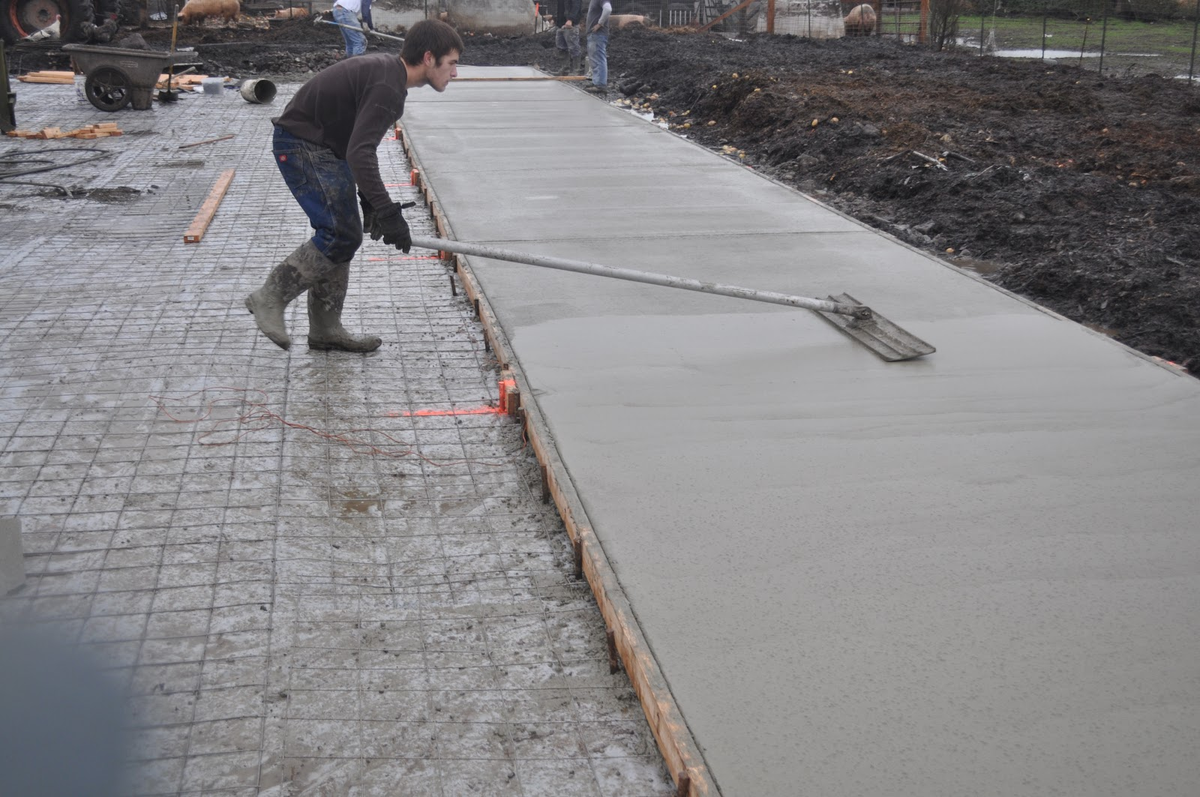
Concrete Slab (Surface Layer)
The concrete slab provides structural support to the vehicle, provides a skid-resistant surface, and prevents the infiltration of excess surface water into the subbase.

Slide 21
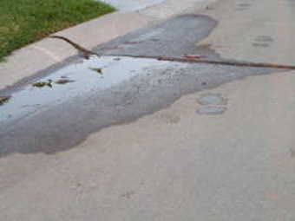
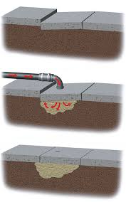
Subbase
The subbase provides uniform stable support for the pavement slab.
The subbase also serves to control frost action, provide subsurface drainage, control swelling of subgrade soils, provide a stable construction platform for rigid pavement construction, and prevent mud pumping of fine-grained soils.
Rigid pavements generally require a minimum subbase thickness of 4 inches (100 mm).

Slide 22
Stabilized Subbase
All new rigid pavements designed to accommodate aircraft weighing 100,000 pounds (45,000 kg) or more must have a stabilized subbase.
The structural benefit imparted to a pavement section by a stabilized subbase is reflected in the modulus of subgrade reaction assigned to the foundation.

Slide 23
Frost Protection Layer
In areas where freezing temperatures occur and where frost-susceptible soil with a high ground water table exists, engineers must consider frost action when designing pavements. Frost action includes both frost heave and loss of subgrade support during the frost-melt period. Frost heave may cause a portion of the pavement to rise because of the nonuniform formation of ice crystals in a frost-susceptible material.
Thawing of the frozen soil and ice crystals may cause pavement damage under loads. The frost protection layer functions as a barrier against frost action and frost penetration into the lower frost-susceptible layers.

