Slide 1
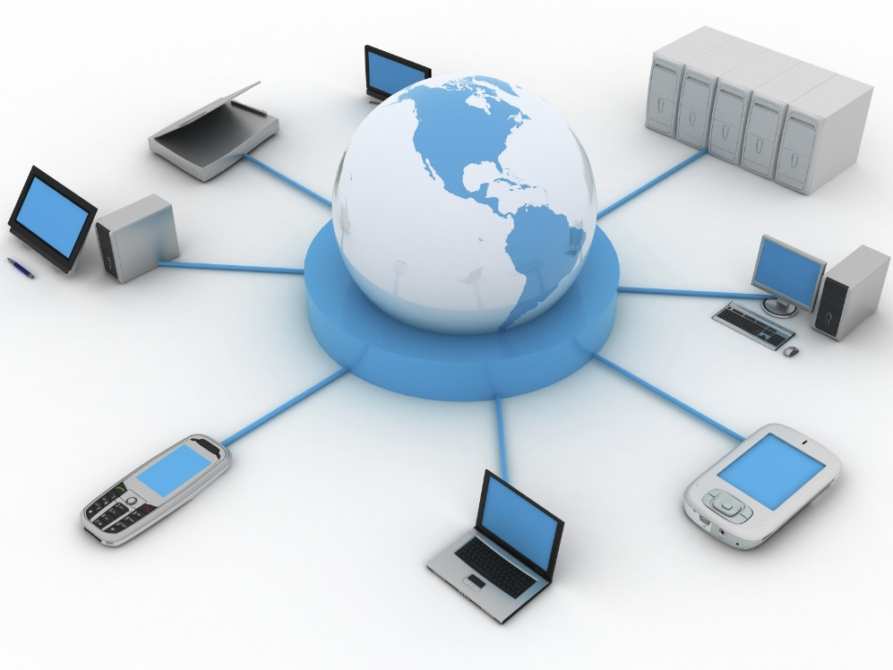
Information system Network

Slide 2
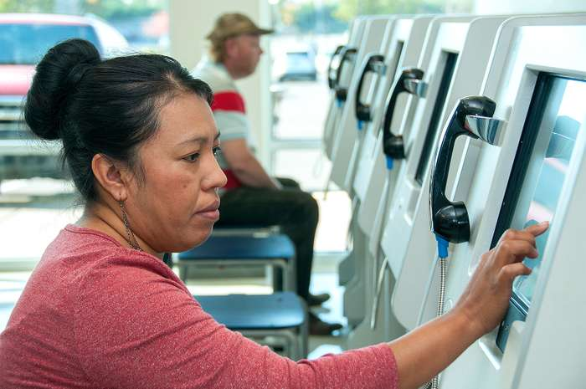
Information system,
an integrated set of components for collecting, storing, and processing data and for providing information, knowledge, and digital products. Business firms and other organizations rely on information systems to carry out and manage their operations, interact with their customers and suppliers, and compete in the marketplace. Information systems are used to run interorganizational supply chains and electronic markets
. For instance, corporations use information systems to process financial accounts, to manage their human resources, and to reach their potential customers with online promotions. Many major companies are built entirely around information systems. These include eBay, a largely auction marketplace; Amazon, an expanding electronic mall and provider of cloud computing services; Alibaba, a business-to-business e-marketplace; and Google, a search engine company that derives most of its revenue from keyword advertising on Internet searches. Governments deploy information systems to provide services cost-effectively to citizens. Digital goods—such as electronic books, video products, and software—and online services, such as gaming and social networking, are delivered with information systems. Individuals rely on information systems, generally Internet-based, for conducting much of their personal lives: for socializing, study, shopping, banking, and entertainment.

Slide 3
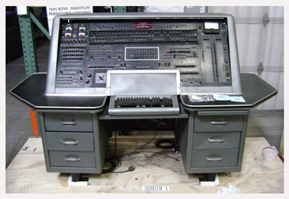
One of the first computers used for such information processing was the UNIVAC I, installed at the U.S. Bureau of the Census in 1951 for administrative use and at General Electric in 1954 for commercial use. Beginning in the late 1970s, personal computers brought some of the advantages of information systems to small businesses and to individuals. Early in the same decade the Internet began its expansion as the global network of networks. In 1991 the World Wide Web, invented by Tim Berners-Lee as a means to access the interlinked information stored in the globally dispersed computers connected by the Internet, began operation and became the principal service delivered on the network. The global penetration of the Internet and the Web has enabled access to information and other resources and facilitated the forming of relationships among people and organizations on an unprecedented scale. The progress of electronic commerce over the Internet has resulted in a dramatic growth in digital interpersonal communications (via e-mail and social networks), distribution of products (software, music, e-books, and movies), and business transactions (buying, selling, and advertising on the Web). With the worldwide spread of smartphones, tablets, laptops, and other computer-based mobile devices, all of which are connected by wireless communication networks, information systems have been extended to support mobility as the natural human condition.

Slide 4
Components Of Information Systems Network
The main components of information systems are computer hardware and software, telecommunications, databases and data warehouses, human resources, and procedures. The hardware, software, and telecommunications constitute information technology (IT), which is now ingrained in the operations and management of organizations.
Computer hardware:
Today throughout the world even the smallest firms, as well as many households, own or lease computers. Individuals may own multiple computers in the form of smartphones, tablets, and other wearable devices. Large organizations typically employ distributed computer systems, from powerful parallel-processing servers located in data centres to widely dispersed personal computers and mobile devices, integrated into the organizational information systems. Sensors are becoming ever more widely distributed throughout the physical and biological environment to gather data and, in many cases, to effect control via devices known as actuators. Together with the peripheral equipment—such as magnetic or solid-state storage disks, input-output devices, and telecommunications gear—these constitute the hardware of information systems. The cost of hardware has steadily and rapidly decreased, while processing speed and storage capacity have increased vastly. This development has been occurring under Moore’s law: the power of the microprocessors at the heart of computing devices has been doubling approximately every 18 to 24 months. However, hardware’s use of electric power and its environmental impact are concerns being addressed by designers. Increasingly, computer and storage services are delivered from the cloud—from shared facilities accessed over telecommunications networks.

Slide 5
Computer software:
Computer software falls into two broad classes: system software and application software. The principal system software is the operating system. It manages the hardware, data and program files, and other system resources and provides means for the user to control the computer, generally via a graphical user interface (GUI). Application software is programs designed to handle specific tasks for users. Smartphone apps became a common way for individuals to access information systems. Other examples include general-purpose application suites with their spreadsheet and word-processing programs, as well as “vertical” applications that serve a specific industry segment—for instance, an application that schedules, routes, and tracks package deliveries for an overnight carrier. Larger firms use licensed applications developed and maintained by specialized software companies, customizing them to meet their specific needs, and develop other applications in-house or on an outsourced basis. Companies may also use applications delivered as software-as-a-service (SaaS) from the cloud over the Web. Proprietary software, available from and supported by its vendors, is being challenged by open-source software available on the Web for free use and modification under a license that protects its future availability.

Slide 6
Telecommunications:
Telecommunications are used to connect, or network, computer systems and portable and wearable devices and to transmit information. Connections are established via wired or wireless media. Wired technologies include coaxial cable and fiber optics. Wireless technologies, predominantly based on the transmission of microwaves and radio waves, support mobile computing. Pervasive information systems have arisen with the computing devices embedded in many different physical objects. For example, sensors such as radio frequency identification devices (RFIDs) can be attached to products moving through the supply chain to enable the tracking of their location and the monitoring of their condition. Wireless sensor networks that are integrated into the Internet can produce massive amounts of data that can be used in seeking higher productivity or in monitoring the environment.
Various computer network configurations are possible, depending on the needs of an organization. Local area networks (LANs) join computers at a particular site, such as an office building or an academic campus. Metropolitan area networks (MANs) cover a limited densely populated area and are the electronic infrastructure of “smart cities.” Wide area networks (WANs) connect widely distributed data centres, frequently run by different organizations. Peer-to-peer networks, without a centralized control, enable broad sharing of content. The Internet is a network of networks, connecting billions of computers located on every continent. Through networking, users gain access to information resources, such as large databases, and to other individuals, such as coworkers, clients, friends, or people who share their professional or private interests. Internet-type services can be provided within an organization and for its exclusive use by various intranets that are accessible through a browser; for example, an intranet may be deployed as an access portal to a shared corporate document base. To connect with business partners over the Internet in a private and secure manner, extranets are established as so-called virtual private networks (VPNs) by encrypting the messages.

Slide 7
A massive “Internet of things” has emerged, as sensors and actuators have been widely distributed in the physical environment and are supplying data, the speed of a driving vehicle, or the blood pressure of an individual. The availability of such information enables a rapid reaction when necessary as well as sustained decision making based on processing of the massive accumulated data.

