Slide 1
Drugs Used in Anemia
Dr.Taseer Ahmad

Slide 2
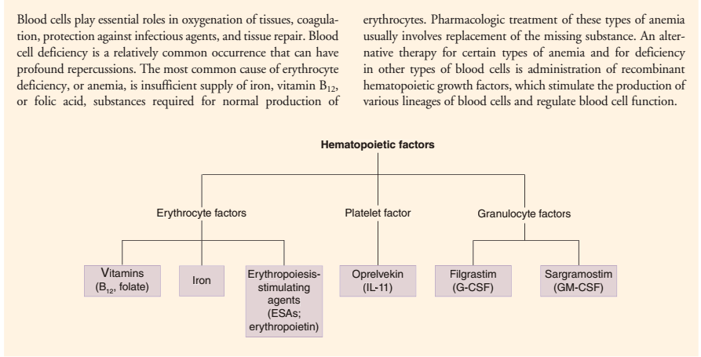
Notes:
Repercussion=an unintended consequence of an event or action, especially an unwelcome one.

Slide 3
There are more than 400 types of anemia, which are divided into three groups: Anemia caused by blood loss.
Anemia caused by decreased or faulty red blood cell production.
Anemia caused by destruction of red blood cells
Anemia is a condition that develops when your blood lacks enough healthy red blood cells or hemoglobin

Slide 5
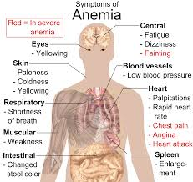

Slide 7
