Slide 1
What are Stomata?
Stomata are specialized epidermal structures that are essential for plant survival and productivity.
TWO guard cells around a pore
Involved in Gas exchange

Slide 2
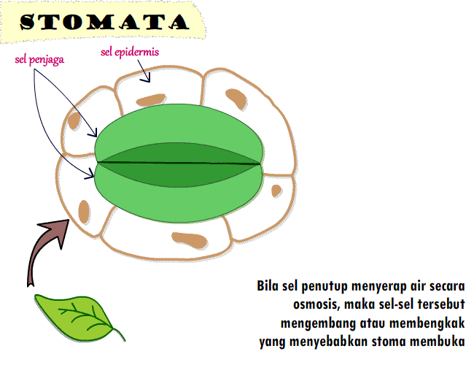

Slide 3
Role of stomata in dihydric conditions:
Opening and closing is achieved by swelling and shrinking of the Guard cells which is driven by gas exchange; cytoskeleton recognition and metabolic production.
This rapid reaction is regulated by a complex network of signaling pathways, in which the major and the best known player, Abcisic acid (ABA) acts in concert with jasmonates (JA), ethylene, auxins , and cytokinins.

Slide 4
Positive and negative regulators of stomatal opening:
ABA and JA are positive regulators of stomatal closure
while auxins and cytokinins are positive regulators of stomatal opening.
The role of ethylene is ambiguous because it can act as Both Positive and Negative regulator of stomatal opening.

Slide 5
Enzymes involved in stomatal action:
Stomatal action is under the control of Phytohormones, particularly when draught condition is considered .

Slide 6
The Regulatory Role Of Ion Channels Localized In The Guard Cell Membrane In The Opening And Closing Of Stomata:
Proper gas exchange
Prevents excessive water loss.
Mature guard cells don’t have plasmodesmata and for this reason more influx and efflux of solutes occur via ion channels, transporters and pumps that are localized in the Plasma membrane (PM).
The action of ion channels, transporters and pumps that are essential for stomatal function is well documented and supported by molecular studies involving mutants in the genes encoding the protein.

Slide 7
In the guard cells, the action of H⁺-ATPase activity is positively regulated by
blue light
auxins
Whereas Ca2+ and ABA act as negative regulators. The efflux of H+ hyperpolarizes the PM and leads to K+ uptake.

Slide 8
Another signal that activates the influx of K via K channels Acidification of apoplast via H extrusion from guard cells.

Slide 9
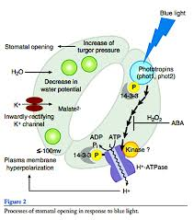

Slide 10
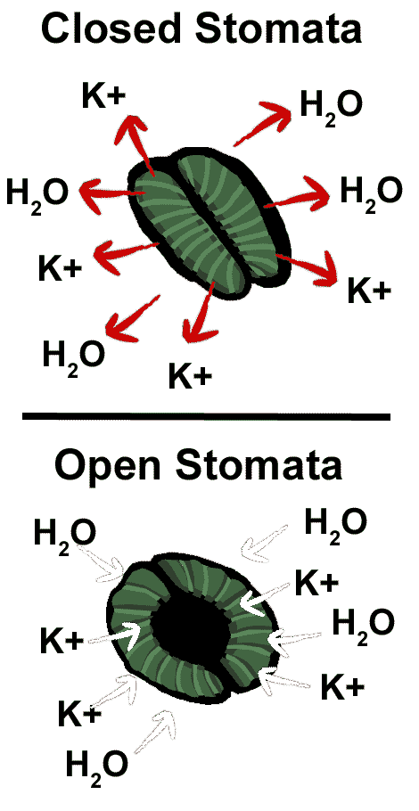
K⁺ ion Balance:
K+ uptake is balanced by counter ions, mainly , Cl obtained from apoplast, Malate 2- that is derived from the starch breakdown or NO3- .

Slide 11
Closing of stomata:
During Stomatal closure, the inhibition of H⁺ ATPase and the activation of anion channels together result in membrane depolarization.
Membrane depolarization creates a driving force for the efflux of K+.
The cytoplasmic Ca2+ -release via channels situated in both the PM and Tonoplast.

Slide 12
Abscisic Acid – How The Proper Regulator Of Main Regulator Of Stomatal Movement Is Achieved In Plants:
A main regulator of stomatal movement.
A main regulator of stomatal movement.
Synthesized in plastids and cytosol mainly in vascular parenchyma but also in guard cells.

Slide 13
Regulation Of Stomatal Opening During Diurnal Cycle – The Role Of ABA:
In darkness, stomata are closed. This is probably caused by an intensive ABA accumulation through the biosynthesis of ABA in the guard cells and the simultaneous import of endogenous ABA from the apoplast to the guard cells using ABA transporters .
During the night, elevated levels of CO2 in the leaves were observed due to respiration.

Slide 14
Protein involved in ABA signaling in stomata:
GPA1 is a positive regulator of stomatal opening.
In Midday, ABA is delivered to the apoplast around the guard cells
In the evening, ABA biosynthesis outweighs the ABA catabolism in the guard cells, which leads to stomatal closure.

Slide 15
Theories:
1
2
Theory Of Photosynthesis In Guard Cells:
By Von Mohl(1856),
Theory of starch-sugar interconversion:
By Sayre(1926).

Slide 16
3.Theory of starch-glucose interconversion:
By Steward in 1964

Slide 17
Factors effecting stomatal action:
Light:
Concentration of K+
CO2 concentration.
Tepmerature
Water contents in mesophyll.

Slide 18
Conclusions:
As per above discussion, it can be concluded that stomatal opening and closing is equally effected by each factor and is necessary for plant survival.

