Slide 1
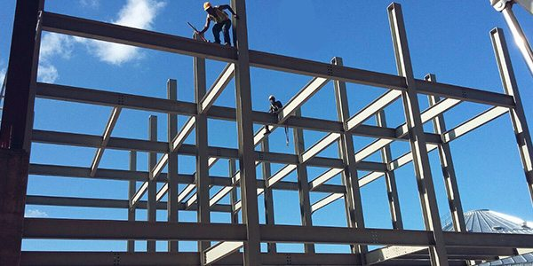
COLLEGE OF ENGINEERING AND TECHNOLOGY UNIVERSITY OF SARGODHA DESIGN OF STRUCTURES (CE-409) 01-Credit Hour
LECTURE-6 & 7
DESIGN OF RETAINING WALL STRUCTURES

Slide 3
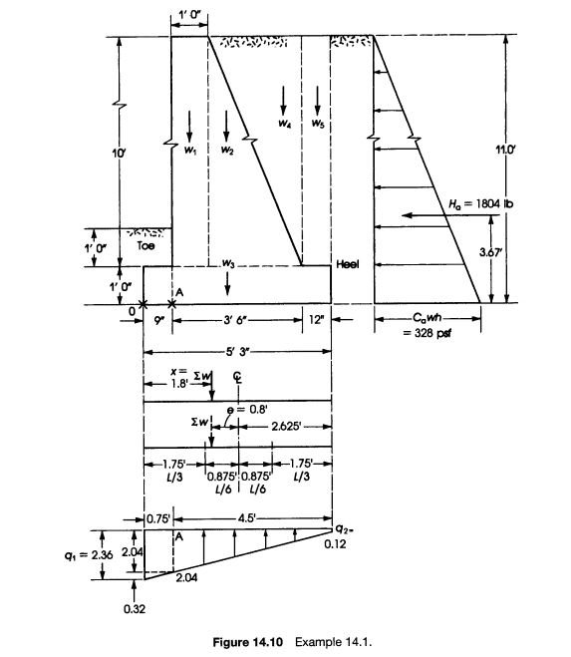

Slide 4
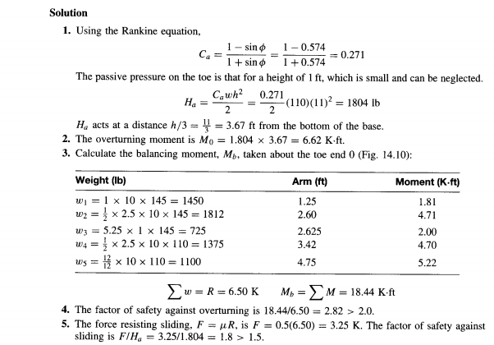

Slide 5
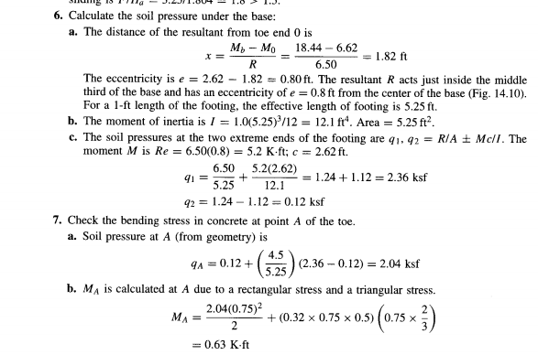

Slide 6
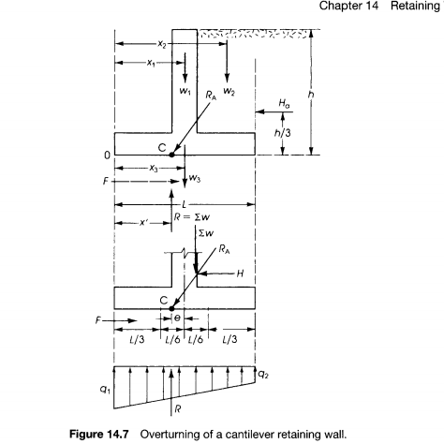

Slide 8
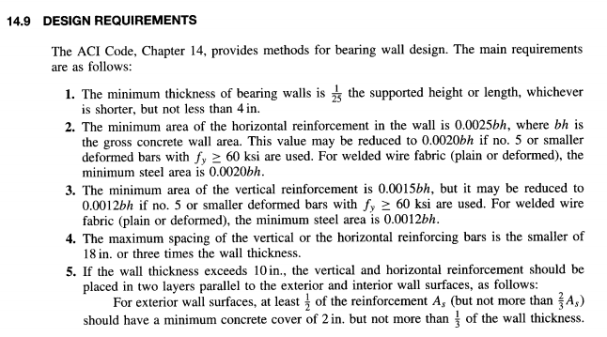

Slide 9
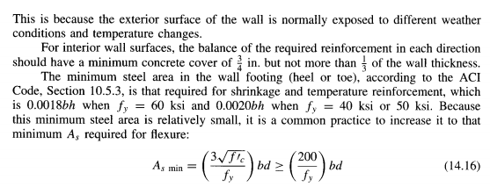

Slide 10
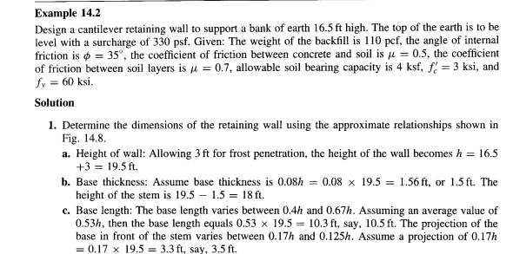

Slide 11
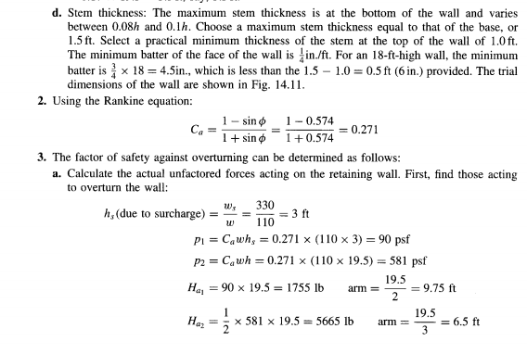

Slide 12
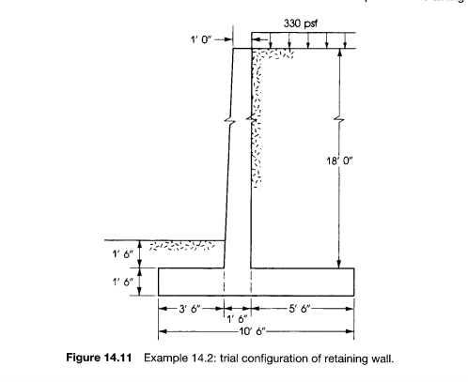

Slide 13
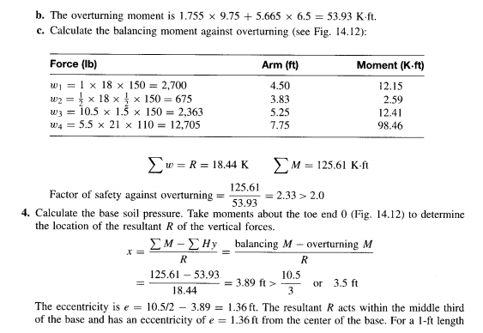

Slide 14
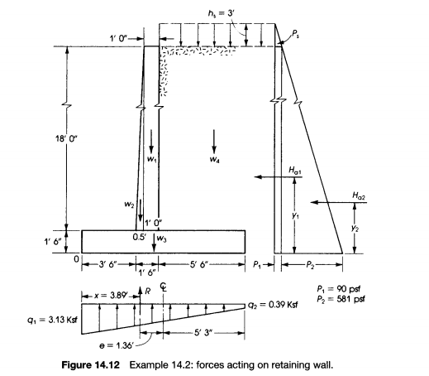

Slide 15
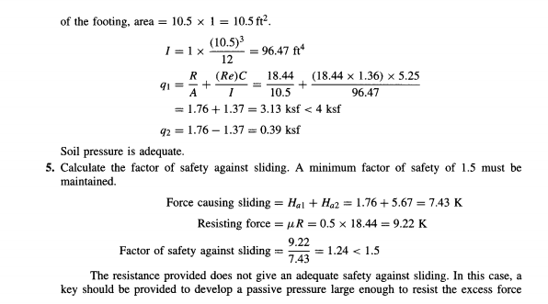

Slide 16
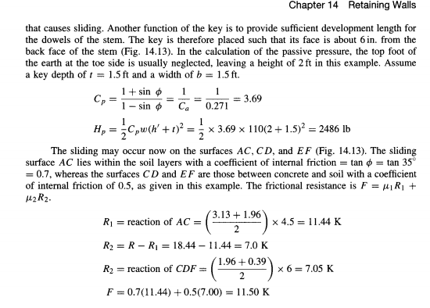

Slide 17
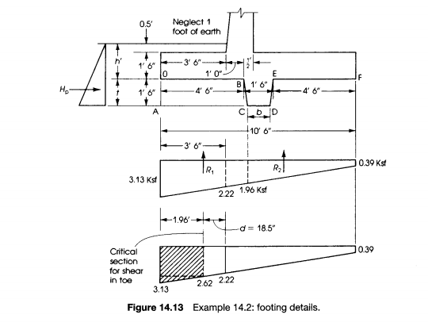

Slide 18
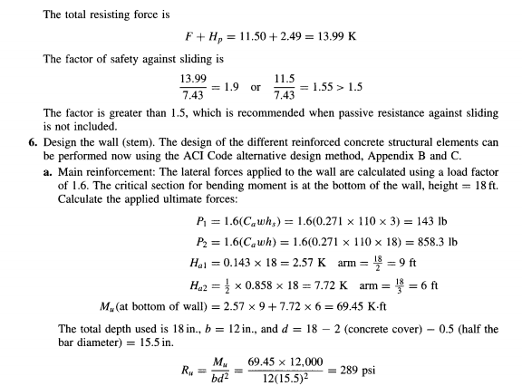

Slide 19
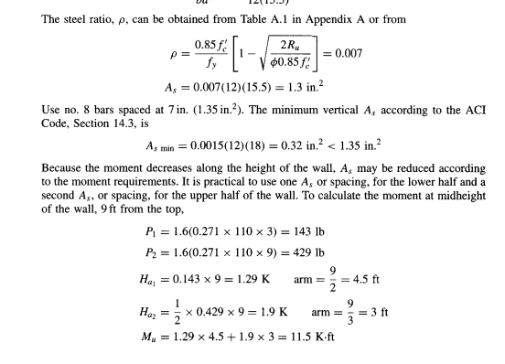

Slide 20
$$Number of bars= \frac{1.3 (As)}{0.785 (Area of \#8 bar)}=1.655$$
$$Spacing of bar = \frac{12}{1.655}=7.27=say 7 inch$$
$$actual Area=actual number of bars= \frac{12}{7}=1.714=1.714 X 0.785=1.35 in2$$

Slide 21
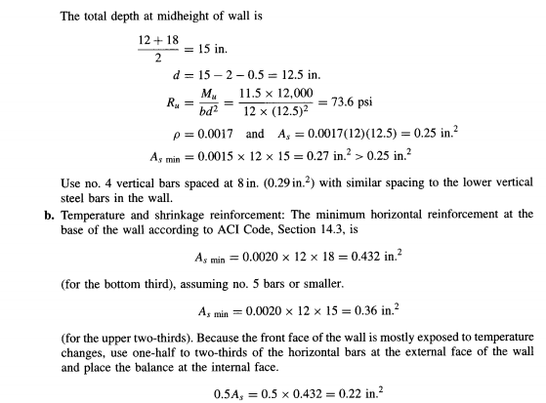

Slide 22
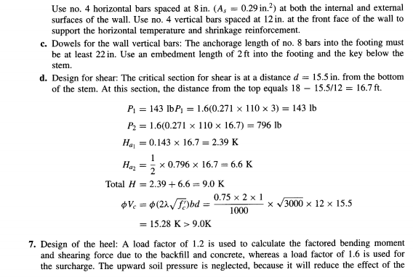

Slide 23
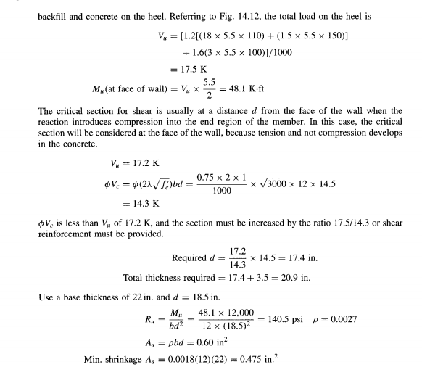

Slide 24
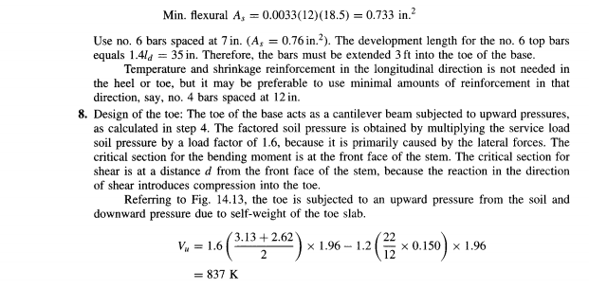

Slide 25
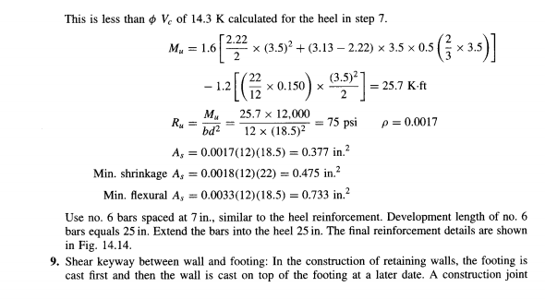

Slide 26
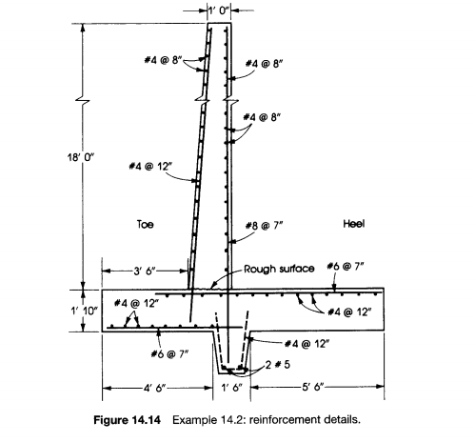

Slide 27
