Slide 1
Structures

Slide 2
Introduction
We will focus on the forces of action and reaction between the connected members.
Connected system of members built to support and to safely withstand the loads applied to it is called Engineering structure.
To determine the forces internal to an engineering structure, we will carry out following procedure.

Slide 3
Introduction
Dismember the structure.
Analyze separate free-body diagrams of individual members or combination of members.
Analysis requires careful application of Newton’s third law.
Each action is accompanied by an equal and opposite reaction.

Slide 4
Introduction
We will analyze the internal forces acting in several types of structures, namely, trusses, frames, and machines.
In this treatment we consider only statically determinate structures, which do not have more supporting constraints than are necessary to maintain an equilibrium configuration.

Slide 5
Plane truss
A framework composed of members joined at their ends to form a rigid structure is called a truss.
Bridges, roof supports and other such structures are common examples of trusses.
Structural members commonly used are I-beams, channels, angles, bars, and special shapes.

Slide 6
Plane truss
These are fastened together at their ends by welding, riveted connections, or large bolts or pins.
When the members of the truss lie essentially in a single plane, the truss is called a plane truss.

Slide 7
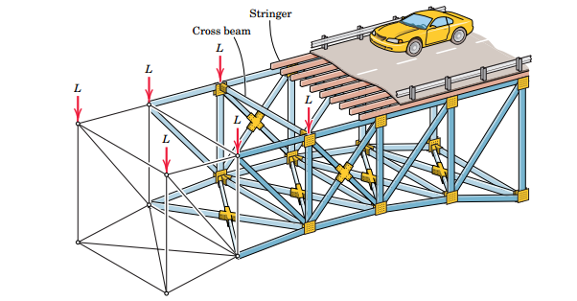

Slide 8
Plane truss
For bridges and similar structures, plane trusses are commonly utilized in pairs with one truss assembly placed on each side of the structure.
The combined weight of the roadway and vehicles is transferred to the longitudinal stringers, then to the cross beams.

Slide 9
Plane truss
Then weight of the stringers and cross beams is transferred to the upper joints of the two plane trusses which form the vertical sides of the structure.
The forces L represent the joint loadings.
Some examples of commonly used trusses which can be analyzed as plane trusses are

Slide 11
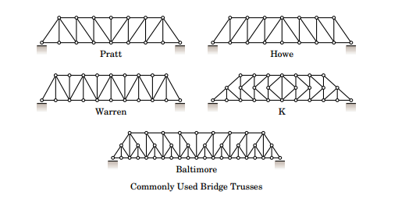

Slide 12
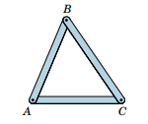
Simple Trusses
The basic element of a plane truss is the triangle.
Three bars joined by pins at their ends constitute a rigid frame.

Slide 13
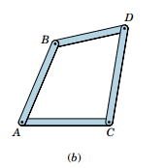
Simple Trusses
The above member is non collapsible and deformation of the members due to induced internal strains is negligible.
Four or more bars pin-jointed to form a polygon constitute a non rigid frame.

Slide 14
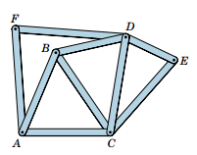
Simple Trusses
Non rigid frame can be made rigid, or stable, by adding a diagonal bar joining A and D or B and C and thereby forming two triangles.
We can extend the structure by adding two end-connected bars, such as DE and CE or AF and DF.

Slide 15
Simple Trusses
These are pinned to two fixed joints. In this way the entire structure will remain rigid.
Structures built from a basic triangle in these manners described above are known as simple trusses.
When more members are present than are needed to prevent collapse, the truss is statically indeterminate.

Slide 16
Simple Trusses
A statically indeterminate truss cannot be analyzed by the equations of equilibrium alone.
Additional members or supports which are not necessary for maintaining the equilibrium configuration are called redundant.

Slide 17
Truss Design
To design a truss following steps are needed
Assume all members to be two-force members
The two forces are applied at the ends of the member equal, opposite, and collinear for equilibrium.
Select appropriate sizes and structural shapes to withstand the forces.
Determine the forces in the various members

Slide 19
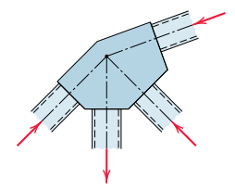
Truss Connections and Supports
When welded or riveted connections are used to join structural members, we may usually assume that the connection is a pin joint if the centerlines of the members are concurrent at the joint.

Slide 20
Truss Connections and Supports
In the analysis of simple trusses all external forces are applied at the pin connections.
For large trusses, a roller support is used at one of the supports to provide for expansion and contraction due to temperature changes and for deformation from applied loads.

Slide 21
Internal and External Redundancy
If a plane truss has more external supports than are necessary to ensure a stable equilibrium, the truss as a whole is statically indeterminate.
The extra supports are external redundancy.
If a truss has more internal members than are necessary to prevent collapse when the truss is removed from its supports, then the extra members constitute internal redundancy
The truss is again statically indeterminate

Slide 22
Internal and External Redundancy
For a truss which is statically determinate externally, there is a definite relation between the number of its members and the number of its joints necessary for internal stability without redundancy.
Because we can specify the equilibrium of each joint by two scalar force equations, there are in all 2j such equations for a truss with j joints.

Slide 23
Internal and External Redundancy
For the entire truss composed of m two-force members and having the maximum of three unknown support reactions, there are in all
m+3 unknowns
Thus, for any plane truss, the equation m+3=2j will be satisfied if the truss is statically determinate internally

Slide 24
Internal and External Redundancy
If m+3>2j, there are more members than independent equations, and the truss is statically indeterminate internally with redundant members present.
If m+3<2j, there is a deficiency of internal members, and the truss is unstable and will collapse under load.

Slide 25
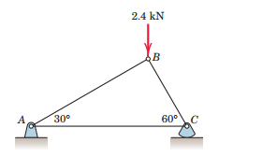

Slide 26
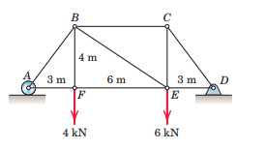
Problem 4/5

Slide 27
Assignment at home 4/3, 4/4, 4/6, 4/9, 4/11

