Slide 1
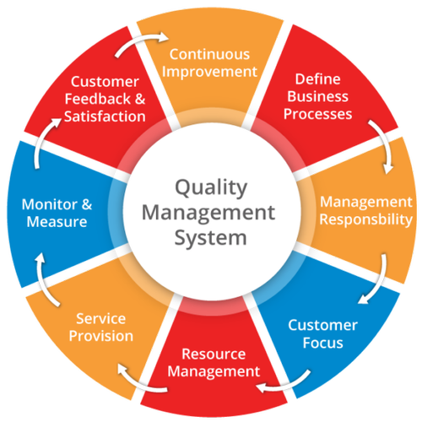
QMS ( ISO – 9000 )
Implementation and Certification
Audits
Expected Problems

Slide 2
Implementation of ISO 9000
Thought for Today
Quality management succeeds when the cost of the system is less than the cost of defects and poor service ,which would otherwise result.

Slide 3
Implementation of ISO 9000
The aim of a QMS is to assure that an organization consistently meets customer needs by controlling the core processes that affect them such as sales orders, design, production, inspection, delivery, etc.
The requirements also go beyond these "core" processes to address support processes like purchasing, training, calibration, maintenance, and performance measurements.

Slide 4
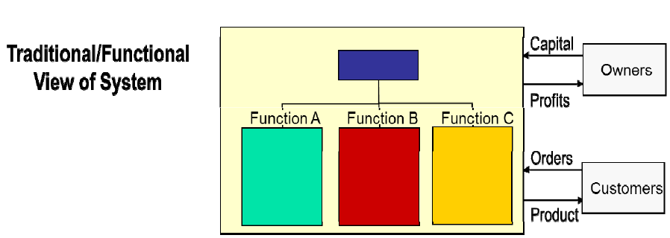
Process‐oriented approach
An important aspect of a QMS is its process‐oriented approach, instead of looking at departments and individual processes, it requires an organization to look at how processes interact and integrate with each other.

Slide 5
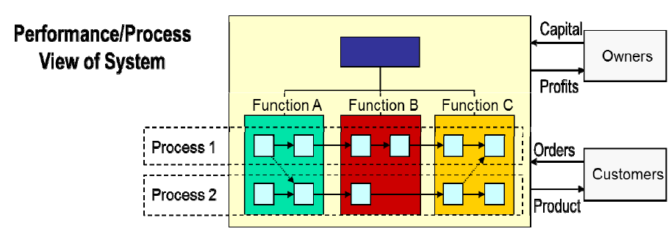
Bottom line: A QMS is much more than a comprehensive set of rules. It will help you manage your business more effectively and improve the performance of your organization on an ongoing basis.

Slide 6
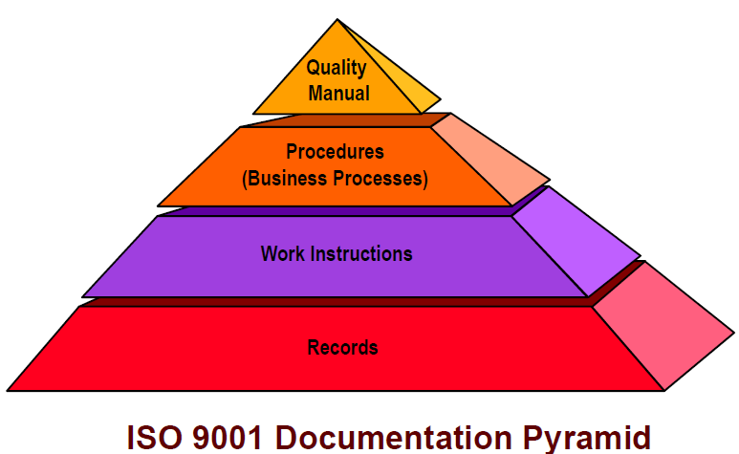
Quality Management System Requirements
To achieve ISO 9001 certification your company must establish, document and implement a QMS and maintain its effectiveness in accordance with the standard.

Slide 7
Quality Manual addresses each area of the standard with a statement explaining how the organization maintains compliance to requirements (Ploicies).
Procedures are “high‐level” documents that detail how the organization’s processes are designed and controlled (Who, When, Where).
Work Instructions are very specific and detail all necessary instructions required for performing a specific task. (training etc)
Records must be maintained to show compliance to quality system requirements ( Proper documentation, testing & maintenance etc)

Slide 8
Documents
Quality System documents should detail processes and procedures to ensure they meet the requirements of the standard. This will ensure that:
Employees perform the same task, the same way, every time
Information is recorded in the same way, every time
New employees are trained to a consistent standard.

Slide 9
Why Implement a Quality Management System?
Quality Management System registration will help you win new customers and retain existing ones. While the goal is to achieve registration, it is not the only goal. The internal benefits of an effective system are significant:
An understanding that quality is not just the responsibility of the quality department, it’s everyone's responsibility.
Documented procedures and work instructions form the basis for repetition and become “the way we do business.”
Less dependency on key individuals, responsibility and accountability for key tasks are distributed across the work force.

Slide 10
Why Implement a Quality Management System?
Internal Audits help identify problems that could impact customer satisfaction and / or operational efficiency.
A formal Corrective and Preventative Action system ensures permanent solutions to problems are developed and implemented.
Operations transformed from detection mode to a prevention mode. Prevention takes a lot less work and is far less expensive than detection.
Increased profitability as productivity improves and rework costs are reduced.
Monitoring and measuring of key quality performance indicators

Slide 11
Resource Management
Provision of Resources
Determine & provide resources needed
Implement & maintain & …
Continually improve QMS
Enhance customer satisfaction
Human Resources
Assignment / Duties of employees
Competence, training, and awareness
Infrastructure – buildings, utilities, equipment, transport, IT
Work Environment – temperature, humidity, lighting,
Cleanliness and safety / protection, etc

Slide 12
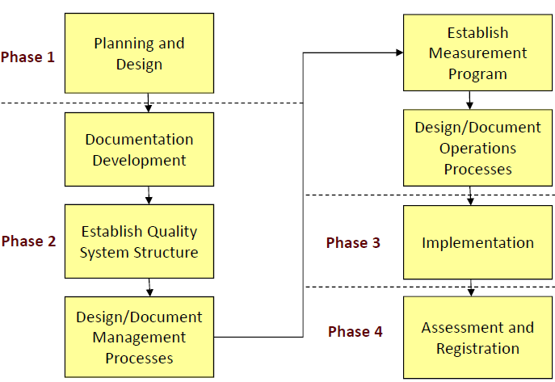
15 Steps to Implement ISO 9001
Designing, documenting and implementing an ISO 9000‐based Quality Management System is a significant undertaking. There are four phase approach.

Slide 13
Step 1 —Decision Making and Commitment
The first task is for top management to decide if the company should pursue ISO 9001
To make an informed decision, top management should have a good understanding of ISO 9001 from a business point of view, the concepts behind ISO 9001, the general process for implementation and the requirements of the standard as they apply to your company.
Top management must also demonstrate its commitment and
determination to implement an ISO 9001 Quality System in the organization.

Slide 14
Top Management Commitment
To provide evidence of commitment to the development and
implementation of a QMS and continually improve its effectiveness, top management can achieve this by:
Communicating to the organization the importance of meeting customer, legal requirements,
Defining the organization's quality policy and making this known to every employee,
Ensuring that quality objectives are established at all levels and
Functions.
Ensuring the availability of resources required for the development and implementation of the quality management system, and Conducting the required management review meetings

Slide 15
Top Management Commitment
Top management should identify the goals to be achieved through the Quality System. Typical goals may be:
To become more efficient and profitable
To produce products and services that consistently meet customers needs and expectations
Improve customers satisfaction
Increase market share
Reduce costs and liabilities

Slide 16
Step 2: Implementation Team & Management Representative
ISO 9001 is implemented by people. The next step is to establish an implementation team and appoint a Management Representative (MR) as its coordinator to plan and oversee implementation.
Implementation team members should include representatives of all organizational functions ‐ Marketing, Design, Development, Planning, Production, Quality control, etc

Slide 17
Step 3: Employee Awareness Training
It is important to inform employees as early as possible of your plan to become ISO 9001 registered. You will need to explain the concept of ISO 9001 and how it will affect employees. Don't delay this simple step, if negative rumors and chitchat.
Since the ISO 9000 Quality System affects all the areas and all workers in the organization, training programs should be structured for different categories of employees ‐ senior managers, middle‐level managers, supervisors and workers

Slide 19
The Training cover
The basic concepts of quality systems and the standard,
The overall impact on the company’s strategic goals.
The changed work processes, and the likely work culture suggestion of the quality system.
Initial training may also be necessary on writing quality manuals, procedures and work instructions. When the in‐house ability to provide this training is not available, it may be necessary to participate in external training courses run by a professional training organizations or an external training organization could provide this training in‐house

Slide 20
Step 4. Perform a Gap Assessment
The next step in the implementation process is to compare your existing quality system with the requirements of the ISO 9001 standard. This is often referred to as " gap assessment'‘ with the goal of determining:
What existing company processes and procedures already meet ISO 9001 requirements.
What existing procedures and processes need to be modified to meet ISO 9001 requirements

Slide 21
What additional procedures and processes need to be created to meet ISO 9001 requirements.
In general, the steps to perform a gap assessment are:
1. What is the present operation/process? What already exists?,
2. Analyze the relevant sections of the ISO 9001 standard to determine what is actually required?
3. Document the “gaps.”
The gap assessment can be performed internally, if the required knowledge exists, or an experienced ISO 9000 consulting firm can provide this service for you.

Slide 22
Step 5 —Implementation Planning
After the gap assessment, you should have a clear picture of how your existing Quality System compares with the ISO 9001 standard.
A detailed implementation plan should be developed that identifies and
describes task required to make your Quality System fully compliant with the standard. This plan should be thorough and specific, detailing:
Quality documentation to be developed
The relevant ISO 9001 standard section
Person or team responsible
Approvals required
Training required
Resources required
Estimated completion date

Slide 23
12 months Implementation Plan

Slide 25
Step 6 —Documentation Development
There is no right or wrong way to document your QMS.
We believe that your company should start with the minimum requirements.
Currently there are six documented procedures required to create an ISO 9001 QMS:
Document Control; Control of Records; Internal Audit;
Uncharacteristic Product; Corrective Action and Preventive Action.
There will be some additional documented procedures that will be helpful for your staff to follow while working on your company’s various processes.

Slide 26
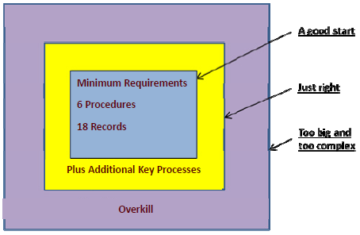

Slide 27
Step 7 —Review and Release Documents
Management should review all of the documentation to ensure it meets the operational needs of the business as well as ISO 9001 requirements.
Following the reviews, subsequent revisions, and final management approval, documentation is released for use.

Slide 28
Step 8 —Implementation and Employee Training
The newly documented Quality System is put into practice throughout the company.
Management and employees are trained on the new or
revised work processes, procedures and work instructions as formalized in your documentation.

Slide 29
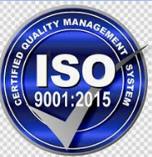
Step 9 —Quality System Registrar Selection
It is advisable to select a Registration Body that is suited to your organization early in your implementation project.
The registration body is an independent organization that is officially accredited to issue Quality
System certifications. The registrar will audit your company's Quality System and if the audit is successful – issue the Quality System certificate.
When choosing a certification body to carry out
your ISO 9001 registration audit, some selection
criteria should be taken into account

Slide 30
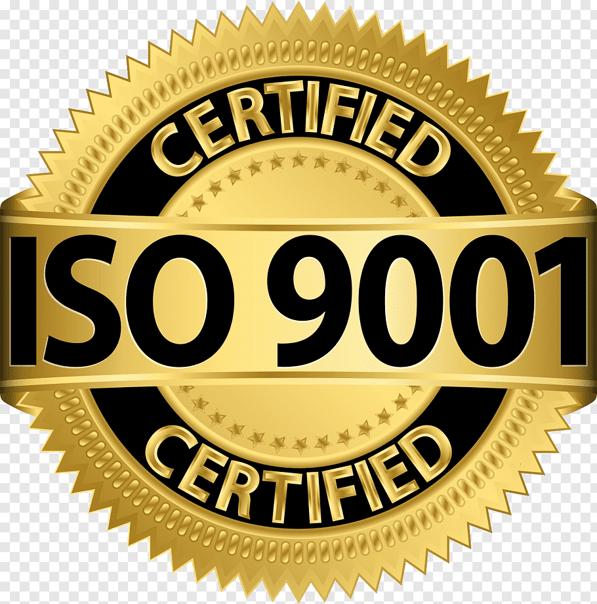
Is the certification body accredited and, if so, by whom? Accreditation means that the certification body has been officially approved as competent to carry out certification by a national accreditation body.

Slide 31
Step 10 — Internal Auditor Training & Commence Internal Audits
ISO 9001 and related standards require that your company periodically perform an internal audit to evaluate the effectiveness of your Quality System and check that it complies with ISO 9001 requirements as well as your organization’s own documented work practices.
A quality audit is a: “Systematic, independent and documented process for obtaining audit evidence and evaluating it objectively to determine the extent to which audit criteria are fulfilled.” ISO 9000:2005

Slide 32
Internal audits are also a great help implementing your Quality
System and a complete internal audit of your Quality System is required before you can pass your registration audit.
Your internal audit program should be planned, taking into consideration the status and importance of the different processes that are running in your organization.
At least two of your employees
will need to be trained as
internal auditors

Slide 33
Step 11. Management Review
When your Quality System has been operating for three to six months and an internal audit of your Quality System has been completed a Management Review should be conducted and corrective actions implemented as necessary
Management reviews are conducted to ensure the continuing suitability, competence and effectiveness of your Quality System. The review should include assessing opportunities for improvement and the need for changes to the Quality System, including the quality policy and quality objectives.

Slide 34
The input to management review should include:
Results of audits,
Customer feed back
Process performance and product compliance
Status of preventive and corrective actions
Follow‐up actions from previous management reviews
Changes that could affect the Quality System, and recommendations for improvements.
Management Reviews should also address pitfalls / drawback / danger to effective Quality System implementation.

Slide 35
Step 12 —Stage 1 Registration Audit
When you Quality System has been in operation for a few months and has stabilized, it is normally time to schedule your
stage 1 registration audit.
Your selected registration body will first carry out an audit of your documentation and then, if your documents meet the requirements of the standard and perform a stage 1 Audit to ensure all applicable ISO 9001 or related standard requirements have been met.

Slide 36
Step 13 – Corrective Actions
Following your stage 1 audit, management will review the results and make corrective actions to fix any non‐conformances (activities that are not in compliance with the requirements of the standard and/or your own documented work practices) found during the stage 1 registration audit.

Slide 37
Task 14 —Stage 2 Registration Audit
Your selected Registrar will perform a stage 2 Registration Audit to ensure all applicable ISO 9001 or related standard requirements have been met and that you have corrected any non‐conformances found during the stage 1 audit.
Following the successful completion of the stage 2 audit your company will be awarded an ISO 9001 certificate, generally for a period of three years.
During this three‐year period, your registration body will carry out periodic surveillance audits to ensure that the system is continuing to operate satisfactorily.

Slide 38
Task 15 —Continual Improvement
Certification to ISO 9000 should not be an end.
You should continually seek to improve the effectiveness and suitability of your Quality System through the use of your:
➢ Quality policy
➢ Quality objectives
➢ Audit results
➢ Analysis of data
➢ Corrective and preventive actions
➢ Management review

