Slide 1
Polygenic Inheritance

Slide 2
Skin Pigmentation Polygenic Inheritance
Learners will be able to:
Explain the Laws of Segregation and Independent Assortment in terms of Mendel’s Laws.
Use a simple model to explain the influence that multiple genes can have on a characteristic.
Extrapolate the simple model to the complexity of skin color.
Explain that complexity is compounded by other gene properties, such as multiple alleles and epistasis.

Slide 3
Many Genes and One Phenotype It’s Complicated
There are many dozens of genes and their expressed proteins involved in skin pigmentation in humans.
A reasonable question is: Can we explain how the products of all relevant genes add up to a given phenotype, in this case skin color? Essentially, we are asking about the nature of polygenic inheritance.
Notes:
Additional resources: https://en.wikipedia.org/wiki/Polygene
http://waynesword.palomar.edu/lmexer5.htm
Image from http://humanorigins.si.edu/evidence/genetics/human-skin-color-variation; Photo courtesy of National Geographic/Sarah Leen

Slide 4
Polygenic Inheritance A Model
To address this question, it is useful to examine a very simple model. This model:
Assumes three genes, each with two alleles. These are designated as A,a; B,b; and E,e.
Simplifies the effect of each gene by saying that the dominant form codes for a “dose” of dark skin and the recessive form codes for a “dose” of light skin. The result is seven skin colors, depending on the doses of dark and light skin alleles.
The genotype AA, BB, EE would produce the darkest skin and the genotype aa, bb, ee would produce the lightest skin.

Slide 5
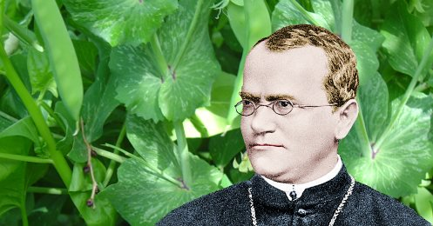
Many Genes and One Phenotype It’s Complicated
When thinking about polygenic inheritance, it’s a good idea to have a handle on how three genes, each with two alleles, are passed down to offspring.
Thus, we invoke the venerable work of the venerable monk, Gregor Mendel (below, with his famous peas), and tie his ideas to what we know about separation of genes and alleles when parents make reproductive cells. The cellular basis of his ideas is meiosis, shown on the next slides.
Notes:
The knowledge of independent assortment is required to work through some problems. This and the next three slides are background for this task.
Image from https://www.famousscientists.org/gregor-mendel/

Slide 6
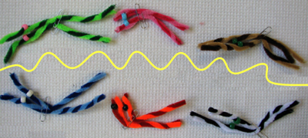
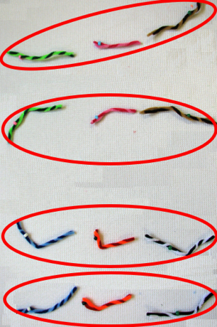
Overview of Meiosis
Each chromosome is duplicated earlier in the process of meiosis. At Metaphase I, the two versions of a given chromosome pair “find” each other.
These chromosome pairs separate during meiosis I. Subsequently, two new cells form, each having one member of a chromosome pair. Then, the two duplicates of a chromosome separate at meiosis II to produce four cells, each with a single chromosome from the original pair.
Notes:
Photos: M Heidemann

Slide 7
Law of Segregation
Next, we’ll look at a single pair of chromosomes. The pipe cleaners represent a duplicated pair of matched (homologous) chromosomes of a parent with what we’ll call the Ee genotype, ready to separate during meiosis I. The beads represent the alleles E (pink) and e (white). Upon separation the two kinds of alleles will segregate. During meiosis II, the duplicated alleles split apart.
Notes:
Photos: M. Heidemann

Slide 8
Law of Assortment: Independent Inheritance of Chromosomes
Each member of a pair of chromosomes randomly align on either side of the “equator” of the cell at Metaphase I. Shown are three pairs that correspond with three genes, with two possible arrangements, A and B. Each member of the three pairs separate independently during meiosis I. During meiosis II, the duplicated alleles split apart.
Notes:
Photos: M. Heidemann

Slide 9
Mendel’s Laws – A Summary
Law of Segregation states that members of a pair of homologous chromosomes segregate during meiosis and are distributed to different gametes.
Law of Independent Assortment states that each member of a pair of homologous chromosomes segregates independently during meiosis so that alleles carried on different chromosomes are distributed randomly to the gametes
Notes:
Source: dictionary.com

Slide 10
Polygenic Inheritance
Back to our three genes: We’ll assume that combinations of the six alleles would result in seven different skin colors, with the top, lightest, color represented by aa bb ee and the bottom, darkest, color by AA BB EE.
Notes:
Image adapted from: http://download-wallpaper.net/content/shades-of-brown-paint.html

Slide 11
Polygenic Inheritance
Some possible combinations of the six alleles that produce these gradations in skin color are:
aa bb ee
Aa bb ee
AA bb ee
AA Bb ee
AA BB ee
AA BB Ee
AA BB EE
Notes:
Image adapted from: http://download-wallpaper.net/content/shades-of-brown-paint.html

Slide 12
Polygenic Inheritance Some Predictions
Assuming that each set of alleles sorts independently of the other two, here are the offspring predicted when mating:
(1) AA BB EE x aa bb ee – all potential offspring would have equal “doses” of each dominant and recessive form and be intermediate in color. Their genotype would be Aa Bb Ee.
Parent 1 Gametes
Parent 1
ABE
Expected Proportions of Offspring
AABBEE
X
=
abe
Parent 2 Gametes
0% 0% 0% 100% 0% 0% 0%
Parent 2
AaBbEe
aabbee
Notes:
Figure adapted from Khan Academy (note that the figure used the C gene rather than E in the example)
https://www.khanacademy.org/science/biology/classical-genetics/variations-on-mendelian-genetics/a/polygenic-inheritance-and-environmental-effects

Slide 13
Polygenic Inheritance Some Predictions
Assuming that each set of alleles sorts independently of the other two, here are the offspring predicted when mating:
(1) AA BB EE x aa bb ee – all potential offspring would have equal “doses” of each dominant and recessive form and be intermediate in color. Their genotype would be Aa Bb Ee.
(2) Aa Bb Ee x Aa Bb Ee – potential offspring would have a range of “doses” for skin color from lightest to darkest:
Parent 1 Gametes
Parent 1
Expected Proportions of Offspring
AaBbEe
X
=
Parent 2 Gametes
2% 9% 23% 31% 23% 9% 2%
Parent 2
AaBbEe
Notes:
Figure adapted from Khan Academy (note that the figure used the C gene rather than E in the example)
https://www.khanacademy.org/science/biology/classical-genetics/variations-on-mendelian-genetics/a/polygenic-inheritance-and-environmental-effects

Slide 14
Polygenic Inheritance Some Predictions
Assuming that each set of alleles sorts independently of the other two, here are the offspring predicted when mating:
(1) AA BB EE x aa bb ee – all potential offspring would have equal “doses” of each dominant and recessive form and be intermediate in color. Their genotype would be Aa Bb Ee.
(2) Aa Bb Ee x Aa Bb Ee – potential offspring would have a range of “doses” for skin color from lightest to darkest.
(3) Aa bb ee x aa bb ee – half the potential offspring would have the lightest skin and half a bit darker.
Parent 1 Gametes
Parent 1
Abe abe
Expected Proportions of Offspring
Aabbee
X
abe
=
Aabbee
aabbee
Parent 2 Gametes
0% 0% 0% 0% 0% 50% 50%
Parent 2
aabbee

Slide 15
Polygenic Inheritance Making predictions
Predict the possible genotypes and expected skin color of the following matings. Remember that each set of alleles assort independently.
Aa Bb Ee x aa BB ee
AA bb EE x aa bb Ee
Aa BB Ee x AA Bb EE

Slide 16
Polygenic Inheritance Making predictions
Predict the possible genotypes and expected skin color of the following matings. Remember that each set of alleles assort independently.
Aa Bb Ee x aa BB ee
AA bb EE x aa bb Ee
Aa BB Ee x AA Bb EE

Slide 17
Model: Unplugged
The simple model is useful in showing that skin color is the result of expressed alleles adding to a phenotype, in this case seven discrete colors, which is certainly not the case in humans.
A way to think of the actual expression and interaction of gene products involved in skin color might be to compare piles of uncooked and cooked spaghetti as explained on the following slides.

Slide 18
Polygenic Inheritance More Genes
Uncooked spaghetti could represent the many genes involved in the expression of skin color. Geneticists think this is about 100 genes.
As shown here, each strand is an individual entity with no interaction with the others.
Notes:
Image from Pixabay

Slide 19
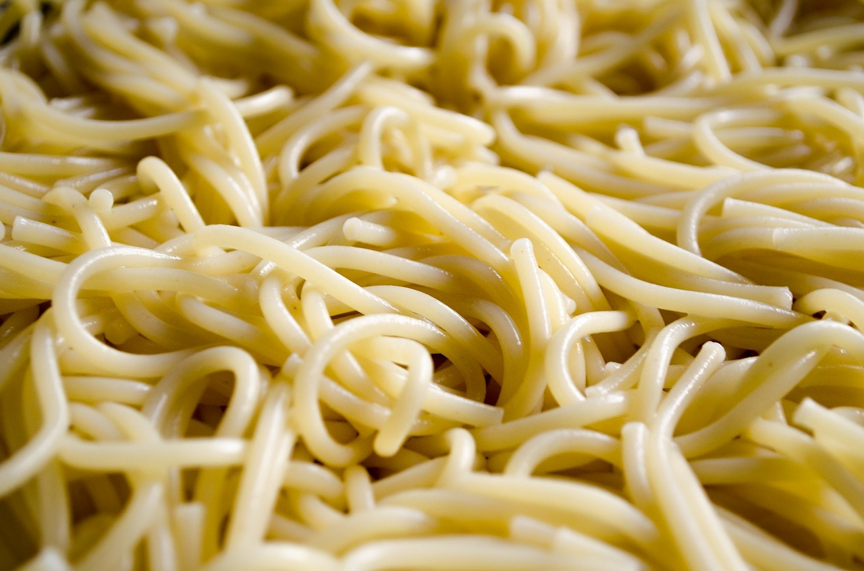
More Genes: Cooked Spaghetti
Uncooked spaghetti is not a good model of polygenic inheritance. A more realistic representation of the interaction of gene products involved in skin color, as with most continuous traits, would be cooked spaghetti. Each strand is intertwined with many others.
Have you ever tried to untangle a pile of cooked spaghetti?
Researchers studying the genetics of skin color are untangling that pile of spaghetti. The task is difficult; at this stage it is more like studying uncooked spaghetti.

Slide 20
More Complications
Each of the three processes for the expression of skin color – making pigment, regulating pigment production, and transporting pigment – depends on the expression of genes across the three processes. Thus, the gene products of one of the three processes depend on the products of the other two.
Making and transporting pigment requires quite a complex machine with lots of interconnecting parts.
Notes:
Image: http://www.nature.com/naturejobs/2012/120906/images/nj7414-165a-i1.0.jpg

Slide 21
One Kind of Complexity One Gene: Multiple Alleles
One complexity is that one gene may have three or more possible alternatives, or alleles. The products of each of these may interact differently with other gene products.
In a totally fictitious example, the N gene influences nose shape in cartoon frogs. The alleles are N, N¹, n, n¹. Some combination of expressed alleles determines the of phenotype of a red nose with a particular shape.
Notes:
From from http://clipart-library.com/clipart/574850.htm

Slide 22
Multiple Alleles and Skin Color
This graphic is an overview of the gene products involved in making two kinds of skin pigment. Two examples of genes with multiple alleles related to skin color are:
there are 9 different transcripts for the DCT/TRYP₂ gene. This gene is involved in making pigment.
the MC1R gene, key to kick-starting melanin synthesis, has at least 15 different forms of the “light” allele, each with a slightly different effect on skin color.

Slide 23
Another complexity: Relationships Between Alleles
Relationships of alleles of a single gene: relationship maybe dominant/recessive, co-dominant, partially dominant, etc.
This is called dominance variation and obviously adds to the task of linking genotypes to phenotypes.
When the relationship between alternative alleles is co-dominant, both alleles are expressed and two functional proteins are made. In this example, the phenotype associated with the gene for color is intermediate. There is no dominant/recessive relationship.
Notes:
Image: https://en.wikipedia.org/wiki/Dominance_(genetics)

Slide 24
More Complexity: Epistasis
The products of different genes may interact in various ways, a phenomenon called epistasis. That is, a given phenotype is regulated by modifier genes.
A well known example is coat color in Labrador retrievers. If the E gene is doubly recessive, ee (circled genotype), the fur is golden (no color). The B gene is “negated”. The e allele probably codes for a non-functional protein required for hair color.
One E allele is sufficient to allow color production to proceed. If the E gene is expressed as EE or Ee (boxed genotype), the dogs will be brown (bb) or black (BB, Bb).
Notes:
Image from: https://online.science.psu.edu/sites/default/files/biol011/Fig-6-16-Epistasis_0.jpg

Slide 25
Epistasis and Skin Color
The biochemistry of producing skin pigments has two separate processes: 1) the pathway for synthesizing pigment from precursors; and 2) regulating the amount of pigment made.
The second set of genes (blue) modifies or regulates the output of the first set (red) of genes by limiting the amount of tyrosine that enters the synthetic pathway.
Notes:
Figure modified from: researchgate.net

Slide 26
Summary
The question asked was: Can we explain how the products of all relevant genes add up to a given phenotype, in this case skin color?
Answer:
Geneticists have determined the properties of some relevant genes and their expressed proteins.
They know how some of them interact.
They also know that the biological basis of skin color is complicated, as shown by the continuous nature of the phenotype.
The current explanations are just the beginning of understanding a very complicated phenotype.

