Slide 1
EXISTENTIALISM Philosophy of Education

Slide 2
Soren Kierkegaard (1813-1855)
Danish philosopher born in Copenhagen.
The father of existentialism.
Human existence is always individual in character, never social.

Slide 3
CONT…
Man functions, grows, develops, makes choices, suffers, experiences intense feelings, and faces God as an individual.
“Life is not a problem to be solved, but a reality to be experienced.”

Slide 4
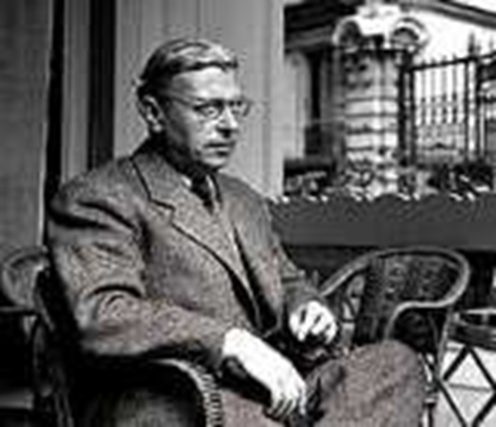
Jean-Paul Sartre (1905-1980)
French philosopher and principal spokesman for the existentialist movement in post-war France.
An atheistic existentialist.
Arguably the best known philosopher of the twentieth century.
“Existence precedes essence.”

Slide 5
CONT…
Essence is created by existence; human nature is a product of existence.
Man first exists without purpose or definition, finds himself in the world and only then, as a reaction to experience, defines the meaning of life.
According to him, since there is no God or designer to give man a purpose, it is up to the individual to choose the life they think best.
We are responsible for everything we do.
“Man is condemned to be free.”
“The destiny of man is placed within himself.”

Slide 6
Why am I here?
Why do I exist?
What is my purpose in life?
What is my
essence?

Slide 7
What is EXISTENCE?
From the Latin words…
ex
(out)
Exsistere
(to stand out)
stare
(to stand)

Slide 8
…To appear
…To arise
…To become
…To be

Slide 9
What is ESSENCE?
…Meaning
…Purpose
…What it is
…Nature

Slide 10
Meaning
An antiphilosophy.
Against the principles of traditional philosophy.
Rationalism, Essentialism, Universalism are all opposed by Existentialists.
According to them objects are simply present and man interprets them.
Man makes them man.
Man is the total sum of his actions.

Slide 11
What is Existentialism?
Existentialism on Metaphysics: Reality is subjective, with existence preceding essence. Existence creates essence.
Existentialism on Epistemology: Knowing is to make personal choices. To choose or apply what I want to know.

Slide 12
CONT…
Existentialism on Axiology: Values should be freely chosen.
Educational Implication: Classroom dialogues stimulate awareness that each person creates self-concept through significant choices.

Slide 13
Underlying Assumptions of Existentialism
The center of existence is man rather than truth, laws, principles or essence.
Man is not alone in the world.
Existentialism propounds the belief that man cannot accept the ready-made concepts of existence forced upon him.

Slide 14
CONT…
Man’s Existence.
Self-knowledge.
Freedom and Responsibility.
Man is not complete.
No acceptance of readymade concepts.

Slide 15
Existential Philosophy of Education
Self Realisation Aim of Education.
Child-centred Education.
Inversion of Realistic Curriculum.
Self Realised Teacher.

Slide 16
Aims of Education
Free individuality.
They have no confidence in Team spirit.
Any of the child may join the group without any compulsion.
Education should help the individual to make him human.
Development of introspective powers – self observation.

Slide 17
Curriculum
Provide scope for the exercise of free choice.
The child should know his own self.
History from the present predictment, Humanities, Fine arts are all to be included in Vocationalisation.
Problem-solving situations should not be there.
Knowledge should bring freedom.

Slide 18
Methods of Teaching
Scientific Method
Question-Answer Method
Case study Method
Against the group method
Knowledge through intimate personal contacts
Individual attention to every individual
No indoctrination
Home education
Education for creativity

Slide 19
Role of Teachers
To help students define their own essence by exposing them to various paths they take in life.
To create an environment in which they freely choose their own preferred way.
To relates with each student openly and honestly.

Slide 20
Role of Teachers
To assist and guide the learner in the process of becoming intelligent, sensitive, choosing, and acting individual who knows the obligation and responsibility of freedom.
To help the individual identify and know himself better.
Identifier of choices who challenges the learner to become fully existent.

Slide 21
Role of Learners
To freely choose what subject/s they want to study as long as they are interested in it.
To define their own essence or meaning of life.

Slide 22
Discipline
Individual is responsible for the consequences of his choices.
Adolescent must be punished, if he is found rebellious in the class.
Teacher encourage – student to work hard – till he knows the subject matter well.
Has to assist and guide each of his student.
Responsible for the freedom of his students.

Slide 23
Educational Implications of Existentialism
Becoming of a human person as one who lives and makes decisions about what he will do and be.
Provide an atmosphere where the individuals develop in a healthy way, find security, encouragement and acceptance by teachers.
Any subject in school can present existential situations for teaching, and the development of human beings.

Slide 24
CONT…
The teacher is in a position to foster individual growth.
Facilitate development or originality and creativity by providing necessary material and equipment.
The teacher is very active and welcomes challenges to his ideas from the students.
The teacher is in the foreground and is the center of attention.
Concern and respect for the individual student should be the main concern of the school.

Slide 25
Contribution of Existentialism
Aimed at Total Development.
Emphasis on Subjective Knowledge.
Emphasis on Importance of Environment.

Slide 26
Summary
Existentialism is a philosophy that emphasizes individual existence, freedom and choice. It is the view that humans define their own meaning in life, and try to make rational decisions despite existing in an irrational universe.

