Slide 2
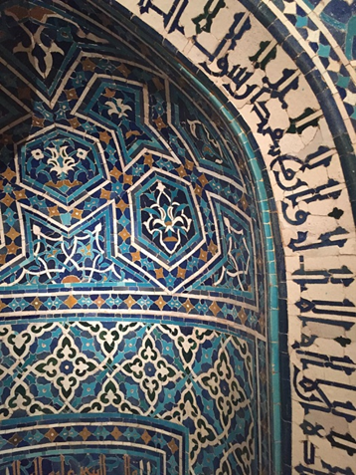
Kufic or Kufic: Kufic is one of the earliest styles to be used to record the word of God in the Qur’an. One of the early Kufic inscriptions can be seen inside the Dome of the Rock in Jerusalem.

Slide 3
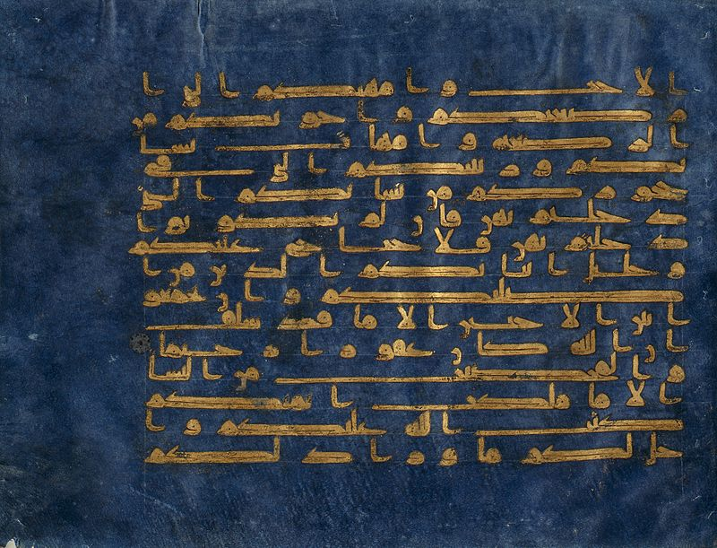
The "Blue Qur'an" manuscript, Abbasid, Baghdad or North Africa, 8-9th centuries
Kufic script, 8th or 9th century (Surah 48: 27–28) Qur'an.

Slide 4
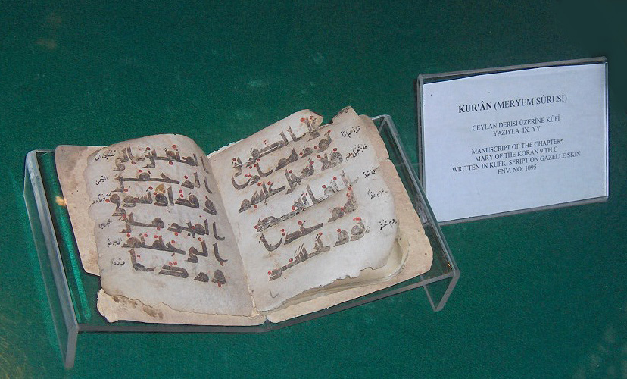
Manuscript of the Surat Maryam of the Qur'an; Kufic script on gazelle skin, 9th century. (Surah 19: 83–86)
Hafsids Bougie Algeria 1249 1276 ornamental Kufic

Slide 5
VARIATIONS OF KUFIC STYLE

Slide 6
Early Kufic
Easten Kufic
Foliate Kufic
Knotted Kufic
Square Kufic
Ornamented Kufic

