Slide 1
HORT 308
MEDICINAL AND AROMATIC PLANTS

Slide 2
Senna

Slide 3
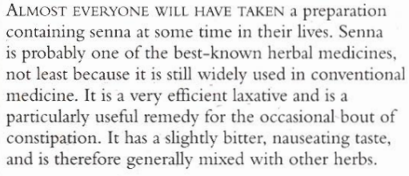
B.N Cassia senna Family: Leguminosae

Slide 4
Habitat and Cultivation
Native to tropical Africa
Now cultivated throughout Africa

Slide 5
Key Constituents
Anthraquinone glycosides
Naphthalene glycosides
Mucilage
Flavonoids
Volatile oil

Slide 6
Key Actions
Stimulant
Laxative
cathartic

Slide 7
Research
Sennosides:
Extensive research for 50 Years
Bowel movement after 10 hours

Slide 8
Traditional and Current Uses
Constipation
Cathartic

Slide 9
Parts Used
Leaves – Stronger than pods (Fresh and Dried)
Pods

Slide 10
Key Preparations
Tablets
Decoction
Infusion
Tincture

Slide 11
Caution
Not More than 10 days

Slide 12
Chrysanthemum

Slide 13
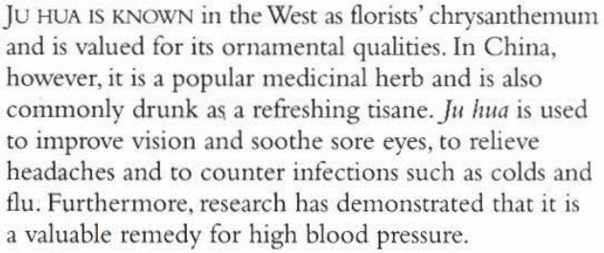
B.N Chrysanthemum morifolium Family: Compositae

Slide 14
Habitat & Cultivation
Native to China
Now cultivated worldwide

Slide 15
Key Constituents
Alkaloids
Volatile oil
Sesquiterpene lactones
Flavonoids
Betaine & choline
Vitamin B₁

Slide 16
Key Actions
Increase sweating
Antiseptic
Lower B.P
Cooling
Fever

Slide 17
Research
Proved in 1970 in China and Japan to lower B.P, relives headaches, dizziness, insomnia. Treatment of angina and antibiotic effect

Slide 18
Traditional & Current Uses
As Beverage
Eye problem
Cooling and antiseptic
Skin complaints (pimples, acne, boils)
Blood Pressure
Convulsions

Slide 19
Key Preparations
Infusion
Leaf Powder
Poultice

