Slide 1
Conducting (elastic or large) arteries
The aorta, common carotid and subclavian arteries, pulmonary trunk, and common iliac arteries (>10 mm diameter)
Have a layer of elastic tissue called the internal elastic lamina at the border between the interna and media
The tunica media consists of 40 to 70 layers of elastic sheets, perforated like slices of Swiss cheese, alternating with thin layers of smooth muscle, collagen, and elastic fibers
Histologically dominant
Notes:
Collagen is the most abundant protein in the human body, found in the bones, muscles, skin, and tendons. It is the substance that holds the body together

Slide 2
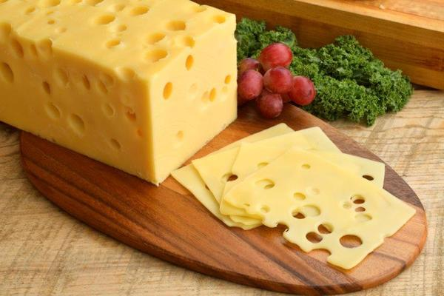
Swiss cheese

Slide 3
Conducting (elastic or large) arteries
There is an external elastic lamina at the border between the media and externa
Difficult to distinguish from the elastic sheets of the tunica media
The tunica externa is less than half as thick as the tunica media and quite

Slide 4
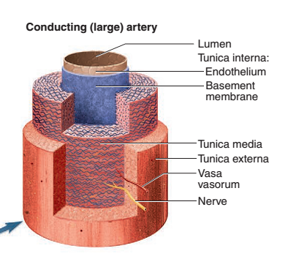
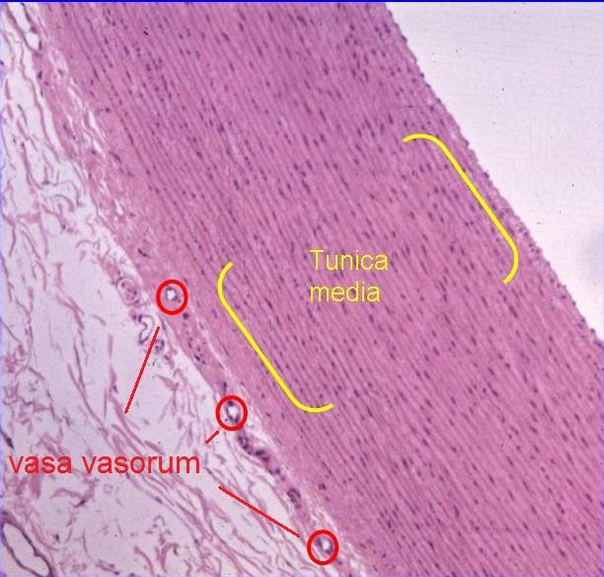

Slide 5
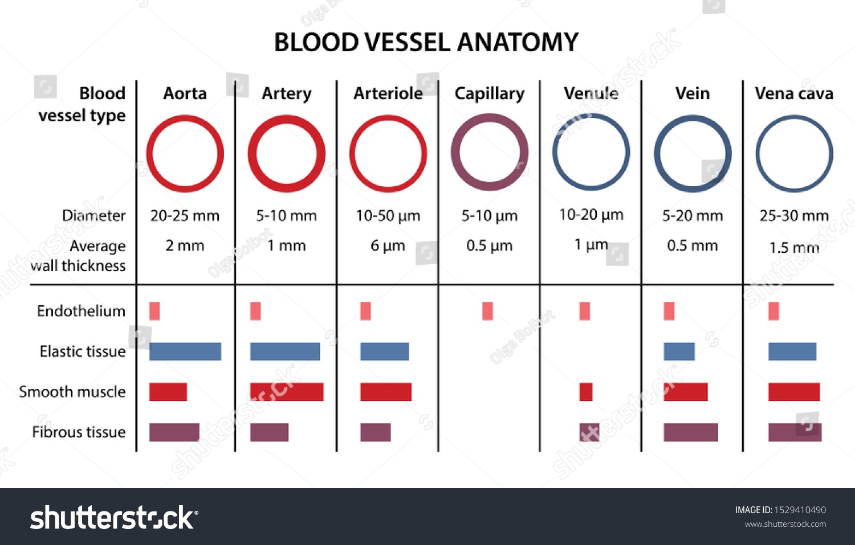

Slide 6
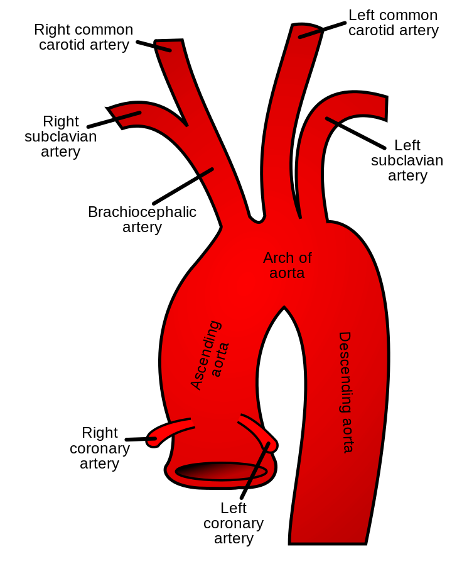
Aorta
Diameter: 350mm Blood flow: 4900 milliliters per minute Common problem: Aortic Stenosis Location: Center of the thorax
https://largest.org/misc/arteries-in-the-human-body/

Slide 7
Distributing (muscular or medium) arteries
Smaller branches that distribute blood to specific organs
Distributing arteries typically have up to 40 layers of smooth muscle constituting about three-quarters of the wall thickness
In histological sections, this smooth muscle is more conspicuous ( visible) than the elastic tissue
Both the internal and external elastic laminae, however, are thick and often conspicuous
Notes:
Conspicuous,,,visible

Slide 8
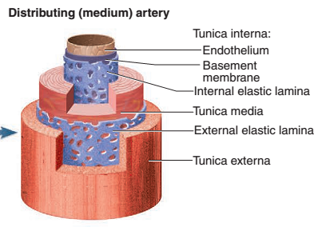
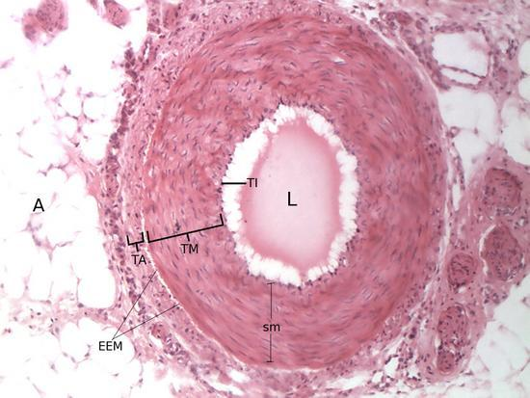
Notes:
Tunica (biology), a layer, sheath or similar covering. "Tunica", an anatomical term for a membranous structure lining a cavity, or covering an organ such as a gland or a blood vessel.

Slide 9
Resistance (small) arteries
Usually too variable in number and location to be given individual names
exhibit up to 25 layers of smooth muscle and relatively little elastic tissue
Have a thicker tunica media in proportion to the lumen
The smallest of these arteries, up to 200 μm in diameter and with only one to three layers of smooth muscle, are called arterioles

Slide 10
