Slide 1
Introduction to Computer
Lecture # 6

Slide 2
Web Server
A Web server is software or hardware that uses HTTP (Hypertext Transfer Protocol) and other protocols to respond to client requests made over the World Wide Web (WWW).
Web server software controls how a user accesses hosted files.
It is accessed through the domain names of websites and ensures the delivery of the site's content to the requesting user.
As hardware, a Web server is a computer that holds web server software and other files related to a website, such as HTML documents, images and JavaScript files.
Web server hardware is connected to the internet and allows data to be exchanged with other connected devices.

Slide 3
Continue..
Web servers often come as part of a larger package of internet- and intranet-related programs that are used for:
Sending and receiving emails.
Downloading requests for File Transfer Protocol (FTP) files.
Building and publishing Web pages.
Considerations in choosing a Web server include:
how well it works with the operating system and other servers
its ability to handle server-side programming
security characteristics and
the particular publishing, search engine and site building tools that come with it.

Slide 4
Searching the Web
The Web is a worldwide resource of information. A primary reason that people use the Web is to search for specific information, including text, pictures, music, and video.
The first step in successful searching is to identify the main idea or concept in the topic about which you are seeking information.
Determine any synonyms, alternate spellings, or variant word forms for the topic. Then, use a search tool to locate the information.

Slide 5
Types of search tools
Two types of search tools are search engines and subject directories.
A search engine is a program that finds Web sites, Web pages, images, videos, news, maps, and other information related to a specific topic.
A subject directory classifies Web pages in an organized set of categories or groups, such as sports or shopping, and related subcategories.

Slide 6
Search Engines
A search engine is helpful in locating information for which you do not know an exact Web address or are not seeking a particular Web site.
Some search engines look through Web pages for all types of information. Others can restrict their searches to a specific type of information, such as images, videos, audio, news, maps, people or businesses, and blogs.
Search engines require that you enter a word or phrase, called search text, that describes the item you want to find.
Your search text can be broad, such as spring break destinations, or more specific, such as Walt Disney World.

Slide 8
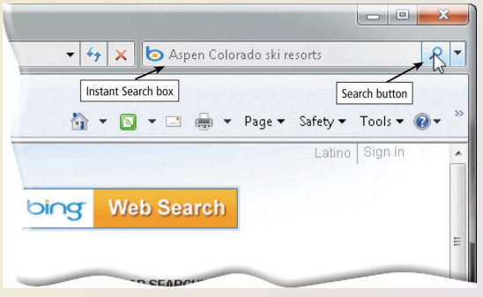
Continue..
Some Web browsers contain an Instant Search box to eliminate the steps of displaying the search engine’s Web page prior to entering the search text.

Slide 9
Search operators
Search operators can help to refine your search.

Slide 10
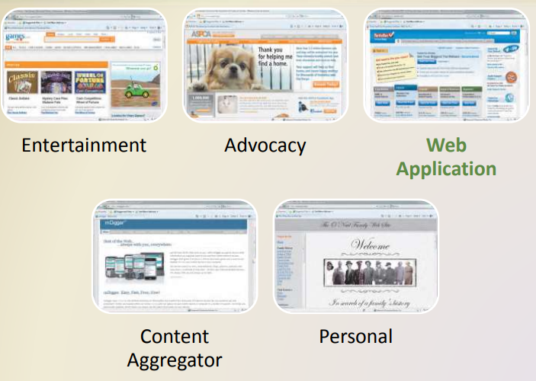
Types of Web Pages

Slide 11
Continue..
Portal
A portal is a Web site that offers a variety of Internet services from a single, convenient location. Most portals offer these free services: search engine; news; sports and weather; Web publishing; reference tools such as yellow pages, stock quotes, and maps; shopping; and e-mail communications services. Popular portals include AltaVista, AOL, Excite, GO.com, iGoogle, Lycos, MSN, and Yahoo!.
News
A news Web site contains newsworthy material including stories and articles relating to current events, life, money, sports, and the weather. News papers and television and radio stations are some of the media that maintain news Web sites.

Slide 12
Continue..
Informational
An informational Web site contains factual information. Many United States government agencies have informational Web sites providing information such as census data, tax codes, and the congressional budget. Other organizations provide information such as public transportation schedules and published research findings.
Business/Marketing
A business/marketing Web site contains content that promotes or sells products or services. Nearly every enterprise has a business/marketing Web site. Many companies also allow you to purchase their products or services online.

Slide 13
Continue..
Blog
A blog, short for Weblog, is an informal Web site consisting of time-stamped articles, or posts, in a diary or journal format, usually listed in reverse chronological order. A blog that contains video clips is called a video blog or vlog.
Wiki
A wiki is a collaborative Web site that allows users to create, add to, modify, or delete the Web site content via their Web browser. Most wikis are open to modification by the general public. Wikis usually collect recent edits on a Web page
Online Social Networks
An online social network, also called a social networking Web site, is a Web site that encourages members in its online community to share their interests, ideas, stories, photos, music, and videos with other registered users. Popular social networking Web sites include MySpace and Facebook.

Slide 14
Continue..
Educational
An educational Web site offers exciting, challenging avenues for formal and informal teaching and learning. For a more structured learning experience, companies provide online training to employees; and colleges offer online classes and degrees. Instructors often use the Web to enhance classroom teaching by publishing course materials, grades, and other pertinent class information. so that someone can review them for accuracy.
Entertainment
An entertainment Web site offers an interactive and engaging environment. Popular entertainment Web sites offer music, videos, sports, games, ongoing Web episodes, sweepstakes, chat rooms, and more.
Advocacy
An advocacy Web site contains content that describes a cause, opinion, or idea. These Web sites usually present views of a particular group or association

Slide 15
Continue..
Web Application
A Web application, or Web app, is a Web site that allows users to access and interact with software through a Web browser on any computer or device that is connected to the Internet. Some Web applications provide free access to their software. Examples of Web applications include Google Docs (word processing, spreadsheets, presentations), TurboTax Online (tax preparation), and Windows Live Hotmail (e-mail).
Content Aggregator
A content aggregator is a business that gathers and organizes Web content and then distributes, or feeds, the content to subscribers for free or a fee. Examples of distributed content include news, music, video, and pictures. Subscribers select content in which they are interested. Whenever this content changes, it is downloaded automatically (pushed) to the subscriber’s computer or mobile device.

Slide 16
Continue..
Personal
A private individual or family not usually associated with any organization may maintain a personal Web site. People publish personal Web pages for a variety of reasons. Some are job hunting.

Slide 17
Web Casting
A combination of the words “web” and “broadcast,” a webcast.
Webcasting is the process of video broadcasting live over the internet. This technology operates in real-time and allows for active conversations among and between the webcaster and their viewers.
Recent developments in technology have made this both an affordable and an effective tool for communication.
Embracing webcasting as a marketing initiative for your company is beneficial in that it is a popular, new trend, allows for direct communication with your audience, and can portray to your customers that you are a subject matter expert.

Slide 18
Benefits to Webcasting
There are a host of benefits that come with utilizing webcasts for your overall marketing strategy.
As mentioned above, it is a popular trend. By embracing trends you can show that your company is on top of the game.
In addition, people generally enjoy visual media content, so by offering something that is both visual and interactive, you will draw in a large audience.
Another major benefit to webcasting is the ability to talk with your customers in real-time. By setting up interactive chat rooms, your audience can interact with one another while also asking you questions which you can answer without delay.
There are many uses for webcasting from marketing, training, and corporate communications, to press conferences and Q&A sessions with customers. Overall, webcasting is capable of reaching geographically dispersed audiences, maximizing brand opportunities, interacting and engaging your audience, and extending your company’s value

Slide 19
Web Publishing
Web publishing is the development and maintenance of Web pages. To develop a Web page, you do not have to be a computer programmer.
For the small business or home user, Web publishing is fairly easy as long as you have the proper tools.

Slide 20
Web Publishing
The five major steps to Web publishing are as follows:
1. Plan a Web site: Think about issues that could affect the design of the Web site.
2. Analyze and design a Web site: Design the layout of elements of the Web site such as links, text, graphics, animation, audio, video, and virtual reality.
3. Create a Web site: Use a word processing program to create basic Web pages or Web page authoring software to create more sophisticated Web sites.
4. Deploy a Web site: Transfer the Web pages from your computer to a Web server.
5. Maintain a Web site: Ensure the Web site contents remain current and all links work properly.

Slide 21
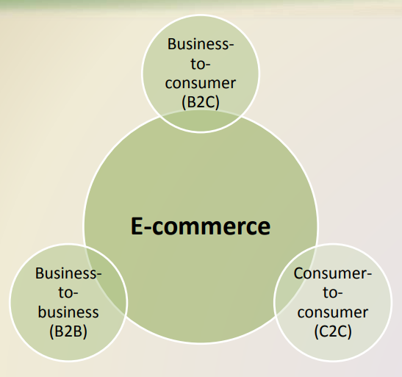
E-Commerce
E-commerce, short for electronic commerce, is a business transaction that occurs over an electronic network such as the Internet.
Anyone with access to a computer or mobile device, an Internet connection, and a means to pay for purchased goods or services can participate in e-commerce.

Slide 22
Types of E-commerce
Business-to-consumer, consumer-to-consumer, and business-to-business.
1.Business-to-consumer (B2C) e-commerce consists of the sale of goods and services to the general public. For example, Apple has a B2C Web site. Instead of visiting a retail store to purchase an iPod, for example, customers can order one directly from Apple’s Web site.
2. Consumer-to-consumer (C2C) e-commerce occurs when one consumer sells directly to another, such as in an online auction.
3. Business-to business (B2B) e-commerce Most e-commerce, though, actually takes place between businesses, which is called business-to business (B2B) e-commerce. Many businesses provide goods and services to other businesses, such as online advertising, recruiting, credit, sales, market research, technical support, and training

