Slide 3
Print media
R I N T
M E D IA
Introduction
Importance
& Characteristics
Types

Slide 4
P Print Media
R I N T
M E D IA
Printing is a process for reproducing text and images typically with ink on paper using a printing press.
A medium that disseminates printed matter is called print media.

Slide 5
IMORTANCE OF PRINT MEDIA

Slide 6
P Characteristics Of Print Media
R I N T
M E D IA
Most effective medium
Public can be read again and again
For educated people
Information is useful for Historian
Information can given in detail

Slide 7
P Different Types Of Print Media
R I N T
M E D IA
News Paper
Magazines
Books

Slide 8
_{P} News Papers
R I N T
M E D IA
Newspaper is one of the most important and effective print media of mass communication.
It was first published in Germany and later spread its roots to the rest of the world.
Its valuable services to the community like information, education, entertainment, persuasion, cultural transmission, record facility etc.

Slide 9
_{P} Functions Of Newspaper
R I N T
M E D IA
Information
Advertising
Opinion Building
Education
Entertainment

Slide 10
P Types Of News paper
R I N T
M E D IA
Daily
Weekly
Monthly
Local
National
International

Slide 11
P Magazine
R I N T
M E D IA
Magazines and periodicals are generally published on a regular schedule, containing a verity of reading material.

Slide 12
P Functions Of Magazine
R I N T
M E D IA
Information
Entertainment
Comment
Advertising
Influence

Slide 13
KINDS Of Magazines
Academic Fashion Sports Political News

Slide 14
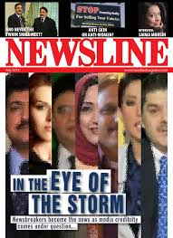
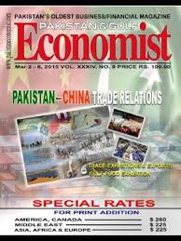
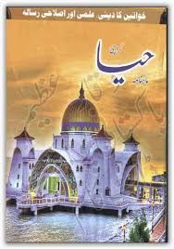
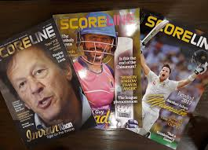
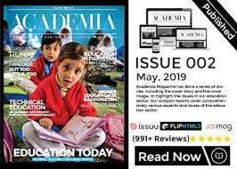

Slide 15
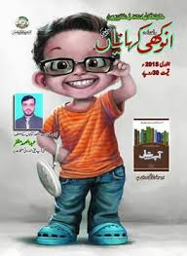
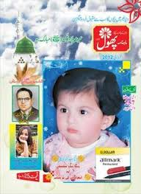
CHILDEREN MAGAZINES

Slide 16
P Books
R I N T
M E D IA
In the past books was not a mass medium but privilege of the elite class. There were two reasons for that. Firstly, books were not printed but transcribed by hand. Secondly, the low literacy level in the masses limited books exclusively to a small fraction of the society. It was the nineteenth century which saw book as a mass medium.

Slide 17
P Types Of Books
R I N T
M E D IA
Trade Books
Paper-back Books
Text Books
Professional Books

Slide 18
Leaflet
Booklet
Pamphlet
Poster

Slide 19
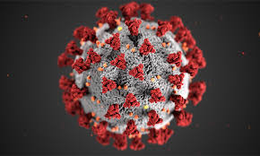
What do you think about it?
The Importance of Print During the Pandemic:

Slide 20
RESEARCH
Yih-Choung Teh, Ofcom’s director for strategy and research, said people were “turning to public authorities and traditional broadcasters for trusted information about Covid-19”.
Providing some escapism
Stopping the spread of fake news

Slide 21
P THANK YOU
R I N T
M E D IA

