Slide 1
The Psychological and Emotional Impact of Emergency Situations

Slide 2
Psychological trauma
According to this definition, it is conceivable that two athletes can experience the same physically “traumatic” injury, yet one can develop an emotional “trauma” reaction related to the incident, whereas the other can experience little or no emotional difficulty following the event. Psychological trauma is caused by feelings of fear, helplessness, or horror.

Slide 3
Critical incident stress management
Critical incident stress management (CISM) is an adaptive, short-term psychological helping-process that focuses solely on an immediate and identifiable problem.
It can include pre-incident preparedness to acute crisis management to post-crisis follow-up. Its purpose is to enable people to return to their daily routine more quickly and with less likelihood of experiencing post-traumatic stress disorder (PTSD).

Slide 4
Critical incident stress management
CISM is ineffective for primary trauma victims, and should only be used for secondary victims, such as responding emergency services personnel. CISM was never intended to treat primary victims of trauma. Most are first responders (Police, Fire, emergency medical services) or work in the mental health field

Slide 5
Types of intervention 1.Defusing
A defusing is done the day of the incident before the person(s) has a chance to sleep.
The defusing is designed to assure the person or people involved that their feelings are normal, to tell them what symptoms to watch for over the short term.

Slide 6
Debriefing
Debriefings are usually the second level of intervention for those directly affected by the incident and often the first for those not directly involved.
A debriefing is normally done within 72 hours of the incident and gives the individual or group the opportunity to talk about their experience, how it has affected them, brainstorm coping mechanisms, identify individuals at risk, and inform the individual or group about services available to them in their community.The final step is to follow up with them the day after the debriefing to ensure that they are safe and coping well or to refer the individual for professional counselling.

Slide 7
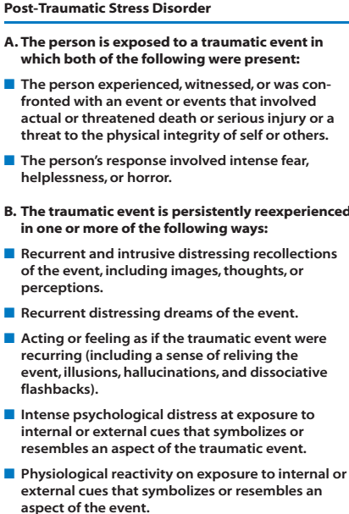

Slide 8
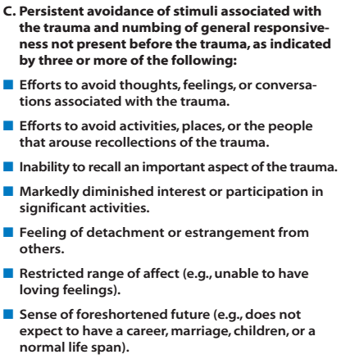

Slide 9
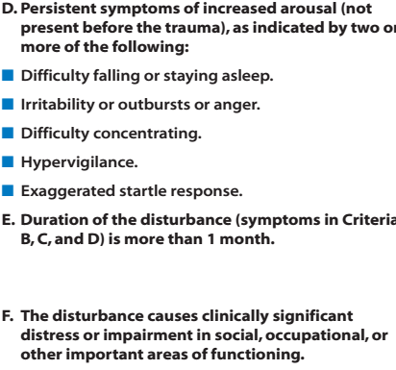

Slide 10
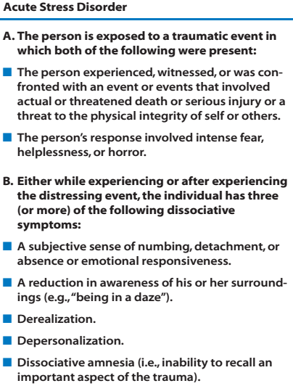

Slide 11
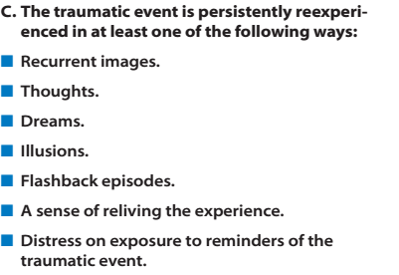

Slide 12
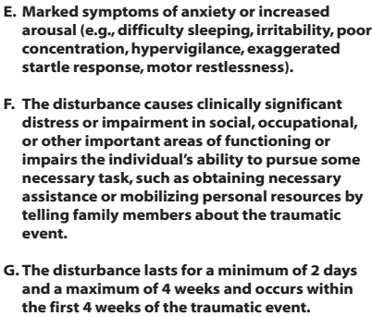

Slide 13
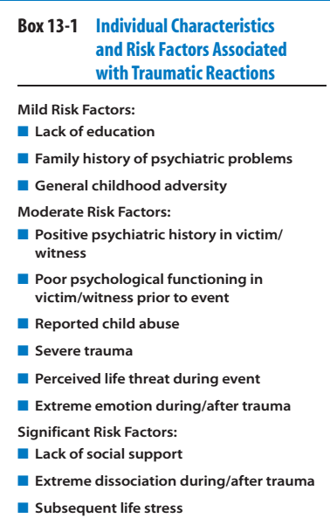

Slide 14
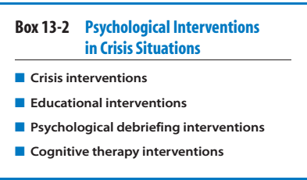
Three characteristics that lead to successful coping are hardiness, self enhancement, and positive emotion.

Slide 16
Individuals who perform crisis intervention work function less like a therapist and operate more like an empathetic consultant whose aim is to reduce distress, ensure basic survival needs, and reconnect individuals to service providers and community resources that will establish a positive and hopeful outlook for long-term recovery.

Slide 17
Educational Interventions
Educational methods including brochures, media portrayals, and public seminars that can be used both before and after traumatic events to reduce the confusion and perceived helplessness that often accompany critical incidents and crisis situations.

Slide 18
Psychological Debriefing Interventions
The International Critical Incident Stress Foundation, Inc. (ICISF) reports that not only has CISD (critical incident stress debriefing) prevented the development of PTSD in a variety of groups, but the procedure was also found to be particularly helpful for intact groups who endured a wide range of potentially traumatic experiences. CISD is more effective in homogenous groups such as athletic teams than in non homogenous groups

Slide 19
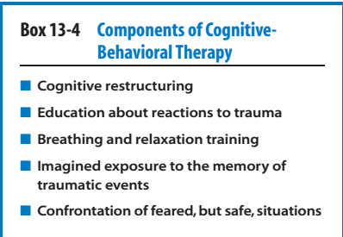

Slide 20
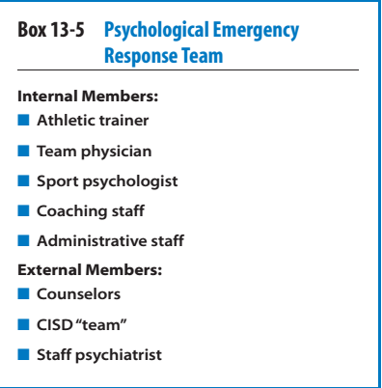

Slide 21
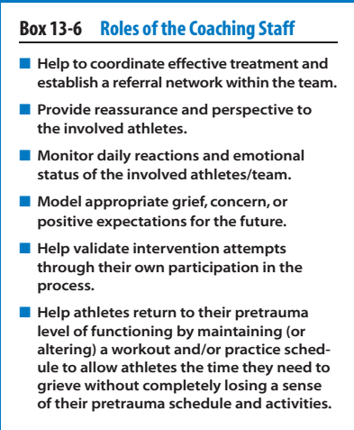

Slide 22
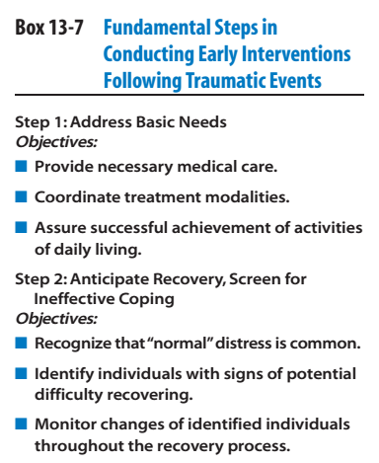

Slide 23
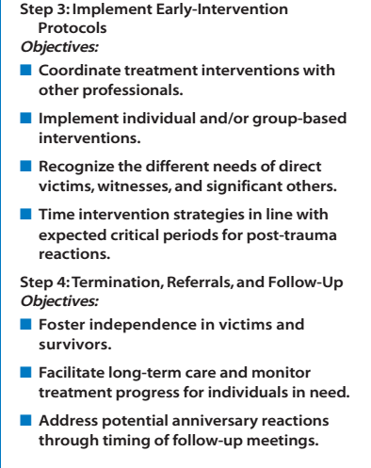

Slide 24
Physical injuries must be treated before psychological interventions.
Signs of effective treatment include the gradual reduction of emotionality during repeated discussions of the traumatic experience; the reformulation of thoughts, beliefs, and perceptions concerning the events; and the reduction of negative emotions or reliance on ineffective coping strategies.
Follow-up debriefing sessions should be held at ideal times, especially anniversaries

Slide 25
Compassion Fatigue
Compassion fatigue represents a caregiver’s diminished ability to feel empathy or interest in helping victims of trauma as a result of being exposed to the intense emotions associated with their experiences.
Lack of social support, a personal history of trauma, and a diminished level of self-care on the provider’s behalf have also been associated with higher levels of compassion fatigue.

