Slide 2
TOPIC: Measurement of soil erosion to conserve soil and water

Slide 3
Soil Erosion
Soil erosion is the process of detachment of soil particles from the soil and there transportation to a new place by water and wind.
Most soil erosion is caused by natural processes
such as water flowing downhill and by the wind.

Slide 4
Natural Processes •
Water flowing downhill • Wind
Human Activities •
Overcropping • Overgrazing • Deforestation

Slide 5
Even a single rain drop can dislodge soil, and start erosion

Slide 6
THESE ARE AGENTS OF EROSION.
GLACIERS
WIND
WATER

Slide 7
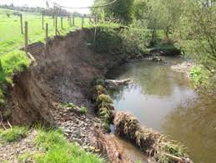
Types of soil erosion
Water erosion
removal of soil by water
Water picks up and carries loose particles of soil as it moves downhill. Sheet ,rills and gullies.

Slide 8
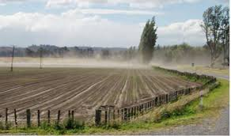
Wind erosion
Wind blows loose soil off flat or sloping land known as wind erosion.

Slide 9
Problems of soil erosion
Problems caused by soil erosion:
Loss of valuable topsoil.
Desertification.
Loss in agricultural production.
Loss of nutrients .
Reduction of infiltration rates .
Loss of nutrients

Slide 10
Methods of Conservation:
Reduce ploughing in dry/windy weather •
Ploughing in dry and windy weather increases the risk of wind erosion.
Planting wind breaks can be effective ✓
Terracing can also be effective.
strip cropping
Avoid overgrazing
Minimum or no tillage
Encourage water infiltration and reduce water runoff

Slide 11
Estimation of soil loss due to water erosion
The equation indicate average annual soil loss unit area due to the erosion..
A = R K LS C P
Where
A = soil loss in t/ha/yr
R = rainfall erosivity factor
L =length of slope factor
S = steepness of slope factor
C = soil cover and management factor
P = erosion control factor

Slide 12
Rainfall erosivity factor(R)
The R factor takes into account the erosive effects of storms.
The total kinetic energy of each storm (intensity and total rainfall) plus the average rainfall during the 30 minute period of greatest intensity is considered.
Sum of the indices for all storms during a year provides an annual index.
Location value of this index is the rainfall erosivity factor (R) in the USLE.

Slide 13
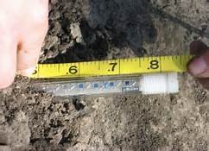
Soil erodibility factor (K)
In USLE factor k is related to the rate at which differant soils erode.
Under the condition of equal slope rainfall , vegetative cover and soil management practices,some soils will erode more easily than others due to inherent soil characteristics.
Its value is low for soils with high infiltration rate.
The soil erodibility factor for different soil types is given in the table.

Slide 14
Topographic factor (LS)
Slope length factor (l) the ratio of soil loss from field slope length to that from 22.13 m length plots under ideal conditions and slope steepness factor factor (s), the ratio of soil loss from field slope gradient (steepness) to that from 9 % slope under otherwise identical conditions can be determined separately . However the procedure has been further simplified by combining L and S factor as topographic factor (LS).the LS is the expected ratio of soil loss per cent area from field slope to that from 22.13 m length of 9 % slope . Nomographs for determining LS factor are developed for convenience . The LS factor for different slope lengths and steepness are given in table .

Slide 15
Wischmier and smith 1978 LS for different slope length and steepness
slope length
slope % 15.35 30.50 45.75 61.00 91.50
2 0.163 0.201 0.227 0.248 0.280
6 0.476 0.673 0.824 0.952 1.170
10 0.968 1.370 i.680 1.940 2.370

Slide 16
Soil cover and management factor (c)
It is the expected ratio of soil loss from land cropped under specific conditions to soil loss from clean tilled fallow on identical soil and slope and under the slope and under the same rainfall .
The c value decrease with increase in soil cover .

Slide 17
Runoff c values and soil under differant crops
Crops runoff mm/yr c value soil loss t/ha/yr
Castor 98 0.61 2.89
Grass 42 0.5 0.37
Tilled fallow 130 1.0 4.71

Slide 18
Erosion control factor (P)
Crops and land subjected to erosion are usually protected by practices that will reduce runoff and erosion . Contour cultivation , stripcropping , terracing , etc are some of the erosion control practices for crops on land subjected to erosion .
Factor (p) in USLE is the ratio of soil loss with a specified erosion control practice to the corresponding loss with up and down cultivation . The p value for contour terraced field are given in table .

Slide 19
The p values for contour cultivation wischmeier and smith 1978
Slope % contour factor strip crop factor
1 to 2 0.40 0.20
3 to 8 0.50 0.25
9 to 12 0.60 0.30

Slide 20
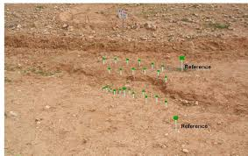
Expected soil loss in any location can be calculated using the USLE . Given the values as
R = 150
K = 0.3
LS = 0.5
C = 1.0
P = 0.5

Slide 21
The expected soil loss would be
A = R K LS C P
= 150 0.3 0.5 1.0 0.5
= 11.25 t/ha

Slide 22
Runoff and soil loss studies in india indicates maximum soil loss (645 t/ha) in cultivated black soil region followed by northestern region (410 t/ha) , ravine region (33 t /ha) and assam valley (28.0 t/ha) .
Total estimated soil loss in the country is 5,333,000,000 t with an average of 16.35 t/ha .

Slide 23
Thank you

