Slide 1
RHEUMATOID ARTHRITIS
M.MUDASSIR NAWAZ
Awais Anjum

Slide 9
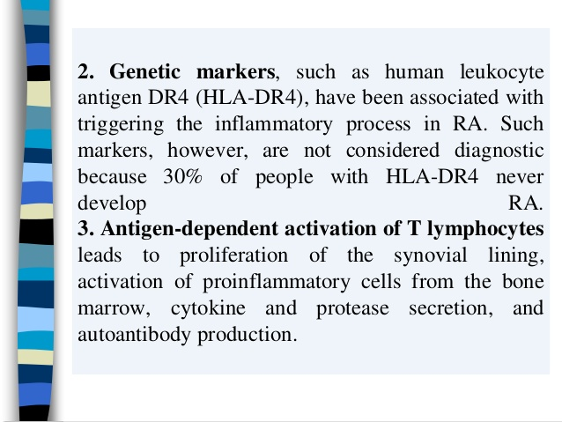

Slide 10
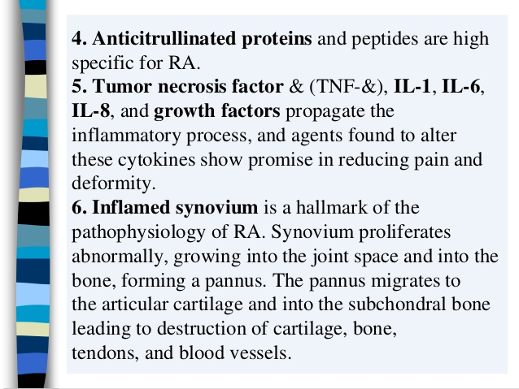

Slide 17
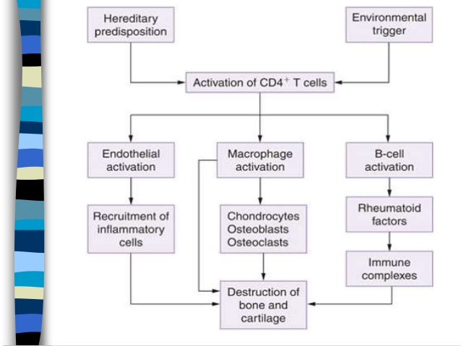

Slide 18
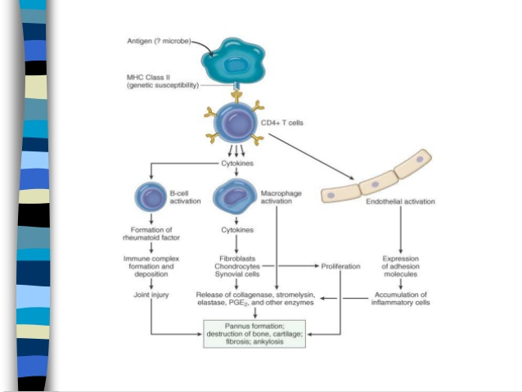

Slide 29
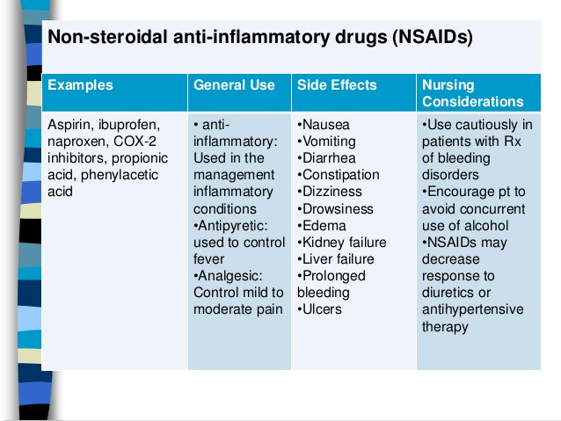

Slide 32
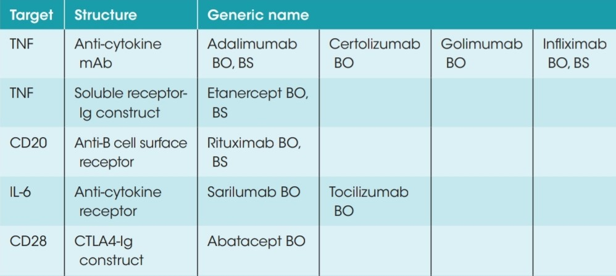
Biologic DMARDS1

Slide 33
Advantages: unique MOA Oral bioavailability Rapid onset of action Short half life
Targeted synthetic DMARDS1
(New therapeutic class)
Target | Structure | Generic name
JAK 1 & 2 | Chemical inhibitor | Baricitinib
JAK 1 & 3 | Chemical inhibitor | Tofacitinab

Slide 34
Marvilimumab , a novel GM-CSF
(Granulocytes-Macrophages colony stimulating factor) receptor alpha monoclonal antibiotic ,in treatment of rheumatoid arthritis.2

Slide 35
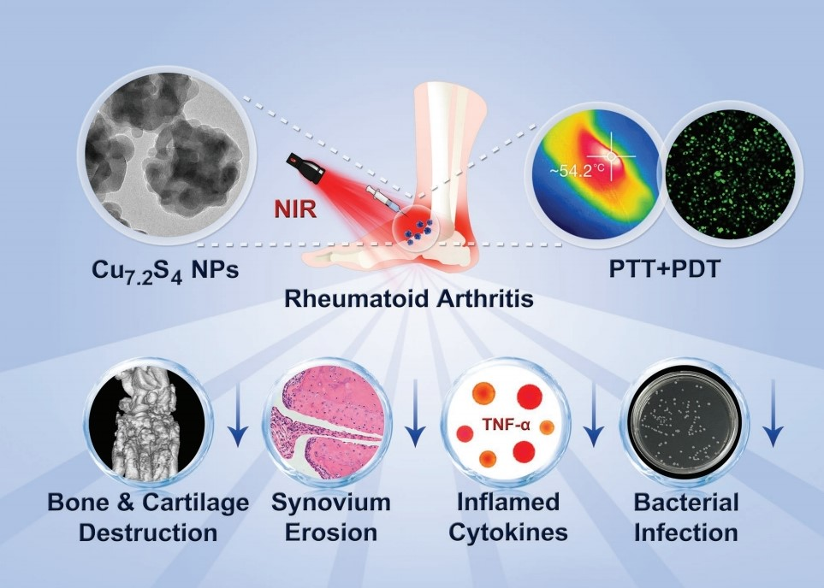
New target in animal model
Pain Relieving effect of NSAIDs-CAI hybrid Molecules in Rheumatoid arthritis.3
A new treatment Modality for RA;
using Cu and near infrared rediation.4

Slide 36
References:
PK Pispati: Manual of Rhrumtology.
Micheal L Snaith ABC of rheumatology; London; BMJ Publishing Group: 1996.
Hillary chappeletal management of early rheumatoid arthritis Scottish Intercollegiate guideline 2000; 13-14
Elaine Moore. Rheumatoid factor diagnosing rheumatoid arthritis and related disorders; Mar 19,2006.
Vinita Agrawaletal muscle involvement in rheumatoid arthritis; clinical and histological characteristics and review of literature ,J India Rheumatol ASSOC,2003:11; 98-103.

Slide 37
Reference:
Rheumatology: biological treatment for rheumatoid arthritis.
A randomised phase llb study of marvilimumab,a novel GM-CSF receptor alpha monoclonal antibody, in the treatment of Rheumatoid arthritis.
Pain relieving effect of NSAIDs-CAI hybrid molecules: systemic and intra-articular treatment against RA
A new treatment modility for RA ;combined photothermal and photodynamic therapy using Cu7.2 s4 nanoparticles

