Slide 2
Index
Introduction of Final Account
Preparation of Final Account
Trading Account
Importance of Trading Account
Profit and Loss Account
Importance Profit and Loss Account
Balance Sheet
Importance Balance Sheet
Importance of Final Account

Slide 3
Introduction
The term ‘Final Accounts’ is a broader term. The three following financial statements are prepared for the preparation of final accounts:
Trading account: It shows gross profit/loss of the business.
Profit & loss account: It shows the net profit/loss of the business.
Balance sheet: It shows the financial position of the business.
These are prepared at the close of the year hence known as final accounts.

Slide 4
Preparation
Final balances of all the accounts in the ledger are transferred to trial balance. From trial balance, expenses and income accounts are transferred to trading account and profit and loss account. Accounts, with balances, which are to be carried forward to the next year, are shown in the balance sheet. The balance sheet constitutes the final stage of accounting.

Slide 6
Trading Account
Trading account is the first stage in the process of preparation of the final accounts. Trading account shows the gross profit or gross loss during an accounting year. Its main components are sales, services rendered in the credit side of such sales or services rendered in the debit side.

Slide 7
Features of trading account
It is the first stage In the preparation of final accounts of a trading concern
It records only net sales and direct cost of goods sold
The balance of this account discloses the gross profit or gross loss
4. The balance | of | this account | is
transferred to | the | profit and | loss
account

Slide 8
Importance
It helps to measure profitability position of the business by showing the relationship between gross profit and sales
It shows the ratios between costs of goods sold and gross profit
It provide the information regarding the efficiency of trading activities
It makes easier to compare among sales, cost of goods sold and gross profit
It helps to provide information regarding closing stock.

Slide 9
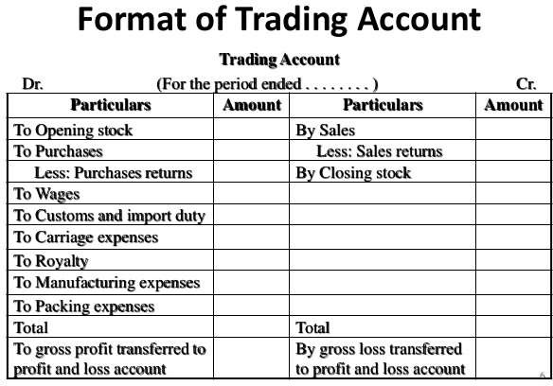

Slide 10
Profit and Loss Account
The profit and loss account shows what net profit and loss your business has made within an accounting period after
deducting all | expenditure | from | the
income. A net profit | is earned if | the | total
expenditure is less than the sales and a net loss if it is greater.

Slide 11
to be continued…
The profit & loss statement is considered one of the most important documents for keeping an eye on the financial health of a business.
It is also sometimes referred to as the ‘income statement’.

Slide 12
Importance of Profit and Loss Account
It provides information about net profit earned or net loss suffered by the business.
It helps in determining whether the business is being run efficiently or not by comparing the Profit and Loss account of two accounting periods.
It helps in taking effective control steps by analysing the various expenses listed in the Profit and Loss account of two accounting periods years.
It allows in the estimation of profit for the coming years by comparing the profit of previous years.

Slide 14
Balance Sheet
They represent assets or liabilities existing on a particular date.
Excess of assets over liabilities represent the capital and is indicative of the financial soundness of a company.
A Balance Sheet is also described as a “Statement showing the Sources and Application of Capital”. It is a statement and not an account and prepared from real and personal accounts.

Slide 15
to be continued…
A balance sheet is often described as a "snapshot of a company's financial condition".
Of the four basic financial statements, the balance sheet is the only statement which applies to a single point in time of a business' calendar year.
The difference between the assets and the liabilities is known as equity or the net assets or the net worth or capital of the company and according to the accounting equation, net worth must equal assets minus liabilities.

Slide 16
Need and Importance of Balance Sheet
Tells about financial position of a firm.
Tells about liquidity position of a firm
Tells about the balance of debtors and creditors.
Tells about the liabilities and assets of the firm
Tells economically capability of the firm
Opening entry on the basis of balance sheet

Slide 17
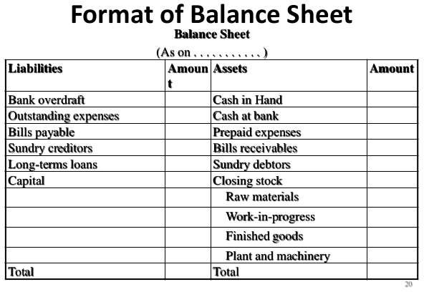

Slide 18
Need and Importance of Final
Account
To know the result of a business
To know the financial position of a business
To get loans from financial institutions
To assess income tax
To conduct comparative study
To assist management of business.

