Slide 1
VIRUSES
Virus is an infectious agent with microscopic size that needs living cells of plants, animals or bacteria to multiply.
The name virus is derived from Latin word meaning “poison” or “slimy liquid”.
They are not animals, plants or bacteria and they can`t do metabolic process without a host cells.

Slide 2
Types of viruses: The body of virus contains nucleic acid (DNA or RNA) and protein. Hence, there are two types of viruses such as DNA virus and RNA virus.
DNA viruses
RNA viruses
Herpesviruses
Poxviruses
Polyomaviruses
Coronaviruses
Influanza viruses
poxviruses

Slide 3
Importance of Viruses
Viruses have both harmful and beneficial roles in human life.
Actually no virus directly involves in human welfare, in most cases scientists use them as beneficiary agents in different fields.
The effect on living activities by the viruses are useful as well as harmful where the living organisms continue the life.

Slide 4
Harmful Effects of Viruses
A vast number of viruses cause human and animal diseases.
Some viruses are epidemic which spreads rapidly to many people and some viruses are pandemic which spread diseases worldwide.
In 2003, the severe acute respiratory syndrome (SARS) also took the lives of nearly 800 people worldwide.

Slide 5
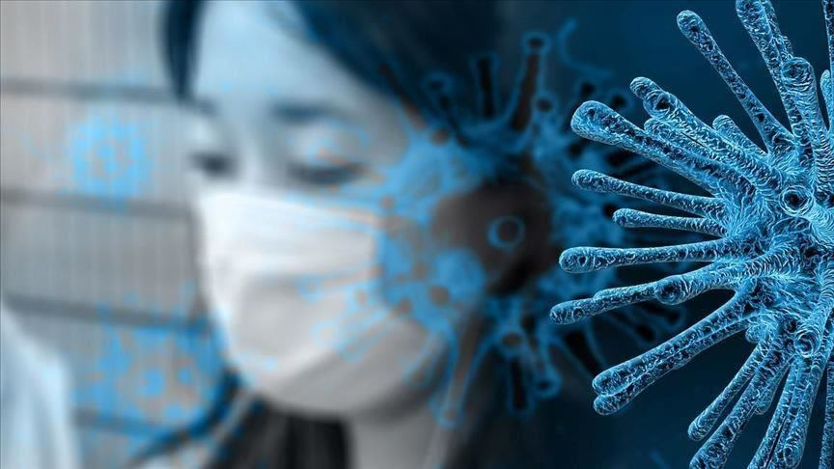
COVID-19 (corona virus disease) is very life threatening disease that already has taken the lives of nearly few lakhs people worldwide.

Slide 6
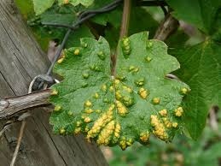
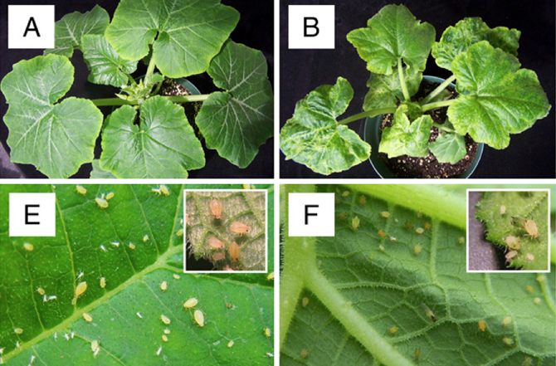
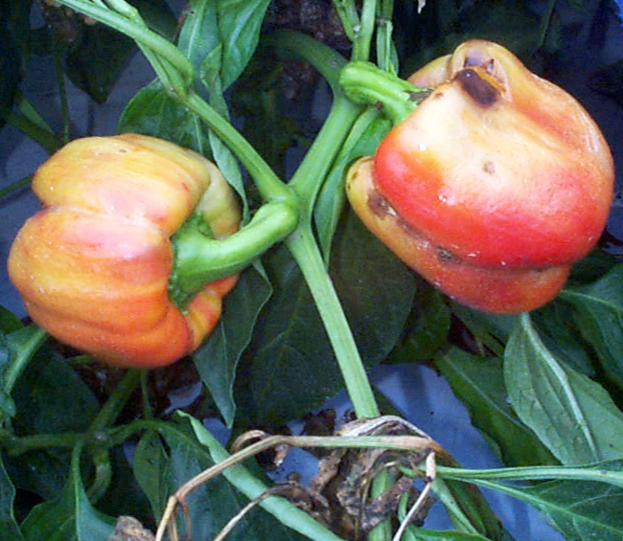
Besides, a vast number of viruses cause plant diseases as rice tungro baciliform virus (RTBV), tobacco mosaic virus (TMV), tomato/papaya ring spot virus, tomato leaf curl, potato leaf roll virus, etc.

Slide 7
The following table shows the various virus diseases in man, animals and plants:
Viruses Polio virus | Diseases Polio | Host Man
Rabies virus | Rabies | Man
Yellow fever virus | Yellow fever | Man
Flavi virus | Dengue | Man
Vaccinia virus | Cow pox | Cow
Foot and mouth virus | Foot and mouth disease | Cow
Papaya ring spot virus | Papaya ring spot disease | Papaya
Tobacco mosaic virus | Tobacco mosaic disease | Tobacco
Bean mosaic virus | Bean mosaic disease | Bean
Tungro virus | Tungro disease of rice | Rice
Bushystant virus | Bushystant disease of tomato | Tomato

Slide 8
Some morphological and pathogenic characteristics of the major hepatitis viruses:
Fh Properties/Diseases | Virus NamevName
 | Hepatitis A virus (HAV) | Hep Hepatitis B virus (HBV)B virus (HBV) | He iHepatitis C virus (HCV)tis C virus (HCV)
Size | 27 nm | 42 nm | various
Nucleic acid | RNA | DNA | RNA
Epidemiology | Endemic and epidemic | Endemic | Endemic
Incubation period | 2-7 weeks | 1-6 months | 2-8 weeks
Symptoms | Fever, Gastro-intestinal tract disorders | Fever, rash, arthritis | Fever, rash, arthritis
Jaundice | 1 in 10 | Common | Common
Onset/duration | Acute, short | Gradual, chronic | Acute to chronic
Complication | Uncommon | Chronic active hepatitis, hepatic cancer | Chronic inflammation, cirrhosis

Slide 9
Beneficial Effect of Viruses
There are many industrial uses of viruses.
Viruses are used in preparation of sera and vaccines to be used against diseases like rabies, polio, hepatitis B, papillomavirus, etc.
The multiplication of viruses in bacterial cells is also utilized in the production of antibodies.

Slide 10
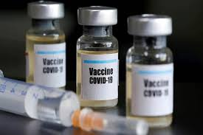
It is used in various pharmaceutical products such as proteins, vaccine, antigens and antibodies.

Slide 11
In the life science, it plays an important role to understand the basic mechanisms of molecular genetics. It is also used in genetic engineering for the production of cloning.

Slide 12
Viruses are also used in biological studies. They are broadly used in research in the field of genetic engineering

Slide 13
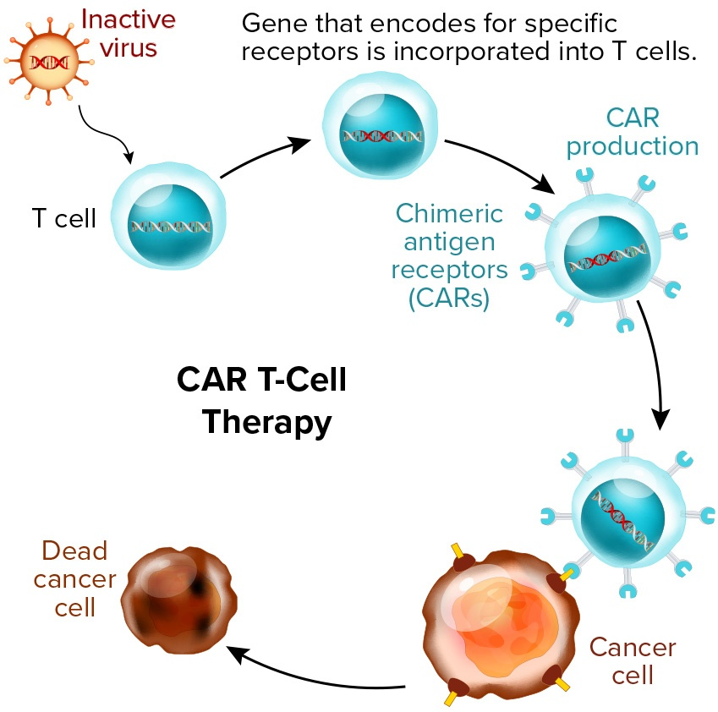
It is used for gene therapy. In this case, viral genes are replaced by the human gene.

Slide 14
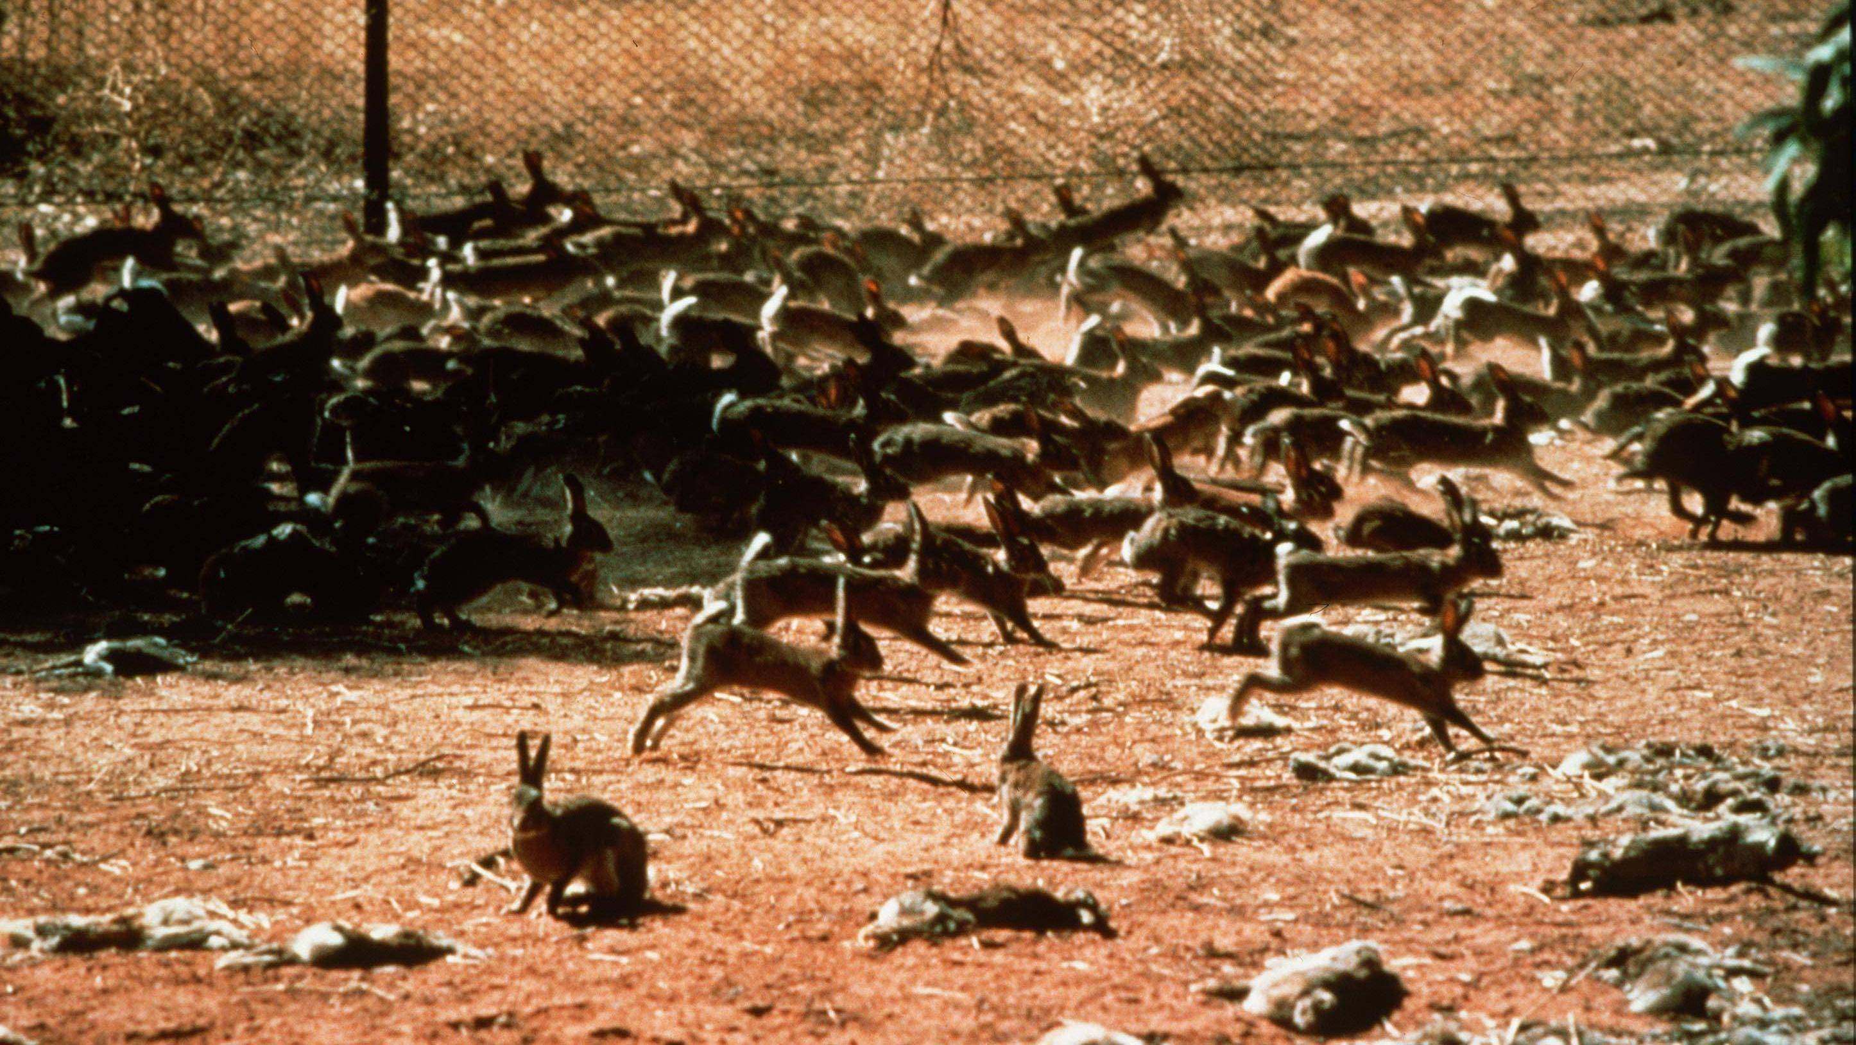
Viruses are used in biological control by human in eradicating pests like insects (by NPV) and in controlling the population of organisms such as rabbits by inducing viral infection.

Slide 15
Viruses are also used in aquatic environment to recycling carbon.
About one million of viruses are found in one teaspoon of seawater.
Among them, majority are bacteriophages.

Slide 16
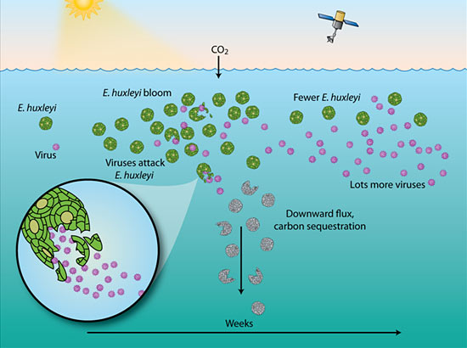
They are not harmful to animals and plants and they play an important role to regulate the freshwater and saltwater ecosystem by destroying bacteria and recycling carbon in the aquatic ecosystem.

