Slide 1
Major environmental issues and control

Slide 2
Environmental issues
An environment is defined as surrounding or conditions in which person, animal or plants survives or operates.
Our environment is constantly changes
Environmental issues are harmful effect of human activities on environment.
These include pollution, overpopulation, waste disposal, climate change, green house effect and global warming

Slide 3
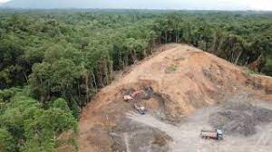
Deforestation
Deforestation means removal of trees from forest or conversion of forest into farms, ranches and urban use.
Deforestation is depletion of trees and forests at an alarming rate.
It causes habitat damage, biodiversity loss, desitification, extinction, global warming and soil erosion.
Natural causes of deforestation are hurricanes, fires, parasites and floods
Anthropogenic causes of deforestation are cattle grazing, timber extraction, mining , oil extraction, dams and road construction

Slide 4
How to control deforestation
Cutting must b replaced by planting young trees to replace the older one that were cut.
Reduce consumption of papers because 2millions trees cut every day to supply paper demand
Recyle paper: recycling 1 ton of paper prevent the cutting of 17 trees & these 17 trees then sequester around 250 ponds of carbon dioxide from air
Donot burn fireoods excessively.
Support numerous internationally and locally focused organization that protect forest from deforestation.
Restoration of degraded forest by carefull planning and monitoring.

Slide 5
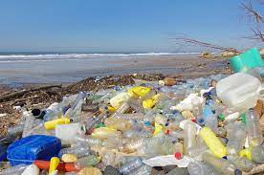
Plastic pollution
Accumulation of plastic objects and particles(e.g – plastc bottles, bags) into environment that adversely affect oceans, land, wildlife, wildlife habitat and humans.
It is estimated that 1.1 to 8.8 million tonnes of plastic waste enter into ocean from communities worldwide each year.
Chlorinated plastic can release harmful chemicals into surrounding and seeps into ground water and cause serioud harm to species that drink water.
Plastic wastes clogs drains and increasing the risk of floods.
Plastic blocks the marine animals digestive tract as result of which they die.
Chemicals release from plastic are hazardous to humans and cause damage to estrogen and thyroid hormone.

Slide 6
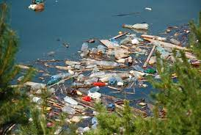
Water pollution
The introduction of harmful substances into rivers, oceans, lakes and ponds which changes the physical, biological or chemical conditions of water is called water pollution.
Polluted water lack oxygen and therefore organism die.

Slide 7
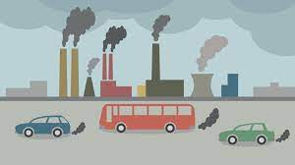
Air pollution
It is result of emission from industries, automobiles and increasing use of fossil fuels.
Gaseous emissions causes the increase in temperature of earth but also cause disease risk among individuals.

Slide 8
Actions u can take to reduce pollution
Use public transport.
Turn of light when not in use because it contribute to air pollution.
Use papers or cloth bags instead of using plastic bags.
Reduction of forest fires and smoking.
Use fans instead of air conditioners.
Use filters for chimneys.
Use environmently safe paints and cleaning products.
Planting trees provides a lot of benefit to environment because it decrease the air pollution.

Slide 9
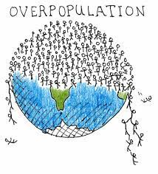
Overpopulation
The earth population is increasing drastically.
Overpopulation is due to increase in survival rate, increased availibility in life saving medicines, vaccines and greater access to nutritiious foods.
Increasing population lead to shortage of resources and if it continues it will be very difficult to sustain a huge population.
A growing population puts greater strain on our natural resource to poduce more to keep greater number of people healthy and productive

Slide 10
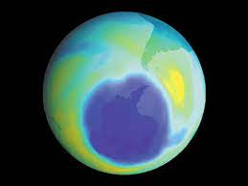
Ozone layer depletion
O.L is a layer of concentrated ozone gas .
It protect us from sun harmful ultravoilet rays coming from sun. UV light has many harmful effects like skin cancers and harms to crops and marine life.
When chlorine and bromine atoms come in contact with ozone in stratosphere, they destroy ozone molecules.
One chlorine atom can destroy 100,000 ozone molecules.
Ozone depleting substances that release chlorine are CFCs, HCFCs, carbon tetrachorideand methyle chloroform, .

Slide 11
How can we protect the ozone layer
Avoid the consumption of gases (CFCs, halogenated hydrocarbons, methyle bromide andand nitrous oxide) dangerous to ozone layer.
Minimize the use of vehicles which emits poisonous gases.
Maintain air conditioners, as their malfunction cause CFCs to escape into atmosphere.
Buy aerosols products thst donot use HCFCs and CFCs as propellants.

Slide 12
Global warming
Global warmingoccur when CO2 ans other air pollutants and green house gases collect in atmosphere and absorb sunlight and solar radiations which causes the average global temperature to increase at faster rate.
Burning of fosil fuels release co2 which makes up 82% of gases in our atmosphere that trap heat.
Too much transportation and electricity means results too many gases in our environment that warm our planet.
Effects: Melting glaciers
Rising sea levels leads to flooding.
Disruption of habitat such as coral reefs in seas, plants and animal species to extinction.
Cause allergies, asthma and infectious disease.

Slide 13
How to control global warming
Planting more trees can reduce amount of carbon dioxide in our atmosphere
Instead of ordering a private transport, do a rideshare
Lower your haeting bills during winter.
Recycling is an absolute neccessity for dealing with waste.
Stop massive deforrestation and use sustainable use of resources.
Use renwable energies like solar, wind, biomass and geothermal

Slide 14
Acid rain
Acid rain or acid deposition is a broad term that include any form of precipitation with acidic components such as sulphuric acid or nitric acid that fall to ground from atmosphere in wet or dry form.
This can include rain, snow, fog, hail, dust that is acidic.
Acid rain results when sulfur dioxide and nitrogen oxide are emitted into atmosphere and transported by wind and air currents that react with water, oxygen, and other chemicals to form sulphuric r nitric acid and fall on ground in form of acid rain.
SO2 and NO2 come from burning fossils fuels, from vehicles , industries and volcanoes

Slide 15
Acid rain

Slide 16
How to control Acid rain
Reduce amount of Sox and NOx released into atmosphere by using less fuels
Use cleaner fuels by
Using coal that contain less sulfur
Using natural gas
Washing coal to reduce
3. Reducing the effect of acid rain by liming because limestone aded to water and soil to neutralize acid

Slide 17
Green house effect
Its is natural process that warm earth surface .
When sun energy reaches earth atmosphere , some of its is reflected back to space and rest is absorbed and re-radiated by green house gases
Green house gases include water vapours, CO2, methane, nitrous oxid, ozone and some artificial chemical such as CFCs.
The absorbed energy warm the atmosphere and surface of earth

Slide 18
Way to reduce green house gases
Buying products with minimal pakaging will help to reduce waste
Plant a tree because trees absorb carbon dioxide and absorb oxygen
Use less hot water

Slide 19
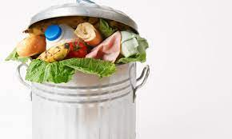
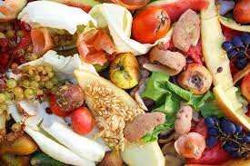
Food waste
Food waste is major part of impact of agriculture on climate
Food intended for human consumption is wasted or lost which is enough to feed 3 billion people.
40% of food waste occur at post harvest and processing levels and 40% of food waste occur at retail and consumer level.
Control
Don’t over buy
keep track of what you have bought and used
Learn to preserve

Slide 20
Natural disasters
Natural disasters like hurricanes, flooding, wildfires and drought affect survivals of entire ecosystems and plants and animals that rely on them.
Endangered species are specially vulnerable when habitat is destroyed.
Disrupt economic and social development
Mental health problems like loss of loved ones, homes and livelihood alter lives of multiple people

Slide 21
Biodiversity loss
Includes extiction of species world wide as well as local reduction and loss of species in certain habitat resulting in loss of biological diversity
Global extinction is being driven by human activities
Types of biodiversity loss
Insect loss
Birds loss
Fresh water fish loss
Plants loss
Native species richness loss

Slide 22
How to prevent from losing biodiversity
Nature preserves
Reducing invasive species
Habitat restoration
Puchase sustainable products

