Slide 1
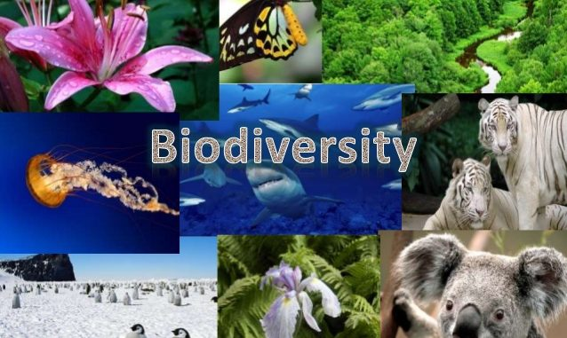

Slide 2
CONTENTS
What is Biodiversity?
Types of Biodiversity
Species Biodiversity
Genetic Biodiversity
Ecosystem Biodiversity
Biodiversity Conservation
Benefits of Biodiversity
Threats to Biodiversity
Conservation of Biodiversity
Conclusion

Slide 3
What is Biodiversity?
The term Biodiversity was first coined by Walter G. Rosen in 1986
The word Biodiversity originates from the Greek word
BIOS = LIFE and Latin word
DIVERSITAS = VARIETY or DIFFERENCE
The whole word BIO DIVERSITY generally therefore means: VARIETY OF LIFE

Slide 4
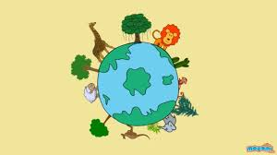
Biodiversity
Biodiversity is the degree of variation of life. It is a measure of the variety of organisms present in different ecosystems

Slide 5
Types Of Biodiversity
Species Biodiversity
Genetic Biodiversity
Ecosystem Biodiversity

Slide 6
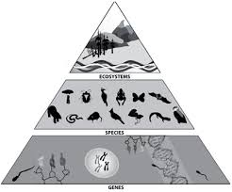

Slide 7
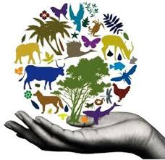
Species Biodiversity
Species Diversity is the effective number of different species that are represented in a collection of individuals

Slide 8
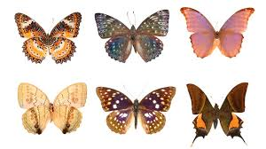
Genetic Biodiversity
Genetic diversity, the level of biodiversity refers to the total number of genetic characteristics in the genetic makeup of a species

Slide 9
Ecosystem Biodiversity
Ecosystem diversity refers to the diversity of a place at the level of ecosystems. The term differs from biodiversity, which refers to variation in species rather than ecosystems

Slide 10
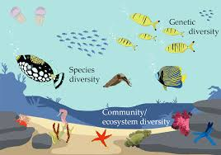

Slide 11
BENEFITS OF BIODIVERSITY
Consumptive value:
Food/Drink
Fuel
Medicine
Batter crop varieties
Industrial Material

Slide 12
Non-Consumptive Value:
Recreation
Education and Research
Traditional value

Slide 13
THREATS TO BIODIVERSITY
Natural causes:
Narrow geographical area
Low population
Low breeding rate
Natural disasters

Slide 14
Anthropogenic causes:
Pollution
Hunting
Global warming and climate change
Agriculture

Slide 15
CONSERVATION OF BIODIVERSITY
Biodiversity inventories
Conserving Biodiversity in protected Habitats
In situ conservation
Ex situ conservation
Seed Bank, Gene Bank, Pollen Bank, DNA Bank

Slide 16
Biodiversity Conservation
In situ
Ex situ
National parks, wildlife sanctuaries
Sacred groves and lakes
Biosphere Reserves
Sacred plant home garden
Terrestrial
Seed Bank, Gene bank, Cryopreservation
Marine
Botanical garden, Zoological garden, Aquaria

Slide 17
Conclusion:
Biodiversity is our life. If the Biodiversity got lost at this rate then in near future, the survival of human being will be threatened. So, it is our moral duty to conserve Biodiversity as well our Environment
Long term maintenance of species and their management requires co-operative efforts across entire landscapes. Biodiversity should be dealt with at scale of habitats or ecosystems rather than at species level

