Slide 1
Powdery Mildew of Mango
Dr. Salman Ahmad
April 10, 2020

Slide 2
Importance:
Occurs regularly in Pakistan.
Incidence recorded up to 100 % in some orchards

Slide 3
Etiology:
Causal organism: Oidium mangiferae
Order: Erysiphales
Family: Erysiphaceae

Slide 4
Symptoms:
Small white spots on all parts of inflorescence*( the complete flower head of a plant including stalks, bracts, and flowers), leaves & fruits
In severe cases, inflorescence completely covered by mildew (growth of fungus) & become blackened
Young leaves curl, distorted (Twisted) & newly set fruits drop off

Slide 5
Symptoms:

Slide 6
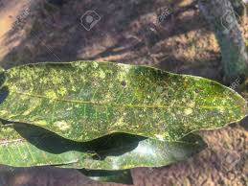
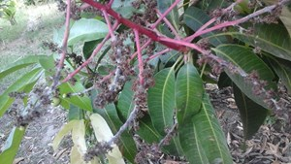
Symptoms:

Slide 7
Disease cycle:
Fungus survive on malformed*(mishappen)/off season panicles & mildew leaves

Slide 8
Epidemiology:
Max temp 25-30°C
Min temp 10-16°C
75-91 % RH

Slide 9
Management:
Cut & burn infected inflorescence in Sep & Oct
3 spray of Benomyl (0.2%), Bavistin (0.1%) at flowering (A- pre bloom, B- full bloom, C- after fruit setting)
A bacterium Bacillus subtilis use as biological control

