Slide 1
Service-Oriented Architecture for Integration

Slide 2
Introduction
In this chapter we will cover:
Importance of Service-Oriented Architecture
Introduction to Service-Oriented and Event-Driven Architectures

Slide 3
Service-Oriented Architecture
A service oriented architecture (SOA) is an architectural pattern in computer software design in which application components provide services to other components via a communications protocol, typically over a network.
The principles of service orientation are independent of any vendor, product or technology.
A service is a self contained unit of functionality, such as retrieving an online bank statement hence a service is discretely invokable operation.

Slide 4
Services can be combined to provide the functionality of a large software application.
SOA makes it easier for software components on computers connected over a network to cooperate.
Every computer can run any number of services, and each service is built in a way that ensures that the service can exchange information with any other service in the network without human interaction and without the need to make changes to the underlying program itself.

Slide 5
Manual Integration Approaches
Historically, people have conducted business between companies.
They have exchanged documents such as purchase orders, advanced shipping notices (ASNs), and delivery advices for ordered products, and finally they have exchanged invoices for payment.
Effectively, through these documents people have acted as the integrators between the processes at each company; that is, between the processes for the buyer and supplier in a typical business trading relationship.

Slide 6
Historically, people have conducted business between companies.
They have exchanged documents such as purchase orders, advanced shipping notices (ASNs), and delivery advices for ordered products, and finally they have exchanged invoices for payment.
Effectively, through these documents people have acted as the integrators between the processes at each company; that is, between the processes for the buyer and supplier in a typical business trading relationship.

Slide 7
The impact of e-business means that the human operator has been taken out of the feedback loop that exists between supplier and buyer.
Instead of a “real-world” event—such as the physical receipt of a mailed order form, or a check, or a telephone enquiry on the status of an account—the real world has migrated to the computer.
When the human operator is removed from a process, the computer is no longer modeling real-world events—it has become the real world itself.

Slide 8
A central integration platform is needed as an interface for all of these communications, similar to the central role historically taken by a mail room, which effectively acted as a central registry.
Like a mail room, the central integration platform needs to be able to accept all input messages received in envelopes, open them, and then direct them to the relevant area or systems within the enterprise for action.
With the central role of the integration platform, all communications should be received and sent in a standard way.

Slide 9
A typical enterprise needs to communicate with not just hundreds, but many thousands of customers, suppliers, and outsourcers.
For this reason, to be effective, any integration solution must be able to scale substantially, to support large online transaction volumes.
Many potential errors can occur when applications are executed between enterprises across the Internet, or within an enterprise via the intranet.
The resolution of these errors requires coordinated error management between applications, regardless of the applications that are involved.

Slide 10
Coordinated Error Management
In Chapter 13 we discussed an online store that needs to use processes from a bank, a logistic (shipping) company, and a supplier.
We considered several RPC protocols that can be used for communication between process components hosted on servers at these different organizations.
We saw how services from these processes are made available as Web services across the Internet using standard protocols such as HTTP, SOAP, WSDL, and UDDI.

Slide 11
In the event of errors occurring during execution of these processes, error recovery and management must be coordinated across the systems that are involved. Figure 14.2 shows some of the possible errors that may arise at the:

Slide 12
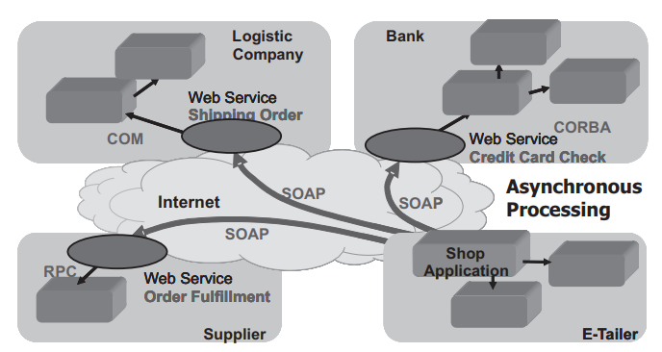

Slide 13
Bank, due to an invalid credit card number or insufficient credit left in the card;
Supplier, due to products that are out of stock and so must be back-ordered;
Logistics company, due to a supplier or customer location that is not serviced by the shipping company.

Slide 14
In the first situation listed earlier, errors can arise at the bank due to an invalid credit card number or insufficient credit left in the card.
The bank uses a compound Web service called Credit Card Check.
This checks the validity of the credit card.
If valid, the card is used immediately by the bank to process payment for the order and deposit it in the online store’s bank account.

Slide 15
The following error situations and recovery actions can arise:
The store invokes the Credit Card Check Web service at the bank. The bank validates the card and notifies the store that it has rejected the credit card, due to an invalid card number or credit limit exceeded. No payment is deposited.
The recovery action taken by the store is typically to request the supplier to cancel the order if the card is rejected for either reason .
The customer must then be notified of the reason for cancellation.

Slide 16
Introduction to Service-Oriented and Event-Driven Architectures
Service-oriented architecture is the term that has emerged to describe executable components, such as Web services, that can be invoked by other programs that act as clients or consumers of those services.
A developer does not need to know how the programs work; they need only know the input required, the output provided, and how to invoke them for execution.
Developers can swap one service out and replace it by another service that is designed to achieve the same or enhanced result without having to worry about their inner workings.

Slide 17
Today standard parts in a car can be interchanged without having to strip down the whole car and rebuild it.
So also with SOA we have similar flexibility, where existing services can be easily replaced by improved services without having to change the internal logic of monolithic application programs as was necessary in the past.
Software categories that provide this SOA flexibility are called BPM or business product integration (BPI) products.

Slide 18
A further term also describes these BPM and BPI execution environments: event-driven architecture.
This is an approach for designing and building applications where business events trigger messages to be sent between independent services that are completely unaware of each other.
An event may be the receipt by the enterprise of a sales order transaction from a customer for processing.
An event may also be a change in a data value that requires a purchase order to be placed with a supplier, when the available quantity of a product in the warehouse falls below a minimum balance threshold.

Slide 19
An event source sends messages to middleware software, which matches the messages against the subscription criteria or business rules of programs or services that want to be notified of these events.
Messages are typically sent using the publish-and-subscribe approach because this enables simultaneous delivery to multiple destinations.

