Slide 1
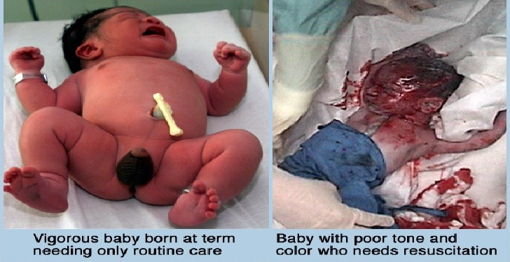
BIRTH ASPHYXIA

Slide 2
DEFINITIONS
Asphyxia means lack of oxygen(hypoxia) due to failure of initiation of breathing.
Hypoxia means arterial oxygen less then normal.
Ischemia means decreased blood flow to cells or organs that is insufficient to maintain their function.

Slide 3
RISK FACTORS
MATERNAL
Hypertension(eclampsia,pre eclampsia)
Pelvic abnormality(cephalopelvic disproportion)
Diabetes mellitus
Nephritis
Hypotension
Infections
Uterine tetany(due to excessive oxytocin)
Maternasl hypoxia from cardiac and pulmonary diseases

Slide 4
Placental
Abruptio placenta
Placental insufficiency due to toxemia or post maturity

Slide 5
Fetal
Cord prolapse
Abnormal lie or presentation
Postmaturity
Anemia
Infections
Cerebral abnormalities
Hypoxia due to pulmonary and cardiac problems

Slide 6
Pathophysiology
Onset of ashyxia is followed by
metabolic acidosis
hypoglycemia
hypoglycemia
alternation in cerebral blood flow

Slide 7
In CNS fluid leaks from increased capillary permeability resulting in cerebral oedema and cell death.
Metabolic consequences include
An acceleration of glycolysis with an increase in brain lactate level
A reduction in high phosphate concentrations

Slide 8
At te same time failure of energy dependent ionic pumps result in
Leakage from cells of the normally intracellular potassium and
Influx into cell of sodium,chloride and calcium

Slide 9
As a consequence,membrane depolarization occur with concomitant release of the exitotoxic neurotransmitters glutamate and aspartate;these in turn activate N-methyl-aspartate receptors which play a critical role in neural damage.

Slide 10
Alternation in cerebral changes accompanies these changes and include
An initial increase in cerebral blood flow
Loss of vascular autoregulation
Reducyion in cardiac output
Hypotension and
Reduction in cerebral blood flow

Slide 11
The pathological changes observed in the brain reflects the combined effect of metabolic derangements that are occuring in the context of cerebral hypoperfusion.
Circulatory changes play a major role in the production of para-sagttal cerebral injury and pereventricular leukomalacia.

Slide 12
Full term infants show cortical necrosis and parasagttal ischemic injury which result in focal or multifocal cortical infarcts that produce focal seizures and hemiplegia.
Preterm infants demonstrate periventricular leukomalacia later spastic diplegia,basal ganglia damage and IVH.

Slide 14
Effects/complications of Asphxia
CNS
Hypoxic ischemic encephlopathy
Renal
Acute tubular necrosis

Slide 15
Respiratory
Respiratory distress syndrome
Meconium aspiration
Persistant puulmonary hypertertension
Apnea
Pulmonary hemorrhage

Slide 16
CVS
Myocardial ischemia
Tricuspid and mitral regurgitation
Cardiac failure

Slide 17
GIT
Necrotizing enterocolitis
Gastric ulcerations
Perforation of gut
Hematological
DIC
Increased risk of hemrrhagic disease of newborn

Slide 18
Metabolic
Hypoglycemia rarely hyperglycemia
Hpocalcemia
Hypomagnesemia
Inappropriate secretion of ADH
Hepatic
Shock liver
Raised lfts

Slide 19
Hypoxic ischemic encephalopathy
This is condition of neonatal encephalopathy secondary to hypoxia and acidosis in newborn infant.
It is graded into 3 stages which have prognostic signifance.infant may progress from one stage to next over frst 24-72 hrs as the effect of hypoxia on various organs become manifest.

Slide 20
STAGES OF HIE
SIGNS | Stage I | Stage II | Stage III
Level of consciousness | hyperalert | lethargic | Stuporous,coma
Muscle tone | Normal | Hypotonic | Flaccid
Posture | Normal | Flexion | Decerebrate
Tendon reflexes | Hyperactive | Hyperactive | Absent
Myoclonus | Present | Present | Absent
Moro reflex | Strong | Weak | Absent
Pupils | Mydriasis | Miosis | Unequal,poor light reflex
Seizures | None | Common | Decerebrate
EEG | Normal | Low voltage | Burst suppression changing to isoelectric seizure activity
Duration | <24 hrs | 24hrs to 14 days | Days to week
Outcome | Good | Variable | Death,severe deficit

Slide 21
Diagnosis
Before birth
Identification of risk factors alert the pediatrician to recieve an asphxiated baby.
Sign of fetal distress as detected by bradycardia,late decelerations,sustained tachycardia on CTG or on USG reducrd fetal activity and breathing movements or by the presence of thick meconium in liquor are good indicators of asphyxia

Slide 22
After birth
Depression of apgar score is most widely used criteria of birth asphyxia.
Apgar score at 15-20 min are more strongly correlated wth asphyxia and subsequent neurological deficits and also describes the success of effort if resusitation.
Apgar score assesses 5 variables easily identified at birth given below.

Slide 24
An apgar score of 3 or less prolondeg for greater then 5 min is regarded as evidence of asphyxia
Low apgar scorev in preterm or SGA infants as they are generally hypotonic and have cyanotic extremities and poor responsiveness
Low apgar score may be present in non asphyxiated infants due to maternal anaesthesia or analgesi,trauma,some neuromuscular disorders,metabolic or infectiou insults to CNS cardiac and pulmonary malformations

Slide 26
Management
Optimal management is prevention
Early detection and management of high risk pregnancies by regular follow up and good obstetrical care and prompt resusitation at labour room

Slide 27
General supportive care
Nurse baby in thermoneutral environment
Vital monitoring and input output record.
Pass ng tube and aspirate the stomach
Regular glucose monitoring
Measure blood gases
Treat hypoxia with oxygen (4L/min)and hypercarbia with IPPV
Treat acidosis
Maintain fluid and electrolyte balance(restrict to 50% if evidence of SIADH).
Review infections risk and treat with antibiotics

Slide 28
Specific managements of complications
CNS
Treat seizures with phenobarbitone
Treat cerebral edema with fluid restriction and careful monitoring of fluid and electrlyte.
CVS
Treat hypotension with plasma and inotropic support
Treat cardiac failure

Slide 29
Renal
Urine output monitoring and should be greater then 1ml/kg/hr.
If there is established renal failure treat it conservatively as acute renal failure.
Pulmonary
Apnea and hypercarbia require IPPV.
Meconium aspiration should be treated by proper tracheal suctioning in labor room and respiratory support given.
Pulmonary hypertension treated with inhaled NO increased oxygen and pulmonary vasodilators

Slide 30
GIT
Treat NEC by proper antibiotics and avoiding enteral feeding
Metabolic
Treat hypoglycemia,hypocalcemaia,
hypomagnesemia accordingly.

Slide 31
Prognosis
Overall full term asphyxiated infants have a mortality of 10-20% and the incidence of neurological sequelae in survivors of 20-45%.
The prognosis depend upon the severity of asphyxia and stage of HIE.
100% of newborn with HIE stage 1 have normal neurological outcome
80% with HIE stage 2 are normal neurologiacally
All children with HIE stage 3 either die or develop severe neurological deficit like cerebral palsy,mental retardation,epilepsy and microcephaly.

Slide 32
Factors associated with increased risk of neurological sequlae are:
Apgar score less then 3 at 20 min of age
Presence of multiorgan failure especially oliguria
Severity and duration of HIE
Presence of early onset of seizures,especially if difficult to control
An abnormal MRI in first 24-72 hours
Severity and duration of EEG abnormalities
Persistant abnormalities of brainstem function
Microcephaly at 3 month of age

