Slide 1
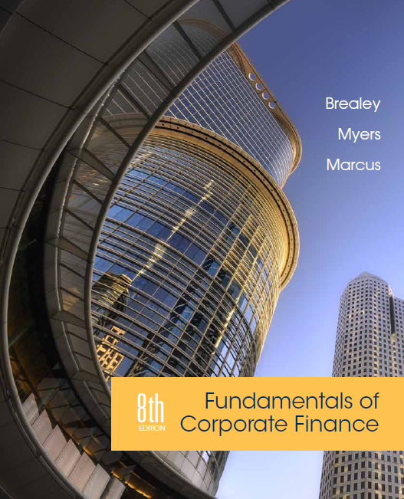
Chapter 16
Debt Policy
Copyright © 2015 by The McGraw-Hill Companies, Inc. All rights reserved

Slide 2
Topics Covered
16.1 How Borrowing Affects Value in a Tax Free Economy
16.2 Debt and the Cost of Equity
16.3 Debt, Taxes and the WACC
16.4 Costs of Financial Distress
16.5 Explaining Financing Choices
Notes:
2

Slide 3
Value and Capital Structure
Assets
Liabilities and Stockholders’ Equity
Value of cash flows from firm’s real assets and operations
Market value of debt
Market value of equity
Value of Firm
Value of Firm
Notes:
2

Slide 4
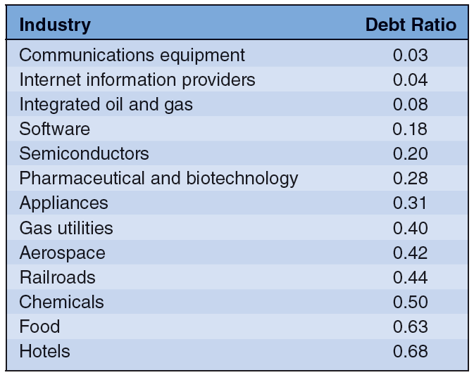
Average Book Debt Ratios
Notes:
2

Slide 5
Value and Capital Structure
Capital structure - The mix of long-term debt and equity financing
Restructuring - Process of changing the firm’s capital structure without changing its real assets
Notes:
2

Slide 6
M&M (Debt Policy Doesn’t Matter)
Modigliani & Miller
When there are no taxes and capital markets function well, the market value of a company does not depend on its capital structure
In other words, financial managers cannot increase value by changing the mix securities used to finance the company
Notes:
3

Slide 7
M&M (Debt Policy Doesn’t Matter)
Assumptions
By issuing 1 security rather than 2, company diminishes investor choice. This does not reduce value if:
Investors do not need choice OR
There are sufficient alternative securities
Capital structure does not affect cash flows e.g...
No taxes
No bankruptcy costs
No effect on management incentives
Notes:
4

Slide 8
M&M (Debt Policy Doesn’t Matter)
Example
River Cruises - All Equity Financed
Data
Number of shares | 100,000
Price per share | $10
Market value of shares | $1 million
Outcome | State of the Economy
 | Slump | Expected | Boom
Operating income | $75,000 | $125,000 | $175,000
Earnings per share | $.75 | $1.25 | $1.75
Return on shares | 7.5% | 12.5% | 17.5%
Notes:
5

Slide 9
M&M (Debt Policy Doesn’t Matter)
Example – continued
50% debt
Data
Number of shares | 50,000
Price per share | $10
Market value of shares | $500,000
Market value of debt | $500,000
Outcome | State of the Economy
 | Slump | Expected | Boom
Operating income | $75,000 | $125,000 | $175,000
Interest | $50,000 | $50,000 | $50,000
Equity earnings | $25,000 | $75,000 | $125,000
Earnings per share | $.50 | $1.50 | $2.50
Return on shares | 5% | 15% | 25%
Notes:
6

Slide 10
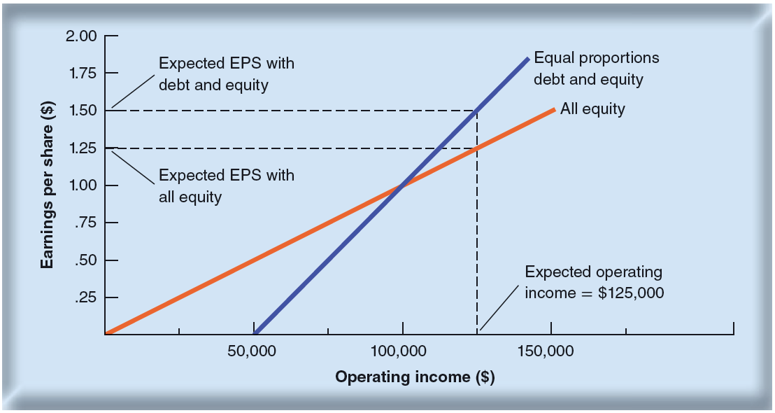
M&M (Debt Policy Doesn’t Matter)
Borrowing increases EPS for River Cruises

Slide 11
M&M (Debt Policy Doesn’t Matter)
Example
River Cruises - All equity financed, debt replicated by investors
Outcome | State of the Economy
 | Slump | Expected | Boom
Earnings on two shares | $1.50 | $2.50 | $3.50
Less interest at 10% | $1.00 | $1.00 | $1.00
Net earnings on investment | $.50 | $1.50 | $2.50
Return on $10 investment | 5% | 15% | 25%
Notes:
7

Slide 12
M&M (Debt Policy Doesn’t Matter)
Example
River Cruises – Firm debt at 50%, investor can unwrap debt
Outcome | State of the Economy
 | Slump | Expected | Boom
Earnings on one share | $.50 | $1.50 | $2.50
Plus interest at 10% | $1.00 | $1.00 | $1.00
Net earnings on investment | $1.50 | $2.50 | $3.50
Return on $10 investment | 7.5% | 12.5% | 17.5%
Notes:
7

Slide 13
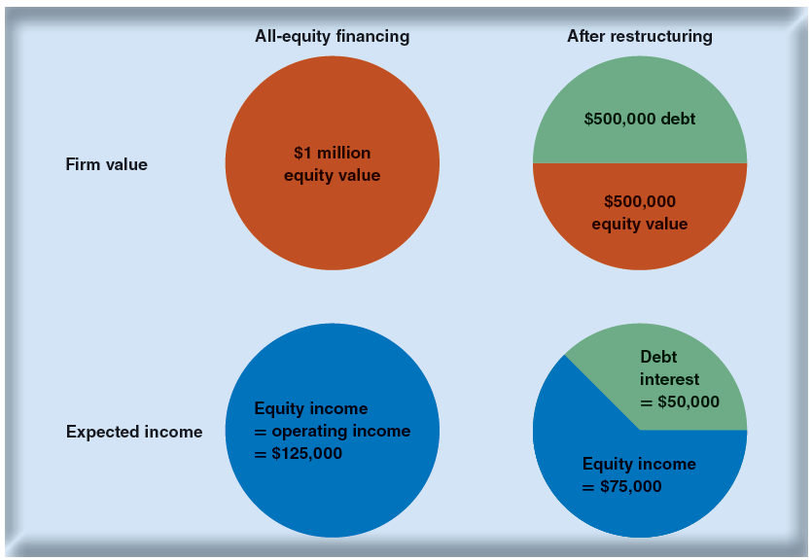
River Cruise’s “Value Pie”

Slide 14
C.S. & Corporate Taxes
Operating Risk (business risk) – Risk in the firm’s operating income
Financial Risk - Risk to shareholders resulting from the use of debt
Financial Leverage - Debt financing to amplify the effects of changes in operating income on the returns to stockholders
Interest Tax Shield- Tax savings resulting from deductibility of interest payments
Notes:
10

Slide 15
Cost of Capital
$r_{equity}=r_{assets}+\frac{D}{E}(r_{assets}$-$r_{debt})$
$$WACC=\left(1−T_{c}\right)r_{debt}\left(\frac{D}{D+E}\right)+r_{equity}\left(\frac{E}{D+E}\right)$$

Slide 16
Weighted Average Cost of Capital
r
r_{E}
WACC with no bankruptcy risk
WACC
r_{D}
D
V

Slide 17
MM’s Proposition II (w/fixed interest rate)
r
r_{E}
r_{A}
r_{D}
D
V

Slide 18
MM’s Proposition II (w/risky debt)
r
r_{E}
r_{A}
r_{D}
Risk free debt
Risky debt
D
V
Includes Bankruptcy Risk
Notes:
9

Slide 19
C.S. & Corporate Taxes
River Cruise DOES create value in a corporate tax environment by using debt financing. This is done by maximizing the cash flows to both equity and bondholders.
 | All Equity | All Debt
EBIT | $192,308 | $192,308
Interest payment | 0 | 50,000
Pretax income | $192,308 | $142,308
Taxes at 35% | 67,308 | 49,808
Net cash flow | $125,000 | $92,500
Notes:
13

Slide 20
C.S. & Corporate Taxes
River Cruise DOES create value in a corporate tax environment by using debt financing. This is done by maximizing the cash flows to both equity and bondholders.
 | All Equity | All Debt
EBIT | $192,308 | $192,308
Interest payment | 0 | 50,000
Pretax income | $192,308 | $142,308
Taxes at 35% | 67,308 | 49,808
Net cash flow | $125,000 | $92,500
Total Cash Flow
All Equity = 125,000
*1/2 Debt = 142,500
(92,500 + 50,000)
Notes:
13

Slide 21
Capital Structure
$$=\frac{(D×r_{D}×T_{c}\text{)} }{r_{D}}=D×T_{c}$$
PV of tax shield
(assume perpetuity)
Example:
$$Tax benefit=500,000×.10×.35=\$17,500$$ $$PV of \$17,500 perpetuity=\frac{\$17,500}{.10}=\$175,000$$
Notes:
18

Slide 22
C.S. & Corporate Taxes
Example
You own all the equity of Space Babies Diaper Co. The company has no debt. The company’s annual cash flow is $10,000, before interest and taxes. The corporate tax rate is 35%. You have the option to exchange part of your equity position for 6% bonds with a face value of $50,000.
Should you do this? Why?
Notes:
11

Slide 23
C.S. & Corporate Taxes
Example
You own all the equity of Space Babies Diaper Co. The company has no debt. The company’s annual cash flow is $10,000, before interest and taxes. The corporate tax rate is 35%. You have the option to exchange part of your equity position for 6% bonds with a face value of $50,000.
 | All Equity | ½ Debt
EBIT | $10,000 | $10,000
Interest payment | 0 | 3,000
Pretax income | $10,000 | $7,000
Taxes at 35% | 3,500 | 2,450
Net cash flow | $6,500 | $4,550
Notes:
13

Slide 24
C.S. & Corporate Taxes
Example
You own all the equity of Space Babies Diaper Co. The company has no debt. The company’s annual cash flow is $10,000, before interest and taxes. The corporate tax rate is 35%. You have the option to exchange part of your equity position for 6% bonds with a face value of $50,000.
 | All Equity | ½ Debt
EBIT | $10,000 | $10,000
Interest payment | 0 | 3,000
Pretax income | $10,000 | $7,000
Taxes at 35% | 3,500 | 2,450
Net cash flow | $6,500 | $4,550
Total Cash Flow
All Equity = 6,500
*1/2 Debt = 7,550
(4,550 + 3,000)
Notes:
14

Slide 25
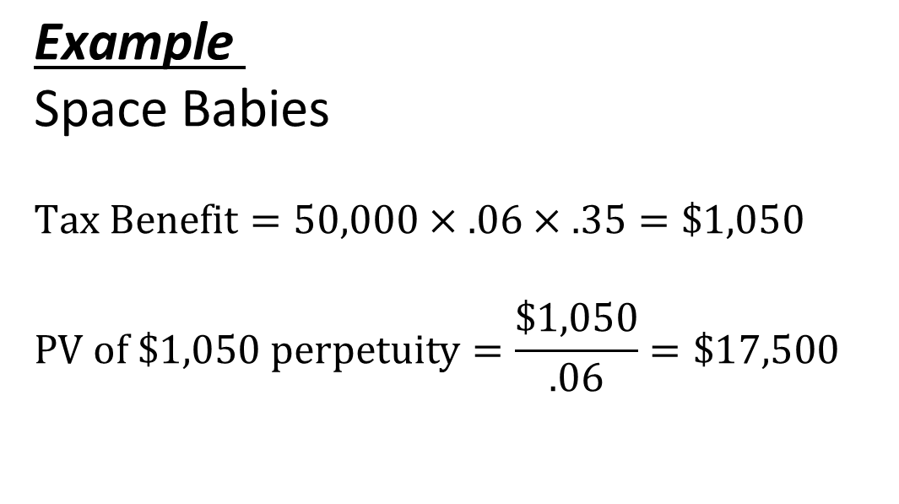
Capital Structure
$\text{Example}$
Space Babies
$$Tax Benefit=50,000×.06×.35=\$1,050$$ $$PV of \$1,050 perpetuity=\frac{\$1,050}{.06}=\$17,500$$
Notes:
18

Slide 26
Financial Distress
Costs of Financial Distress - Costs arising from bankruptcy or distorted business decisions before bankruptcy.
Market Value = Value if all Equity Financed
+ PV Tax Shield
- PV Costs of Financial Distress
Notes:
24

Slide 27
Financial Distress
Maximum value of firm
PV costs of
financial distress
PV of interest
tax shields
Market Value of The Firm
Value of levered firm
Value of all equity financed firm
Optimal amount
of debt
Debt
Notes:
25

Slide 28
Financing Games
The First Game: Bet the Bank’s Money
The Second Game: Don’t Bet Your Own Money
These games demonstrate an inherent conflict between shareholders and bondholders

Slide 29
Financing Games
Risk shifting - Firms threatened with default are tempted to shift to riskier investments
Debt overhang - Firms threatened with default may pass up positive-NPV projects because bondholders capture part of the value added
Loan covenant - Agreement between firm and lender requiring the firm to fulfill certain conditions to safeguard the loan

Slide 30
Financial Choices
Trade-off Theory - Debt levels are chosen to balance interest tax shields against the costs of financial distress
Pecking Order Theory - Theory stating that firms prefer to issue debt rather than equity if internal finance is insufficient
Costs of financial distress - Costs arising from bankruptcy or distorted business decisions before bankruptcy
Financial Slack - Ready access to cash or debt financing
Notes:
26

