Slide 1
Case Formulation

Slide 2
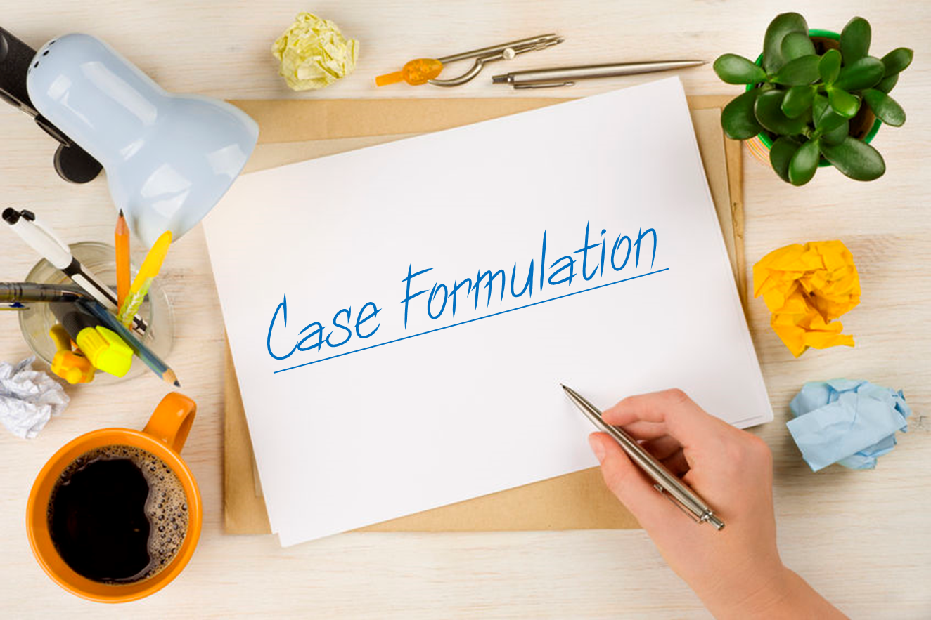

Slide 3
Case Formulation
Case formulation is a core clinical skill that links assessment information and treatment planning
It's a hypothesis about the mechanisms that cause and maintain the problem
It answers the question, “Why is this
person, having this type of problem, now?”

Slide 4
DSM-5 Informed Case Formulation Process
DSM-5 Enhancements
Assessment
DSM-5 Organization
DSM-5 Background information
Case
Formulation
DSM-5 Criteria Sets
DSM-5 Background Information
Best practice guidelines are often tied to a diagnosis
DSM-5 measures to monitor progress
Treatment
Planning

Slide 5
DSM-5’s Single Axis System
There is one diagnostic axis on which all of the following can be coded:
All mental disorders (formerly on Axis I and II)
Other Conditions that May be the Focus of Treatment (V-codes; formerly Axis I)
Medical disorders (formerly Axis III)

Slide 6
Steps in Case Formulation
The case formulation should be developed in collaboration with the client to ensure engagement and increase commitment to treatment.
To develop a strong case formulation, the following steps are recommended (Persons, 2008):

Slide 7
1- Conduct a thorough assessment to determine the presence of specific diagnoses, symptoms, and problems. It’s important to create a list of all of the client’s presenting symptoms and problems in various areas and life domains (i.e., panic attacks, excessive worry, low mood, poor academic performance, relationship difficulties).

Slide 8
2- Develop an initial case formulation based on tentative or “working” hypotheses about:
Factors that predisposed the client to develop the symptoms and problems
Factors that precipitated the most recent episode
Maintaining factors
Protective factors

Slide 9
3- Set up experiments to test out the initial case formulation. The results of these tests will confirm or disprove hypotheses about factors that cause or maintain the client’s symptoms and problems. For example, a therapist may use a thought record to test out whether a client’s procrastination stems from perfectionistic beliefs, which may reveal that procrastination or difficulty initiating tasks is instead due to thoughts of hopelessness. The case formulation should be revised based on the results.

Slide 10
4- The case formulation should continue to be tested and revised throughout treatment with the goal of targeting mechanisms involved in the onset and maintenance of the client’s symptoms and problems. With ongoing consent of the client, it should be used as a guide for treatment planning and clinical decision making.

Slide 11
Components of Case Formulation

Slide 12
A case formulation should provide a coherent summary and explanation of a client’s symptoms and problems. It should include the following components (Persons, 2008):
Problems: Psychological symptoms and features of a disorder, and related problems in various areas of life—social, interpersonal, academic, occupational.
Mechanisms: Psychological factors—cognitive, behavioral—that cause or maintain the client’s problems. Mechanisms are the primary treatment targets.

Slide 13
Origins: Distal factors or processes that lead to the mechanisms and thereby predispose the client to developing certain psychological symptoms and problems.
Precipitants: Proximal factors that trigger or worsen the client’s symptoms and problems. Precipitants can be internal—physiological symptoms that trigger a panic attack—or external—a stressful life event that triggers a depressive episode.

Slide 14
DSM-5 Tools and Enhancements
Clinical rating scales
WHODAS 2.0
Cultural Formulation Interview

Slide 15
Clinical Rating Scales
Rationale for adding:
Measurement-informed care
Dimensional assessment of severity
Assessment of broad range of symptoms
Types
Cross-Cutting Symptom Measures
Disorder-Specific Severity Measures
Disability Measures (WHODAS 2.0)
Personality Inventories

Slide 16
Cross-Cutting Symptom Measures
Assesses symptoms across the major domains of psychopathology
Two types:
Level 1
Level 2
Versions
Adult self-report
Parent/guardian-rated version (for children)
Youth self-report

Slide 17
Level 1 Cross-Cutting Symptom Measure
Description: Adult version measures 13 domains of symptoms
Rate each item:
How much or how often “you have you been bothered by…in the past two weeks.”
5-point rating scale from 4 (severe, nearly everyday) to 0 (none or not at all)
Scoring: Rating of 2 or higher (Mild, several days) should be followed up by further clinical assessment. On items for suicidal ideation, psychosis and substance use, a rating of 1 (Slight) or higher should be used.

Slide 18
Level 2 Assessment Measure
Description: A brief rating scale for a particular symptom (e.g., anxiety, depression, substance use)
Indications: When a Level 1 item is rated above the cut-off
Can be readministered periodically to plot change

Slide 19
Disorder-Specific Rating Scales
Description: Disorder-specific rating scales that correspond to the diagnostic criteria
Indications:Used to confirm a diagnostic impression, assess severity, and monitor progress
Versions: Adult, Youth and Clinician rated

Slide 20
WHODAS 2.0 (World Health Organization Disability Assessment Schedule 2.0)
A generic assessment instrument for health and disability.
Used across all diseases, including mental, neurological and addictive disorders
Short, simple and easy to administer (5 to 20 minutes)
Applicable in both clinical and general population settings
A tool to produce standardized disability levels and profiles
Applicable across cultures, in all adult populations

Slide 21
This questionnaire asks about difficulties due to health conditions. Health conditions include diseases or illnesses, other health problems that may be short or long lasting, injuries, mental or emotional problems, and problems with alcohol or drugs
Description: A 36-item measure that assesses disability in adults 18 years and older
Rating: “How much difficulty have you had doing the following activities in the past 30 days.” Rated 1 (None) to 5 (Extreme or cannot do)
Scoring: Calculate average score for each domain and overall
Versions: Adult and proxy-administered

Slide 22
Domains on the WHODAS 2.0
Understanding and communicating
Getting around
Self-care
Getting along with people
Life activities
Participation in society

Slide 23
Cultural Formulation Interview (CFI)
Description: A 16-item semistructured interview to assess the impact of culture on key aspects of the clinical presentation and treatment plan
Indications: Use as part of the initial assessment with any client but is especially indicated when there are significant differences in “cultural, religious or socioeconomic backgrounds of the clinician and the individual”

Slide 24
CFI Domains
Cultural definition of the problem
Causes of the problem, stressors and available supports
Coping efforts and past help-seeking
Current help-seeking and the clinician- client relationship

Slide 25
Clinical Applications of DSM-5 Enhancements
During initial assessment:
Administer Level 1 Cross-Cutting Symptom Measure
Complete intake including social history, mental status, and diagnostic assessment
Administer Level 2 measures as needed
WHODAS 2.0 can be administered as indicated
Use aspects of the CFI interview throughout
Follow-up sessions
Administer disorder-specific measures
Re-administer periodically to assess progress

Slide 26
DSM-5 and Case Formulation
Biopsychosocial model in case formulation
The Five P’s of Case Formulations
Doing a case formulation using DSM-5

Slide 27
Biopsychosocial Model in Case Formulation
Psychological
Factors
Sociocultural Factors
Biological Factors
Case Formulation

Slide 28
The Five P’s of Case Formulation
Presenting problem
What is the client’s problem list?
What are DSM diagnoses?
Predisposing factors
Over the person’s lifetime, what factors contributed to the development of the problem?
Think biopsychosocial
Precipitants factors
Why now?
What are triggers or events that exacerbated the problem?
Perpetuating factors
What factors are likely to maintain the problem?
Are there issues that the problem will worsen, if not addressed
Protective/positive factors
What are client strengths that can be drawn upon?
Are there any social supports or community resources ?

Slide 30
The Five P’s in DSM-5
Diagnostic criteria
Disorder-specific criteria set (Presenting Problem)
Subtypes and specifiers (Presenting Problem)
Explanatory text information
Diagnostic features (Presenting Problem)
Associated features (Presenting Problem)
Prevalence (Presenting Problem)
Development and course (Predisposing, Perpetuating and
Protective Factors)
Risk and prognostic factors (Predisposing, Perpetuating Protective Factors)
Culture-related diagnostic issues (5 P’s)
Gender-related diagnostic issues (5 P’s)
Suicide risk (Presenting Problem)
Functional consequences (Perpetuating Factors)
Differential diagnosis (Presenting Problem)
Comorbidity (Presenting Problem and Perpetuating Factors)

Slide 31
Case of Helen
Helen was fired from her job one month ago because she started making numerous mistakes and had trouble concentrating.
About three months ago she started feeling "down“ after a break-up with a man she had been dating for a few months.
She has trouble falling asleep and has noticed a significant decline in her appetite. She feels like a failure and believes that no one will want to hire her again.

Slide 32
Helen Continued
She has thoughts of committing suicide but admits, "I could never do it."The only thing that seems to help is when she participates in a bible-reading group every Tuesday night.
She explains, "During that time I'm more like my old self and at least that night I can sleep."
She also reports that her mood improves when she visits her friends. However, she reports such low energy throughout the day that she is unable to schedule a job interview.

Slide 33
Helen Continued
She had a similar episode about two years ago after she was laid off from her former job.
She reports that it took four months before she began feeling "normal" again and positive about herself.
Her history indicates that her mother had severe depression and was hospitalized on several occasions when Helen was young. She describes her as “negative” and often absent in her youth. However, Helen always did well in school and had an active social life.
Her work history has been very consistent up to her lay off.

Slide 34
Diagnostic Work-Up
DSM-5 measures:
Level 1(positive for depression, sleep problems and avoiding certain events)
WHODAS 2.0
General Disability Score = 85 (2.36; Mild)
Subscale: Life activities = 14 (3.5; Moderate)
Subscale: Participation in Society = 28 ( 3.5; Moderate)
Differential diagnosis: What are the possibilities?
Diagnostic Impression:
296.33 Major Depressive Disorder, recurrent, severe severity
V62.29 Other Problems related to employment

Slide 35
Case Formulation
Why is she so depressed?
Predisposing factors?
Precipitating factors?
Perpetuating factors?
Positive or protective factors?
How does the diagnosis and case formulation inform your treatment plan?

Slide 36
Guide to Case Formulation
State the problem or diagnostic impression.
State the precipitant
Describe critical predisposing factors
Include a statement about perpetuating or maintaining factors
Highlight protective and positive qualities

Slide 37
Write a Case Formulation
Helen presents with……(1) which appears to be precipitated by…..(2). Factors that seem to have predisposed her to depression include….(3). The current problem is maintained by….(4).However, her protective and positive factors include….(5).

Slide 38
From Formulation to Treatment
How does the formulation inform the treatment plan?
Best practices for this disorder?
Which types of interventions will address the predisposing, precipitating and perpetuating factors?
How do you ensure that diversity factors are considered?
How do you tailor treatments so that they are more strength-based?

Slide 39
Final Thoughts…
Begin using DSM-5 enhancements
DSM-5 can help you identify the five P’s
Case formulation is a skill and has been tied to better outcome

