Slide 1
Synecology of Halophytes

Slide 2
ECOLOGICAL GROUPS
‘Groups of plants growing under the same set of environmental factors constitute ecological groups’

Slide 3
In 1895 Warming classified plants into ecological groups
On the basis of
Type of substratum
Adaptic factors of the soil
Availability of water
Ecological groups of plants
Hydrophytes
Xerophytes
Epiphytes
Halophytes

Slide 4
HALOPHYTES

Slide 5
Inhabit in saline soils
Tolerant to a high concentration of soluble inorganic salts
The plants are affected by these dissolved inorganic salts
The effect may be partially osmotic and partially chemical
To maintain turgidity cell sap is much more concentrated

Slide 6
SALIENT FEATURES OF HALOPHYTES
A vast number of halophytic flora are succulents
Leaves may be thin ,small leathery, and spiny to minimise loss of water in transpiration
They have evergreen leaves which have water storage tissue, prominent palisade cells, and thick cuticle

Slide 7
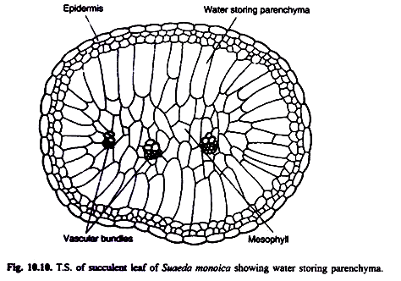

Slide 8
Ecological Requirements
The ecological conditions which are essential for the development of mangrove vegetation or halophytes are:
Shallow water with thick mud
Water logged saline soil or sandy or loose soil or heavy clays containing large amount or organic matter
High rainfall
High humidity in the atmosphere and cloudy weather

Slide 9
ADAPTIC FEATURES OF HALOPHYTES
STILT ROOTS
PNEUMATOPHORES
VIVIPARY
SHRUBY AND WOODY NATURE
SALT GLANDS

Slide 10
Stilt Roots
Formation of stilt-like prop roots arising from the main trunk of the trees
Provide efficient anchorage of plants in the loose sandy soil where fixation by the shallow ordi­nary roots is often difficult

Slide 12
Pneumatophores
Production of negatively geotropic respiratory roots, pneumatophores for efficient aeration
Provided for gaseous exchange because the soil is water-logged and the aeration in the root medium is consequently much below optimal
E.g. Mangrooves

Slide 14
Vivipary
Halophytes of sea coasts or other saline soil bordering the seas have developed a peculiar type of germination known as vivipary
Defined as germination of seeds before the fruits break off from the plant
The large embryo, without endosperm, grows and develops in the seed within the fruit when it is still attached to the plant

Slide 16
Shrubby Nature
Plants are generally shrubs
Herbs are somewhat rare, except perhaps, Acanthus ilicifolius, Heliotropium ovalifolium

Slide 17
Salt Glands
Superfluous salts are excreted by guttation through special glands
All these salt-excreting of halophytes, are sometimes referred to Crinohalophytes
Examples: Spartina, Glaux maritina, Cressa cretica, Frankenia sp., Limonium sp.

Slide 18
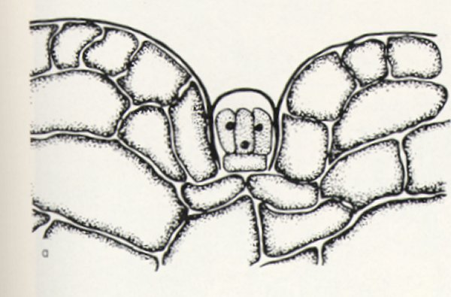
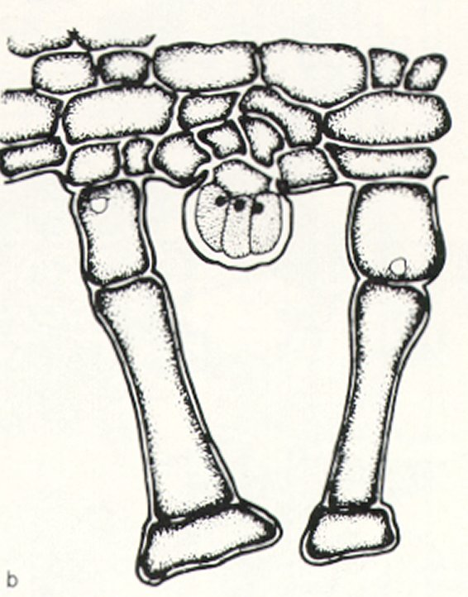
Salt Glands in Black Mangrove (Avicennia marina)
a
(a) sunken gland on upper epidermis; (b) elevated gland on lower epipermis
b
Concentrations of secreted salts is typically so high that under dry atmospheric conditions, the salts crystallize

Slide 20
Xerophytic Adaptations in Halophytes
Succulence of stem is a common characteistic
Leaves are xerophilous, generally small in size, thick and are very often glossy
There are also thick cuticles, large mucilage cells, protected stomata but never truly sunken and sometimes large-celled thin-walled aqueous tissues
Sometimes old leaves serve as water reservoirs for younger leaves
These adaptations certainly seem xeromorphic in nature and exhibit an ancestral relationship of both groups

Slide 21
Future Ecological Prospects
The most important opportunities relate to reforestation or replanting and ecological recovery of saline areas that have fallen into disuse
Coastal development and protection
Production of cheap biomass for renewable energy
Climate improvement and CO2 sequestration.
Roles in stabilization of coasts and beaches
Food chain and life support systems
Development of aquaculture, agriculture and wild-life sanctuary and recreation areas
Provide tannin, thatching material, fodder, fish poison, food products, medicine
Wood for building purposes fuel, and boat and canoe making for the residents of coastal areas

