Slide 1
Data and Computer Communications
Chapter 9 – Spread Spectrum
Eighth Edition
William Stallings

Slide 2
Spread Spectrum
Important encoding method for wireless communications
Analog & digital data with analog signal
Spreads data over wide bandwidth
Makes jamming and interception harder
Two approaches, both in use:
Frequency Hopping
Direct Sequence
Notes:
Spread spectrum is an increasingly important form of encoding for wireless communications. It it can be used to transmit either analog or digital data, using an analog signal. The basic idea of spread spectrum is to modulate the signal so as to increase significantly the bandwidth (spread the spectrum) of the signal to be transmitted. It was initially developed for military and intelligence requirements. The use of spread spectrum makes jamming and interception more difficult and provides improved reception. The first type of spread spectrum developed is known as frequency hopping. A more recent type of spread spectrum is direct sequence. Both of these techniques are used in various wireless communications standards and products.

Slide 3
General Model of Spread Spectrum System
Notes:
Input is fed into a channel encoder that produces an analog signal with a relatively narrow bandwidth around some center frequency. This signal is further modulated using a sequence of digits known as a spreading code or spreading sequence. Typically, but not always, the spreading code is generated by a pseudonoise, or pseudorandom number, generator. The effect of this modulation is to increase significantly the bandwidth (spread the spectrum) of the signal to be transmitted. On the receiving end, the same digit sequence is used to demodulate the spread spectrum signal. Finally, the signal is fed into a channel decoder to recover the data.

Slide 4
Spread Spectrum Advantages
Immunity from noise and multipath distortion
Can hide / encrypt signals
Several users can share same higher bandwidth with little interference
CDM/CDMA Mobile telephones
Notes:
Several advantages can be gained from this apparent waste of spectrum by this approach:
• The signals gains immunity from various kinds of noise and multipath distortion. The earliest applications of spread spectrum were military, where it was used for its immunity to jamming.
• It can also be used for hiding and encrypting signals. Only a recipient who knows the spreading code can recover the encoded information.
• Several users can independently use the same higher bandwidth with very little interference. This property is used in cellular telephony applications, with a technique know as code division multiplexing (CDM) or code division multiple access (CDMA).

Slide 5
Pseudorandom Numbers
Generated by a deterministic algorithm
Not actually random
But if algorithm good, results pass reasonable tests of randomness
Starting from an initial seed
Need to know algorithm and seed to predict sequence
Hence only receiver can decode signal
Notes:
A comment about pseudorandom numbers is in order. These numbers are generated by an algorithm using some initial value called the seed. The algorithm is deterministic and therefore produces sequences of numbers that are not statistically random. However, if the algorithm is good, the resulting sequences will pass many reasonable tests of randomness. Such numbers are often referred to as pseudorandom numbers. The important point is that unless you know the algorithm and the seed, it is impractical to predict the sequence. Hence, only a receiver that shares this information with a transmitter will be able to decode the signal successfully.

Slide 6
Frequency Hopping Spread Spectrum (FHSS)
Signal is broadcast over seemingly random series of frequencies
Receiver hops between frequencies in sync with transmitter
Eavesdroppers hear unintelligible blips
Jamming on one frequency affects only a few bits
Notes:
With frequency-hopping spread spectrum (FHSS), the signal is broadcast over a seemingly random series of radio frequencies, hopping from frequency to frequency at fixed intervals. A receiver, hopping between frequencies in synchronization with the transmitter, picks up the message. Would-be eavesdroppers hear only unintelligible blips. Attempts to jam the signal on one frequency succeed only at knocking out a few bits of it.

Slide 7
Frequency Hopping Example
Notes:
A number of channels are allocated for the FH signal. Typically, there are 2^{k} carrier frequencies forming 2^{k} channels. The spacing between carrier frequencies and hence the width of each channel usually corresponds to the bandwidth of the input signal. The transmitter operates in one channel at a time for a fixed interval; for example, the IEEE 802.11 standard uses a 300-ms interval. During that interval, some number of bits (possibly a fraction of a bit, as discussed subsequently) is transmitted using some encoding scheme. A spreading code dictates the sequence of channels used. Both transmitter and receiver use the same code to tune into a sequence of channels in synchronization.

Slide 8
FHSS (Transmitter)
At each successive interval (each k PN bits), a new carrier frequency is selected. The frequency synthesizer generates a constant-frequency tone whose frequency hops among a set of 2^{k} frequencies, with the hopping pattern determined by k bits from the PN sequence. This is known as the spreading or chipping signal c(t).
Notes:
For transmission, binary data are fed into a modulator using some digital-to-analog encoding scheme, such as frequency shift keying (FSK) or binary phase shift keying (BPSK). The resulting signal s_{d}(t) is centered on some base frequency. A pseudonoise (PN), or pseudorandom number, source serves as an index into a table of frequencies; this is the spreading code referred to previously. Each k bits of the PN source specifies one of the 2^{k} carrier frequencies. At each successive interval (each k PN bits), a new carrier frequency is selected. The frequency synthesizer generates a constant-frequency tone whose frequency hops among a set of 2^{k} frequencies, with the hopping pattern determined by k bits from the PN sequence. This is known as the spreading or chipping signal c(t). This is then modulated by the signal produced from the initial modulator to produce a new signal with the same shape but now centered on the selected carrier frequency. A bandpass filter is used to block the difference frequency and pass the sum frequency, yielding the final FHSS signal s(t).

Slide 9
Frequency Hopping Spread Spectrum System (Receiver)
Notes:
On reception, the spread spectrum signal is demodulated using the same sequence of PN-derived frequencies and then demodulated to produce the output data. At the receiver, a signal of the form s(t) defined on the previous slide, will be received. This is multiplied by a replica of the spreading signal to yield a product signal. A bandpass filter is used to block the sum frequency and pass the difference frequency, which is then demodulated to recover the binary data.

Slide 10
Slow and Fast FHSS
Commonly use multiple FSK (MFSK)
Have frequency shifted every T_{c} seconds
Duration of signal element is T_{s} seconds
Slow FHSS has T_{c} ≥ T_{s}
Fast FHSS has T_{c} < T_{s}
FHSS quite resistant to noise or jamming
With fast FHSS giving better performance
Notes:
A common modulation technique used in conjunction with FHSS is multiple FSK (MFSK), which uses M = 2^{L} different frequencies to encode the digital input L bits at a time. For FHSS, the MFSK signal is translated to a new frequency every T_{c} seconds by modulating the MFSK signal with the FHSS carrier signal. The effect is to translate the MFSK signal into the appropriate FHSS channel. For a data rate of R, the duration of a bit is T = 1/R seconds and the duration of a signal element is T_{s} = LT seconds. If T_{c} is greater than or equal to T_{s}, the spreading modulation is referred to as slow-frequency-hop spread spectrum; otherwise it is known as fast-frequency-hop spread spectrum.
Typically, a large number of frequencies is used in FHSS so that bandwidth of the FHSS signal is much larger than that of the original MFSK signal. One benefit of this is that a large value of k results in a system that is quite resistant to jamming. If frequency hopping is used, the jammer must jam all 2^{k} frequencies. With a fixed power, this reduces the jamming power in any one frequency band to S_{j}/2^{k}. In general, fast FHSS provides improved performance compared to slow FHSS in the face of noise or jamming, as will discuss shortly.

Slide 11
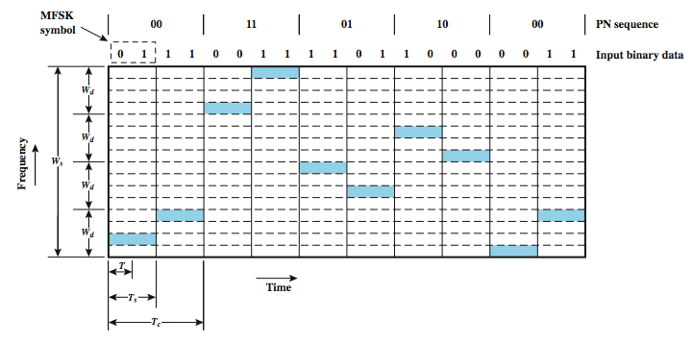
Slow MFSK FHSS
Notes:
Here we have M = 4, which means that four different frequencies are used to encode the data input 2 bits at a time. Each signal element is a discrete frequency tone, and the total MFSK bandwidth is W_{d} = Mf_{d}. We use an FHSS scheme with k = 2. That is, there are 4 = 2^{k} different channels, each of width W_{d}. The total FHSS bandwidth is W_{s} = 2^{k}W_{d}. Each 2 bits of the PN sequence is used to select one of the four channels. That channel is held for a duration of two signal elements, or four bits (T_{c} = 2T_{s} = 4T).

Slide 12
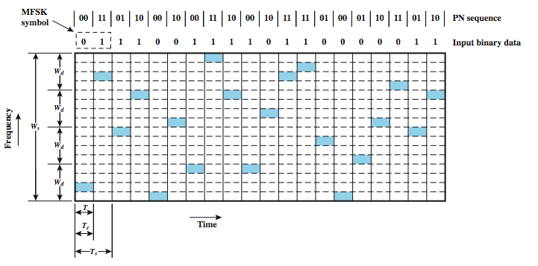
Fast MFSK FHSS
Notes:
Again, M = 4 and k = 2. In this case, however, each signal element is represented by two frequency tones. Again, W_{d} = Mf_{d} and W_{s} = 2^{k}W_{d}. In this example T_{s} = 2T_{c} = 2T. In general, fast FHSS provides improved performance compared to slow FHSS in the face of noise or jamming. For example, if three or more frequencies (chips) are used for each signal element, the receiver can decide which signal element was sent on the basis of a majority of the chips being correct.

Slide 13
Direct Sequence Spread Spectrum (DSSS)
Each bit is represented by multiple bits using a spreading code
This spreads signal across a wider frequency band
Has performance similar to FHSS
Notes:
With direct sequence spread spectrum (DSSS), each bit in the original signal is represented by multiple bits in the transmitted signal, using a spreading code. The spreading code spreads the signal across a wider frequency band in direct proportion to the number of bits used. Therefore, a 10-bit spreading code spreads the signal across a frequency band that is 10 times greater than a 1-bit spreading code.

Slide 14
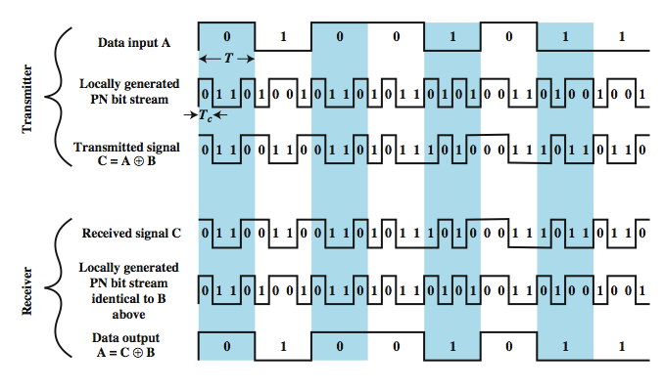
Direct Sequence Spread Spectrum Example
Notes:
One technique with direct sequence spread spectrum is to combine the digital information stream with the spreading code bit stream using an exclusive-OR (XOR). Note that an information bit of one inverts the spreading code bits in the combination, while an information bit of zero causes the spreading code bits to be transmitted without inversion. The combination bit stream has the data rate of the original spreading code sequence, so it has a wider bandwidth than the information stream. In this example, the spreading code bit stream is clocked at four times the information rate.

Slide 15
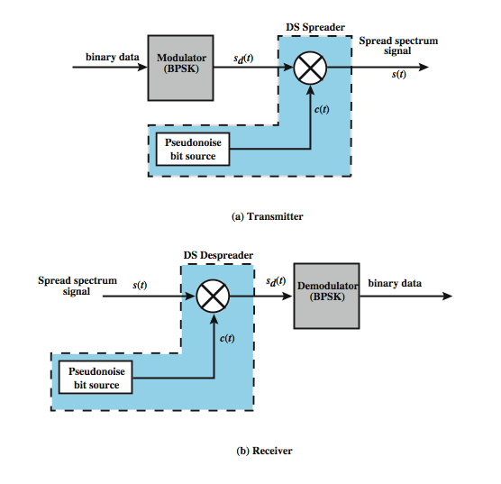
Direct Sequence Spread Spectrum System

Slide 16
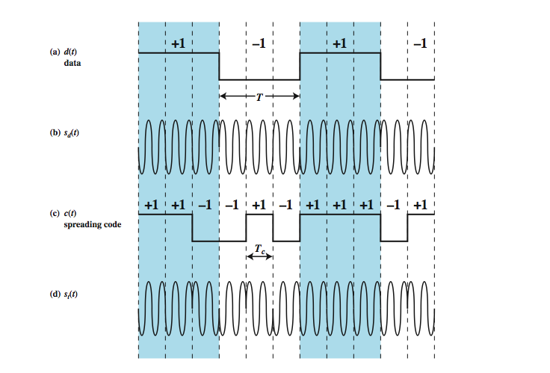
DSSS Example Using BPSK

Slide 17
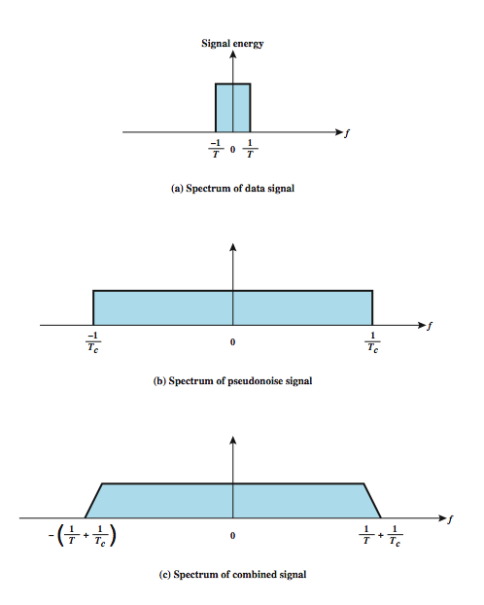
Approximate Spectrum of DSSS Signal

Slide 18
Code Division Multiple Access (CDMA)
A multiplexing technique used with spread spectrum
Given a data signal rate D
Break each bit into k chips according to a fixed chipping code specific to each user
Resulting new channel has chip data rate kD chips per second
Can have multiple channels superimposed
Notes:
CDMA is a multiplexing technique used with spread spectrum. The scheme works in the following manner. We start with a data signal with rate D, which we call the bit data rate. We break each bit into k chips according to a fixed pattern that is specific to each user, called the user’s code, or chipping code. The new channel has a chip data rate, or chipping rate, of kD chips per second. With CDMA, the receiver can sort out transmission from the desired sender, even when there may be other users broadcasting in the same cell.

Slide 19
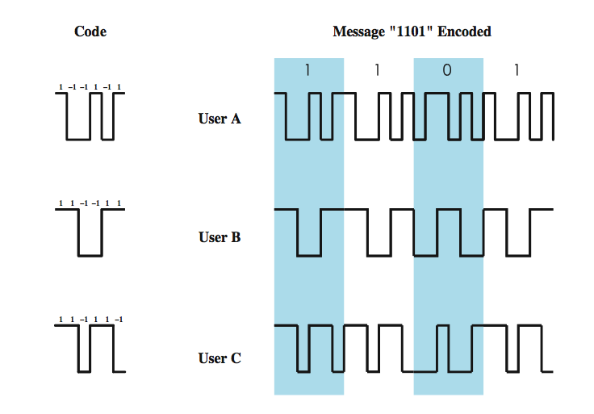
CDMA Example
Notes:
As an illustration we consider a simple example with k = 6. It is simplest to characterize a chipping code as a sequence of 1s and –1s. Figure shows the codes for three users, A, B, and C, each of which is communicating with the same base station receiver, R. Thus, the code for user A is c_{A} = <1, –1, –1, 1, –1, 1>. Similarly, user B has code c_{B} = <1, 1, –1, –1, 1, 1>, and user C has c_{C} = <1, 1, –1, 1, 1, –1>. We now consider the case of user A communicating with the base station. The base station is assumed to know A’s code. For simplicity, we assume that communication is already synchronized so that the base station knows when to look for codes. If A wants to send a 1 bit, A transmits its code as a chip pattern <1, –1, –1, 1, –1, 1>. If a 0 bit is to be sent, A transmits the complement (1s and –1s reversed) of its code, <–1, 1, 1, –1, 1, –1>.
At the base station the receiver decodes the chip patterns. If the decoder is linear and if A and B transmit signals s_{A} and s_{B}, respectively, at the same time, then S_{A} (s_{A} + s_{B}) = S_{A} (s_{A}) + S_{A} (s_{B}) = S_{A} (s_{A}) since the decoder ignores B when it is using A’s code. The codes of A and B that have the property that S_{A} (c_{B}) = S_{B} (c_{A}) = 0 are called orthogonal. Using the decoder, S_{u}, the receiver can sort out transmission from u even when there may be other users broadcasting in the same cell. In practice, the CDMA receiver can filter out the contribution from unwanted users or they appear as low-level noise. However, if there are many users competing for the channel with the user the receiver is trying to listen to, or if the signal power of one or more competing signals is too high, perhaps because it is very near the receiver (the “near/far” problem), the system breaks down.

Slide 20
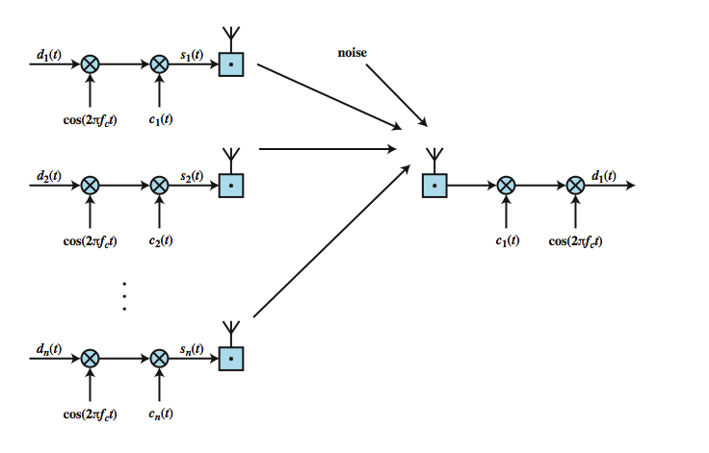
CDMA for DSSS
Notes:
Let us now look at CDMA from the viewpoint of a DSSS system using BPSK. Stallings DCC8eFigure 9.11 depicts a configuration in which there are n users, each transmitting using a different, orthogonal, PN sequence (compare Figure 9.7). For each user, the data stream to be transmitted, d_{i}(t), is BPSK modulated to produce a signal with a bandwidth of W_{s} and then multiplied by the spreading code for that user, c_{i}(t). All of the signals, plus noise, are received at the receiver's antenna. Suppose that the receiver is attempting to recover the data of user 1. The incoming signal is multiplied by the spreading code of user 1 and then demodulated. The effect of this is to narrow the bandwidth of that portion of the incoming signal corresponding to user 1 to the original bandwidth of the unspread signal, which is proportional to the data rate. Incoming signals from other users are not despread by the spreading code from user 1 and hence retain their bandwidth of W_{s}. Thus the unwanted signal energy remains spread over a large bandwidth and the wanted signal is concentrated in a narrow bandwidth. The bandpass filter at the demodulator can therefore recover the desired signal.

Slide 21
Summary
Looked at use of spread spectrum techniques:
FHSS
DSSS
CDMA
Notes:
Chapter 9 summary.

