Slide 1
Motif and Design

Slide 2
Motif
In art and iconography, a motif is an element of an image. A motif may be repeated in a pattern or design, often many times, or may just occur once in a work.

Slide 3
Types of Motifs
A motif may be an element in the iconography of a particular subject or type of subject that is seen in other works, or may form the main subject, as the Master of Animals motif in ancient art typically does. The related motif of confronted animals is often seen alone, but may also be repeated, for example in Byzantine silk and other ancient textiles.

Slide 4
Where the main subject of an artistic work such as a painting is a specific person, group, or moment in a narrative, that should be referred to as the "subject" of the work, not a motif, though the same thing may be a "motif" when part of another subject, or part of a work of decorative art such as a painting on a vase.

Slide 5
Ornamental or decorative art can usually be analysed into a number of different elements, which can be called motifs. These may often, as in textile art, be repeated many times in a pattern. Important examples in Western art include acanthus, egg and dart and various types of scrollwork.

Slide 6
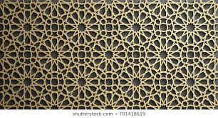

Slide 7
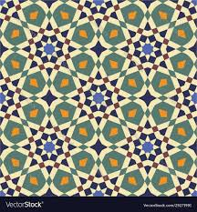

Slide 8
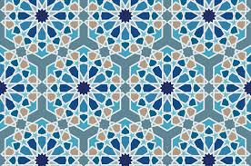

Slide 9
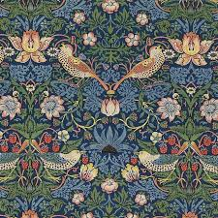
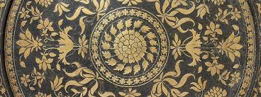

Slide 11
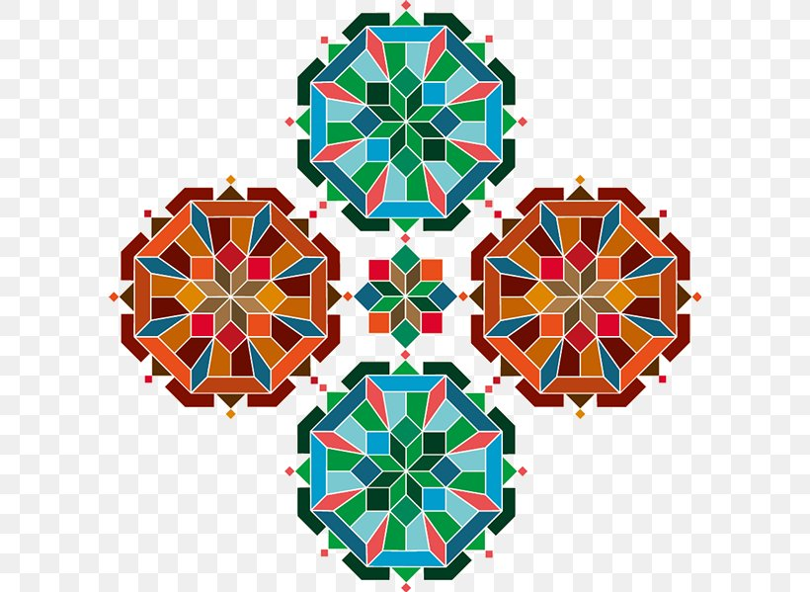

Slide 12
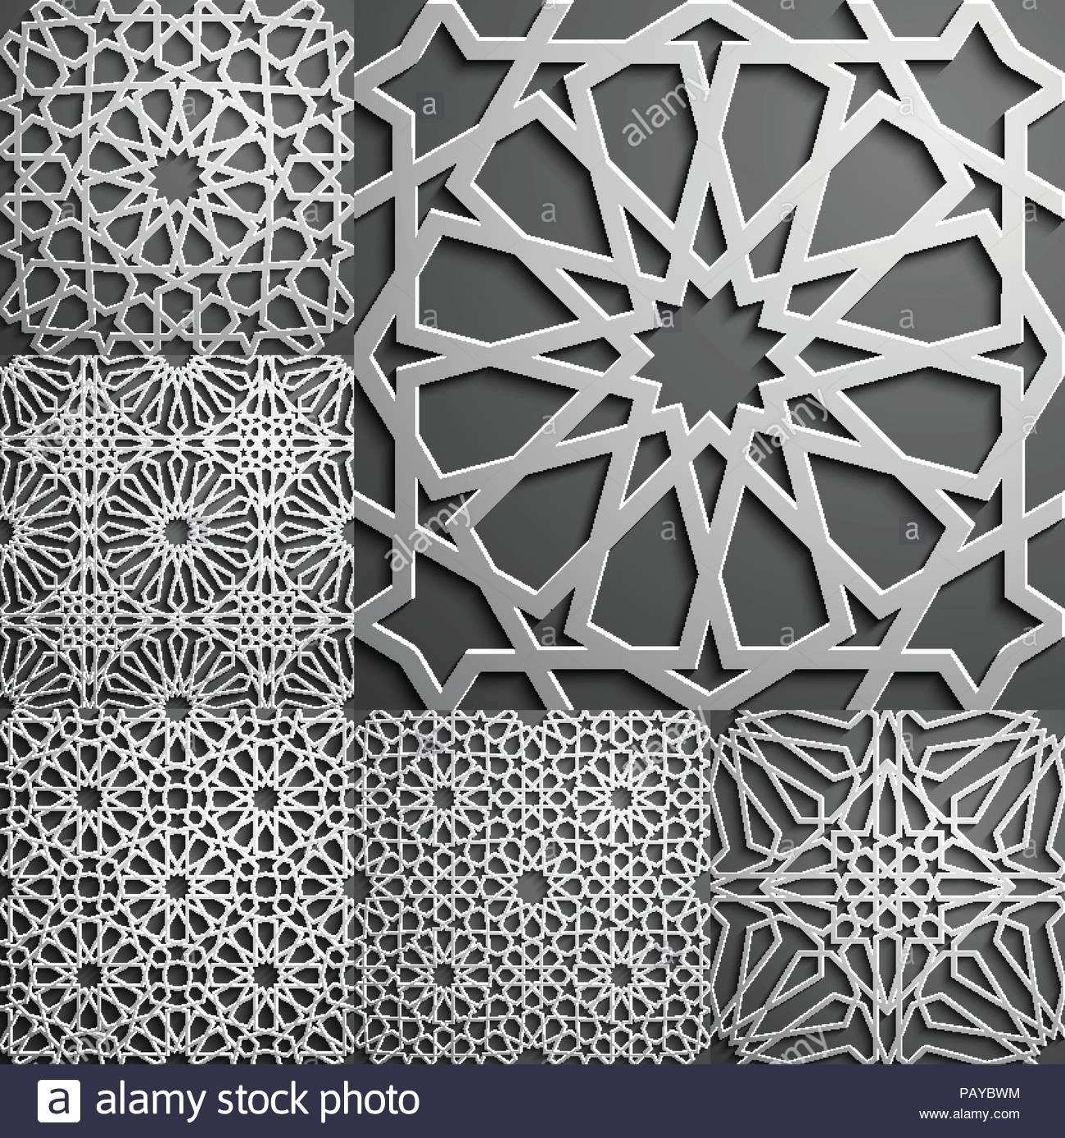

Slide 13
