Slide 1
Histology of Spleen

Slide 3
Largest lymphoid organ
Present in the upper part of abdominal cavity
behind the stomach ( Upper left quadrant )
Covered by peritoneum

Slide 4
COMPONENTS
Connective Tissue Framework
Capsule
Trabeculae
Reticular Stroma (Fibres)
Parenchyma
White pulp
Red pulp

Slide 5
Connective Tissue Framework

Slide 6
Capsule
Covers the spleen
Formed by dense irregular connective tissue and few smooth muscle fibre.
Trabeculae are given off from the capsule into the spleen and divide its parenchyma.

Slide 7
Reticular Stroma
Made up of reticular fibres
Forms a mesh work
Supports the cells of parenchyma

Slide 8
Parenchyma

Slide 9
The interior of spleen shows
Rounded white/grey areas surrounded by red
matrix White Pulp
Dark red matrix
Red Pulp

Slide 11
White Pulp
Made up of aggregation of lymphoid tissue around a small artery (central artery)
This artery is a branch of trabecular artery that
leaves the trabeculum and enters the pulp
On entering the pulp it is surrounded by lymphoid tissue, the periarterial lymphatic sheath (PALS)
Populated by T lymphocytes, to become central artery or white pulp artery

Slide 12
Around the course of PALS, there are large collection of B lymphocytes forming lymphatic nodules with germinal centres (white pulp)
In these nodules the central artery occupies an eccentric position

Slide 13
The lymphatic nodules (white pulp) are surrounded by an immunologically active zone containing few T lymphocytes
This functional zone between the white and red pulp is called marginal zone

Slide 14
Spleen

Slide 15
Spleen

Slide 18
Red Pulp
Modified lymphoid tissue
Infiltrated with all the cells of circulating blood dark red colour
It is composed of splenic cords of Billroth and broad splenic venous sinuses in between the cords

Slide 19
The splenic cords consists of spongy network of reticular fibres, lymphocytes, macrophages, plasma cells and all elements of the circulating blood

Slide 20
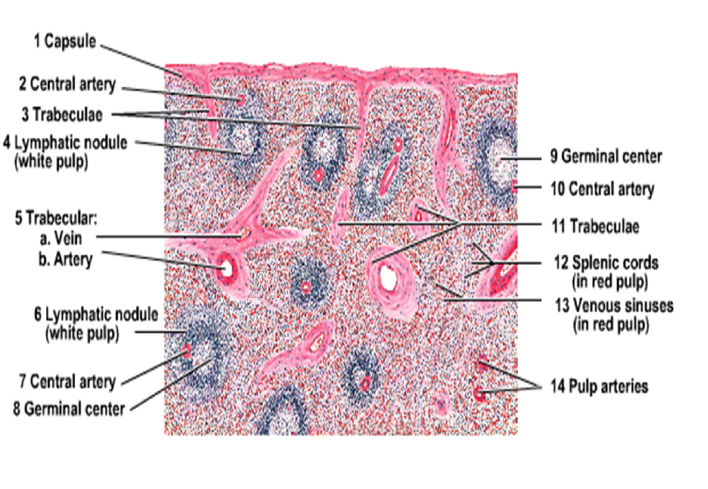

Slide 21
Spleen

Slide 22
Splenic Venous Sinuses
The splenic venous sinuses are lined by endothelial cells
Externally the sinuses are encircled by reticular fibres

Slide 25
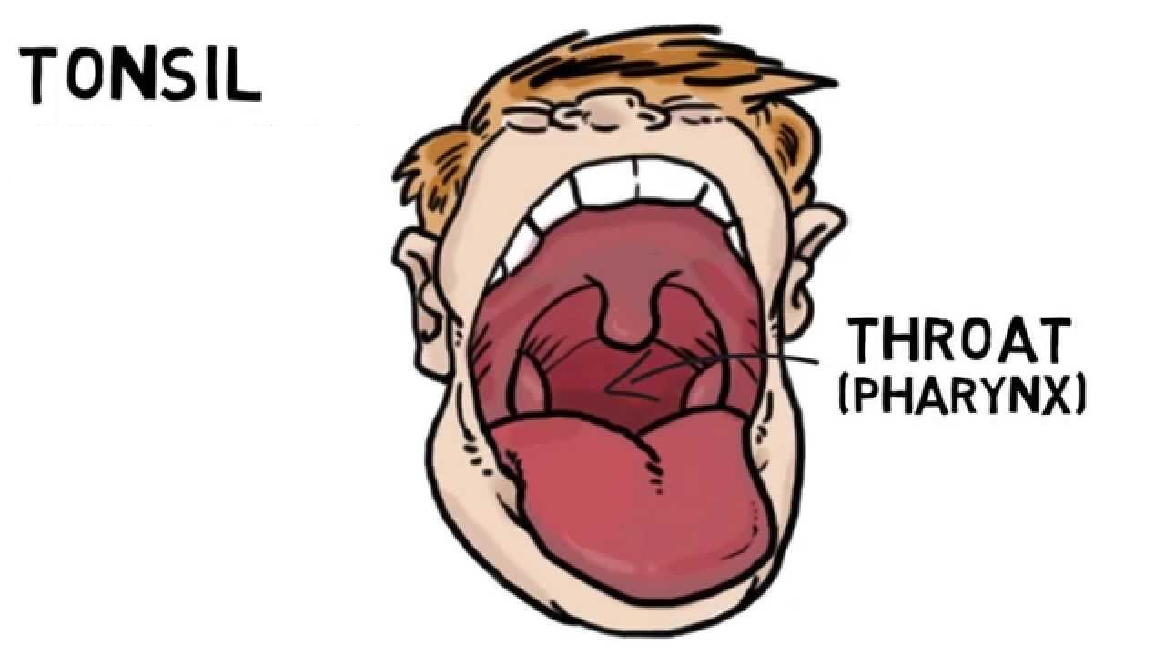
Palatine Tonsils

Slide 26
Each palatine tonsil consists of diffused lymphoid tissue in which lymphatic nodules are present
The lymphoid tissue is covered by stratified squamous nonkeratinized epithelium
This epithelium form deep invaginations into the substance of the tonsil in the form of several tonsillar crypts.

Slide 27
The parenchyma consists of a dense accumulation of lymphoid follicles which show Germinal center.
The deep aspect is isolated from subjacent structures by a band of dense connective tissue called Capsule.
The lumen of the crypt usually contains some lymphocytes, food debris and bacteria.

Slide 28
Palatine Tonsil

Slide 29
dense lymphatic tissue that is accumulated in
the connective tissue underlying the epithelium.

Slide 30
lymphoid nodules and germinal
centers

Slide 31
Pharyngeal Tonsil

Slide 32
This is a mass of lymphoid tissue present on the posterior wall of the nasopharynx in the midline.
Covered by pseudostratified columnar ciliated epithelium.
No crypts are present
Diffuse mass of lymphoid tissue is present under epithelium
The deeper surface also covered by thin capsule of fibrous connective tissue.

Slide 33
Lingual Tonsil
Mass of lymphoid tissue located in the root of the tongue.
Is covered by stratified squamous epithelium.
Lingual tonsil has many crypts.
Beneath the epithelium there is a layer of lymphatic nodules.
A thin capsule separates from the underlying structures.

Slide 34
MCQS
What is the term for the entire lymphatic region of the spleen? a. Malpighian corpuscle b. Trabeculae c. White pulp d. Red pulp e. Cords of Billroth

Slide 35
What are the splenic cords? a. Cords of Billroth b. Cords of Paneth c. Cords of Bellini d. Cords of Rothchild e. Cords of Hassall

Slide 36
Where are the splenic sinuses? a. Malpighian corpuscle b. Trabeculae c. White pulp d. Red pulp e. Cords of Billroth

Slide 37
What does the PALS stand for? a. Papillary layer sinus b. Peyer's lymphatic sheath c. Periarterial lymphatic sheath d. Peripheral lymphatic sinus e. Parenchymal lymphatic sheath

Slide 38
Identify
1
5
3
2
4

Slide 39
Identify
1
2
4
3
5

