Slide 1
Metabolic Syndrome
Usman Sabir
Roll No. 03
PhD Pharmacology
Semester 1
Presented to : Dr. Abdul Malik
University of Sargodha

Slide 2
Alternative names for Metabolic syndrome
Metabolic syndrome is also called
Insulin resistance syndrome
Syndrome X
Polymetabolic syndrome
Deadly quartet
Civilization syndrome
Amaia Rodríguez et al. 2017

Slide 3
Metabolic Syndrome
Metabolic syndrome (MetS) is a cluster of metabolic disorders such as abdominal obesity, insulin resistance, atherogenic dyslipidemia and hypertension.
Individuals with metabolic syndrome are at higher risk to develop cardiovascular disease, stroke and disease related to fat deposition in artery walls.
Approximately 20-25% of the world population are suffering from it.
Amaia Rodríguez et al 2017.

Slide 4
Definition
MetS is defined by a constellation of an interconnected
physiological, biochemical, clinical, and metabolic factors that directly increases the risk of atherosclerotic cardiovascular disease (ASCVD), T2DM, and all cause mortality.
According to WHO :
“This is collection of unhealthy body measurements and abnormal laboratory test results include atherogenic dyslipidemia, hypertension, glucose intolerance, proinflammatory state, and a prothrombotic hypercoagulability state.”
Amaia Rodríguez et al 2017.

Slide 5
Signs and Symptoms
The major features of metabolic syndrome include:
High blood pressure
Central Obesity
Hypertension
Elevated LDL
low HDL cholesterol
Insulin resistance
High triglyceride levels
Excess body fat around the waist

Slide 6
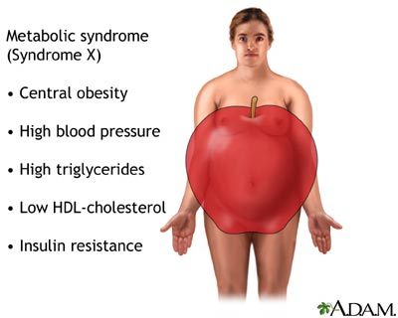

Slide 7
Table 1 Historical and recent deﬁnitions of MetS
Clinical and biochemical features | WHO 1998² | EGIR 1999³ | NCEP ATP III 2001⁴ | AACE 2003⁵ | IDF 2005⁶ | AHA/NHLBI 2005⁷ | Consensus (AHA/NHLBI + IDF) 2009⁸
Insulin resistance | Impaired glucose | Plasma insulin | Any three of | Impaired glucose |  | Any three of | Any three of
 | tolerance, impaired | concentration | the following | tolerance or impaired |  | the following | the following
 | fasting glucose, | N 75th percentile | fasting glucose,
 | T2DM, or lowered | of nondiabetic patients, | plus any of the
 | insulin sensitivity | plus any two of | following
 | plus any two | the following
 | of the following
Obesity | Abdominal obesity | WC ≥94 cm in men; | WC N102 cm in men, | BMI ≥25 kg/m² | BMI N30 kg/m² or | WC ≥102 cm in | Raised WC
 | (waist-to-hip ratio | ≥80 cm in women | N88 cm in women |  | WC with | men, ≥ 88 cm | (population- and
 | N0.9 in men or N0.85 |  |  |  | ethnicity-speciﬁc | in women | country-speciﬁc
 | in women, or |  |  |  | values, ª plus any |  | deﬁnitions)
 | BMI N 30 kg/m²) |  | two of the following
Plasma glucose | Impaired glucose | FPG ≥110 mg/dL | FPG ≥110 mg/dL | Impaired fasting | FPG ≥100 mg/dL | FPG ≥100 mg/dL | FPG ≥100 mg/dL
concentration ^{b} | tolerance, impaired |  |  | glucose, or Impaired |  |  | or on diabetes
 | fasting glucose, |  |  | glucose tolerance |  |  | treatment
 | or T2DM
Hypertension | BP ≥140/90 mm Hg | BP ≥140/90 mm Hg, | BP ≥130/85 mm Hg | BP ≥130/85 mm Hg | BP ≥130/85 mm Hg, | BP ≥130/85 mm Hg, | BP ≥130/85 mm Hg,
 |  | or on antihypertensive |  |  | or on antihypertensive | or on antihypertensive | or on antihypertensive
 |  | medication |  |  | medication | medication | treatment
Triglycerides | TG ≥150 mg/dL | TG ≥150 mg/dL | TG ≥150 mg/dL | TG ≥150 mg/dL | TG ≥150 mg/dL | TG ≥150 mg/dL | TG ≥150 mg/dL
(TG) ^{c} |  | or on treatment |  |  | or on treatment | or on treatment | or on treatment
HDL-cholesterol | HDLC b40 mg/dL | HDLC b39 mg/dL in | HDLC b40 mg/dL | HDLC b40 mg/dL | HDLC b40 mg/dL in | HDLC b40 mg/dL | HDLC b40 mg/dL
(HDLC) ^{d} | in men and | men or women, | in men and | in men and b50 mg/dL | men and b50 mg/dL | in men and b50 mg/dL | in men and b50 mg/dL
 | b50 mg/dL in | or on treatment | b50 mg/dL | in women | in women, | in women, or on | in women, or on
 | women |  | in women |  | or on treatment | treatment | treatment
Other | Urinary albumin
 | excretion
 | ≥20 μg/min,
 | or ACR ≥30 mg/g

Slide 8
Environmental
Physical inactivity
Smoking
Energy dense food
Stress
Genetics
Thrifty genotype
Thrifty phenotype
Adipose tissue hyperplasia and
hypertrophy
Altered FFA metabolism
Altered release of adipokines
↑ Leptin
↑ AT II
↑ Aldosterone
↑ Factor VII
↑ Factor V
↑ PAI-I
↑ Portal FFA
Insulin resistance hyperinsulinemia
Activate RAAS and SNS
Oxidative stress
endothelial dysfunction
↑ Lipoprotein synthesis
↑ Gluconeogenesis
Impairs 𝛽-cell function
of pancreas
↑ Sodium reabsorption vasoconstriction
Proinﬂammatory state prothrombotic state
Dyslipidemia
Hyperglycemia overt T2DM
Hypertension
Hypercoagulable state
Metabolic syndrome

Slide 9
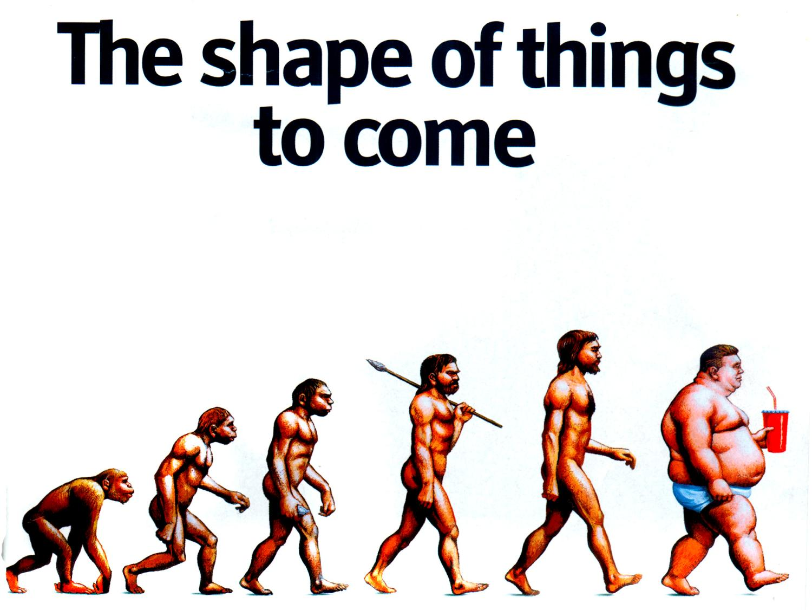

Slide 10
COMPLICATIONS
CVD
Fatty liver/ NAFLD
PCOD
Sleep apnoea
Cholesterol gallstones
Others…….

Slide 12
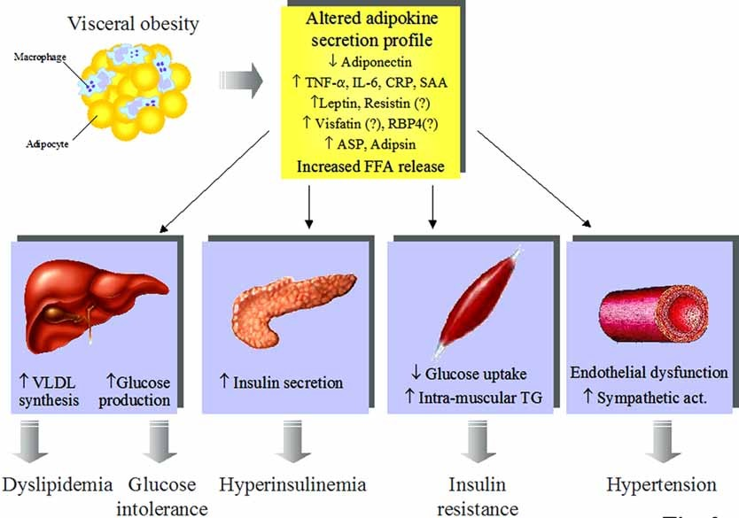

Slide 13
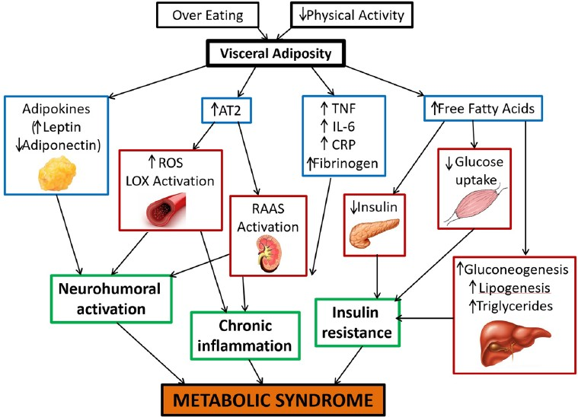

Slide 14
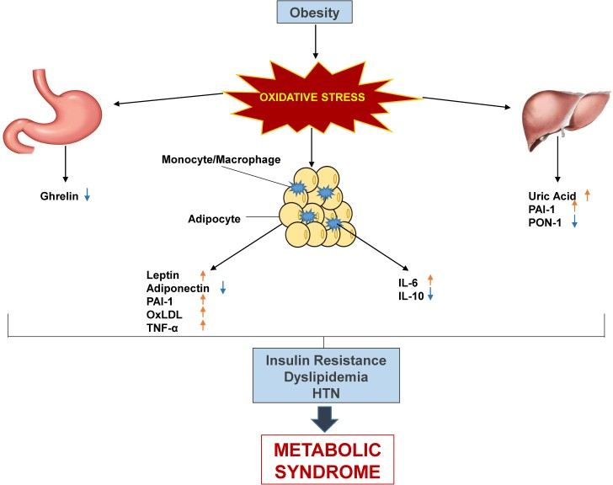

Slide 15
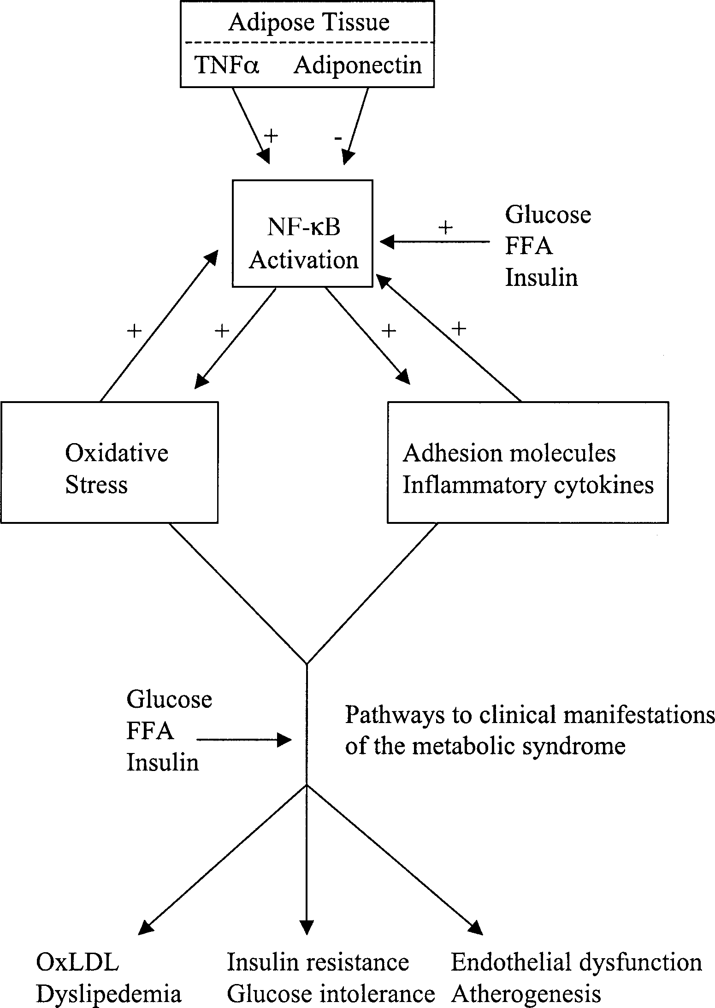

Slide 20
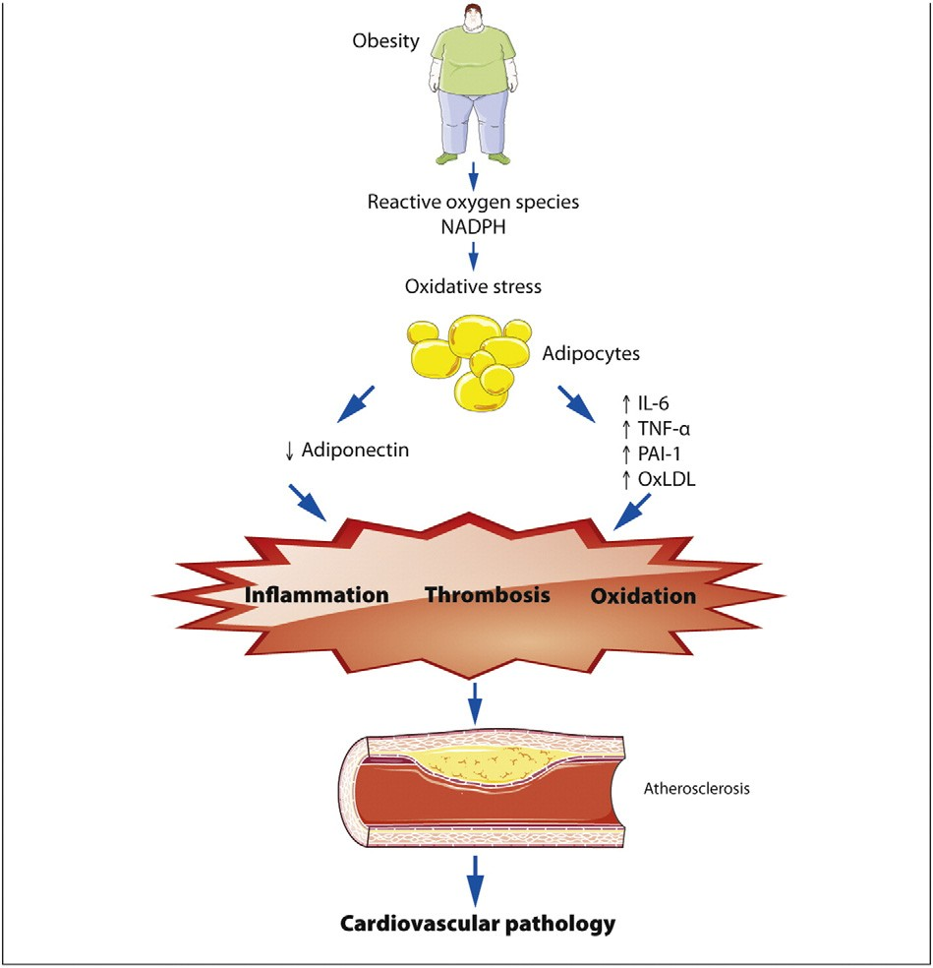

Slide 21
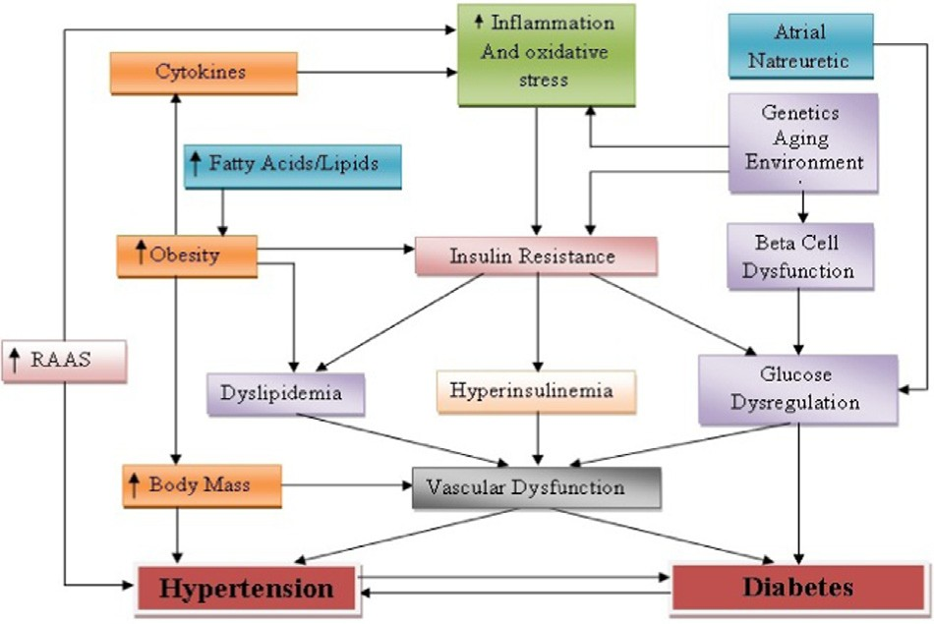

Slide 22
Digonosis Criteria
Clinically MetS syndrome is diagnosed on the following criteria:
Abdominal obesity/waist circumference ( ≥94-102 cm in men or ≥ 80-88 cm in women)
High Blood pressure ( ≥130/85 mm Hg)
Abnormal fasting glucose ( ≥100 mg/dL)’
Elevated Triglycerides ( ≥150 mg/dL)
Low HDL ( Males <40 mg/dL; Females<50 mg/dL)

Slide 23
 | IDF (Obesity + >2) | AHA(>3) | NCEP ATP III (>3) | WHO( Insulin re- sistance/Diabetes + >2) | EGIR(hyperinsulinemia + >2)
Obesity | BMI >30kg/m2 or specific gender and ethnicity waist circumference cutoffs | Waist circumference for males >40in, females>35in | Waist circumference for males >40in, females>35in | Waist/hip ratio>0.9 in males and >0.85 in females or BMI>30kg/m2 | Waist circumference for males >94cm, fe- males>80cm
Elevated Tri- glycerides | TG>150mg/dL or treatment of this lipid abnormality | Fasting TG>150mg/dL or treatment of this lipid ab- normality | TG>150mg/dL or treatment of this lipid abnormality | TG>150mg/dL | TG >177mg/dL
Decreased HDL | HDL <40mg/dL in males and <50mg/dL in females or specific treatment for this lipid abnormality | HDL<40mg/dL in males and <50mg/dL in females or treatment for this lipid ab- normality | HDL<40mg/dL in males and <50mg/dL in females or treatment for this lipid ab- normality | HDL<35mg/dL in males and <39mg/dL in females | HDL< 39 mg/dL
Hypertension | SBP >130 or DBP >85 mm Hg or treatment of previously diagnosed hypertension | BP>130/85mm Hg or taking medication for hypertension | SBP >130 or DBP >85 mm Hg or taking medication for hypertension | >140/90mm Hg | >140/90mm Hg or taking medication for hypertension
Hyperglycemia | Fasting plasma glucose >100mg/dL or previously diagnosed type 2 diabetes | Fasting glucose >100mg/dL or taking medicine for high glucose | Fasting glucose >100mg/dL or taking medicine for high glucose | Insulin resistance required | Insulin resistance re- quired(plasma insulin >75th percentile)
Other |  |  |  | Urine albumin > 20µg/min or Albumin: creatinine ratio > 30mg/g

Slide 24
Markers of Metabolic Syndrome
Based on the risk factors multiple biological markers are suggested for diagnosis of MetS.
Adipose tissue marker: adiponectin and leptin
Insulin resistance: Oral Glucose Tolerance Test (OGTT)
Dyslipidemia: Apolipoprotein B or LDL/HDL)
Inflammation markers: C-reactive protein,
Thrombosis markers: high fibrinogen or plasminogen activator inhibitor-1

Slide 25
Biomarker | Source | Metabolic Syndrome | Interventions shown to “normalize” levels
 |  |  | Lifestyle Modi- fication | Antihypertensive | Diabetic | Lipid Lowering | Other
Leptin | Adipocytes Cardiomyocyte Vascular Smooth Muscle | I | Weight loss [98] | Hydralazine Valsartan Ramipril [98] Candesartan [98] Amlodipine[ Efonidipine pindolol Bunazosin Methyldopa | Metformin [104] |  | Bromocriptine
Adiponectin | Adipocytes | D | Weight loss | Valsartan | Metformin Sitagliptin Pioglitazon Troglitazon Rosiglitazon Glimeperide | Atorvastatin (increases HMW adiponectin) [
Ghrelin | Stomach | D | Weight loss [115] | Valsartan | Rosiglitazone Metformin [ |  | Flutamide Estrogen therapy
PAI-1 | Adipocytes Hepatocytes Smooth muscle cells, Platelets | I | Weight loss [56] | Imidapril Candesartan (cannot sustain decreased PAI >4 weeks) [120] | Metformin Troglitazone | Statins [122] | Sibutramine
Uric Acid | Liver | I | Weight loss | 1. Losartan [124] | 1. Metformin | 1.Atorvastatin [ | 1.Sibutramine

Slide 26
Biomarker | Source | Metabolic Syndrome | Interventions shown to “normalize” levels
 |  |  | Lifestyle Modi- fication | Antihypertensive | Diabetic | Lipid Lowering | Other
 |  |  |  | 2. Calcium Channel Blockers 3. ACEI | 2.Troglitazone [ | Simvastatin Fenofibrate | 2. Orlistat [125]
IL-6 | M1 macrophage | I | Weight loss[127] | 1.ACEI [128] 2.Olmesartan [129] | Metformin [ | Atorvastatin [131] Pravastatin [132] Simvastatin [133] | Hydrocortisone [ Celecoxib [135]
TNFα | Visceral Adipo- cytes, M1 mac- rophages | II | Weight loss [127] | Olmesrtan[ | Metformin [ | Atorvastatin [ Pravastatin [ | Orlistat [ Hydrocortisone
IL-10 | Monocytes, M2 macrophage | D | Weight loss[136] |  | Metformin [130] | Statins [137] | Triamcinolone Montelukast [138] 3.IFNβ [ 4.Beta 1-3 Glucan [140]
OxLDL | Adipocytes | I | Weight loss [141] Vegan Diet [142] | Fosinopril [143] |  | Statins] Ezetimibe [145] | Celecoxib [146]
PON-1 | Liver | D | Weightloss**(dec reases pon1) [141] | Eplerenone [147]) | 1.Rosiglitazone 2.Sulfonueras[ | Fibrates [ Statins ([151]) Probu 4.Ezetimibe

Slide 27
Adipokine promotors | Inhibitory/ atheroprotective
Inflammatory | Anti-inflammatory
IL-1, IL-6, TNF-a, IFN-a, IFN-b, IL-8. IP-10, TGF-b, MCP-1, leptin, resistin | IL_4, IL-10, TGF-b
Hypertensive | Antihypertensive
Renin, angiotensinogen, angiotensin II | Angiotensin II receptor blockers
Insulin resistance | Insulin sensitivity
TNF-a, IL-6, resistin | Adiponectin, leptin, AgRP, MMIF, Acylation-stimulating protein
Procoagulant | Anticoagulant
PAI-I, tissue factor, TNF-a, IL-6, TGF-b | Adiponectin
Angiogenetic | Atheroprotective
Leptin, IL-8, VEGF, FGF-2, MCP-1, IP-10, VCAM, ICAM, monobutyrin | Adiponectin
Lipogenetic (adipogenesis) | Lipolytic
IGF-1, angiotensinogen, angiotensin II, visfatin, acylation-stimulating protein | TNF-a, IL-6,

Slide 28
Risk Factors
Risk Factors for Metabolic Syndrome can be classified on the following basis:
Non-modifiable risk factors include age, sex, race, and family history of CVD, which can identify high-risk populations
Behavioral risk factors include sedentary lifestyle, unhealthful diet, heavy alcohol or cigarette consumption.
Physiological risk factors include hypertension, obesity, lipid problems, and diabetes.

Slide 29
The risk of having metabolic syndrome increases with age, affecting less than 10% of people in their 20’s and 40% of people in their 60’s.
Metabolic syndrome is generally more common among blacks and Mexican-Americans than among Caucasians.
However, warning signs of metabolic syndrome can appear during childhood. For children aged between 6 and <10 years: Abdominal obesity is required as essential criteria.
Silvia Gancheva et al 2015

Slide 30
Prevalence
The prevalence of MetS increases with age, region and population
Epidemiologic studies show that the prevalence of metabolic syndrome is higher in men (31.4% ) than in women (27.0%).
Estimates of metabolic syndrome prevalence are 30% to 50% in overweight children and adolescents.
Metabolic syndrome was associated with a 1.54 times higher relative cardiovascular risk.

Slide 31
Women with metabolic syndrome had a 1.33 times higher relative risk of cardiovascular events and death compared with men.
A meta-analysis showed that patients with metabolic syndrome had a 1.78 times higher relative risk of cardiovascular events and death compared with individuals without metabolic syndrome.
Silvia Gancheva et al 2015

Slide 32
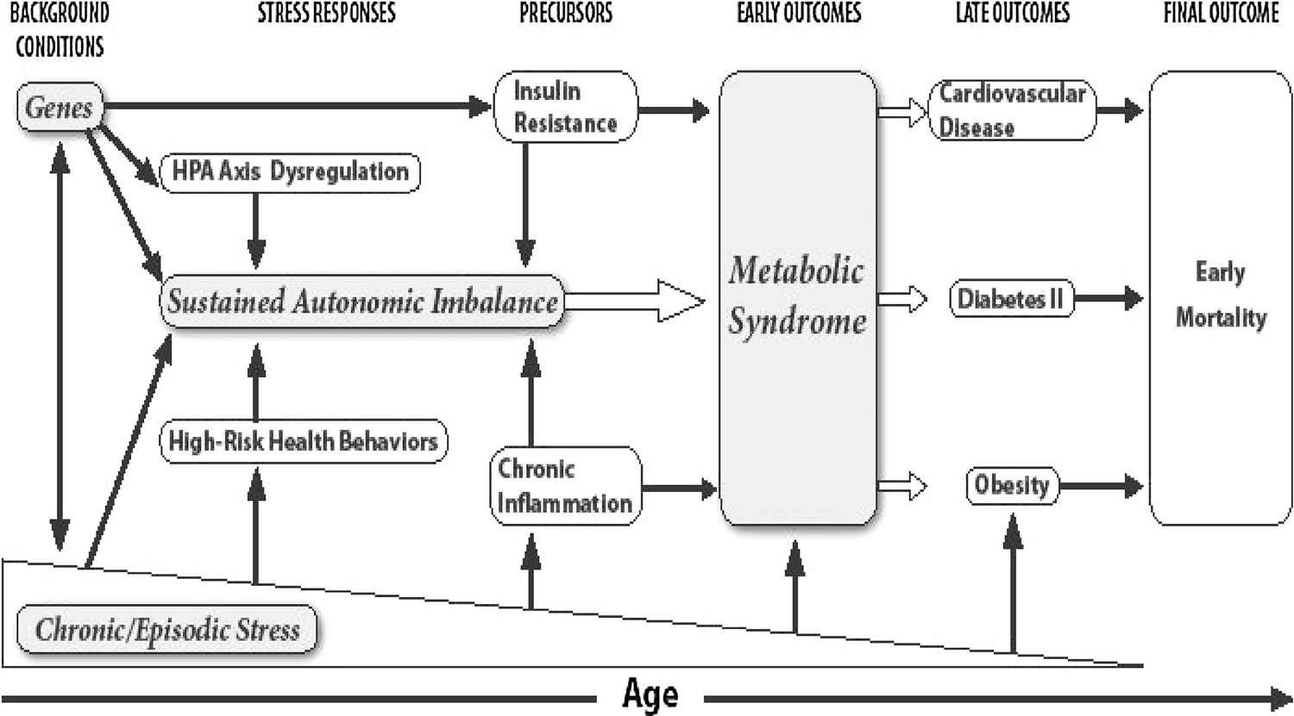

Slide 33
Models for Metabolic syndrome
Diet induced metabolic syndrome:
The modern diet, especially in Western countries, is rich in carbohydrates such as fructose and sucrose as well as saturated fat which induced complications including metabolic syndrome, cardiovascular diseases and nonalcoholic fatty liver disease.
Carbohydrate enriched diet
Fructose induced MetS
Sucrose induced MetS
High Fat Diet Induced MetS
Hypercholesterolemic MetS models
Silvia Moreno-Fernández et al 2018

Slide 34
Researchers (Year) | Types of diet | Treatment length | Strains of animal | Components of metabolic | syndrome
 |  |  |  | Obesity Hyperglycemia | Hypertension | Dyslipidemia
Thirunavukkarasu et al. [41] | High-fructose diet | 3 weeks | Male Wistar rats | - ✓ | ✓ | -
Sanchez-Lozada et al. [42] | High-fructose diet (60 %) | 8 weeks | Male Sprague-Dawley rats | - - | ✓ | ✓
 | Fructose drinking water (10 %) |  |  | - - | ✓ | ✓
Shahraki et al. [105] | High-fructose diet | 8 weeks | Male Wistar rats | ✗ ✓ | - | ✓
Mahmoud and Elshazly [106] | Fructose drinking water (10 %) | 12 weeks | Male Wistar rats | ✓ ✓ | ✓ | ✓
Mansour et al. [107] | High-fructose diet | 16 weeks | Male Wistar albino rats | ✓ ✓ | - | ✓
Mamikutty et al. [108] | Fructose drinking water | 8 weeks | Male Wistar rats | ✓ ✓ | ✓ | ✓
Di Luccia et al. [109] | High-fructose diet | 8 weeks | Male Sprague-Dawley rats | ✓ ✓ | - | ✓
Jurgens et al. [35] | Fructose drinking water (15 %) | 10 weeks | Male NMRI mice | - | - | -
 | Sucrose soft drink (10 %) |  |  | ✗ - | - | -
 | Non-caloric soft drink |  |  | ✗ - | - | -
Oron-Herman et al. [51] | High-sucrose diet | 7 weeks | Male spontaneously hypertensive rats | ✗ ✓ | ✓ | ✗
 | High-fructose diet |  | Male Sprague-Dawley rats | ✗ ✓ | ✓ | ✓
Aguilera et al. [45] | Sucrose drinking water (30 %) | 21 weeks | Male Wistar rats | - | ✓ | ✓
Vasanji et al. [49] | Sucrose drinking water (32 %) | 10 weeks | Male Sprague-Dawley rats | - ✓ | - | ✓
Pang et al. [50] | High-sucrose diet | 6 weeks | Male Sprague-Dawley rats | - ✗ | ✓ | ✓

Slide 35
Researchers (Year) | Types of diet | Treatment length | Strains of animal | Components of metabolic syndrome
 |  |  |  | Obesity Hyperglycemia Hypertension | Dyslipidemia
Dobrian et al. [110] | High-fat diet | 10 weeks | Male Sprague-Dawley rats | ✓ - ✓ | ✓
Ghibaudi et al. [59] | High-fat diet | 24 weeks | Male Sprague-Dawley weanling rats | ✓ ✓ - | ✓
Rossmeisl et al. [111] | High-fat diet | 8 weeks | Male C57BL/6 J mice | ✓ ✓ - | ✓
 |  |  | Male AKR/J (AKR) mice | ✓ ✓ - | ✓
Gallou-Kabani et al. [112] | High-fat diet (60 %) | 20 weeks | Male & female C57Bl/6 J mice | ✓ ✓ - | ✓
 |  |  | Male & female A/J mice | ✗ - | ✓
Fraulob et al. [60] | High-fat diet | 16 weeks | Male C57BL/6 mice | ✓ ✓ - | ✓
Graham et al. [61] | High-fat diet | 40 weeks | Male C57BL/6 mice | - - - | ✓

Slide 36
Halade et al. [56] | High-fat diet | 24 weeks | Female C57Bl/6 J mice | - - | -
Davidson et al. [113] | High-fat diet | 24 weeks | Male Sprague-Dawley rats | ✓ ✓ - | ✓
Pirih et al. [114] | High-fat diet | 13 weeks | C57BL/6 mice (wild type) | - ✗ - | ✓
 |  |  | Hyperlipidemic (Ldlr−/−) mice | - ✓ - | ✓
Podrini et al. [115] | High-fat diet | 12 weeks | Female C57BL/6NTac mice | ✓ ✓ - | ✓
Xu et al. [57] | High-fat diet | 12 weeks | Male C57BL/6 mice | - - | -
Fujita and Maki [24] | High-fat diet | 4 weeks | Male C57BL/6 J mice | - - | ✓
Gancheva et al. [116] | High-fat diet | 8 weeks | Male Wistar rats | ✓ ✓ - | ✓
Li et al. [62] | High-fat diet | 16 weeks | Male C57BL/6 mice | ✓ ✓ - | ✓
Suman et al. [23] | High-fat diet | 10 weeks | Male Wistar rats | ✓ ✓ ✓ | ✓

Slide 37
Researchers (Year) | Types of diet | Treatment | Strains of animal | Components of metabolic | syndrome
 |  | length |  | Obesity Hyperglycemia | Hypertension | Dyslipidemia
Poudyal et al. [29] | High-carbohydrate high-fat diet | 16 weeks | Male Wistar rats | ✓ ✓ | ✓ | ✓
Panchal et al. [30] | High-carbohydrate high-fat diet | 16 weeks | Male Wistar rats | ✓ ✓ | ✓ | ✓
Hao et al. [31] | High-carbohydrate high-fat diet | 14 weeks | Male Wistar rats | ✓ ✓ | ✓ | ✓
Senaphan et al. [22] | High-carbohydrate high-fat diet | 16 weeks | Male Sprague- Dawley rats | ✗ ✓ | ✓ | ✓
Dissard et al. [117] | High-fat high-fructose diet | 32 weeks | Male C57BL/6 mice | ✓ ✓ | ✗ | ✓
Barrios-Ramos et al. [118] | Hypercholesterolemic diet & fructose drinking water | 4 weeks | Male Wistar rats | ✓ ✓ | ✓ | ✓
Gancheva et al. [116] | High-fat high-fructose diet | 8 weeks | Male Wistar rats | ✓ ✓ | - | ✓
Yang et al. [119] | High-fat high sucrose diet | 4 weeks | Male C57BL/6 J mice | ✓ ✓ | - | ✓
Zhou et al. [120] | High-sucrose high-fat diet | 48 weeks | Male Sprague- Dawley rats | ✓ ✓ | - | ✓
t

Slide 38
PROS
Suitable for the investigations of non-genetic lifestyle-dependent MetS in humans
Inexpensive (dependent on the kind of diet)
CONS : Delayed onset of MetS
A lengthy duration of diet regimen (usually takes up to 16 weeks
Sok Kuan Wong et al 2017

Slide 39
Genetic Models
Genetic animal models are imperative in order to investigate the pathogenesis of MetS caused by genetic factors.
Zucker rats (ZDF): Obese Zucker rats are widely investigated and are among the best models for the study MetS. ZDF possess a (fa/fa) mutation and leptin receptor deficiency.
SHR (Spontaneously Hypertensive Rats): SHR are predominantly used for studies of arterial hypertension and the related medication treatment.
Wistar Ottawa Karlsburg W rats: This was one of the first genetic models used for the study of diabetes.

Slide 40
LCR (Low capacity runners): LCR represent a genetic model of rats with low aerobic capacity.
Sterol regulatory element binding protein spontaneously hypertensive rats: This model could therefore provide valuable opportunities for investigating pathogenetic mechanisms that may relate fatty liver disease to the metabolic syndrome.
Stroke prone – SHR fatty (fa/fa) rats: SHRSP rats develop hypertension related disorders, such as nephropathy, cardiac hypertrophy and atherosclerosis.
Spontaneoulsy hypertensive/NDmc-corpulent rats: The SHR-cp exhibit, in fact, metabolic and histopathologic characteristics associated with metabolic disorders
Leptin receptor deficit rats.
Oa/ob mice
Sok Kuan Wong et al 2017

Slide 41
pros
Examples: ZF rat, ZDF rat, DS/obese rat, Koletsky rat, POUND mouse
Severe and spontaneous occurring MetS
CONS
Do not resemble the criteria of MetS in humans with intact leptin receptor gene
Mutation in leptin or leptin receptor gene rarely occur in humans
Costly
Mutations/deficiencies in animals are not easily manipulated

Slide 42
Chemical induced MetS
MetS model induced by using chemical such as glucocorticoid, antipsychotic, alloxan andstreptozotocin.
Glucocorticoid induced MetS:
Both endogenous and exogenous glucocorticoids have been used to develop MetS in animal models.
Glucocorticoids stimulate the differentiation of pre-adipocytes into mature adipocytes.
Glucocorticoids increase lipolysis to release free fatty acids and increase proteolysis in muscle to increase
free amino acids.
Glucocorticoids promote gluconeogenesis in liver and cause hyperglycemia.
Sunil K. Panchal and Lindsay Brown 2011

Slide 43
Antipsychotic induced MetS
Antipsychotic drugs have been associated with a high incidence of MetS, evidenced by body weight gain, increased visceral fat, impaired glucose tolerance, and insulin resistance in animal studies.
The weight gain caused by antipsychotic treatment contributes to the development of diabetes and dyslipidemia.

Slide 44
Alloxan and streptozotocin induced MetS
Alloxan and streptozotocin are structural analogues of glucose that enter pancreatic beta cells via the GLUT2 transporter.
In contrast to patients with metabolic syndrome, alloxan and streptozotocin induced diabetic rats are hypoinsulinaemic, do not gain weightand are usually hypotensive.

Slide 45
PROS
Suitable for the investigations of drug-related MetS in human
Inexpensive
C0NS
Delayed onset of MetS
Sujay kumar Raut et al 2018

Slide 46
Treatment of Metabolic Syndrome
Treatment of Obesity:
Treatment of obesity includes two major approaches:
Lifestyle-based intervention: (Diet, Exercise and Behavior therapy).
Medical/surgical intervention: (Pharmacotherapy and Bariatric surgery).
Christina L et al 2017

Slide 47
Dietary modification should be age-specific, providing appropriate optimum nutrient intake for the maintenance of normal growth and development.
Regular physical activity is important for the prevention of excessive weight gain. The current recommendation is for 30–60 minutes of regular physical activity daily.
Behavior modification programs have been shown to have both short- and long-term beneficial effects in some patients, and involve intensive parental involvement.

Slide 48
Pharmacological therapy
Orlistat is a gastric and pancreatic lipase inhibitor that decreases free fatty acid and cholesterol absorption.
It can reduce fat absorption by ~ 30% in individuals eating a 30% fat diet.
Octreotide treatment caused weight loss, reduced insulin resistance, and reduced acanthosis nigricans.
Sibutramine is a serotonin and adrenaline reuptake inhibitor that decreases appetite and reduces food intake.
Metformin is a biguanide frequently used to treat type 2 diabetes in adolescents.

Slide 49
Promising new drugs
Noradrenergic drugs, such as phentermine, chlorphentermine, phenylpropanolamine, and amphepramone (diethylpropion), decrease appetite and food intake.
Topiramate is a novel broad spectrum anticonvulsant drug used in children and adults. Topiramate causes weight loss in normal weight and obese patients.
Rimonabant is the first in the class of selective endocannabinoid type 1 receptor blockers. Blocking these eceptors is thought to decrease feeding behavior.

Slide 50
Bariatric surgery
Gastroplasty is a procedure that decreases the storage capacity of the stomach and consumption of solid food.
Bariatric procedures for weight loss can be divided into malabsorptive and restrictive procedures.
Although they are effective in inducing weight loss, because of the increased risk of metabolic complications.
There are several reports on bariatric surgery in adolescents supporting sustained weight loss and improvement or resolution in obesity related morbidity.

Slide 51
Treatment of Dyslipidemia
Pharmacological therapy:
Bile acid sequestrants (resins, such as cholestyramine and cholestipol) used to be the preferred drug in pediatric patients with familial hypercholesterolemia.
The preferred drugs for the treatment of hypercholesterolemia in adults are the 3-hydroxy-3-methylglutaryl coenzyme A reductase inhibitors (statins).
Statin therapy results in an up to 30–40% reduction in LDL, a more modest reduction in triglycerides, nd an elevation in HDL levels.
Christina L et al 2017

Slide 52
Alternative drugs such as ezetimibe that primarily
lower LDL levels by reducing cholesterol absorption in the intestine, such are now available.
Fibrates (gemfibrozil, fenofibrate) are primarily used to treat hightriglyceride levels, usually with accompanying low HDL levels.
Cholesterol absorption inhibitors, or plant sterols and stanols coadministered with a statin, offer new options in the treatment of adult patients with familial hypercholes- terolemia.

Slide 53
Promising new drugs:
Alternative treatment for high triglyceride concentration is fish oil or omega-3 fatty acids.
The PPARα/ dual agonist drug has efficacious glucose- and lipid-low-ering activities. Thus, this drug is ideal for treatment of type 2 diabetes an dyslipidemia.
Colesevelam is the newest bile resin with fewer side effects and drug interactions. It has been found to be safe alone or in combination with statin therapy in lowering LDL levels.
Scott M. Grundy 2009

Slide 54
Treatment of Hypertension
Pharmacological therapy:
A number of novel drug include endothelin receptor antagonists, renin inhibitors, and vasopeptidase inhibitors are under active investigation in adults for the treatment of hypertension.
The use of ACE inhibitors or angiotensin receptor blockers in children with diabetes and proteinuric renal diseases and the use of ?-adrenergic blockers or calcium channel blockers in hypertensive children with migraine headaches.
Lawson Wulsin et al 2015

Slide 55
Promising new drugs
Endothelin is a small peptide hormone important in the control of blood flow and cell growth.
Darusentan is a selective endothelin receptor A antagonist under development for treating cardiovascular disorders.
Aliskiren is a renin inhibitor that prevents the formation of both angiotensin I and II.
Omapatrilat is a vasopeptidase inhibitor that is furthest along in clinical development for reduction in blood
pressure.

Slide 56
Treatment of Type 1 diabetes
Taurine (2-aminoethanesulfonic acid) is a sulfur-containing amino acid that taurine intake may be beneficial in the prevention of metabolic syndrome including diabetes, obesity, dyslipidemia, and hypertension.
Type 1 diabetes is usually induced by administering either streptozotocin or alloxan, both of which destroy pancreatic b cells.
Treatment with taurine has been shown to improve hyperglycemia in streptozotocin-treated rats.
Taurine also improve alloxan- induced declines in the number and the size of pancreatic islets

Slide 57
Treatment of Type 2 Diabetes
Four classes of pharmacological agents: insulin, insulin-sensitizing agents, insulin-stimulating agents, and glucose absorption inhibitors are available for the treatment of type 2 diabetes.
Repaglinide and nateglinide are non sulfonylurea agents that cause a prompt short-lived burst of insulin secretion.
The amylin analogs, glucagon like peptide 1 (GLP-1) agonists, dipeptidyl peptidase IV inhibitors, and glitazars are promising new agents that control glucose levels.
CLIFFORD J BAILEY et al 2015

Slide 58
NOVEL TARGETS AND FUTURE PROSPECTS
1. PPAR beta/delta is emerging as a potential target for the pharmacotherapy of metabolic syndrome. Activation of this nuclear receptor seems improve both insulin sensitivity and plasma lipid profile without causing weight gain (Coll et al., 2009).

Slide 59
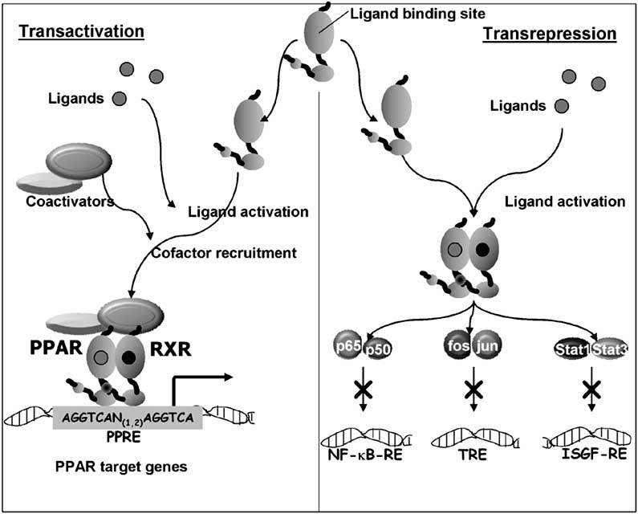

Slide 60
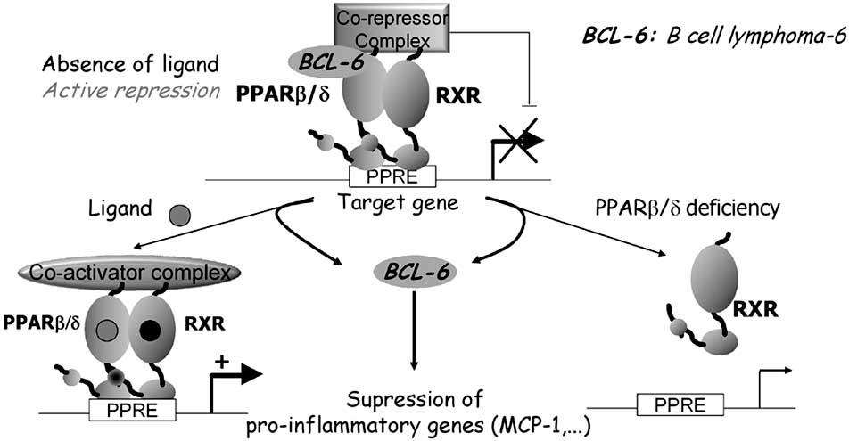

Slide 61
Figure 4. Actions of peroxisome proliferator-activated receptor (PPAR) ligands
PPAR ligand
Retinoic acid
PPARα
FA oxidation inflammation TG, HDL
PPARγ
Adipogenesis Lipogenesis
inflammation insulin sensitivity
Glucose-lowering
PGC-1α
AGGTCAXAGGTCA
PPARδ
FA oxidation energy uncoupling
PPRE
Key: PGC-1α = PPAR coactivator PGC-1α; FA = fatty acid; TG = triglyceride; HDL = high-density lipoprotein; PPRE = PPAR response element;
= increase; = decrease.

Slide 62
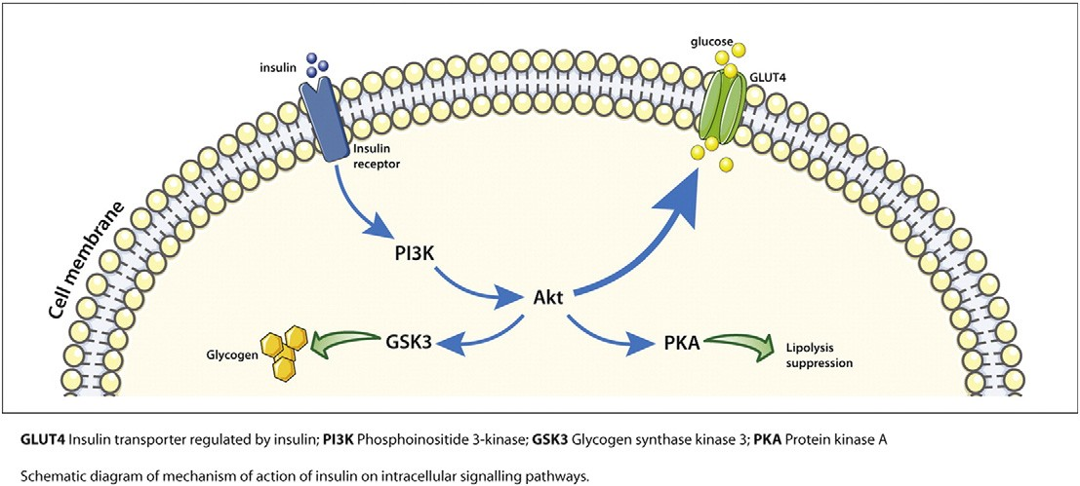
Insulin receptor intracellular pathways

Slide 63
GHRELIN
Ghrelin is a neuroendocrine hormone secreted primarily by the stomach that stimulates appetite directly via activation of the GH secretagogue receptor 1a (GHSR-1a) in the hypothalamus, and indirectly by increasing expression of orexigenic peptides, such as neuropeptide Y (NPY).
It may also be protective of vasculature by antagonizing the effects of vasoconstrictors, such as endothelin 1, and promoting the effects of vasodilators, such as nitric oxide (NO).
Furthermore, it can help to promote lipolysis via stimulation of hypothalamic AMP-activated protein kinase (AMPK). Research into the vasoprotective and lipolytic properties of ghrelin is emerging and presents two pathways by which ghrelin can exert a protective effect against metabolic syndrome.
Metabolic syndrome is associated with lower levels of ghrelin, and progressively lower ghrelin levels are associated with increasing metabolic syndrome severity. Ghrelin levels decrease with increasing number of metabolic syndrome derangements.
Kathleen Martin1 et al 2015

Slide 64
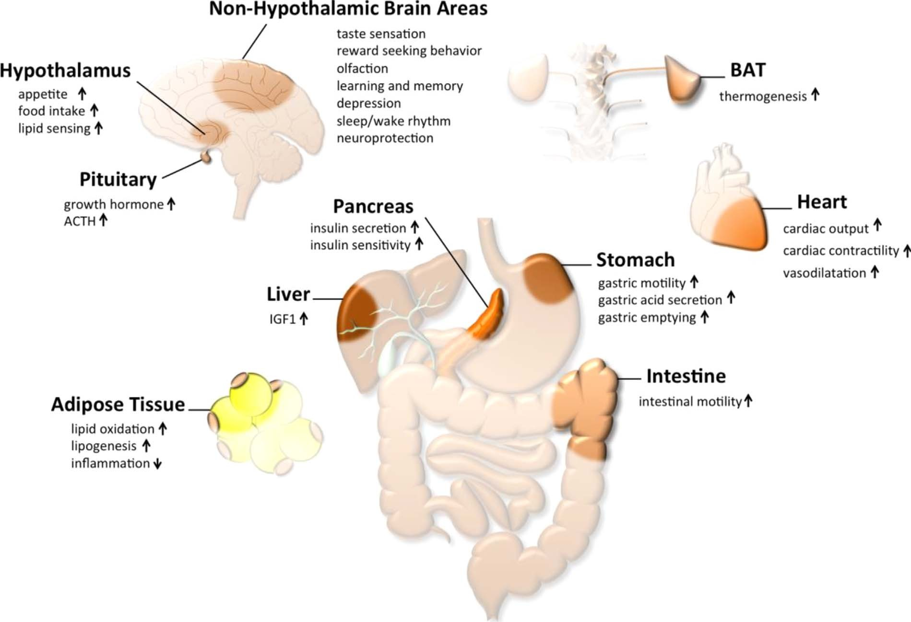

Slide 65
LEPTIN
Leptin is an adipokine, which under normal physiological conditions functions to reduce appetite, increase energy expenditure, increase sympathetic activity, facilitate glucose utilization, and improve insulin sensitivity.
It is expressed in levels proportionate to adipose mass, and though it is produced mostly by adipocytes, it is also produced by vascular smooth muscle cells, cardiomyocytes, and placenta in pregnant women. The functional leptin receptor is in the hypothalamus where it functions to increase energy expenditure and reduce appetite.
Kathleen Martin et al 2015

Slide 66
ADIPONECTIN
Adiponectin, like leptin, is an adipose derived plasma protein with widespread effects.
The most favorable metabolic effects on insulin sensitization and protection against diabetes.
Adiponectin has many functions, including anti-atherogenesis, insulin sensitization, lipid oxidation enhancement, and vasodilatation.
The expression of adhesion molecules in vascular endothelial cells, adhesion of monocytes to endothelial cells (via TNF-α inhibition), vascular smooth muscle cell proliferation and migration, and foam cell formation (via oxidized LDL (OxLDL) inhibition).
It has insulin-sensitizing activities, with high levels exerting a protective effect against type 2 diabetes in diabetes-prone individuals.
Magali Gary-Bobo 2018

Slide 67
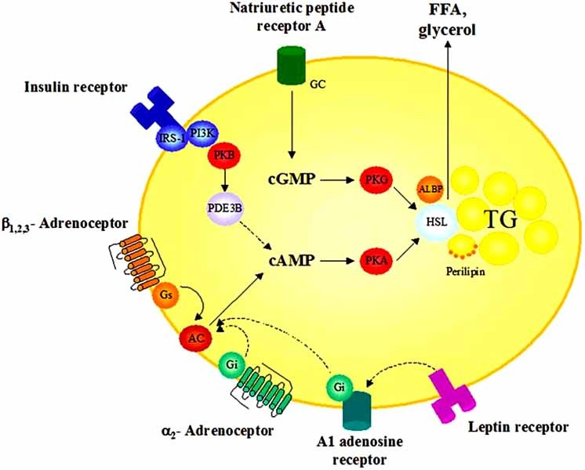

Slide 68
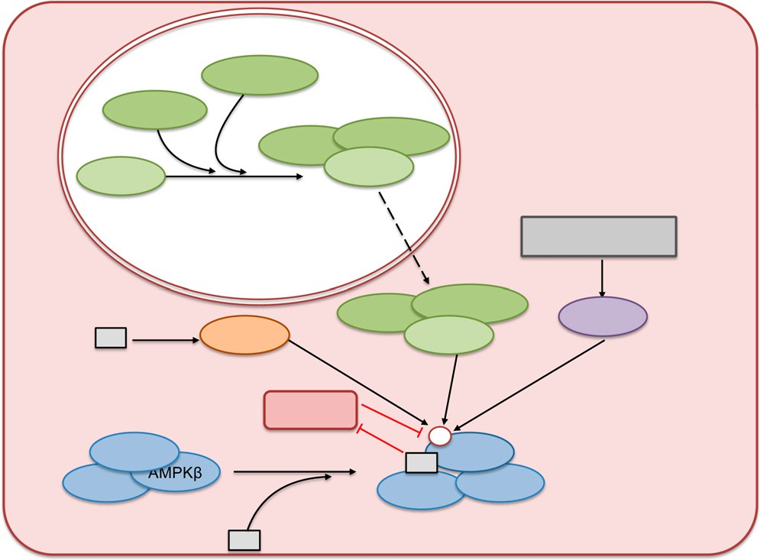

Slide 69
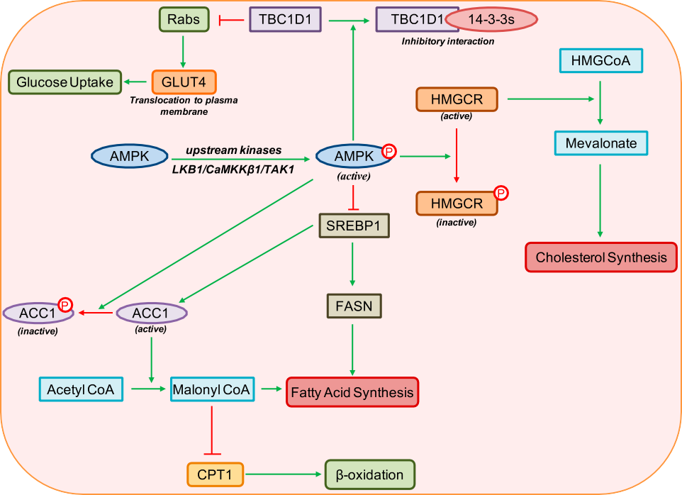

Slide 70
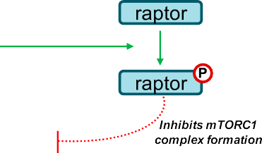
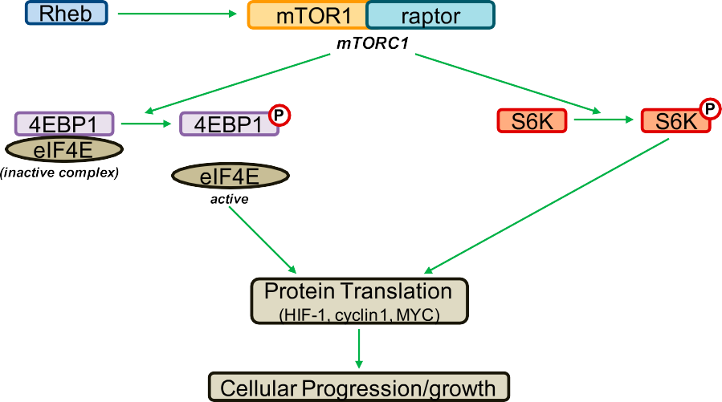

Slide 71
Sympathetic Nervous System

Slide 72
Overeating |  | Chronic thermogenesis |  | IR/hyperinsulinemia |  | SNS overactivity
IR |  | Hyperinsulinemia |  | ↑ NPY activity |  | SNS overactivity
Visceral adiposity |  | ↑ Leptin |  | Leptin resistance |  | SNS overactivity
Chronic stress |  | ↑ Glucocorticoids |  | ↑ HPA axis |  | SNS overactivity
Arterial stiffness |  | ↓ Arterial baroreflex |  | ↑ Arterial pressure |  | SNS overactivity
.

Slide 73
CB₁-R antagonism improves metabolic syndrome features
Adiponectin involvement in the anti-obesity effects of rimonabant
CB₁-R antagonism inhibits preadipocyte proliferation

Slide 74
Plasminogen Activator Inhibitor – 1
Plasminogen Activator Inhibitor-1 (PAI-1) is the primary of four serine peptidase inhibitors that functions to modulate extracellular matrix remodeling and fibrinolysis. It binds to and deactivates tissue plasminogens (tissue type plasminogen activator (tPA), urokinase plasminogen activator (uPA)).
tPA is thought to be responsible for intravascular plasminogen activation, with fibrin regulating its activity, and uPA is responsible for plasminogen activation on migrating cells, with the uPA receptor regulating its activity on different cells. Thus, PAI-1 can inhibit intravascular fibrinolysis and cell-associated proteolysis

Slide 75
Anti-obesity drugs in pipeline
Tesofensine (NS2330) is a serotonin–noradrenaline–dopamine reuptake inhibitor from the phenyltropane family of drugs, which is currently under development for therapy of obesity. Tesofensine has completed Phase 1 and 2 trials. It primarily acts as an appetite suppressant, but possibly acts also by increasing resting energy expenditure. The published phase 2 trial showed promising levels of weight loss, greater than those achieved by any other available drugs (Astrup et al., 2008).
Glucagon-like peptide 1 receptor (GLP-1R) agonists are drugs that are licensed for the treatment of type 2 diabetes. Glucagon-like pepetide-1 (GLP-1) is a gut hormone that is secreted by the endocrine L-cells after food intake. It suppresses glucagon production, stimulates pancreatic insulin secretion, prolongs gastric emptying and has been shown to promote satiety (Turton et al., 1996

Slide 76
Receptor-interacting protein-140 (RIP140, aka NCOR2) is a nuclear hormone co-repressor, which regulates fat accumulation. It interacts with nuclear receptors such estrogen, thyroid hormone and retinoic acid receptors through 2 C-terminal receptor-interacting domains (RIDs). It serves as a scaffold protein.

Slide 77
Mice with global RIP140 knockout are lean and resistant to high-fat diet-induced obesity and fatty liver disease. Silencing RIP 140 in animal models results in a long lasting weight-loss, resistance to diet-induced obesity, and enhanced metabolic rate (Puri et al., 2007; Puri et al., 2008).
RNAi against RIP140 is being developed by the CytRx R&D Company for the treatment of obesity and type 2 diabetes.

Slide 78
Other Novel Targets to treat OBESITY
SMRT is another nuclear hormone receptor co-repressor. Disruption of the molecular interaction between SMRT and nuclear hormone receptors leads to increased adiposity and a decreased metabolic rate in genetically engineered mice (Nofsinger et al., 2008). These studies suggest that targeting the molecular interaction between nuclear hormone receptors and their regulatory cofactors may result in development of novel therapeutics that can control obesity.
Several MC4R agonists have been studied in animal models and humans. A piperazine-based highly specific partial MC4R agonist has been shown to have good oral bioavailability in rat (Hong et al., 2011). It reduces food intake by almost 40%. The MC3/4R agonist Melanotan II (MTII) has been similarly shown to cause reduced food intake and weight reduction in rodents, but it is less specific for MC4R, has been mainly administered intracerebroventricularly, and its oral bioavailability is unknown (Getting, 2006).

Slide 79
PPARbeta/delta is emerging as a potential target for the pharmacotherapy of metabolic syndrome. Activation of this nuclear receptor seems improve both insulin sensitivity and plasma lipid profile without causing weight gain (Coll et al., 2009). The limitations in use of TZD drugs include the risk for salt retention and heart failure, and osteoporosis, particularly in elderly women.
Another inhibitor of adipogenesis in preclinical trials is CDDO-Imidazolide (CDDO-Im). CDDO-Im activates the nuclear factor (erythroid-derived 2)-like 2 (Nrf2) pathway and results in increased mitochondrial biogenesis, reduced adipogenesis and increased energy metabolism. This drug has been shown to reduce total body weight, and body fat and diminishes hepatic lipid accumulation in rodents (Chartoumpekis and Kensler, 2013).
Novel targets for treatment of obesity

Slide 80
Peptidergic signaling pathways
Recent advances in understanding of the peptidergic signaling of hunger and satiety from the gastrointestinal tract mediated by GLP-1, cholecystokinin (CCK), peptide YY (PYY) and ghrelin, and the homeostatic mechanisms of leptin and its upstream pathways in the hypothalamus, have opened new horizons for drug development against obesity.
Eur J Pharmacol. 2015 .Kathleen Martin1, Mitra Mani2, and Arya Mani.

Slide 81
Several GHS-R ligands are in development, and an anti-obesity vaccine which prevents ghrelin from reaching the central nervous system has been developed (Schellekens et al., 2010).
Other pharmacologic approaches include antibodies against ghrelin, ghrelin enantiomers which can neutralize ghrelin (Becskei et al., 2008), and decrease acyl ghrelin through inhibition of GOAT (Gualillo et al., 2008).
Despite great enthusiasm for development of novel drugs to target ghrelin, most, if not all anti-ghrelin anti-obesity drugs have failed owing to pharmacodynamics problems, but most importantly, lack of sustained effect on weight loss.

Slide 82
Peptide YY
The gut hormone peptide YY (PYY) is a 36-amino acid peptide that is synthesized in endocrine L-cells in the distal gastrointestinal tract and is released into the circulation in response to food intake. The peptide has a number of tyrosine residues at the C- and N- terminus and hence, it was named PYY (Tatemoto and Mutt, 1980). Together with neuropeptide Y (NPY) and pancreatic polypeptide (PP), it belongs to a family of peptides, that share a common characteristic U-shape tertiary structure known as the PP-fold (Berglund et al., 2003).
These peptides mediate their effects through five subtypes of a 7 transmembrane GPCR known as Y receptor (Y1, Y2, Y4, Y5 and Y6). YY3–36 has the highest affinity for the Y2-receptor subtype, followed by Y1 and Y5 subtypes (Cabrele and Beck-Sickinger, 2000).

Slide 83
Effects of peripheral PYY administration on feeding
PYY levels are low in the fasting state, but peak after a meal and remain elevated for several hours (Adrian et al., 1985). Peripheral infusion of YY3–36 has dose-dependent anorectic effects in rodents (Batterham et al., 2003; Karra and Batterham, 2010) (Batterham et al., 2002). Peripheral infusion of PYY1–36 has weaker anorectic effects that likely result from its conversion to PYY3–36 by DP-IV (Chelikani et al., 2004; Unniappan et al., 2006). Mice with global PYY knockout are hyperphagic, exhibit weight gain and have increased subcutaneous and visceral fat that are rescued by exogenous replacement of PYY3–36 (Batterham et al., 2006).
J-104870 is a selective inhibitor of PYY. It has high affinity for the Y1 receptor and inhibits NPY-dependent calcium influx (Kanatani et al., 1999). Intracerebroventricular and intraperitoneal administration of J-104870 reduces food intake in rats (Kanatani et al., 1999).
shown that high dose systemic PYY antagonists reduce body weight, while low doses reduce adipocyte hypertrophy without effects on plasma lipids, glucose, insulin, and total body weight (Ishihara et al., 2002).

Slide 84
NPY receptors as potential targets for anti-obesity drug development
In contrast to PYY, the related 36 amino acid neuropeptide Y (NPY) is mainly expressed in the brain, and mainly activates Y1 receptors, which results in inhibition of adenylate cyclase and cyclic AMP generation, exerting orexigenic effects (Herzog et al., 1992; Motulsky and Michel, 1988; Zhu et al., 1992).
Consistent with its peripheral effects, it promotes rat 3T3-L1 pre-adipocyte proliferation in vitro (Yang et al., 2008). Pharmacological inhibition of the Y1 receptor by central administration of the Y1 antagonists, however, results in significant attenuation of feeding in rodents, suggesting both central and peripheral effects (Kask et al., 1998).

Slide 85
Wnt and low-density lipoprotein receptor-related protein 6 (LRP6)
Wnt signaling is an ancient pathway involved in embryonic development. It is also a nutrient sensing pathway, which can be activated by sensing glucose and via insulin signaling (Anagnostou and Shepherd, 2008).
Altered function of Wnt/LRP6 signaling has been associated with diabetes and metabolic syndrome (Go et al., 2014; Saxena et al., 2006; Singh et al., 2013a; Singh et al., 2013b).
There are 19 different ligands, which can activate canonical as well as non-canonical pathways to regulate transcription, calcium signaling, and cell polarity.

Slide 86
Dyrk1 family of proteins-novel targets for drug development
The dual specificity tyrosine-regulated kinases (Dyrk) family of proteins belongs to the larger group of kinases that also includes CDKs, GSK3, and MAPKs (Lee et al., 2000; Tejedor et al., 1995; Yang et al., 2001). Members of the Dyrk family of protein kinases, many of which have been implicated in nutrient sensing, have significant homology in the kinase domain and an upstream sequence called the Dyrk homology domain (Aranda et al., 2011).
The Dyrk1B ortholgue in yeast, YAK1, is a nutrient sensing protein that is inhibited by glucose. It enhances gluconeogenesis and diminishes glycolysis by inhibiting the yeast transcription factor MSN2 (Livas et al., 2011; Thevelein and de Winde, 1999).
Eur J Pharmacol. 2015 .Kathleen Martin1, Mitra Mani2, and Arya Mani.

Slide 87
Dyrk1B, a novel gene for truncal obesity, metabolic syndrome
We recently identified Dyrk1B as the disease gene in outlier families with early onset CAD and central obesity in Southwest Iran (Keramati et al., 2014).
Increased adipogenic transformation of preadipocytes even in the absence of an adipogenic cocktail. The mutant also potentiates the effect of the wildtype Dyrk1B protein on transcription of the rate limiting gluconeogenic enzyme glucose-6-phosphatase (G6pase) in heterozygotes and hence, acts as a gain of function mutation.
Dyrk1B protein is a dual specificity kinase, with its tyrosine phosphorylation activity primarily involved in autophosphorylation, and an arginine-directed serine/threonine kinase activity. Its kinase activities are promoted by signaling from Rho-Rac1 (Deng et al., 2003).
Its expression is inhibited by RAS-MEK-ERK (Deng et al., 2003). Interestingly, loss of function mutations in this pathway were recently linked to obesity and insulin resistance in humans and mice (Costanzo-Garvey et al., 2009; Laura R. Pearce, 2013; Revelli et al., 2011).
Targets for its serine/threonine phosphorylation include HNF1-alpha, glycogen synthase (Skurat and Dietrich, 2004), FOXO1 and SIRT1/2 (Guo et al., 2010; Lim et al., 2002), which are all proteins involved in glucose metabolism and transcription of insulin, GLUT2, glucokinase (Al-Quobaili and Montenarh, 2008; Khoo et al., 2003), and Glucose 6- phosphatase (von Groote-Bidlingmaier et al., 2003). Dyrk1B is a pancellular protein (Leder et al., 1999).

Slide 88
Interplay between leptin, NPY1 and Dyrk family of proteins
Mnb and Dyrk1A and B are highly expressed in arcuate nucleus, olfactory bulb and hippocampus. Both Dyrk1A and B have CREB binding motifs in their promoters. Thus, the stimulatory effects of NPY can similarly affect Dyrk1B expression and FOXO1 activation. These findings suggest a potential role of Dyrk1B in regulation of appetite. Whether Dyrk1B mutation and/or overexpression enhances food intake and weight gain is being currently investigated.
In summary, genetic studies of obesity and adipogenesis in human and rodents over last decade have led to identification of novel genes and pathways that are potentially strong targets for development of novel therapeutics against morbid obesity. The focus of future studies should be focused on targeting genes that constrain ectopic fat generation and prevent its complications.

Slide 90
PHYTOCONSTITUUENNTS
NARIINGIN
CAPSICISN
ALLICIN
BARBERRINE
ANTHHROCYANIN

Slide 91
Turmeric | Curcumin | Anti-inflammatory, antioxidant
(Curcuma longa) |  | ­ Insulin sensitivity
 |  | ¯ Obesity
 |  | ¯ Leptin and ­ adiponectin
Garlic | Allicin | Anti-inflammatory
(Allium sativum) |  | Antioxidant
 |  | ­ Insulin sensitivity
 |  | ¯ Total cholesterol and triglycerides
 |  | ­ Adiponectin levels
Cinnamon | Polyphenols | Antithrombotic
(Cinnamomum verum) |  | Anti-inflammatory
 |  | ­ Insulin sensitivity
 |  | Improves fasting blood glucose, blood
 |  | pressure, and body composition
Rhizoma coptidis | Berberine | ­ Insulin sensitivity
 |  | ¯ Body weight
 |  | ¯ Triglycerides
 |  | ¯ Systolic blood pressure
Neem | Neem oil | ­ Insulin secretion
(Azadirachta indica) |  | ¯ Postprandial hyperglycemia
Bergamot orange | Bergamot essential oil | Anti-inflammatory and antioxidant effects
(Citrus bergamia) |  | ¯ Lectin-like oxidized low-density lipoprotein
 |  | receptor-1 expression
 |  | ¯ Reactive oxygen species formation
Cumin (Cuminum cyaminum) | Cuminaldehyde | ¯ Lipid levels
 |  | ¯ Blood glucose levels
Fenugreek | Saponins, galactomannan | ¯ Body weight
(Trigonella foenum) |  | ¯ Triglycerides and total cholesterol
 |  | ­ Insulin sensitivity
 |  | ¯ Postprandial blood glucose
Cardamom | Terpenine, cineol | ¯ Systolic blood pressure
(Elettaria cardamomum) |  | ¯ Platelet aggregation
Ginger | Gingerols, shogaols, | Anti-inflammatory
(Zingiber officinale) | parasols | ¯ Cyclooxygenase-2, ¯ 5-lipoxygenase
 |  | ¯ Systolic blood pressure
Grapes (Vitus vinifera) | Resveratrol, | ¯ Adipogenesis
 | 3,5,4¢-trihydroxy-trans- | ­ Lipolysis
 | stilbene | ¯ Insulin resistance
 |  | ¯ Body mass index
Onions (Allium cepa) | Quercetin | Anti-inflammatory
 |  | Antioxidant
 |  | ¯ Adipogenesis
 |  | ­ Lipolysis
 |  | ¯ Blood glucose, ¯ cholesterol levels
Fish oils (Omega fatty acids) | Polyunsaturated fatty | ¯ Lipogenesis
 | acids | ­ Fatty acid oxidation
 |  | Regulate peroxisome proliferator-activated
 |  | receptor gamma
Broccoli (Brassica oleracea) | Sulforaphrane | Activates nuclear factor erythroid 2-related
 |  | factor 2
 |  | Antioxidant
 |  | Anti-inflammatory

Slide 92
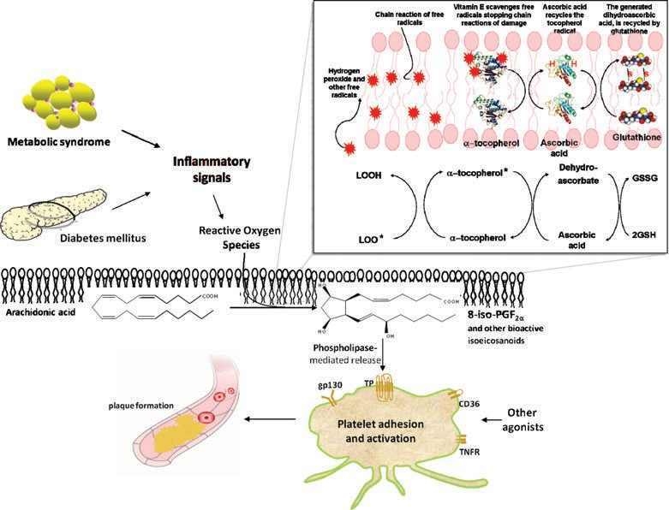

Slide 93
THANK YOU

