Slide 1
The Cell Cycle and How Cells Divide

Slide 2
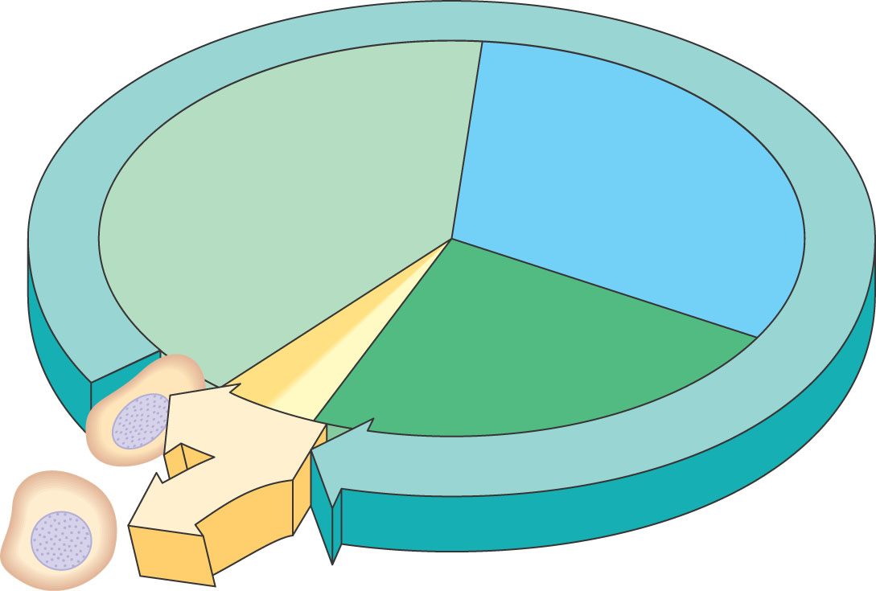
Phases of the Cell Cycle
The cell cycle consists of
Interphase – normal cell activity
The mitotic phase – cell divsion
INTERPHASE
Growth
G ₁
(DNA synthesis)
Growth
G₂
Cell Divsion

Slide 3
Functions of Cell Division
100 µm
200 µm
20 µm
(a) Reproduction. An amoeba, a single-celled eukaryote, is dividing into two cells. Each new cell will be an individual organism (LM).
(b) Growth and development. This micrograph shows a sand dollar embryo shortly after the fertilized egg divided, forming two cells (LM).
(c) Tissue renewal. These dividing bone marrow cells (arrow) will give rise to new blood cells (LM).

Slide 4
Cell Division
An integral part of the cell cycle
Results in genetically identical daughter cells
Cells duplicate their genetic material
Before they divide, ensuring that each daughter cell receives an exact copy of the genetic material, DNA

Slide 5
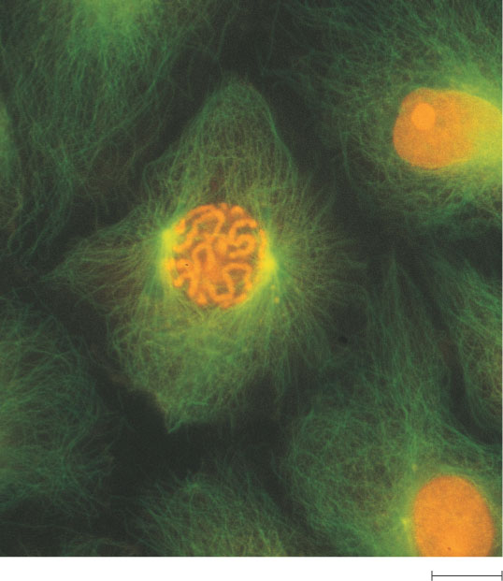
DNA
Genetic information - genome
Packaged into chromosomes
Figure 12.3
50 µm

Slide 6
DNA And Chromosomes
An average eukaryotic cell has about 1,000 times more DNA then an average prokaryotic cell.
The DNA in a eukaryotic cell is organized into several linear chromosomes, whose organization is much more complex than the single, circular DNA molecule in a prokaryotic cell

Slide 7
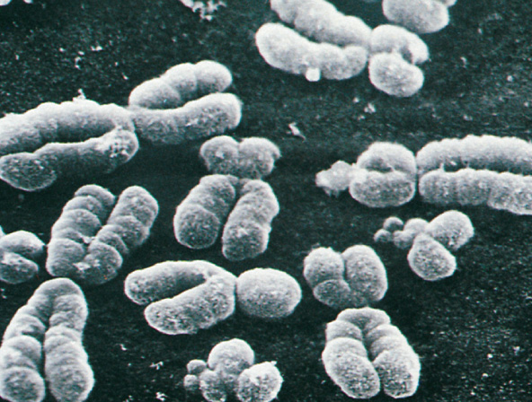
Chromosomes
All eukaryotic cells store genetic information in chromosomes.
Most eukaryotes have between 10 and 50 chromosomes in their body cells.
Human cells have 46 chromosomes.
23 nearly-identical pairs

Slide 8
Structure of Chromosomes
Chromosomes are composed of a complex of DNA and protein called chromatin that condenses during cell division
DNA exists as a single, long, double-stranded fiber extending chromosome’s entire length.
Each unduplicated chromosome contains one DNA molecule, which may be several inches long

Slide 9
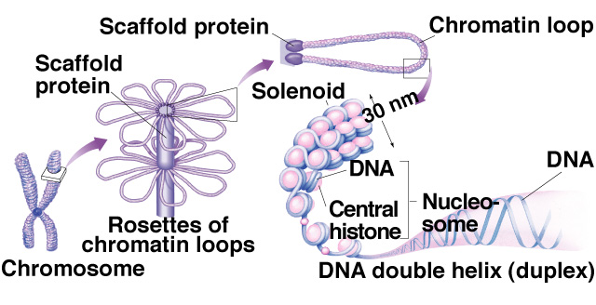
Structure of Chromosomes
Every 200 nucleotide pairs, the DNA wraps twice around a group of 8 histone proteins to form a nucleosome.
Higher order coiling and supercoiling also help condense and package the chromatin inside the nucleus:

Slide 10
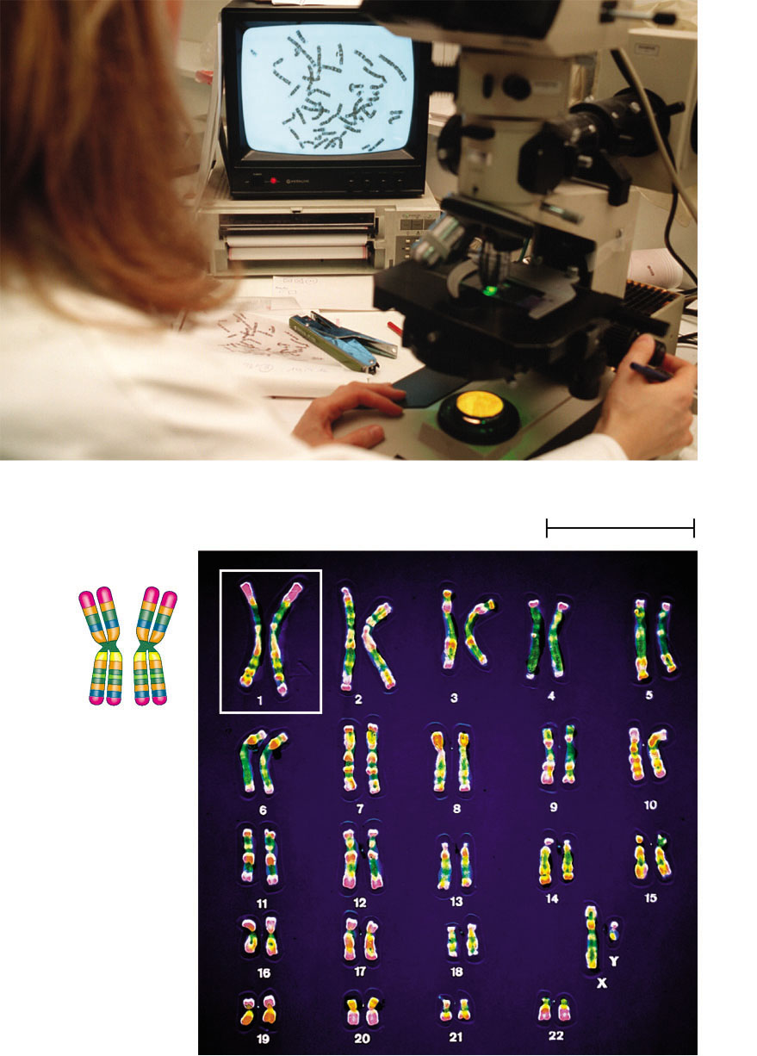
Karyotype
An ordered, visual representation of the chromosomes in a cell
Chromosomes are photographed when they are highly condensed, then photos of the individual chromosomes are arranged in order of decreasing size:
In humans each somatic cell has 46 chromosomes, made up of two sets, one set of chromosomes comes from each parent
Pair of homologous
chromosomes
5 µm
Centromere
Sister
chromatids

Slide 11
Chromosomes
Non-homologous chromosomes
Look different
Control different traits
Sex chromosomes
Are distinct from each other in their characteristics
Are represented as X and Y
Determine the sex of the individual, XX being female, XY being male
In a diploid cell, the chromosomes occur in pairs. The 2 members of each pair are called homologous chromosomes or homologues.

Slide 12
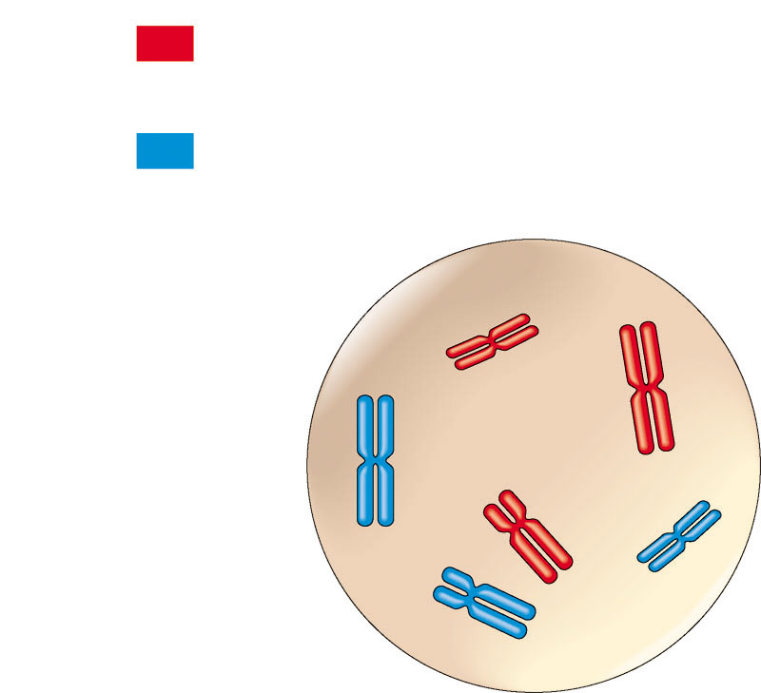
Chromosomes
A diploid cell has two sets of each of its chromosomes
A human has 46 chromosomes (2n = 46)
In a cell in which DNA synthesis has occurred all the chromosomes are duplicated and thus each consists of two identical sister chromatids
Maternal set of
chromosomes (n = 3)
2n = 6
Paternal set of
chromosomes (n = 3)
Two sister chromatids
of one replicated
chromosome
Centromere
Two nonsister
chromatids in
a homologous pair
Pair of homologous
chromosomes
(one from each set)

Slide 13
Homologues
Homologous chromosomes:
Look the same
Control the same traits
May code for different forms of each trait
Independent origin - each one was inherited from a different parent

Slide 14
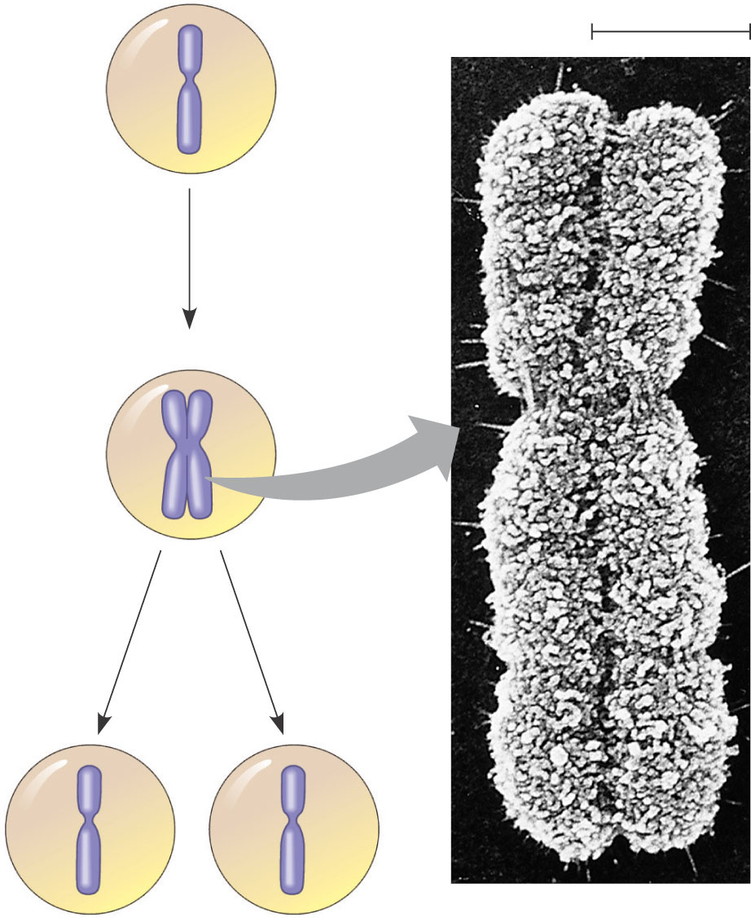
Chromosome Duplication
In preparation for cell division, DNA is replicated and the chromosomes condense
Each duplicated chromosome has two sister chromatids, which separate during cell division
0.5 µm
A eukaryotic cell has multiple chromosomes, one of which is represented here. Before duplication, each chromosome has a single DNA molecule.
Chromosome duplication (including DNA synthesis)
Once duplicated, a chromosome consists of two sister chromatids connected at the centromere. Each chromatid contains a copy of the DNA molecule.
Centromere
Sister chromatids
Separation of sister chromatids
Mechanical processes separate the sister chromatids into two chromosomes and distribute them to two daughter cells.
Centrometers
Sister chromatids

Slide 15
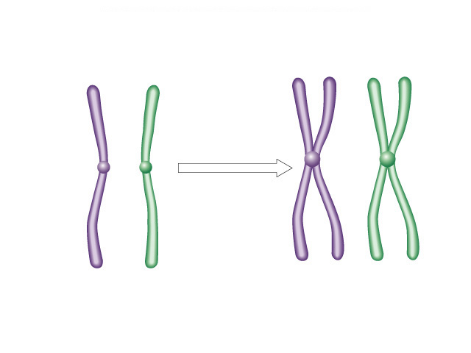
Chromosome Duplication
Because of duplication, each condensed chromosome consists of 2 identical chromatids joined by a centromere.
Each duplicated chromosome contains 2 identical DNA molecules (unless a mutation occurred), one in each chromatid:
Non-sister chromatids
Centromere
Duplication
Sister
chromatids
Sister
chromatids
Two unduplicated
chromosomes
Two duplicated chromosomes
Copyright © The McGraw-Hill Companies, Inc. Permission required for reproduction or display.

Slide 16
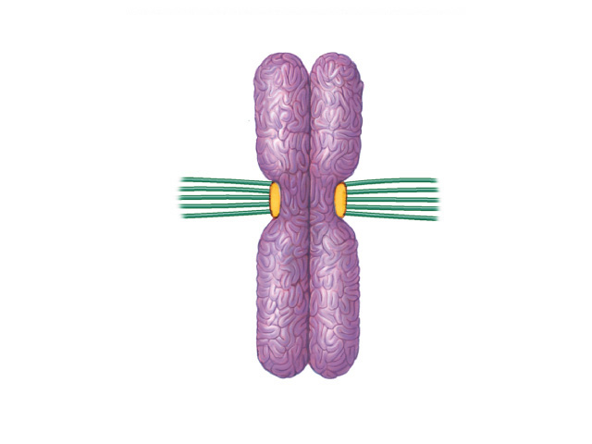
Structure of Chromosomes
The centromere is a constricted region of the chromosome containing a specific DNA sequence, to which is bound 2 discs of protein called kinetochores.
Kinetochores serve as points of attachment for microtubules that move the chromosomes during cell division:
Metaphase chromosome
Centromere
region of
chromosome
Kinetochore
Kinetochore
microtubules
Sister Chromatids
Copyright © The McGraw-Hill Companies, Inc. Permission required for reproduction or display.

Slide 17
Structure of Chromosomes
Diploid - A cell possessing two copies of each chromosome (human body cells).
Homologous chromosomes are made up of sister chromatids joined at the centromere.
Haploid - A cell possessing a single copy of each chromosome (human sex cells).

Slide 18
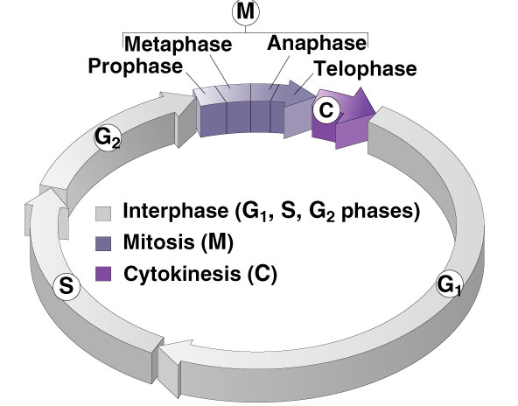
Phases of the Cell Cycle
Interphase
G₁ - primary growth
S - genome replicated
G₂ - secondary growth
M - mitosis
C - cytokinesis

Slide 19
Interphase
G₁ - Cells undergo majority of growth
S - Each chromosome replicates (Synthesizes) to produce sister chromatids
Attached at centromere
Contains attachment site (kinetochore)
G₂ - Chromosomes condense - Assemble machinery for division such as centrioles

Slide 20
Mitosis
Some haploid & diploid cells divide by mitosis.
Each new cell receives one copy of every chromosome that was present in the original cell.
Produces 2 new cells that are both genetically identical to the original cell.
DNA duplication during interphase
Mitosis
Diploid Cell

Slide 21
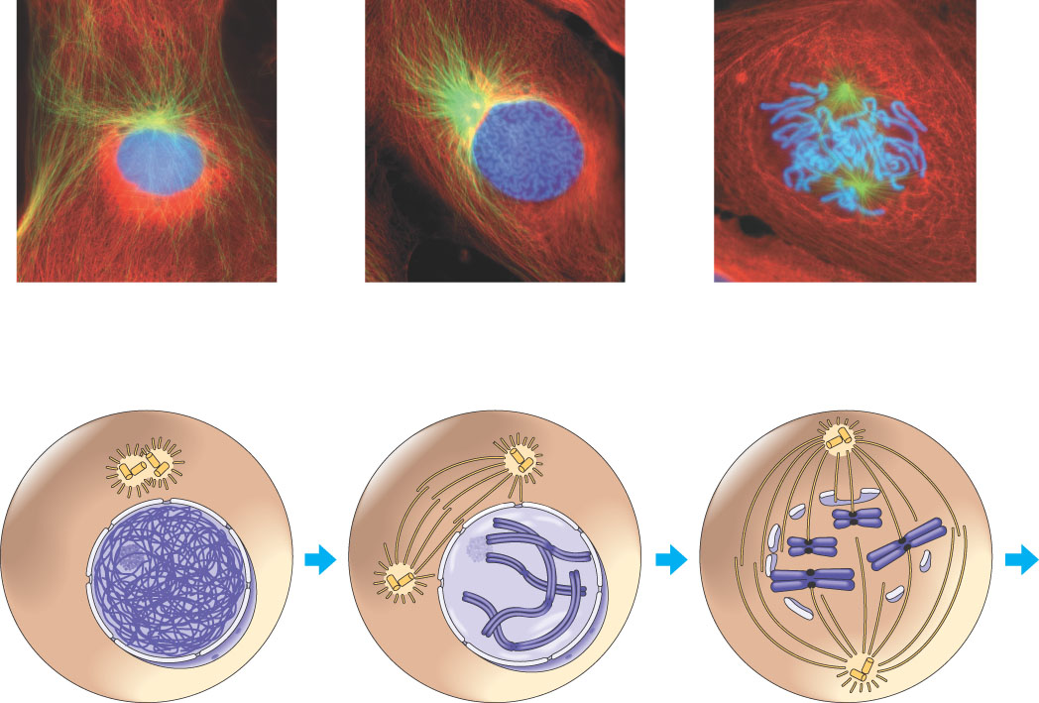
Mitotic Division of an Animal Cell
G₂ OF INTERPHASE
PROPHASE
PROMETAPHASE
Centrosomes (with centriole pairs)
Early mitotic spindle
Aster
Fragments of nuclear envelope
Chromatin (duplicated)
Kinetochore
Centromere
Nonkinetochore microtubules
Nucleolus
Nuclear envelope
Plasma membrane
Chromosome, consisting of two sister chromatids
Kinetochore microtubule

Slide 22
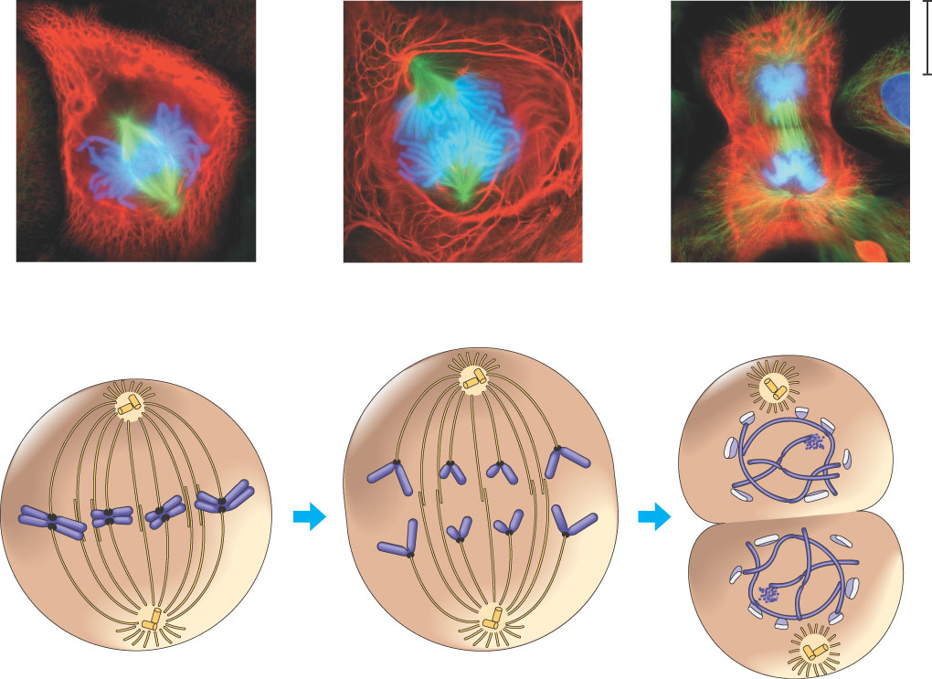
Mitotic Division of an Animal Cell
METAPHASE
ANAPHASE
TELOPHASE AND CYTOKINESIS
Metaphase plate
Cleavage furrow
Nucleolus forming
Nuclear envelope forming
Spindle
Centrosome at one spindle pole
Daughter chromosomes

Slide 23
G₂ of Interphase
A nuclear envelope bounds the nucleus.
The nucleus contains one or more nucleoli (singular, nucleolus).
Two centrosomes have formed by replication of a single centrosome.
In animal cells, each centrosome features two centrioles.
Chromosomes, duplicated during S phase, cannot be seen individually because they have not yet condensed.
The light micrographs show dividing lung cells from a newt, which has 22 chromosomes in its somatic cells (chromosomes appear blue, microtubules green, intermediate filaments red). For simplicity, the drawings show only four chromosomes.
G₂ OF INTERPHASE
Centrosomes (with centriole pairs)
Chromatin (duplicated)
Nucleolus
Nuclear envelope
Plasma membrane

Slide 24
Prophase
The chromatin fibers become more tightly coiled, condensing into discrete chromosomes observable with a light microscope.
The nucleoli disappear.
Each duplicated chromosome appears as two identical sister chromatids joined together.
The mitotic spindle begins to form. It is composed of the centrosomes and the microtubules that extend from them. The radial arrays of shorter microtubules that extend from the centrosomes are called asters (“stars”).
The centrosomes move away from each other, apparently propelled by the lengthening microtubules between them.
PROPHASE
Early mitotic spindle
Aster
Centromere
Chromosome, consisting of two sister chromatids

Slide 25
Metaphase
Metaphase is the longest stage of mitosis, lasting about 20 minutes.
The centrosomes are now at opposite ends of the cell.
The chromosomes convene on the metaphase plate, an imaginary plane that is equidistant between the spindle’s two poles. The chromosomes’ centromeres lie on the metaphase plate.
For each chromosome, the kinetochores of the sister chromatids are attached to kinetochore microtubules coming from opposite poles.
The entire apparatus of microtubules is called the spindle because of its shape.
METAPHASE
Metaphase plate
Spindle
Centrosome at one spindle pole

Slide 26
The Mitotic Spindle
The spindle includes the centrosomes, the spindle microtubules, and the asters
The apparatus of microtubules controls chromosome movement during mitosis
The centrosome replicates, forming two centrosomes that migrate to opposite ends of the cell
Assembly of spindle microtubules begins in the centrosome, the microtubule organizing center
An aster (a radial array of short microtubules) extends from each centrosome

Slide 27
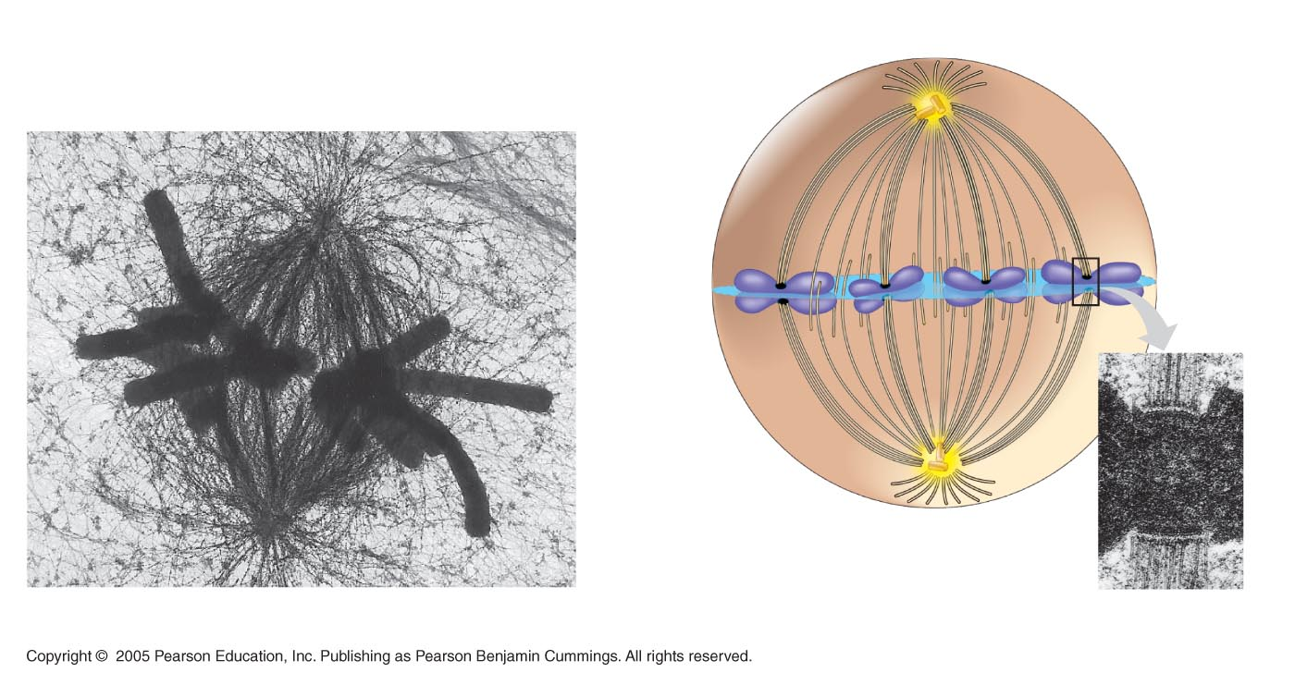
The Mitotic Spindle
Some spindle microtubules attach to the kinetochores of chromosomes and move the chromosomes to the metaphase plate
In anaphase, sister chromatids separate and move along the kinetochore microtubules toward opposite ends of the cell
Aster
Centrosome
Sister
chromatids
Microtubules
Chromosomes
Metaphase
plate
Kineto-
chores
Overlapping
nonkinetochore
microtubules
Kinetochore
microtubules
Centrosome
1 µm
0.5 µm

Slide 28
Anaphase
Anaphase is the shortest stage of mitosis, lasting only a few minutes.
Anaphase begins when the two sister chromatids of each pair suddenly part. Each chromatid thus becomes a full- fledged chromosome.
The two liberated chromosomes begin moving toward opposite ends of the cell, as their kinetochore microtubules shorten. Because these microtubules are attached at the centromere region, the chromosomes move centromere first (at about 1 µm/min).
The cell elongates as the nonkinetochore microtubules lengthen.
By the end of anaphase, the two ends of the cell have equivalent—and complete—collections of chromosomes.
ANAPHASE
Daughter chromosomes

Slide 29
Telophase
Two daughter nuclei begin to form in the cell.
Nuclear envelopes arise from the fragments of the parent cell’s nuclear envelope and other portions of the endomembrane system.
The chromosomes become less condensed.
Mitosis, the division of one nucleus into two genetically identical nuclei, is now complete.
TELOPHASE AND CYTOKINESIS
Cleavage furrow
Nucleolus forming
Nuclear envelope forming

Slide 30
Mitosis in a plant cell
Nucleus
Chromatine condensing
Chromosome
Nucleolus
1
Prophase. The chromatin is condensing. The nucleolus is beginning to disappear. Although not yet visible in the micrograph, the mitotic spindle is staring to from.
2
Prometaphase. We now see discrete chromosomes; each consists of two identical sister chromatids. Later in prometaphase, the nuclear envelop will fragment.
3
Metaphase. The spindle is complete, and the chromosomes, attached to microtubules at their kinetochores, are all at the metaphase plate.
5
Telophase. Daughter nuclei are forming. Meanwhile, cytokinesis has started: The cell plate, which will divided the cytoplasm in two, is growing toward the perimeter of the parent cell.
4
Anaphase. The chromatids of each chromosome have separated, and the daughter chromosomes are moving to the ends of cell as their kinetochore microtubles shorten.

Slide 31
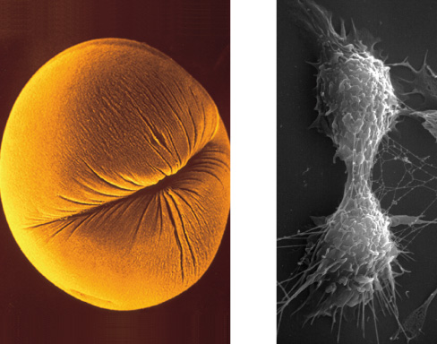
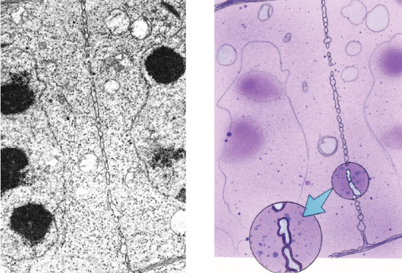
Cytokinesis
Cleavage of cell into two halves
Animal cells
Constriction belt of actin filaments
Plant cells
Cell plate
Fungi and protists
Mitosis occurs within the nucleus

Slide 32
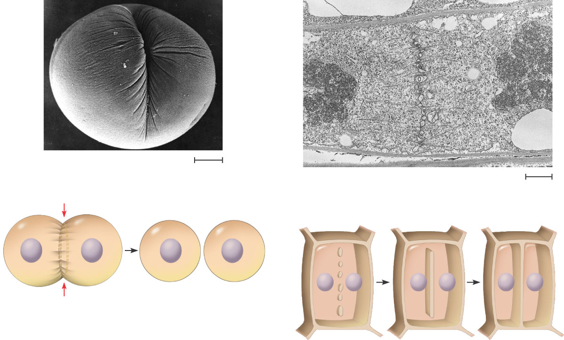
Cytokinesis In Animal And Plant Cells
Cleavage furrow
100 µm
Vesicles forming cell plate
Wall of patent cell
1 µm
Cell plate
New cell wall
Contractile ring of microfilaments
Daughter cells
Daughter cells
(a) Cleavage of an animal cell (SEM)
(b) Cell plate formation in a plant cell (SEM)

Slide 33
