Slide 1
Metarterioles
Short vessels that link arterioles and capillaries.
Instead of a continuous tunica media, they have individual muscle cells spaced a short distance apart, each forming a precapillary sphincter that encircles the entrance to one capillary

Slide 2
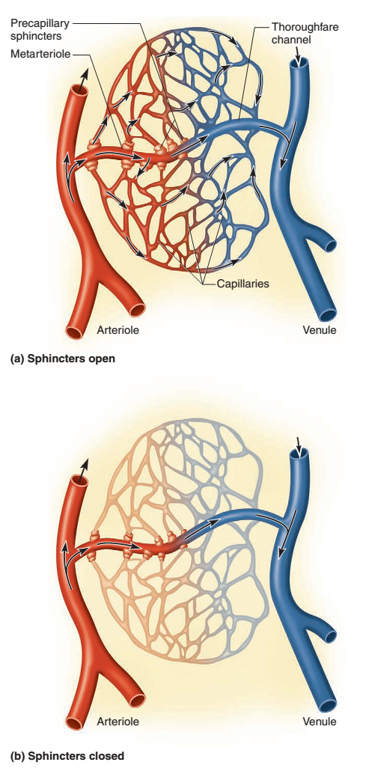
Notes:
a thoroughfare channel connects the metarteriole to a venule

Slide 3
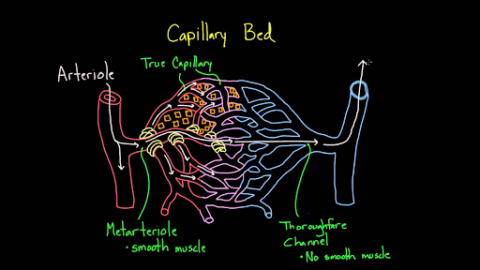

Slide 4
Arterial Sense Organs
Certain major arteries above the heart have sensory structures in their walls that monitor blood pressure and chemistry
These receptors transmit information to the brainstem that serves to regulate the heartbeat, vasomotion, and respiration
Notes:
Vasomotion is the spontaneous oscillation in tone of blood vessel walls, independent of heart beat, innervation or respiration

Slide 5
1. Carotid sinuses.
Baroreceptors (pressure sensors)
Ascending the neck on each side is a common carotid artery, which branches near the angle of the mandible, forming the internal carotid artery to the brain and external carotid artery to the face
The carotid sinuses are located in the wall of the internal carotid artery just above the branch point
Relatively thin tunica media and an abundance of glossopharyngeal nerve fibers in the tunica externa
Notes:
The mandible (or lower jaw bone, latin: mandibula) is the only movable cranial bone. The mandible is a single bone connected to the skull by the temporomandibular joint

Slide 6
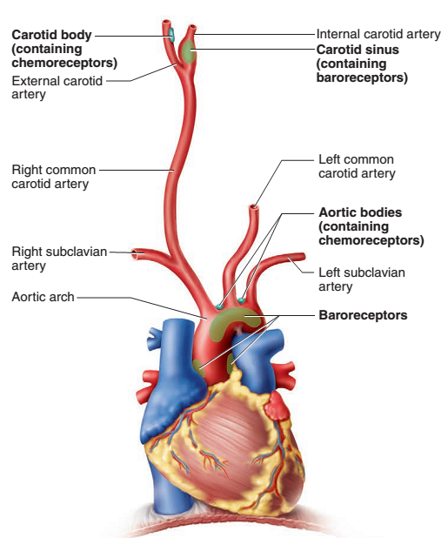

Slide 7
2. Carotid bodies
Also located near the branch of the common carotid arteries
These are oval receptors innervated by sensory fibers of the vagus and glossopharyngeal nerves
They are chemoreceptors that monitor changes in blood composition
They primarily transmit signals to the brainstem respiratory centers
Notes:
The glossopharyngeal nerve, known as the ninth cranial nerve (CN IX), is a mixed nerve that carries afferent sensory and efferent motor information. It exits the brainstem out from the sides of the upper medulla, just anterior (closer to the nose) to the vagus nerve
The vagus nerve, historically cited as the pneumogastric nerve, is the tenth cranial nerve or CN X, and interfaces with the parasympathetic control of the heart, lungs, and digestive tract.

Slide 8
3. Aortic bodies
These are one to three chemoreceptors located in the aortic arch near the arteries to the head and arms
They are structurally similar to the carotid bodies and have the same function

Slide 9
Capillaries
Blood capillaries are composed of only an endothelium and basal lamina. Their walls are as thin as 0.2 to 0.4 μm
They average about 5 μm in diameter at the proximal end
The number of capillaries has been estimated at a billion and their total surface area at 6,300 m²
Scarcely any cell in the body is more than 60 to 80 μm
Notes:
The basal lamina is a layer of extracellular matrix secreted by the epithelial cells, on which the epithelium sits

