Slide 1
Memory Management

Slide 2
To cover
Overview.
Strategies for Allocating Variables to Memory.
Design Patterns for Limited Memory.
Memory Management in Mobile Java.
Symbian OS Memory Management.

Slide 3
Overview
Memory management is different from managing some other resources
Tangling everywhere
Mobile devices memory is a critical resource
cost of the device low
running programs are competing for it
Explicitly allocate memory in many imperative languages, such as C and C++
Memory consumption in mobile devices a cross-cutting problem

Slide 4
Strategies for Allocating Variables to Memory
Stack and the heap are principle memory areas
Run-time infrastructure and the programmer are responsible for their management
In heap, sharing of data is easy and natural
Stack-based variables references should use with care
stack increases and decreases, and may overwrite referred data
Statically allocated to a permanent location or dynamically allocated from stack or heap

Slide 5
Static Allocation
Throughout program life variable remains allocated
Memory locations used by it cannot be deallocated.
int * pointer_to_static() { static int x; return &x; }
Singleton pattern
a single instance (or a few instances) of a class, and make it known to all subsystems.

Slide 6
Stack
Transient objects
Those that live only a limited period of time, are to be stored in the stack.
int * pointer_to_int()
{ int x; return &x; }
Returned reference points to a location in the memory
Potentially overwritten by any later functions that will be called by the program

Slide 9
Stack Limitations
Hard-to-repeat errors and complex debugging tasks.
Stack could exhaust when data is accidentally copied by making a method or function call
Better to allocate big objects from the heap
to ensure that the object is not accidentally modified via a reference, const definition can be used where applicable

Slide 10
Heap
All data structures whose size or structure can be altered dynamically must be allocated to the heap.
Since, unknown structures are impossible to reserve enough space from the stack.
Global object, should be allocated memory from heap.
garbage collection is a responsibility of the caller if there is no automation
Heap can be slower than using the stack

Slide 11
Design Patterns for Limited Memory
Design should be based on the most adequate data structure, which offers the right operations.
Use singly link list instead double if it is enough.
Better performance if support can be gained from cache.
Design patterns created for help in designing small memory software.
Linear Data Structures:
Where different elements are located next to each other in the memory.
For instance, implementations of lists and tree-like data structures.
Linear data structures are generally better for memory management than non-linear ones.

Slide 12
Design Patterns for Limited Memory
Less fragmentation:
Linear data structures occupy memory place from one location.
whereas non-linear ones can be located in different places.
Obviously, the former results in less possibility for fragmentation.
Less searching overhead:
Reserving a linear block of memory for several items only takes one search for a suitable memory element in the run-time environment
whereas non-linear structures require one request for memory per allocated element.
Combined with a design where one object allocates a number of child objects, this may also lead to a serious performance problem.

Slide 13
Design Patterns for Limited Memory
Design-time management:
Linear blocks are easier to manage at design time, as fewer reservations are made.
This usually leads to cleaner designs.
Monitoring:
Addressing can be performed in a monitored fashion, because it is possible to check that the used index refers to a legal object.
Cache improvement:
using linear data structures, it is more likely that the next data element is already in cache

Slide 14
Design Patterns for Limited Memory
Index uses less memory:
An absolute reference to an object usually consumes 32 bits,
whereas by allocating objects to a vector of 256 objects, assuming that this is the upper limit of objects, an index of only 8 bits can be used.
Furthermore, it is possible to check that there will be no invalid indexing.

Slide 15
Design Patterns for Limited Memory
Basic Design Decisions:
Allocate all memory at the beginning of a program.
Reserving all the resources is particularly attractive when the most important or mandatory features like emergency calls
Allocate memory for several items, even if you only need one.
a number of objects is reserved with one allocation request.
less complex structure in the memory.
fewer memory allocations, and cache use is improved.
Use standard allocation sizes.
easy to reuse a deallocated area in the memory.
fragmentation of memory can be prevented.

Slide 16
Design Patterns for Limited Memory
Reuse objects.
programmer actively participates in the process of selecting object construction and destruction policy
Release early, allocate late.
objects occupying a large amount of memory are deallocated before allocating new objects.
Use permanent storage or ROM when applicable.
in case of battery removal from the device, unsaved data will be lost
save all data to permanent storage as soon as possible.
Avoid recursion.
size of a single stack frame in KVM is 28 bytes (7×4 bytes).
functions calling themselves recursively can end up using a lot of stack

Slide 17
Design Patterns for Limited Memory
Data Packing
way to reduce memory consumption.
Consider word alignment.
struct S { char c1; // Actually a boolean. int i; char c2; };
three words are required
By changing the data structure to struct S { char c1; // Actually a boolean. char c2; int i; };

Slide 18
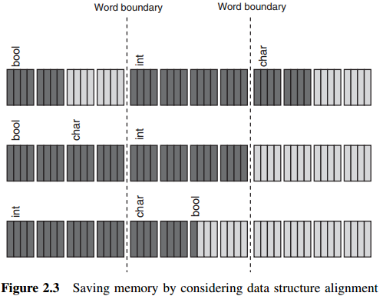
Design Patterns for Limited Memory
c1 and c2 fit in the same word.
improvement can be gained by using only one bit for the Boolean value, assuming that there would be some other data to include in the saved bits.

Slide 19
Design Patterns for Limited Memory
Use compression with care.
May impair performance while compressing data or opening files
three different compression techniques:
Table compression
also referred to as nibble coding or Huffman coding
encoding each element of data in a variable number of bits
so that the more common elements require fewer bits.
Difference coding
representing sequences of data according to the differences between them.
Adaptive compression
is based on algorithms that analyze the data to be compressed

Slide 20
Design Patterns for Limited Memory
Use efficient resource storage format.
ensure that images, sounds, and movies are stored in the most efficient way
possible to save some space by combining many image files into one image file.

Slide 21
Design Patterns for Limited Memory
Discussion
memory management are not problem-free.
when improving a certain property of software design, some other part is downgraded or compromised.
Increased minimal memory usage.
simplistic implementation.
Decreased flexibility.
it is possible that some hardware configurations are invalidated.
Downgraded performance.
Using some form of compression can lead to decreased memory use
packing a lot of information into the same memory word can lead to downgraded performance.

Slide 22
Design Patterns for Limited Memory
Longer initialization and shutdown sequences
it is possible to handle some of the operations associated with memory at the beginning or at the end of the program
rather than in the middle of the execution, startup and termination of the program can become slower.
Potential unintuitiveness in designs
When an experienced designer composes a design in a memory-aware fashion,
some of the decisions can be unintuitive to less experienced developers.
Impaired reusability
The more one addresses particularities of a certain design problem in the solution,
the less likely it is that the same solution could be used again in another context.

Slide 23
Design Patterns for Limited Memory
To summarize, it is a necessity to balance between the different requirements addressing the properties of designs.

Slide 24
Memory Management in Mobile Java
Code optimization could be error prone
Such systems running on Virtual Machines
May cause abstraction leakage
Motivation
Despite of managing resources automatically, use appropriate data structures (garbage collection using DS)
For instance, implementing a stack of references on a virtual machine
The stack is implemented as a vector.
An index (size) to the vector is used as the stack pointer
Stack pointer is incremented by one, when a new item is added.
Public void push(Object e) {
ensureCapacity( ); // Check that slots are available.
elements [size++] = e;
}
Notes:
Spolsky's article cites many examples of leaky abstractions that create problems for software development:
The TCP/IP protocol stack is the combination of the TCP protocol, which tries to provide reliable delivery of information, running on top of the IP protocol, which provides only 'best-effort' service. When IP loses a packet TCP has to retransmit it, which takes additional time. Thus TCP provides the abstraction of a reliable connection, but the implementation details leak through in the form of potentially variable performance (throughput and latency both suffer when data has to be retransmitted).
Iterating over a large two-dimensional array can have radically different performance if done horizontally rather than vertically, depending on the order in which elements are stored in memory. One direction may vastly increase cache misses and page faults, both of which greatly delay access to memory.
The SQL language abstracts away the procedural steps for querying a database, allowing one to merely define what one wants. But certain SQL queries are thousands of times slower than other logically equivalent queries. On an even higher level of abstraction, ORM systems, which isolate object-oriented code from the implementation of object persistence using a relational database, still force the programmer to think in terms of databases, tables, and native SQL queries as soon as performance of ORM-generated queries becomes a concern.
Although network file systems like NFS and SMB let one treat files on remote machines as if they were local, the connection to the remote machine may slow down or break, and the file stops acting as if it was local.
The ASP.NET web forms programming platform, not to be confused with ASP.NET MVC, abstracts away the difference between HTML code to handle clicking on a hyperlink (<a>) and code to handle clicking on a button. However, ASP.NET needs to hide the fact that in HTML there is no way to submit a form from a hyperlink. It does this by generating a few lines of JavaScript and attaching an onclick handler to the hyperlink. However, if the end user has JavaScript disabled, the ASP.NET application malfunctions. Furthermore, one cannot naively think of event handlers in ASP.NET in the same way as in a desktop GUI framework such as Windows Forms; due to the fundamental limitations of the Web, processing event handlers in ASP.NET requires exchanging data with the server and reloading the form.

Slide 26
Similarly, when an element is removed from the stack, the stack pointer is decremented by one.
public Object pop(){ if(size == 0) throw new EmptyStackException(); return elements[--size]; }
Reference to garbage collection, there can be ‘ghost’ references to objects that are unusable
but remain valid and accessible in the vector used in the implementation.
Such ‘ghosts’ are a result of executing several push and pop operations.
The garbage collector is not allowed to deallocate them before the last reference to them has been erased, and having an accidental unused reference counts in this respect.

Slide 27
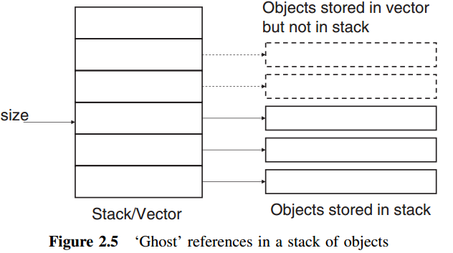
the problem can be solved by setting vector element to zero in method pop:
public Object pop() {
if(size == 0) throw new EmptyStackException();
Object result = elements[--size];
elements[size] = null;
return result;
}

Slide 28
Rules of Thumb for Mobile Java
Avoid small classes.
it is better for memory consumption to merge small classes into bigger ones.
Usually inner classes contain only little functionality, like a particular listener of some user action.
keeping the number of different exceptions as small as possible.
For instance, the memory consumption of an application that was implemented using two different structural alternatives, shrank to almost half from 14 019 bytes to 7467 bytes when the number of classes was reduced from 14 to 1 without altering the behavior of the application (Hartikainen et al. 2006).
Avoid dependencies.
one might save memory by removing references

Slide 29
Select the size when relevant, and manage vector/string usage.
whenever possible, by providing the size of the vector instead of using the default size
Consider using array versus using vector.
the difference between array- and vector-based implementations is relevant both in terms of the number of objects and used bytes.
vector effectively need to wrap integers to objects to be able to store their values
an implementation where the correct size is given in the constructor, allocates up to 24% less memory in terms of size.

Slide 30
Use StringBuffer.
Concatenating String with the + operator or with the append method consumes memory as the virtual machine needs to create temporary objects.
Using strings
Using StringBuffer
// StringBuffer based implementation.
public void useStringBuffer() {
String s = "";
StringBuffer sb = new StringBuffer(AMOUNT);
for(int i = 0; i < AMOUNT; i++) {
sb = sb.append("a");
}
s = sb.toString();
}
// String based implementation.
public void useString()
{
String s = "";
for(int i = 0; i < AMOUNT; i++)
{
s = s + "a";
}
}

Slide 31
Manage class and object structure.
Inheritance can sometimes cost memory
When creating an object of a child class also its parent class needs to be loaded
All the variables from the parent are present in a child object
hierarchy of classes constructed can lead to superfluous loading and memory consumption.
Generate less garbage.
Reusing old objects to avoid making garbage.
Consider obfuscation.
majority of the content of a Java library often consists of metainformation and strings.
one can reduce footprint by obfuscating the names of public instance variables and methods, classes, and packages to a smaller form.

Slide 32
Handle array initialization.
Long arrays static initializer can consume a lot of space
Improved tool support can offer solutions that consume less memory.
In practice, the difference only becomes meaningful when the size of an array is over 1000 (Hartikainen, 2005).

