Slide 1
Social Institutions

Slide 2
What is a Social Institution?
-a group of social positions, connected by social relations, performing a social role, e.g. universities, government, families.

Slide 3
What is Social Institution?
Any institution in a society that works to socialize the group of people in it.

Slide 4
Characteristics of an Institution
Palispis (1996)
Institutions are purposive.
Relatively permanent in content.
Institutions are structured.
Institutions are a unified structure.
Institutions are necessarily value-laden.

Slide 5
Functions of an Institutions
1. Institutions simplify social behavior for the individual person.
2. Provide ready-made forms of social relations and social roles for individual.
3. Act as agencies of coordination and stability for the total culture.
4. Control behavior.

Slide 6
Major Social Institutions
The Family
Education
Religion
Economic
Political
Recreational

Slide 7
The Family

Slide 8
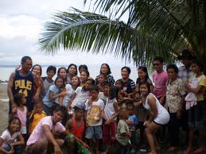
Family
- is the smallest social institution with the unique function or producing and rearing the young.

Slide 10
The Family
The smallest social institution with the unique function or producing and rearing the young.
It is the basic unit of Pakistani society and the educational system where the child begins to learn .
The basic agent of socialization because it is here where the individual develops values, behaviors, and ways of life through interaction with members of the family (Vega, 2004).

Slide 11
Characteristic of the Pakistani Family
The family is closely knit and has strong family ties.
The Pakistani family is usually extended one and therefore, big.
In the Pakistani family, kinship ties are extended to include the sponsors.

Slide 12
Functions of the Family
1. Reproduction of the race and rearing of the young.
2. Cultural transmission or enculturation.
3. Socialization of the child.
4. Providing affection and a sense of security.
5. Providing the environment for personality development and the growth of self-concept in relation to others.
6. Providing social status.

Slide 13
Kinds of Family

Slide 14
Kinds of Family Patterns
According to Membership
Conjugal or Nuclear Family | Husband, wife and children
Consanguine or extended Family | Married couple, their parents, siblings, grandparents, uncles, aunts and cousins

Slide 15
…according to STRUCTURE
Conjugal or Nuclear Family
-the primary or elementary family consisting of husband, wife and children.
b. Consanguine or Extended Family
-consist of married couple, their parents, siblings, grandparents, uncles, aunts, and cousins.

Slide 16
…according to Authority
I. Patriarchal Family:: the male members alone have the right to decide the matters of the family
ii.Matriarchal Family: the female members alone have the right to decide the matters of the familyExample :Pakistan ,china Japan
Example:Nayer and Tiya casts in Kerala,the Khasi and Garo tribes of Assam and the North American Indians
iii.Eagalitarian Family:When power and authority are shared by male and female in the family is called eagalitarian family.

Slide 17
Marriage
According to Horton and Hunt
“Marriage is the approved social pattern whereby two or more persons establish a family”

Slide 18
…according to term of MARRIAGE
a. Polyandry
-one woman is married to two or more men at the same time.
Polygamy
-one man is married to two or more women at the same time.
c. Cenogamy
- two or more men mate with two or more women in group marriage.

Slide 19
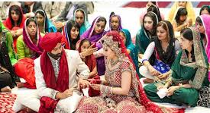
Marriage Patterns • Monogamy:
The marriage of one husband and one wife.
Example:popular all over the world.

Slide 20
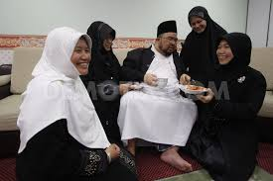
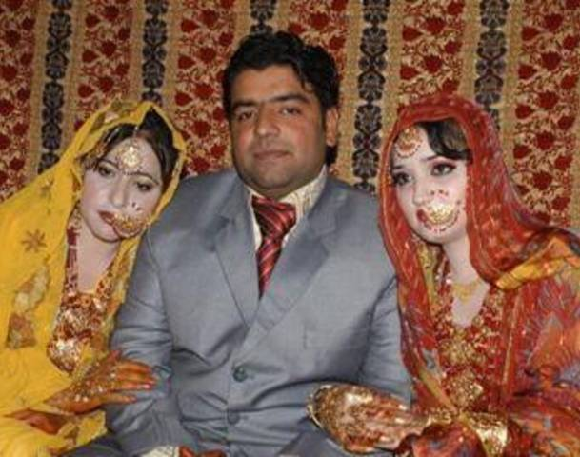
Polygamy:
One form of polygamy is polygyny
Polygyny:”in which a man has two or more wives at the same time
Example: In Islamic countries and Middle East
Sororal Polygyny:two or more of a polygynous man's wives are sisters
Non Sororal Polygyny:2 or more of a polygynous man's wives are not sisters

Slide 21
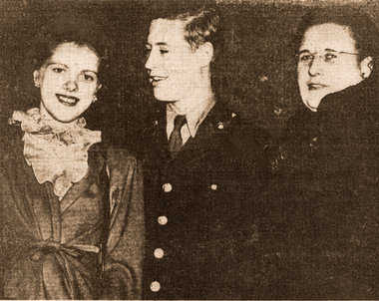
Polyandry
“Marriage in which a woman has more than one husband.”
Example:Himalayan societies.Mountainous Tibet.
Fraternal polyandry “the custom whereby two or more of a polyandrous
Woman’s husbands are brothers.Todas tribe in India

Slide 22
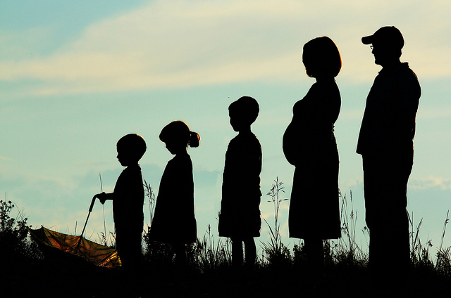
Kinds of Family Patterns
According to Place of Residence
Patrilocal | Married couple lives with the parents of the husband
Matrilocal | Married couple lives with the parents of the wife
Neolocal | Married couple maintains a separate household and live by themselves

Slide 23
…according to Descent Patterns
Patrilineal descent: Kinship traced through the father’s family; property passed from father to son
• Matrilineal descent: Kinship traced through mother’s family; property passed from mother to daughter
• Bilateral descent: kinship traced through both parents; property inherited from either side of the family

Slide 24
…according to AUTHORITY
a. Partriarchal
- when the father is considered the head and plays a dominant role.
b. Matriarchal
- when the mother or female is the head and makes the major decisions.
c. Equalitarian
- when both father and mother share in making decisions and are equal in authority.

Slide 25
…according to marriage arrangements
a. Partriarchal
- when the father is considered the head and plays a dominant role.
b. Matriarchal
- when the mother or female is the head and makes the major decisions.
c. Equalitarian
- when both father and mother share in making decisions and are equal in authority.

Slide 26
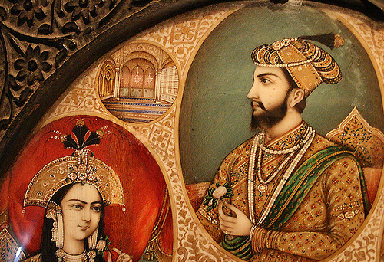
Hypergamy
“A woman marriage to a man of higher caste”
Example :Mughal .Feudal

Slide 27
Endogamy
A marriage is occur(arranged) in family relatives,caste,religion,tribe and sect.
Example :Pakistani and Indian villages

Slide 28
Exogamy
A marriage is occur(arranged) out of family relatives,caste,religion,tribe and sect
Example :Pakistani cities.Indian cities

Slide 29
Group Marriage
A form of marriage involving two or more men and two or more women as marriage partners at the same time
Example:western cultures,such as the Aweikoma of southern Brazil.

