Slide 1
Chapter 11: The t Test for Two Related Samples

Slide 2
Repeated-Measures Designs
The related-samples hypothesis test allows researchers to evaluate the mean difference between two treatment conditions using the data from a single sample.
In a repeated-measures design, a single group of individuals is obtained and each individual is measured in both of the treatment conditions being compared.
Thus, the data consist of two scores for each individual.

Slide 3
Hypothesis Tests with the Repeated-Measures t
The repeated-measures t statistic allows researchers to test a hypothesis about the population mean difference between two treatment conditions using sample data from a repeated-measures research study.
In this situation it is possible to compute a difference score for each individual:
difference score = D = X₂ – X₁
Where X₁ is the person’s score in the first treatment and X₂ is the score in the second treatment.

Slide 4
Hypothesis Tests with the Repeated-Measures t (cont.)
The related-samples t test can also be used for a similar design, called a matched-subjects design, in which each individual in one treatment is matched one-to-one with a corresponding individual in the second treatment.
The matching is accomplished by selecting pairs of subjects so that the two subjects in each pair have identical (or nearly identical) scores on the variable that is being used for matching.

Slide 5
Hypothesis Tests with the Repeated-Measures t (cont.)
Thus, the data consist of pairs of scores with each pair corresponding to a matched set of two "identical" subjects.
For a matched-subjects design, a difference score is computed for each matched pair of individuals.

Slide 6
Hypothesis Tests with the Repeated-Measures t (cont.)
However, because the matching process can never be perfect, matched-subjects designs are relatively rare.
As a result, repeated-measures designs (using the same individuals in both treatments) make up the vast majority of related-samples studies.

Slide 7
Hypothesis Tests with the Repeated-Measures t (cont.)
The sample of difference scores is used to test hypotheses about the population of difference scores. The null hypothesis states that the population of difference scores has a mean of zero,
H₀: μ_{D} = 0

Slide 8
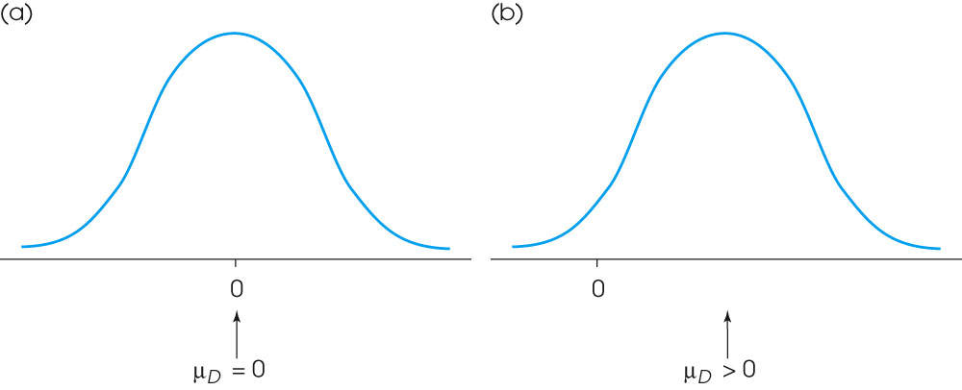
Notes:
Figure 11.2
(a) A population of difference scores for which the mean is μ_{D} = 0. Note that the typical difference score (D value) is not equal to zero. (b) A population of difference scores for which the mean is greater than zero. Note that most of the difference scores are also greater than zero.

Slide 9
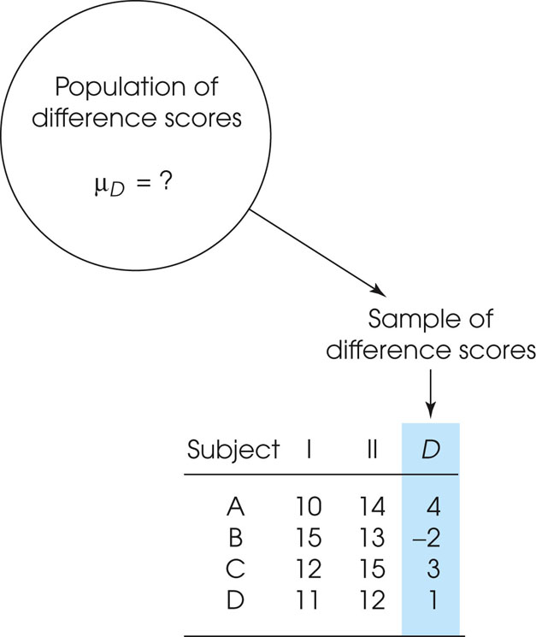
Notes:
Figure 11.3
A sample of n = 4 people is selected from the population. Each individual is measured twice, once in treatment I and once in treatment II, and a difference score, D, is computed for each individual. This sample of difference scores is intended to represent the population. Note that we are using a sample of difference scores to represent a population of difference scores. Note that the mean for the population of difference scores is unknown. The null hypothesis states that for the general population there is no consistent or systematic difference between the two treatments, so the population mean difference is μ_{D} = 0.

Slide 10
Hypothesis Tests with the Repeated-Measures t (cont.)
In words, the null hypothesis says that there is no consistent or systematic difference between the two treatment conditions.
Note that the null hypothesis does not say that each individual will have a difference score equal to zero.
Some individuals will show a positive change from one treatment to the other, and some will show a negative change.

Slide 11
Hypothesis Tests with the Repeated-Measures t (cont.)
On average, the entire population will show a mean difference of zero.
Thus, according to the null hypothesis, the sample mean difference should be near to zero.
Remember, the concept of sampling error states that samples are not perfect and we should always expect small differences between a sample mean and the population mean.

Slide 12
Hypothesis Tests with the Repeated-Measures t (cont.)
The alternative hypothesis states that there is a systematic difference between treatments that causes the difference scores to be consistently positive (or negative) and produces a non-zero mean difference between the treatments:
H₁: μ_{D} ≠ 0
According to the alternative hypothesis, the sample mean difference obtained in the research study is a reflection of the true mean difference that exists in the population.

Slide 13
Hypothesis Tests with the Repeated-Measures t (cont.)
The repeated-measures t statistic forms a ratio with exactly the same structure as the single-sample t statistic presented in Chapter 9.
The numerator of the t statistic measures the difference between the sample mean and the hypothesized population mean.

Slide 14
Hypothesis Tests with the Repeated-Measures t (cont.)
The bottom of the ratio is the standard error, which measures how much difference is reasonable to expect between a sample mean and the population mean if there is no treatment effect; that is, how much difference is expected by simply by sampling error.
obtained difference M_{D} – μ_{D}
t = ───────────── = ─────── df = n – 1
standard error s_{MD}

Slide 15
Hypothesis Tests with the Repeated-Measures t (cont.)
For the repeated-measures t statistic, all calculations are done with the sample of difference scores.
The mean for the sample appears in the numerator of the t statistic and the variance of the difference scores is used to compute the standard error in the denominator.

Slide 16
Hypothesis Tests with the Repeated-Measures t (cont.)
As usual, the standard error is computed by
s² s
s_{MD} = ___ or s_{MD} = ___
n √n

Slide 17
Measuring Effect Size for the Independent-Measures t
Effect size for the independent-measures t is measured in the same way that we measured effect size for the single-sample t and the independent-measures t.
Specifically, you can compute an estimate of Cohen=s d to obtain a standardized measure of the mean difference, or you can compute r² to obtain a measure of the percentage of variance accounted for by the treatment effect.

Slide 18
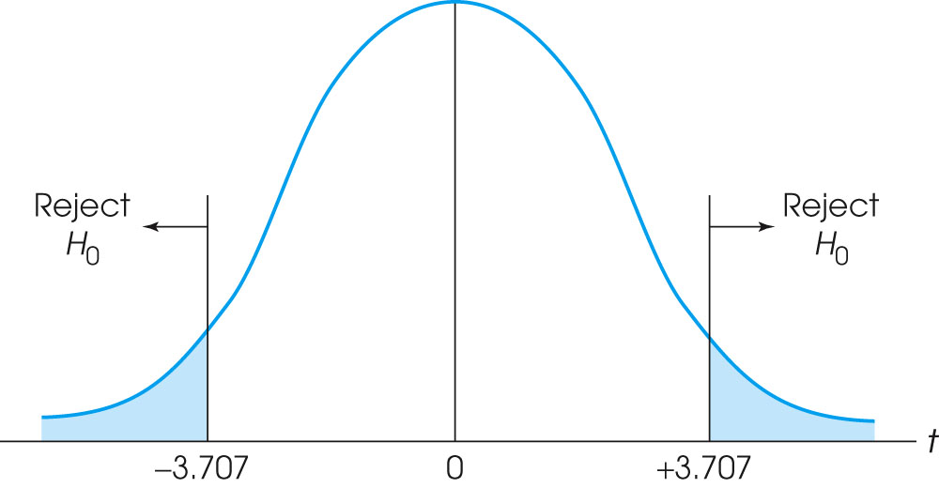
Notes:
Figure 11.4
The critical region for the t distsribution with df = 6 and α = .01.

Slide 19
Comparing Repeated-Measures and Independent-Measures Designs
Because a repeated-measures design uses the same individuals in both treatment conditions, this type of design usually requires fewer participants than would be needed for an independent-measures design.
In addition, the repeated-measures design is particularly well suited for examining changes that occur over time, such as learning or development.

Slide 20
Comparing Repeated-Measures and Independent-Measures Designs (cont.)
The primary advantage of a repeated-measures design, however, is that it reduces variance and error by removing individual differences.
The first step in the calculation of the repeated-measures t statistic is to find the difference score for each subject.

Slide 21
Comparing Repeated-Measures and Independent-Measures Designs (cont.)
This simple process has two very important consequences:
1. First, the D score for each subject provides an indication of how much difference there is between the two treatments. If all of the subjects show roughly the same D scores, then you can conclude that there appears to be a consistent, systematic difference between the two treatments. You should also note that when all the D scores are similar, the variance of the D scores will be small, which means that the standard error will be small and the t statistic is more likely to be significant.

Slide 22
Comparing Repeated-Measures and Independent-Measures Designs (cont.)
2. Also, you should note that the process of subtracting to obtain the D scores removes the individual differences from the data. That is, the initial differences in performance from one subject to another are eliminated. Removing individual differences also tends to reduce the variance, which creates a smaller standard error and increases the likelihood of a significant t statistic.

Slide 23
Comparing Repeated-Measures and Independent-Measures Designs (cont.)
The following data demonstrate these points:
Subject | X | X₂ | D
A | 9 | 16 | 7
B | 25 | 28 | 3
C | 31 | 36 | 5
D | 58 | 61 | 3
E | 72 | 79 | 7

Slide 24
Comparing Repeated-Measures and Independent-Measures Designs (cont.)
First, notice that all of the subjects show an increase of roughly 5 points when they move from treatment 1 to treatment 2.
Because the treatment difference is very consistent, the D scores are all clustered close together will produce a very small value for s².
This means that the standard error in the bottom of the t statistic will be very small.

Slide 25
Comparing Repeated-Measures and Independent-Measures Designs (cont.)
Second, notice that the original data show big differences from one subject to another. For example, subject B has scores in the 20's and subject E has scores in the 70's.
These big individual differences are eliminated when the difference scores are calculated.
Because the individual differences are removed, the D scores are usually much less variable than the original scores.
Again, a smaller variance will produce a smaller standard error, which will increase the likelihood of a significant t statistic.

Slide 26
Comparing Repeated-Measures and Independent-Measures Designs (cont.)
Finally, you should realize that there are potential disadvantages to using a repeated-measures design instead of independent-measures.
Because the repeated-measures design requires that each individual participate in more than one treatment, there is always the risk that exposure to the first treatment will cause a change in the participants that influences their scores in the second treatment.

Slide 27
Comparing Repeated-Measures and Independent-Measures Designs (cont.)
For example, practice in the first treatment may cause improved performance in the second treatment.
Thus, the scores in the second treatment may show a difference, but the difference is not caused by the second treatment.
When participation in one treatment influences the scores in another treatment, the results may be distorted by order effects, and this can be a serious problem in repeated-measures designs.

