Slide 1
PLANT ECOLOGY
TOPIC:- HISTORY OF PLANT ECOLOGY AND RECENT DEVELOPMENT IN FIELD OF ECOLOGY

Slide 2
ECOLOGY
It is a new science.
It is considered as an important branch of science, having only become prominent during 20th century.
Its history stems all the way back to 4th century.
One of the first scientist ecologist whose writings survive may have been Aristotle or perhaps his student Theophrastus both of whom had interest in many species of animals and plants.

Slide 3
Historical Background
Contribution of different scientists

Slide 4
The Botanical Geography
Alexander von Humboldt
Father of ecology.
He was the first to take on the study of relationship between organism and their environment.
His famous work is “the idea of Plant Geography’’

Slide 5
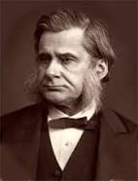
Tomas Henry Huxley
A British biologist who championed Darwin’s Theory of evolution.
His work include Zoological evidences as to Man’s place in nature (1863) and science and culture (1881).

Slide 6
Ecological damage
It was first reported in the 18 century , as the multiplication of colonies caused deforestation.
Since the 19th century with the industrial revolution, more and more pressing concerns have grown about impact of human activities on environment.
The term ecologist has been in use since end of 19th century.

Slide 7
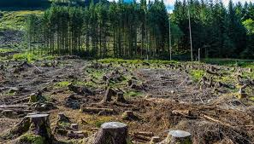
Deforestation

Slide 8
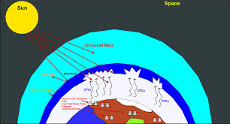
Ozone Layer depletion

Slide 9
Ecosystem
The term ecosystem was coined by a British ecologist Arthur Tansely, in 1935.
Ecosystem is an interactive system between biocoensis and its biotopes
Ecology thus became the science of ecosystem.
Over 19th century botanical geography and zoological geography combined to form biogeography.

Slide 10
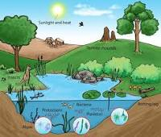
Ecosystem

Slide 11
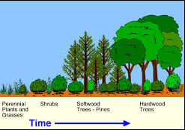
Ecological Succession
Ecological succession is a process by which a natural community moves from a simpler level of organization to a more complex community.
At the turn of 20th century Henry Chandler Cowles worked on “dynamic ecology” and was one of the founder of dynamic ecology.

Slide 12
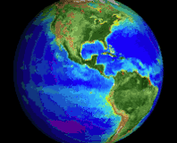
The Biosphere
Eduard Seuss was an Australian geologist who gave the term Biosphere in 1875.
Seuss gave the term biosphere for a condition promoting life.
Such as those found on earth.
Including fauna, flora, minerals and matter cycles, etc.

Slide 13
In 1920s Vladimir I. Vernadsky, a Russian geologist gave a detailed idea of biosphere in his work “The Biosphere” (1926). He refined the biosphere as the some of all the ecosystems and describe the biogeochemical cycles .

Slide 14
Human ecology
Human ecology began in 20th century
It was recognized that human have colonize all the continents so are an important part of ecology.
So the relationship of human with environment is called human ecology.

Slide 15
Conti..
Humans greatly modified the environment through development of habitat, by intensive exploitation activities such as logging, fishing and as a side effect of agriculture, mining and industry.

Slide 16
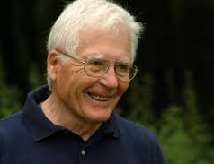
James lovelock and Gaia hypothesis
It was a new look at life on earth, he was of view that earth is a single living macro-organism.
Gaia theory was embraced by many environmental movement as an inspiring view ;Earth-mother.
So it should be loved as a mother, Gaia was becoming sick of human activities like deforestation, industrialization pollution etc.

Slide 17
Development of ecology in 18th and 19th century.
Ecology developed substantially in 18th and 19th century.
It began with Carl Linnaeus and his work on economy of nature.
Soon came Alexander von Humboldt and his work on botanical geography

Slide 18
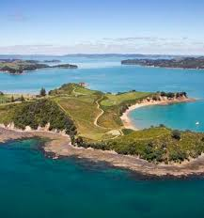
Nature conservancy
The history of ecology is intertwined with history of conservation efforts in particular founding of the Nature Conservancy.

Slide 19
Malthusian Influence
Malthus Thomas Robert gave his influential work on population and population limits in early 19th century.
His work was very important for shaping the way Darwin saw the world worked.
Malthus wrote:-
The increase in population can limited by means of subsistence.

Slide 20
Darwinism and science of ecology.
It is often held as root of ecology.
He proposed on the 0rign of species the mechanism the clearly fit within the boundaries of modern ecology.

Slide 21
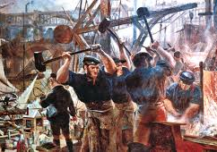
Industrial revolution
Since 19th century, with industrial revolution, more and more pressing concerns have grown about human impact on the environment.
The term ecologist has been used since the end of 19th century.

Slide 22
Animals ecology-Charles Elton
In 20th century an English zoologist and ecologist, Charles Elton worked on animal ecology and is regarded as father of Animal ecology.
Elon studied the population fluctuations dynamics.
He also coined the terms food chain food cycle in his famous book Animals ecology.

Slide 23
Hutchinson
He is attributed as being the first to influence science with theory within the discipline of ecology.
He was the first to combine science with mathematics.
His another major contribution is this that he gave the present definition of niche.

Slide 24
Recent development in ecology
Recent development in ecology includes
study of crisis caused by humans
How to conserve ecosystem
behavior of organism with each other and their enviroment.

Slide 25
THE END

