Slide 1
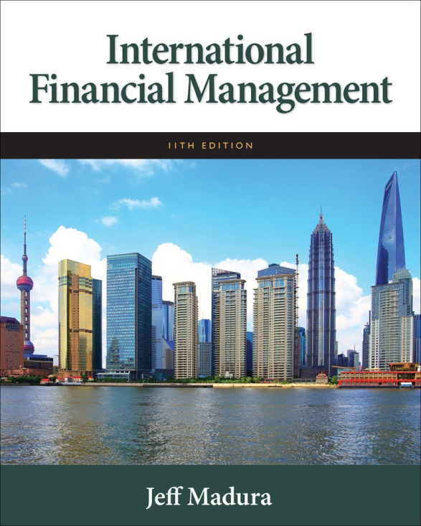

Slide 2
4
Exchange Rate Determination
Chapter Objectives
Explain how exchange rate movements are measured.
Explain how the equilibrium exchange rate is determined.
Examine factors that determine the equilibrium exchange rate.
Explain the movement in cross exchange rates.
Explain how financial institutions attempt to capitalize on anticipated exchange rate movements.
2

Slide 3
Measuring Exchange Rate Movements
Depreciation: decline in a currency’s value
Appreciation: increase in a currency’s value
Comparing foreign currency spot rates over two points in time, S and S_{t-1}
A positive percent change indicates that the currency has appreciated. A negative percent change indicates that it has depreciated.

Slide 4
Exhibit 4.1 How Exchange Rate Movements and Volatility Are Measured

Slide 5
Exchange Rate Equilibrium
The exchange rate represents the price of a currency, or the rate at which one currency can be exchanged for another.
Demand for a currency increases when the value of the currency decreases, leading to a downward sloping demand schedule. (See Exhibit 4.2)
Supply of a currency increases when the value of the currency increases, leading to an upward sloping supply schedule. (See Exhibit 4.3)
Equilibrium equates the quantity of pounds demanded with the supply of pounds for sale. (See Exhibit 4.4)
In liquid spot markets, exchange rates are not highly sensitive to large currency transactions.

Slide 6
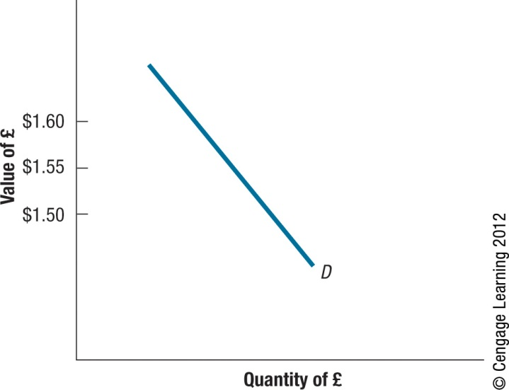
Exhibit 4.2 Demand Schedule for British Pounds
6

Slide 7
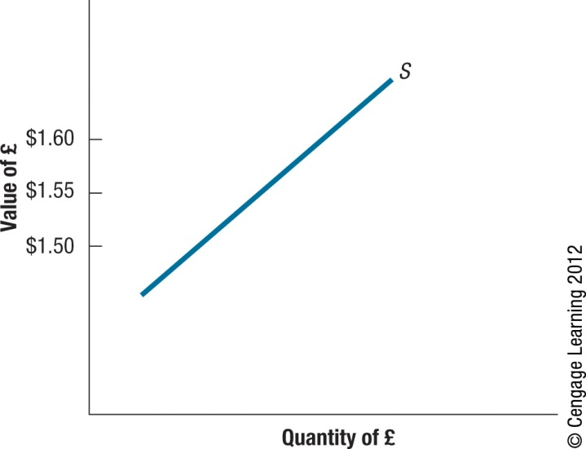
Exhibit 4.3 Supply Schedule of British Pounds for Sale
7

Slide 8
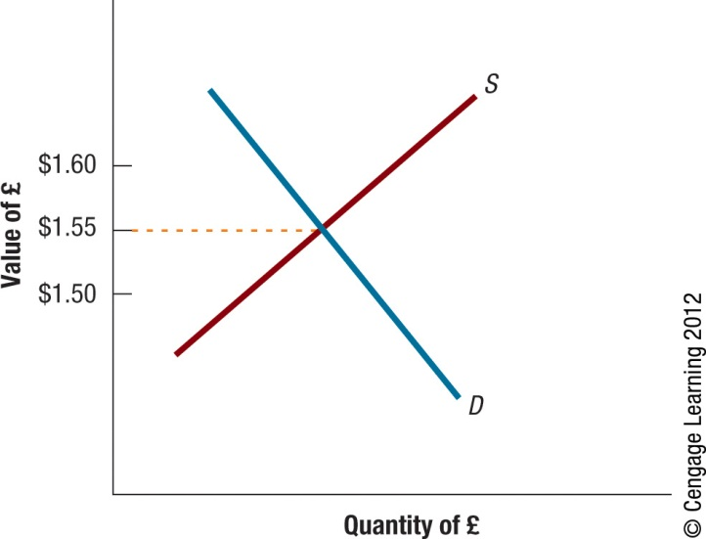
Exhibit 4.4 Equilibrium Exchange Rate Determination
8

Slide 9
Factors That Influence Exchange Rates
The equilibrium exchange rate will change over time as supply and demand schedules change.

Slide 10
Factors That Influence Exchange Rates
Relative Inflation: Increase in U.S. inflation leads to increase in U.S. demand for foreign goods, an increase in U.S. demand for foreign currency, and an increase in the exchange rate for the foreign currency. (See Exhibit 4.5)
Relative Interest Rates: Increase in U.S. rates leads to increase in demand for U.S. deposits and a decrease in demand for foreign deposits, leading to a increase in demand for dollars and an increased exchange rate for the dollar. (See Exhibit 4.6)
Fisher Effect:

Slide 11
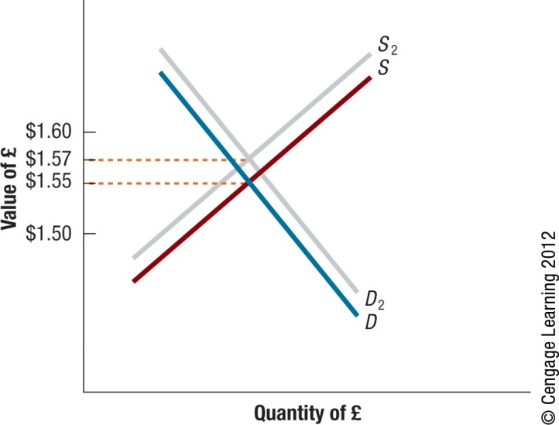
Exhibit 4.5 Impact of Rising U.S. Inflation on the Equilibrium Value of the British Pound
11

Slide 12
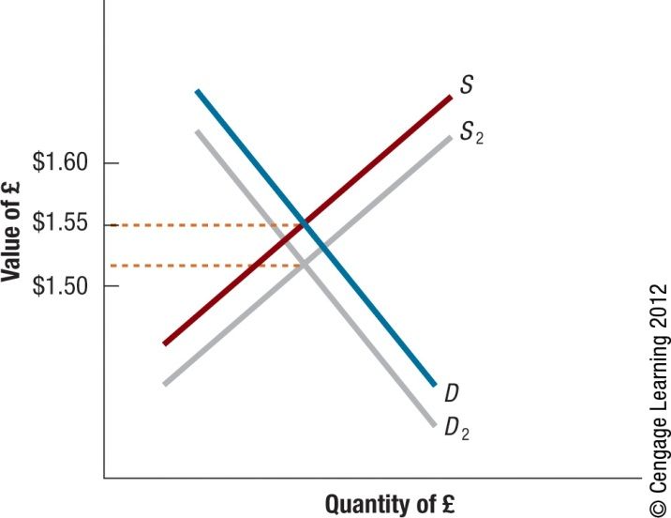
Exhibit 4.6 Impact of Rising U.S. Interest Rates on the Equilibrium Value of the British Pound
12

Slide 13
Factors That Influence Exchange Rates
Relative Income Levels: Increase in U.S. income leads to increased in U.S. demand for foreign goods and increased demand for foreign currency relative to the dollar and an increase in the exchange rate for the foreign currency. (See Exhibit 4.7)
Government Controls via:
Imposing foreign exchange barriers
Imposing foreign trade barriers
Intervening in foreign exchange markets
Affecting macro variables such as inflation, interest rates, and income levels.

Slide 14
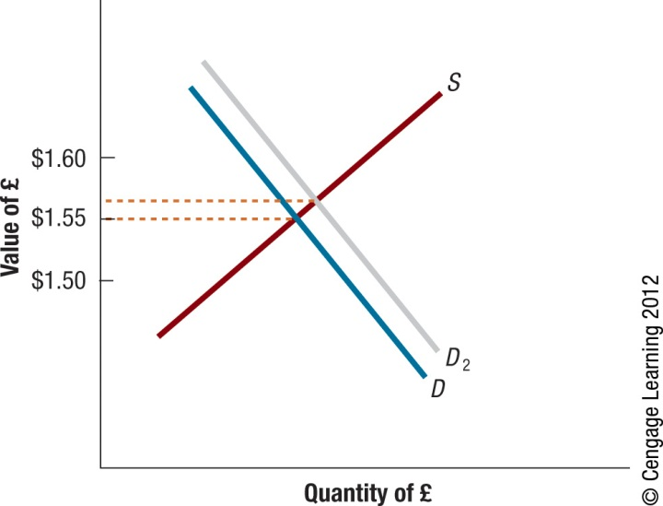
Exhibit 4.7 Impact of Rising U.S. Income Levels on the Equilibrium Value of the British Pound
14

Slide 15
Factors That Influence Exchange Rates
Expectations: If investors expect interest rates in one country to rise, they may invest in that country leading to a rise in the demand for foreign currency and an increase in the exchange rate for foreign currency.
Impact of signals on currency speculation. Speculators may overreact to signals causing currency to be temporarily overvalued or undervalued.

Slide 16
Factors that Influence Exchange Rates
Interaction of Factors: some factors place upward pressure while other factors place downward pressure. (See Exhibit 4.8)
Influence of Factors across Multiple Currency Markets: common for European currencies to move in the same direction against the dollar.

Slide 17
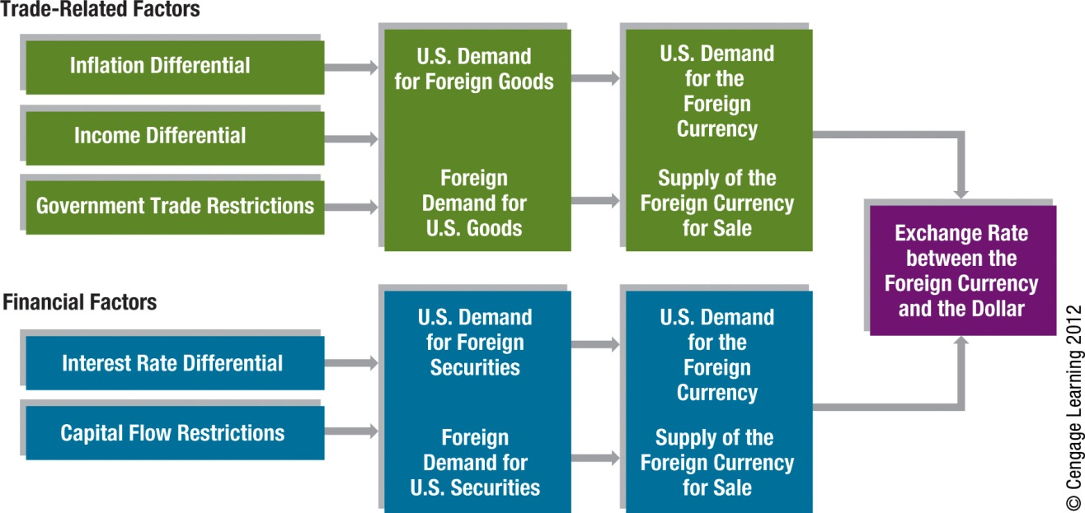
Exhibit 4.8 Summary of How Factors Can Affect Exchange Rates
17

Slide 18
Movements in Cross Exchange Rates
If currencies A and B move in same direction, there is no change in the cross exchange rate.
When currency A appreciates against the dollar by a greater (smaller) degree than currency B, then currency A appreciates (depreciates) against B.
When currency A appreciates (depreciates) against the dollar, while currency B is unchanged against the dollar, currency A appreciates (depreciates) against currency B by the same degree as it appreciates (depreciates) against the dollar.

Slide 19
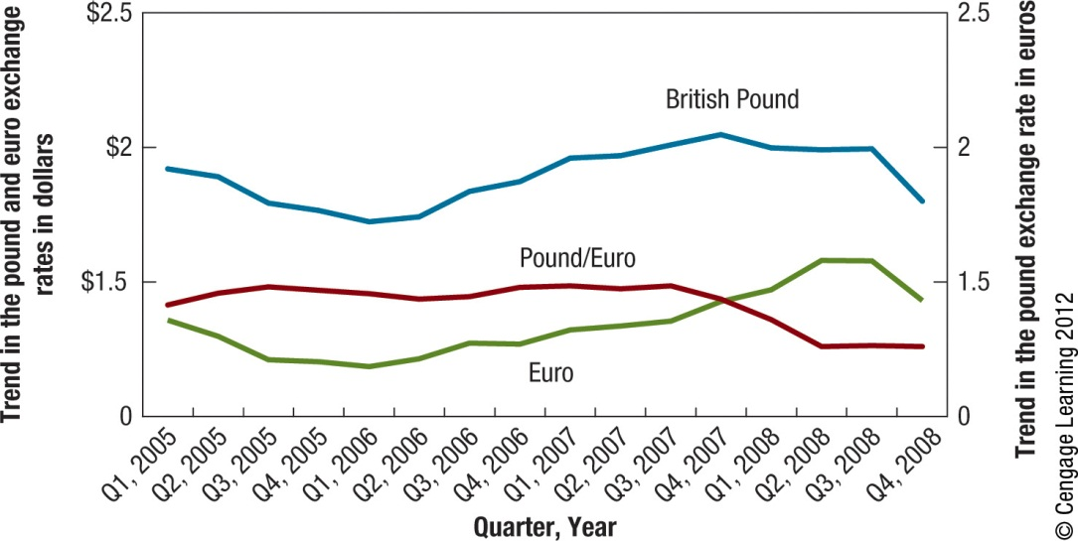
Exhibit 4.9 Trends in the Pound, Euro, and Pound/Euro
19

Slide 20
Anticipation of Exchange Rate Movements
Institutional speculation based on expected appreciation - When financial institutions believe that a currency is valued lower than it should be in the foreign exchange market, they may invest in that currency before it appreciates.
Institutional speculation based on expected depreciation - If financial institutions believe that a currency is valued higher than it should be in the foreign exchange market, they may borrow funds in that currency and convert it to their local currency now before the currency’s value declines to its proper level.
Speculation by individuals – Individuals can speculate in foreign currencies.
The “Carry Trade” – Where investors attempt to capitalize on the differential in interest rates between two countries.

Slide 21
SUMMARY
Exchange rate movements are commonly measured by the percentage change in their values over a specified period, such as a month or a year. MNCs closely monitor exchange rate movements over the period in which they have cash flows denominated in the foreign currencies of concern.
The equilibrium exchange rate between two currencies at any point in time is based on the demand and supply conditions. Changes in the demand for a currency or the supply of a currency for sale will affect the equilibrium exchange rate.

Slide 22
SUMMARY (Cont.)
The key economic factors that can influence exchange rate movements through their effects on demand and supply conditions are relative inflation rates, interest rates, and income levels, as well as government controls. As these factors cause a change in international trade or financial flows, they affect the demand for a currency or the supply of currency for sale and therefore affect the equilibrium exchange rate.
Unique international trade and financial flows between every pair of countries dictate the unique supply and demand conditions for the currencies of the two countries, which affect the equilibrium cross exchange rate. The movement in the exchange rate between two non-dollar currencies can be determined by considering the movement in each currency against the dollar and applying intuition.

Slide 23
SUMMARY (Cont.)
Financial institutions can attempt to benefit from expected appreciation of a currency by purchasing that currency. Conversely, they can attempt to benefit from expected depreciation of a currency by borrowing that currency, exchanging it for their home currency, and then buying that currency back just before they repay the loan.

