Slide 1
Using knowledge of pharmacokinetic parameters, clinicians can design optimal drug regimens, including the route of administration, the dose, the frequency, and the duration of treatment.
Consequently, through the study of pharmacokinetics, the researchers will be able to individualize therapy for the patient

Slide 2
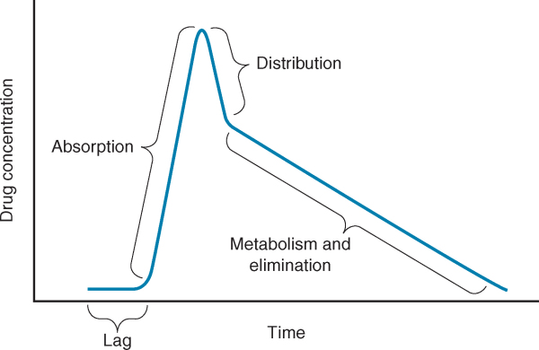

Slide 3
ABSORPTION OF DRUGS
Absorption is the transfer of a drug from the site of administration to the bloodstream.
The rate and extent of absorption depend on
the environment where the drug is absorbed
Chemical characteristics of the drug
The route of administration (which influences bioavailability).
Routes of administration other than intravenous may result in partial absorption and lower bioavailability

Slide 4
