Slide 1
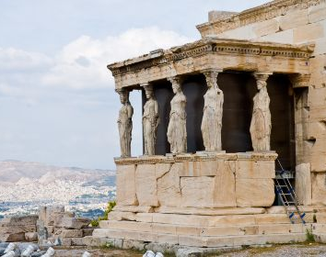
Modes of Philosophy

Slide 2
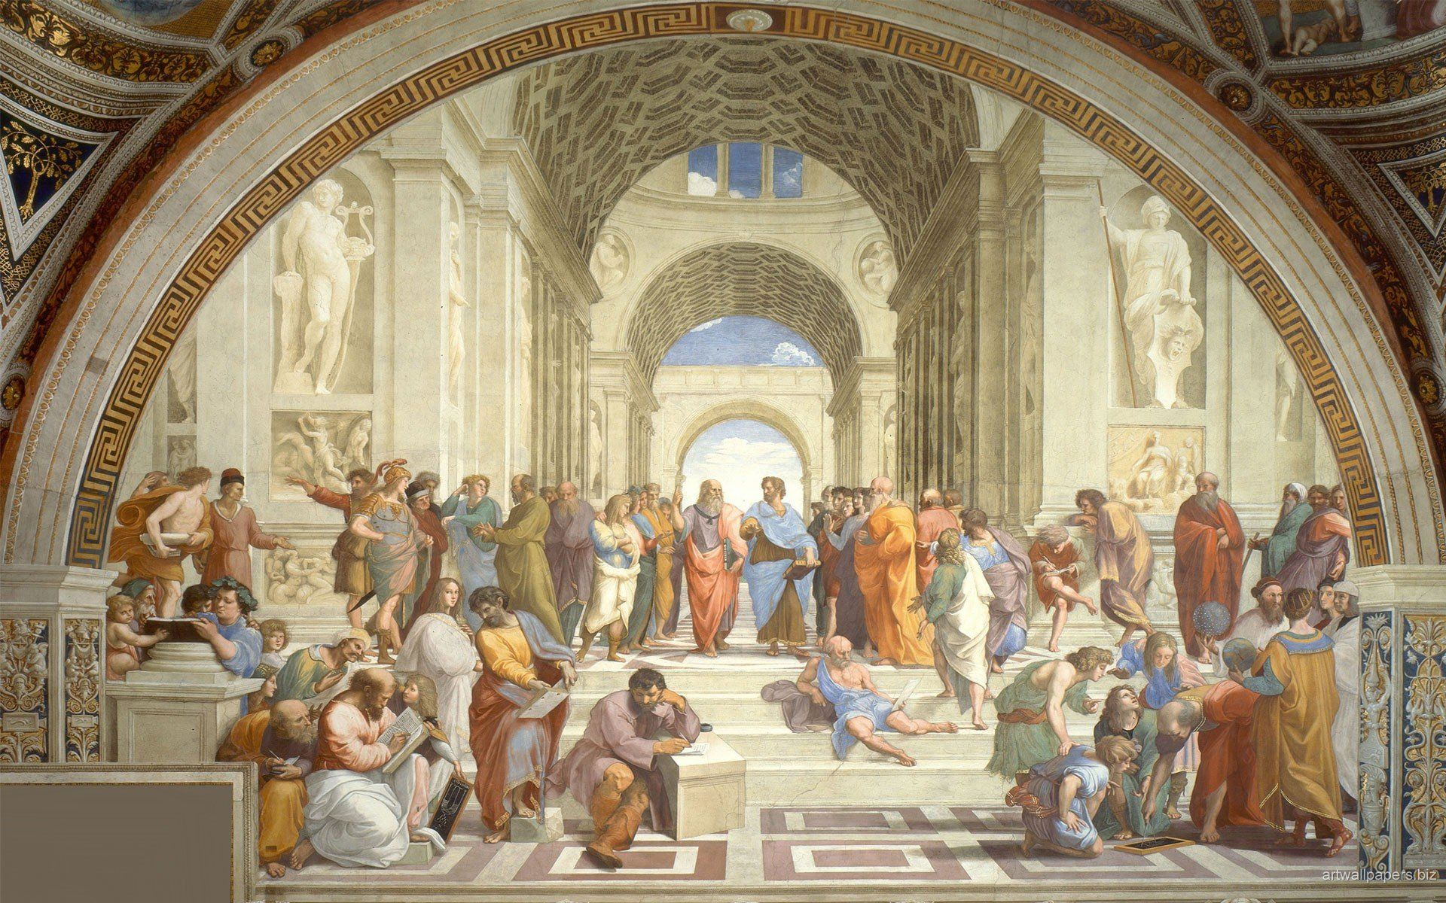
WHAT are the STYLES/ MODES of PHILOSOPHY
SPECULATIVE STYLE
PERSPECTIVE STYLE
ANALYTICAL STYLE

Slide 3
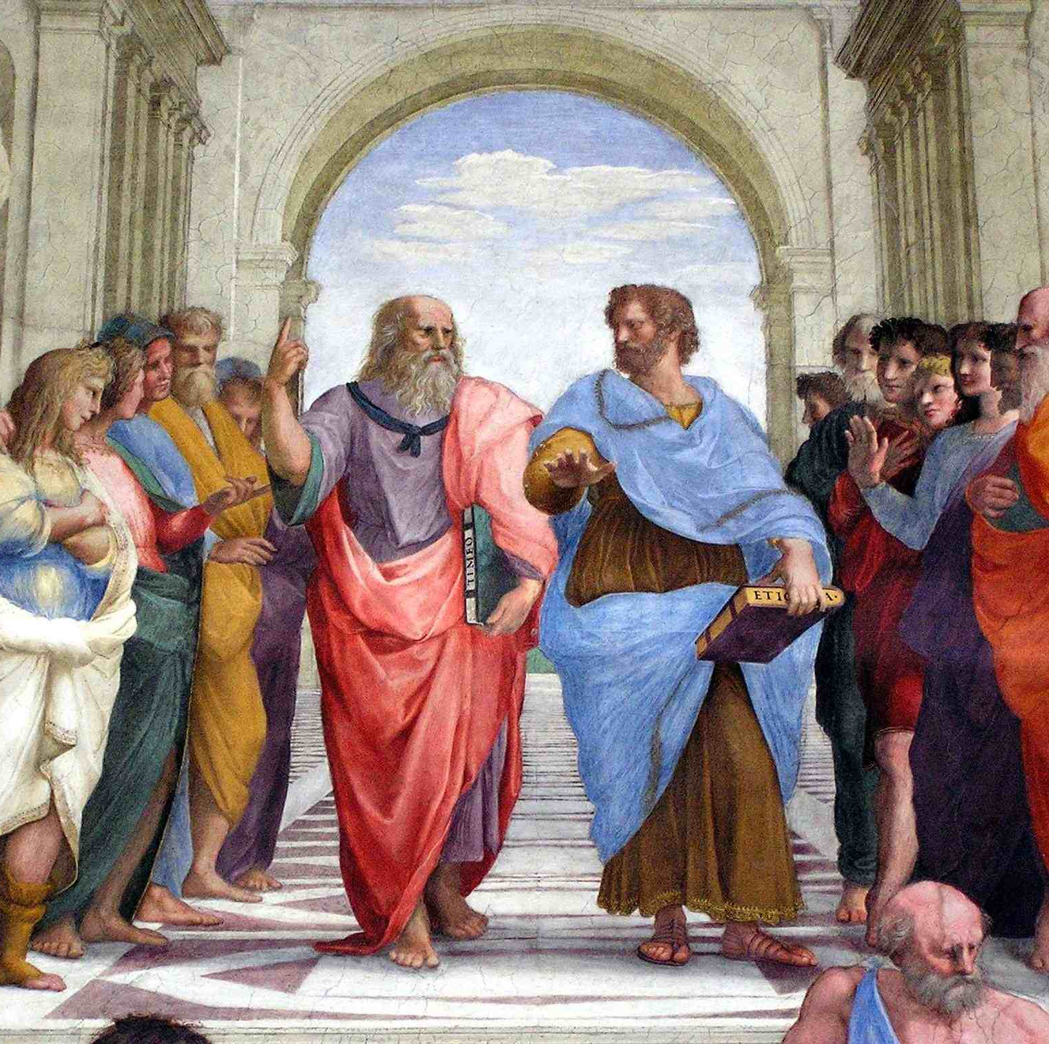
SPECULATIVE PHILOSOPHY
Speculative philosophy is concerned with developing theories regarding……..
Purpose of creation of man
Purpose of evolution of society
Thinking about various aspect of human personality
Questions related to Speculative philosophy
What does it mean to be?
What does it mean to think?
How are being and thought related?
What does it mean to ask these questions?

Slide 4
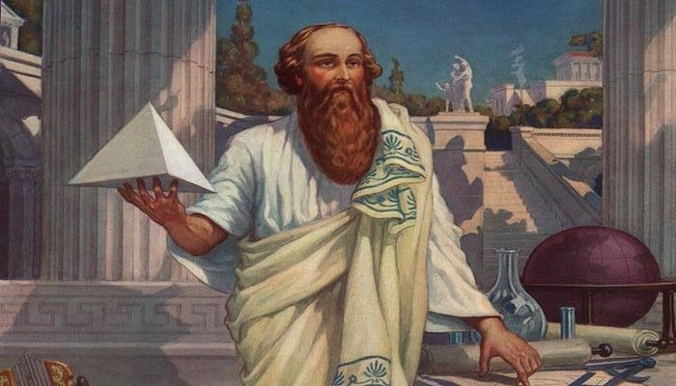
SPECULATIVE PHILOSOPHY
Speculative style is associated with ONTOLOGY ( The study of Metaphysics)
This style of philosophy deals with Theory Development
It focus on purpose of the creation of Man, different aspects of Human personality and evaluation of Human Society.
It focus on Whole of Reality. It is search of Order and Wholeness.
It uses Imagination for new possibilities.
It is not a scientific style. No focus on Empirical Evidences.
It is also called European Style of Philosophy
Big-bang Theory is example of this style.

Slide 5
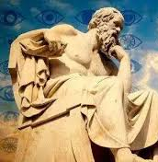
PERSPECTIVE PHILOSOPHY
Perspective philosophy evaluates various social values. It determines:
What is beauty?
What is good or bad?
What attitudes are better?
What values are better than others and beneficial for mankind?

Slide 6
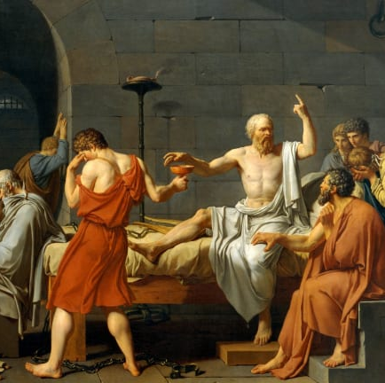
PERSPECTIVE PHILOSOPHY
It is associated with AXIOLOGY (the study of values).
It is also called Normative style.
It focuses on Values and Ideals, Right, Wrong.
Perspective Style of Philosophy seeks to establish standards for assessing values, judging conduct and appraising art.
It also examines what we mean by good and bad, right and wrong, beauty and ugly.
It also focus on how these things, good or bad effect our life.

Slide 7
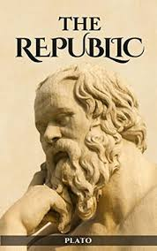
ANALYTICAL PHILOSOPHY
Analytical philosophy explains the whole with the help of the parts. Plato is the creator of this philosophy. He explains Ideal State by dividing the whole state into parts like social and civic institutions, citizens and groups.

Slide 8
ANALYTICAL PHILOSOPHY
Analytical style is associated with EPISTEMOLOGY (study of knowledge)
It is also called critical style.
The Philosophers belonging to this style are called Critics.
Analytical philosopher focuses on words and meaning.
The analytical philosophers examines such notions as course, mind, academic freedom, equality of opportunities etc., in order to the different meaning they carry in different context.

