Slide 1
HORT 308
MEDICINAL AND AROMATIC PLANTS

Slide 2
Lemon

Slide 3
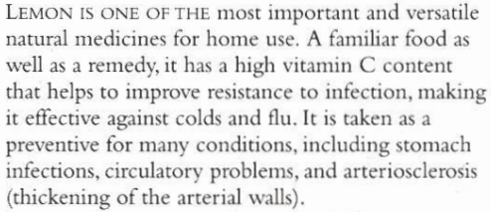
B.N Citrus limon Family: Rutaceae

Slide 4
Habitat & Cultivation
Native to India
Now cultivated in Mediterranean and subtropical areas of the world

Slide 5
Key Constituents
Volatile Oil (2.5% of peel), limonene
Coumarins
Bioflavonoids
Vitamins A₁, B₁, B₂, B₃ and C (40-50mg/100g of fruit)
Mucilage

Slide 6
Key Actions
Antiseptic
Antirheumatic
Antibacterial
Antioxidant
Reduce fever

Slide 7
Traditional & Current Uses
Valuable Medicine (Whole Book)
Established properties: After digestion, alkaline effect and reduce acidity which cause rheumatism
Volatile Oil: Antiseptics and antibacterial
Strengthens inner lines if blood vessels
General tonic & food
Juice is good for cold, flu and chest infections, acne, athlete’s foot, stings, ringworms and sunburn

Slide 8
Parts Used
Fruit
Peel
Pith

Slide 9
Key Preparations
Juice
Essential Oil

Slide 10
Coleus

Slide 11
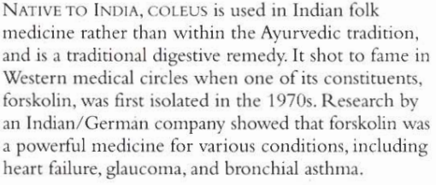
B.N Coleus forskohlii Family: Labiatae

Slide 12
Habitat & Cultivation
Native to India
Grown at dry slopes of Indian plains & in foothills of Himalayas
Sri Lanka, Nepal and parts of Eastern Africa
In Gujarat India grown for pickles approximately 1000 tons harvested yearly

Slide 13
Key Constituents
Volatile Oil
Diterpenes (forskolin)

Slide 14
Key Actions
Lowers B.P
Antispasmodic
Dilates bronchioles
Dilates blood vessesl
Heart tonic

Slide 15
Traditional & Current Uses
Digestion Remedy: Gas , abdominal discomfort
Circulatory Remedy: Improves blood supply to brain
Respiratory problems
Glaucoma (excess pressure in eyes)

Slide 16
Parts Used
Leaves (Fresh & Dried)
Roots (Dried)

Slide 17
Key Preparations
Infusion
Decoction

