Slide 1
虛擬化技術 Virtualization Technique
System Virtualization
Memory Virtualization

Slide 2
Agenda
Basic concept of memory management
Memory Virtualization
Shadow page table

Slide 3
Basic concept of memory management

Slide 4
Memory Management Unit
A hardware component responsible for handling accesses to memory requested by the CPU
Address translation: virtual address to physical address (VA to PA)
Memory protection
Cache control
Bus arbitration
Page tables are maintained by operating system, and MMU only references them.
TLB updates are performed automatically by page-table walking hardware
Notes:
Memory access is done through a TLB to speed up the virtual address translation done by the MMU. This is regardless of whether or not the system implements virtual memory. Whenever a memory reference is made, CPU generates a logical or virtual address which needs to be translated to a corresponding physical address for the desired memory location or offset in main memory. This translation is done via a lookup table (known as page table on a paging system) that stores mappings from virtual page numbers to their corresponding physical page (aka frame) numbers. This lookup table or page table can be implemented purely in hardware (CPU registers), but owing to size requirements, it has to be maintained as a separate data structure in main memory (DRAM). Thus, when the virtual to physical address translation happens, 2 memory accesses are required
First for the page table to get the physical frame number which is then combined with an offset (within the frame) to get the actual physical address of the memory location referenced by CPU.
Second for the access done to the desired memory location with the physical address computed above.

Slide 5
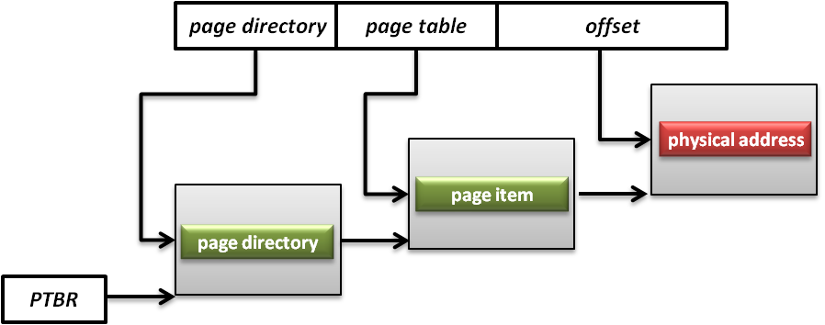
Page Tables
A page table is the data structure used by a virtual memory system to store the mapping between virtual addresses and physical addresses
Translation table base register(TTBR)
Also called page table base register
A register that stores the address of the base page table for MMU
Notes:
In a traditional system there are typically 2 address spaces – the virtual address space (VAS) and the physical address space (PAS). The OS and user processes run in the VAS. The OS manages the mapping from VAS to PAS through the use of the Memory Management Unit (MMU) provided in the processor. The OS maintains a page table that maps each page in the current VAS to a page in the PAS. Typically the OS will maintain one page table per user level process

Slide 6
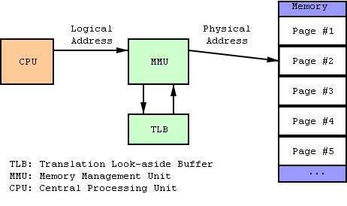
TLB
Translation look-aside buffer
A CPU cache that memory management hardware uses to improve virtual address translation speed
The TLB is typically implemented as content-addressable memory (CAM)
The CAM search key is the virtual address and the search result is a physical address

Slide 7
VA -> PA mapping
Virtual address (VA) = virtual page number + page offset
Let page size is 4kB
=> log₂(page_size) => log₂(4000) => 12 bits for page offset
Let 0xFc51908b is a 32 bit address VA
Fc519 is an index in page table which tells the corresponding frame number
Suppose frame number is 00512
physical address(PA)= frame number + Page offset
PA => 0x0051208b

Slide 8
Memory Virtualization
Concepts
Shadow page table
Hardware assistance
Comparison

Slide 9
Memory Management on a VM
Traditionally, OS fully controls all physical memory space and provides a continuous addressing space to each process
Guest OS is just one of user space processes of host OS
If guest OS is allowed to access the physical memory arbitrarily, then what happens?
In system virtualization, VMM should make all virtual machines share the physical memory space

Slide 10
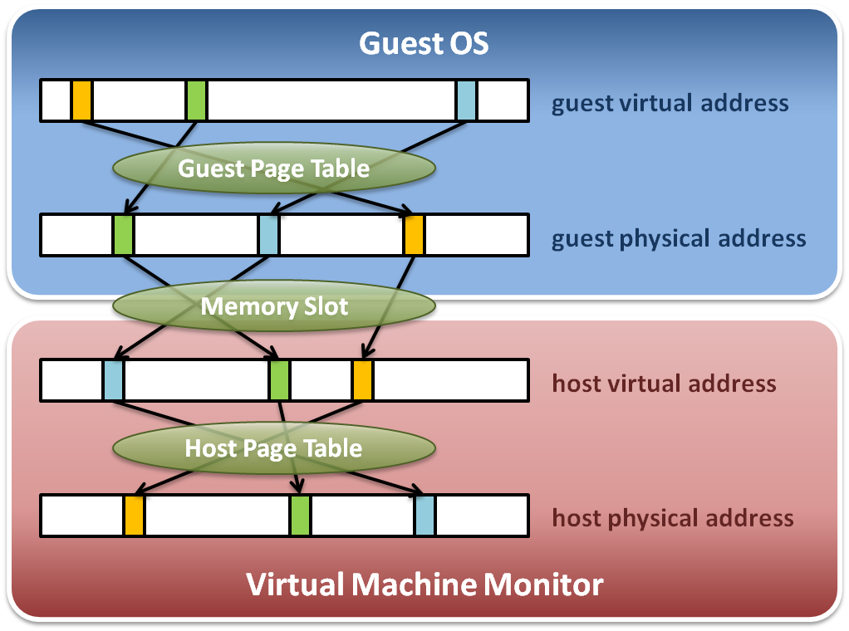
Memory Virtualization
Memory virtualization architecture

Slide 11
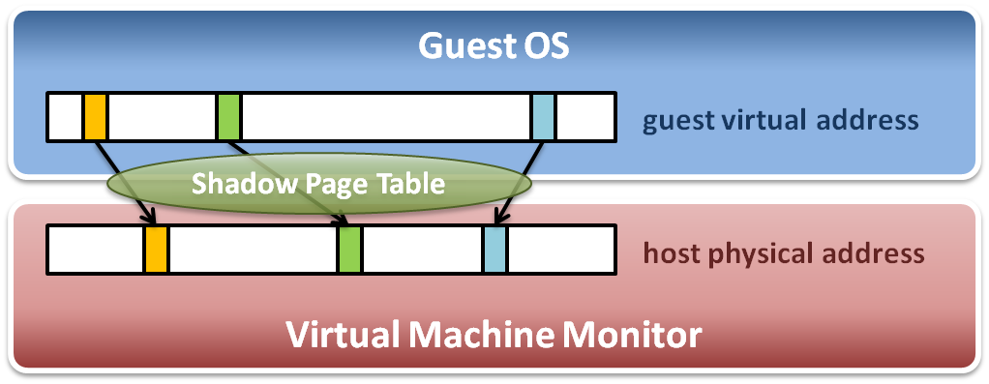
Memory Virtualization
The performance drop of memory access is usually unbearable. VMM needs further optimization.
VMM maintains shadow page tables :
Direct virtual-to-physical address mapping
Use hardware TLB for address translation

Slide 12
Memory Virtualization
Concepts
Shadow page table
Hardware assistance
Comparison

Slide 13
Shadow Page Table
Map guest virtual address to host physical address
Shadow page table
Guest OS will maintain its own virtual memory page table in the guest physical memory frames.
For each guest physical memory frame, VMM should map it to host physical memory frame.
Shadow page table maintains the mapping from guest virtual address to host physical address.
Page table protection
VMM will apply write protection to all the physical frames of guest page tables, which lead the guest page table write exception and trap to VMM.

Slide 14
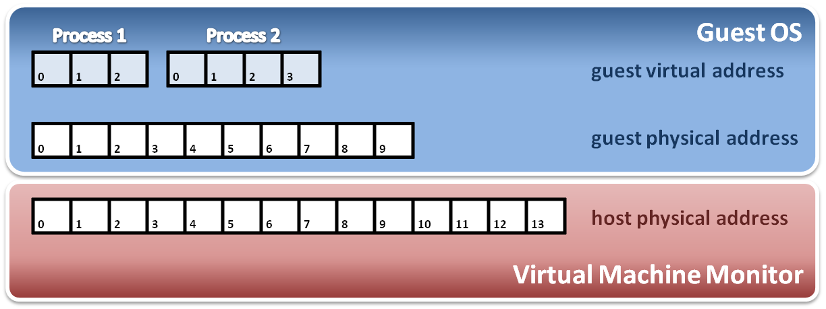
Shadow Page Table
Construct shadow page table
Guest OS will maintain its own page table for each process.
VMM maps each guest physical page to host physical page.
Create shadow page tables for each guest page table.
VMM should protect host frame which contains guest page table. (that means to write protect the guest page tables in host memory)
Write protection

Slide 15
SPT Maintenance
If guest OS modify one of its page tables, then the corresponding entry of SPT must be updated.
We call it “shadow” because SPT is just like the shadow of page tables of guest OS.
How to identify this kind of modification?
Guest OS could read/write a physical frame with the help of SPT.
Mark those physical frames used as guest page tables read-only, so that when a guest OS tries to modify its guest page table, an exception would be triggered.
Then VMM checks the modification and updates the corresponding entry on SPT

Slide 16
Shadow Page Table
Shadow page table operations :
Context switch
New process
Access
Process 1
Page Table
Process 2
Page Table
Process 3
Page Table
Virtual PTPR
Guest OS
Real PTPR
VMM
Page fault !
Shadow 1
Page Table
Shadow 1
Page Table
Shadow 3
Page Table
Load !
Corresponding mapping table
Switch the pointer to new location
Create new shadow page table mapping to new process

Slide 17
Big Overhead
A page fault caused by guest OS would launch the walking process that costs a lot of overhead.
Several steps to get a new entry on shadow page table
Walk page tables on guest OS
Check the permission on guest
Offset shift: GPA to HVA
Walk page tables on VMM
Check the permission on VMM
New entry established!
Invalidate the TLB entry
Each new process on guest OS would consume two pages. One is the page table on guest OS, and the other is the corresponding shadow page table.

Slide 18
Other Issues
Page fault and page protection issue
When a physical page fault occurs, VMM needs to decide whether this exception should be injected to guest OS or not
If the page entry in a guest page table is still valid, VMM prepares for the corresponding page and does not inject any exception to guest OS.
If the page entry in a guest page table is invalid, then VMM directly injects the virtual page fault to guest OS.

