Slide 1
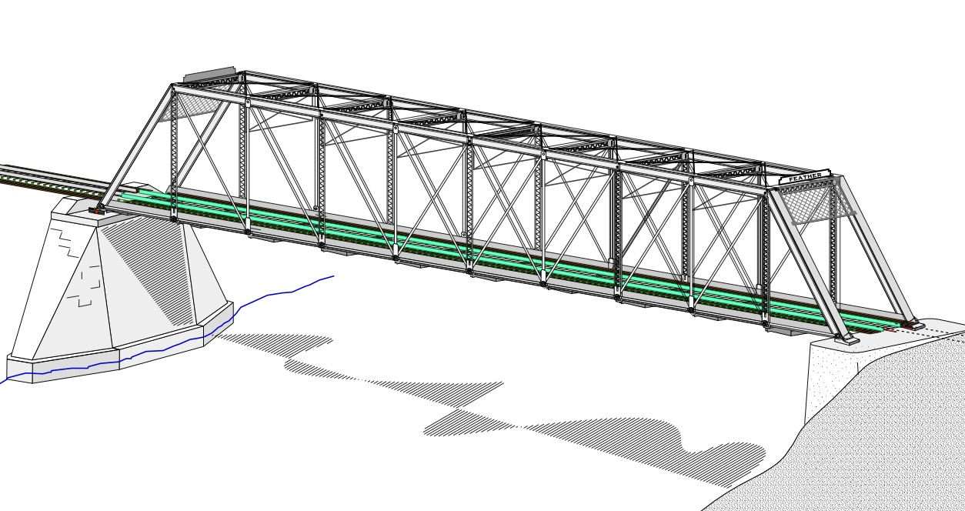
COLLEGE OF ENGINEERING AND TECHNOLOGY UNIVERSITY OF SARGODHA STEEL STRUCTURES (CT-313) (B.S TECHNOLOGY)
LECTURE-46, 47 & 48
CONNECTIONS
Engineer Aqeel Ahmed
Lecturer, Civil Engineering Department
CET, UOS, Sargodha

Slide 2
Connections
Connections of structural steel members are of critical importance.
An inadequate connection, which can be the “Weak Link” in a structure has been the cause of numerous failures.
Failure of structural member is rare; most structural failures are the result of poorly designed or detailed connections.
The problem is compounded by confusion that sometimes exists regarding responsibility of for the design of connections.
In many cases, the connections are not designed by the same engineer structure who designs the rest of the structure, but by someone associated with steel fabricator who furnishes the material for the project.
The structural engineer responsible for the production of the design drawings, however, is responsible for the complete design, including the connections .

Slide 3
Connections…..
It is therefore incumbent upon the engineer to be proficient in connection design, if only for the purpose of validating a connection designed by else.
Modern Steel Structures are connected by welding or bolting (either High -Strength or “common” bolts) or by a combination of both.
Until fairly recently, connections were either welded or riveted.
In 1947, the Research Council of Riveted and Bolted Structural joints was formed and its first specification was issued in 1951.
This document authorized the substitution of high-strength bolts for rivets on a one-for-one basis.
Since that time, high strength bolting has rapidly gained in popularity and today the widespread use of high-strength bolts has rendered the rivet obsolete in civil engineering structures.

Slide 4
Connections…..
There are several reasons for this change.
Two relatively unskilled workers can install high strength-strength bolts, whereas four skilled workers were required for riveting.
In addition, the riveting operation was noisy and somewhat dangerous because of the practice of tossing the heated rivet from the point of heating to the point of installation.
Riveted connection design is no longer covered by AISC specification but many existing structures contain riveted joints and the analysis of these connection is required for the strength evaluation and rehabilitation of older structures.
Welding has several disadvantages over bolting.
A welded connection is often simpler in concept and requires few, if any, holes (sometimes erection bolts may be required to hold the member in position for the welding operation).

Slide 5
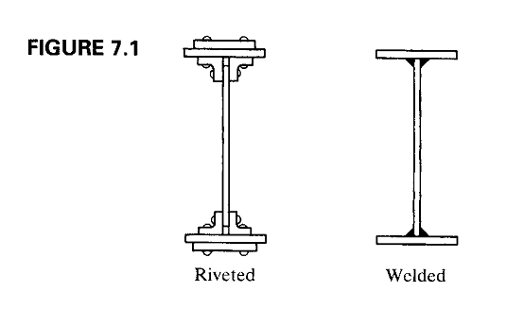
Connections…..
Connections that are extremely complex with fasteners can become very simple when welds are used.
A case in point is the plate girder shown in figure 7.1. before welding became widely used, this type of built up shape was fabricated by riveting.

Slide 6
Connections…..
To attach the flange plates to the web plates, angle shapes were used to transfer load between the two elements.
If cover plates were added, the finished product became even more complicated.
The welded version however, is elegant in its simplicity.
On the negative side, the skilled workers are required for welding and inspection can be difficult and costly.
This last disadvantage can be partially overcome by using shop welding instead of field welding whenever possible.
Quality welding can be more easily ensured under the controlled conditions of fabricating shop.
When a connection is made with a combination of welds and bolts, welding can be done in the shop and bolting in the filed.

Slide 7
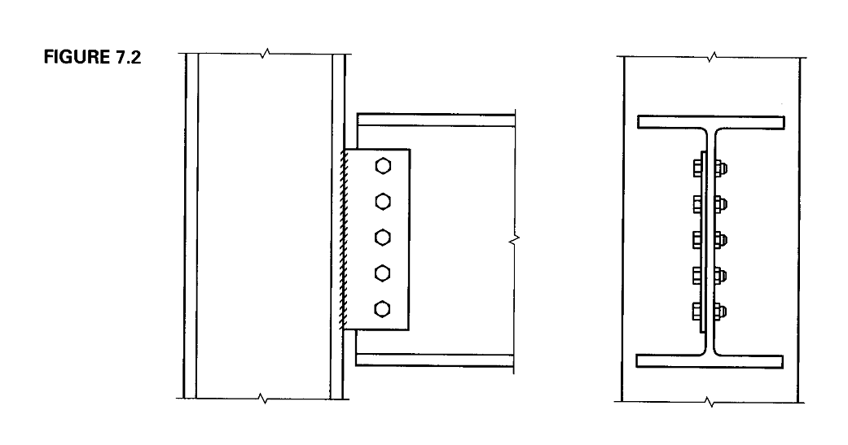
Connections…..
In the single-plate beam-to-column connection shown in figure 7.2, the plate is shop welded to the column flange and filed bolted to the beam web.

Slide 8
Connections…..
In considering the behavior of different types of connections, it is convenient to categorize them according to the type of loading.
The tension member splices shown in figure- 7.3 a and b subject the fasteners to forces that tend to shear the shank of fasteners

Slide 10
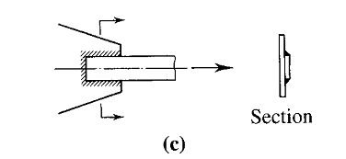
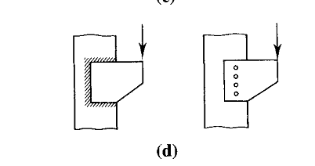
Connections…..
Similarly, the weld shown in figure 7.3 c must resist shear forces.
The connection of a bracket to a column flange as in figure 7.3 d, whether by fasteners or welds, subjects the connection to shear when loaded as shown.

Slide 11
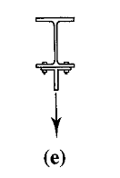
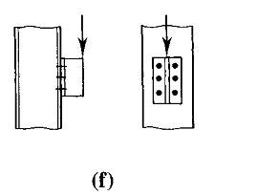
Connections…..
The hanger connection shown in figure 7.3 e puts the fasteners in tension.
The connection shown in figure 7.3 f produces both shear and tension in the upper row of fasteners.
The strength of fastener depends on whether it is subjected to shear or tension or both.
Welds are weak in shear and are usually assumed to fail in shear regardless of the direction of loading.
Once the force per fastener or force per unit length of weld has been determined, it is a simple matter to evaluate the adequacy of the connection.

Slide 12
Connections…..
This determination is the basis for the two major categories of connections.
If the line of action of the resultant force to be resisted passes through the center of gravity of the connection, each part of the connection is assumed to resist an equal share of the load and the connection is called a Simple Connection.
In such connections illustrated in figure 7.3 a, b and c, each fastener or each unit length of weld will resist an equal amount of force. (there is actually a small eccentricity in the connections of figure 7.3a, b and c).
The load capacity of the connection can then be found by multiplying the capacity of each fastener or inch of weld by the total number of fasteners or the total length of the weld.
Eccentrically loaded / Eccentric connections are those in which the line of action of load does not act through the center of gravity of the connection

Slide 13
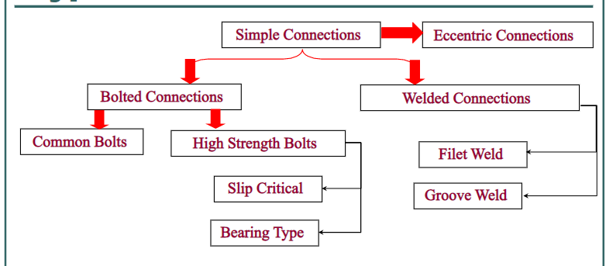
Connections…..
The connections shown in figure 7.3 d and f are of this type.
In these cases, the load is not resisted equally by each fastener or each segment of weld and the determination of distribution of the load is the complicating factor in the design of this type of connection.
The AISC specification deals with connections in chapter J, “Design of Connection” where bolts and welds are covered.

Slide 14
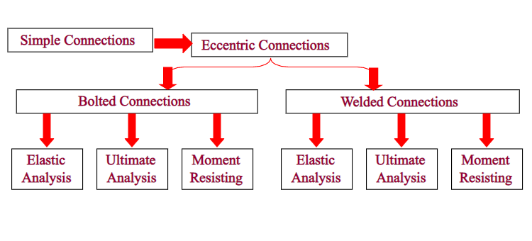
Connections……..

Slide 15
Bolted Shear Connections: Failure Modes
Before considering the strength of specific grades of bolts, we need to examine the various modes of failure that are possible in connections with fasteners subjected to shear.
There are two broad categories of failure: failure of the fasteners and failure of the parts being connected.
Consider the lap joint shown in figure 7.4a, failure of the fastener can be assumed to occur as shown.
The average shearing stress in this case will be
Where P is the load acting on an individual fastener, A is the cross-sectional area of the fastener and d is its diameter.

Slide 16
Bolted Shear Connections: Failure Modes…….
The load can be written as:
Although the loading in this case is not perfectly concentric, the eccentricity is small and can be neglected.
The connection in Figure-7.4b is similar, but analysis of free body diagrams of portions of fastener shank shows that each cross-sectional area is subjected to half the total load, or , equivalently, two cross-sections are effective in resisting the total load.
In either case, the load is and this loading is called double shear.
The bolt loading in the connection in figure-7.4a, with only one shear plane is called single shear.
The addition of thickness of material to the connection will increase the number of shear planes and further reduce the load on each plane, however, that will increase the length of the fastener and could subject it to bending.

Slide 17
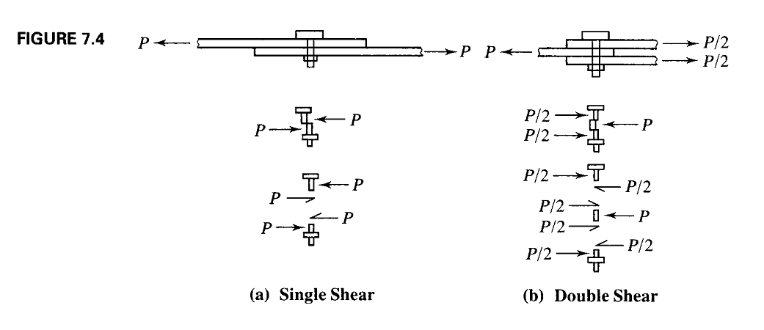
Bolted Shear Connections: Failure Modes…….

Slide 18
Bolted Shear Connections: Failure Modes…….
Other modes of failure in shear connections involve failure of parts being connected and fall into two categories:
FAILURE RESULTING FROM EXCESSIVE TENSION, SHEAR, OR BENDING IN THE PARTS BEING CONNECTED
If a tension member is being connected, tension on both gross area and effective net area must be investigated.
Depending on the configuration of connection, block shear might also need to be considered.
Block shear must also be examined in beam-to-column connections, in which the top flange of the beam is coped.
The design of a tension member will usually be done in parallel with the design of the member itself because the two processes are interdependent.

Slide 19
Bolted Shear Connections: Failure Modes…….
FAILURE OF THE CONNECTED PART BECAUSE OF BEARING EXERTED BY THE FASTENER
If the hole is slightly larger than the fastener and the fastener is assumed to be placed loosely in the hole, contact between the fastener and the connected part will exist over approximately half the circumference of the fastener when a load is applied.
This condition is illustrated in figure-7.5.
The stress will vary form a maximum at A to zero at B.
For simplicity, an average stress computed as the applied force divide by the projected area of contact is used.
Thus the bearing stress would be computed as where P is the force applied to the fastener, d is the fastener diameter and t is the thickness of part subjected to the bearing. The load will be

Slide 20
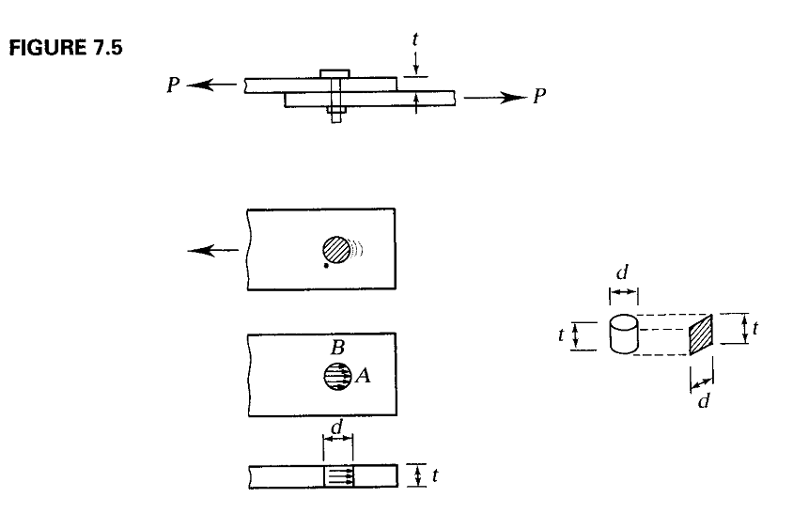
Bolted Shear Connections: Failure Modes…….

Slide 21
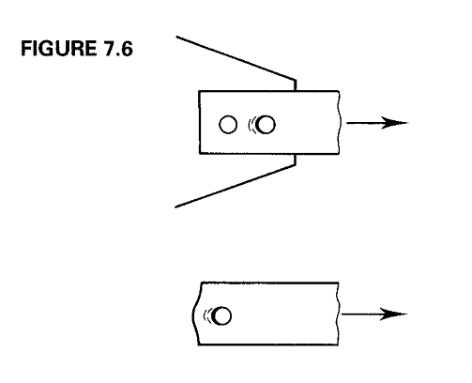
Bolted Shear Connections: Failure Modes…….
FAILURE OF THE CONNECTED PART BECAUSE OF BEARING EXERTED BY THE FASTENER………………
The bearing problem can be complicated by the presence of a nearby bolt or the proximity of a edge in the direction of load as shown in figure 7.6.
The bolt spacing and edge distance will have an effect on the bearing strength.

Slide 22
THANKS

