Slide 1
Lecture 12
Using Business Normalization for Future Business Needs

Slide 2
Introduction
Normalization was developed in the late 1960s by Dr. Edgar (Ted) Codd.
while working on relational theory as a research fellow at the IBM San Jose Research Laboratory.
He applied mathematical set theory as a formal discipline to identify and structure data in relational databases.
Business normalization resolves redundant data and inconsistent information problems.
It identifies the data resource needed by the business.
Redundant versions are combined as an integrated.
When updated, information derived from it is accurate and consistent and is available to all who are authorized to access it.

Slide 3
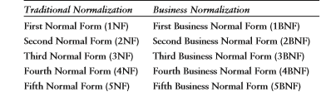
Business Normalization
Business normalization is used by business managers and business staff, as well as by IT computer staff.
It depends on knowledge of the business, rather than of computers.
Both variants of normalization define five normal form rules: First Normal Form (1NF) to Fifth Normal Form (5NF) for traditional normalization; and First Business Normal Form (1BNF) to Fifth Business Normal Form (5BNF) for business normalization.

Slide 4
First Business Normal Form (1BNF)
The rule for 1BNF is expressed as follows.
First Business Normal Form (1BNF) Rule
1BNFStep1: Identify and remove repeating group attributes to another entity.
1BNF Step 2: The primary key of this other entity is made up of a compound key, comprising the primary key of the entity in which the repeating group originally resided together with the repeating group key itself, or instead another unique key based on business needs.
1BNF Step 3: The name of the new entity initially may be based on a combination of the name of the repeating group and the name of the entity in which the repeating group resided.
1BNF Step 4: It may later be renamed according to its final attribute content after business normalization is completed.

Slide 5
First Business Normal Form (1BNF)EXAMPLE
EMPLOYEE (employee number#, [name], (address), [postcode], ((skill number#, [skill name], skill level)), sales quota, [manager title], job name, salary)
LEGEND primary key#, [selection attribute], (group attribute), {derived attribute}, non key attribute, ((repeating group)), foreign key#

Slide 6
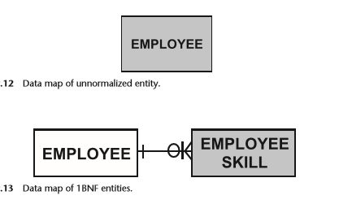
First Business Normal Form (1BNF)EXAMPLE
EMPLOYEE (employee number#, [name], (address), [postcode], sales quota, [manager title], job name, salary)
EMPLOYEE SKILL (employee number#, skill number#, [skill name], skill level)
“skills will eventually be gained by many employees (such as through training)

Slide 7
Second Business Normal Form (2BNF)
The rule for 2BNF is shown next.
Second Business Normal Form (2BNF) Rule
2BNF Step 1: Identify and remove to another entity those attributes which are only partially dependent on the primary key and also dependent on one or more other key attributes, or ...
2BNF Step 2: which are dependent on only part of the compound key and possibly one or more other key attributes.

Slide 8
Second Business Normal Form (2BNF)EXAMPLE
Skill level is the level of a skill held by an employee. It is dependent on both key attributes and does not satisfy the 2BNF rule. It remains in EMPLOYEE SKILL.
EMPLOYEE SKILL (employee number#, skill number#, skill level)
Skill name depends only on skill number#. It is not at all dependent on employee number#. It satisfies the 2BNF rule and so is moved into a new entity SKILL.
SKILL (skill number#, [skill name])
EMPLOYEE SKILL now contains only attributes that depend on the entire compound primary key, and so is in 2BNF. The 2BNF result is shown next.
EMPLOYEE (employee number#, [name], (address), [postcode], sales quota, [manager title], job name, salary)
EMPLOYEE SKILL (employee number#, skill number#, skill level)
SKILL (skill number#, [skill name])

Slide 9
Second Business Normal Form (2BNF)EXAMPLE
Similarly,SKILL and EMPLOYEE SKILL have a common key (skillnumber#) and so are joined.
Skillnumber # is the primary key of SKILL so the degree and nature at SKILL is mandatory one.
Skill number# is part of the compound key of EMPLOYEE SKILL, so the association degree at EMPLOYEE SKILL is many.
Its nature depends on business rules: We will use optional becoming mandatory to show “a skill will be gained, or learned, by employees through training.

