Slide 1
THE DEVELOPMENT PROCESS

Slide 2
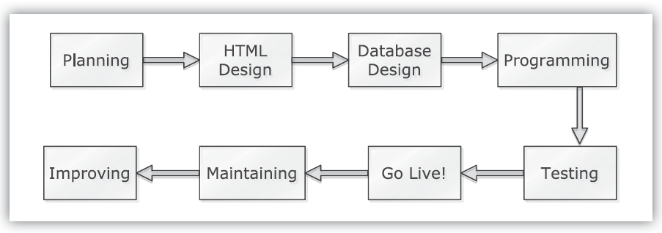
THE DEVELOPMENT PROCESS
After you’ve finalized your business plan, researched the laws, decided upon a hosting company, and selected a payment system, it’s time to start putting down HTML tags, SQL commands, and if-then statements.

Slide 3
Site Planning
What should the site do?
What should it look like?
Who are the target users?
What browsers and/or devices should the site support?
Use pen and paper, or any application in which you can make notes, and be as inclusive as you possibly can.

Slide 4
Site Planning (Cont..)
The best thing you can do at this point is look online. The Web is a rich collection of both the good and the bad, so look at the sites you like and use.
What do they do well? What would you do differently? What fonts, colors, and designs appeal to you?
There’s an old adage about writing: good writers borrows, great ones steal. That’s kind of true for the Web sites, too.

Slide 5
HTML Design
Two simple solutions:
Hire a qualified designer to create the HTML templates.
Use an off-the-shelf design that you tweak a bit.
If you don’t have the budget or time to purchase a custom design, you can take an existing one and modify it to your needs.
Some designs are free to use as long as you give credit to the designer in the footer. Other designs are free for noncommercial use but require licenses for commercial endeavors.
In any case, you can take the existing template and then adjust the HTML and CSS to personalize the design for your or your client’s tastes.

Slide 6
HTML Design (Cont..)
Think about:
How will the look and function of the site be different if the user is logged in?
How will navigation be handled?
How are items added to the cart?
How will the cart contents be shown?
Also pay attention to the fundamentals of the user interface: simplicity, ease of use, proper navigation, obvious access to the cart, and so on.

Slide 7
Database Design
Designing the database is a key step, largely because changes to the database at a later date have far larger implications and potential complications than changing any other aspect of the site.
Make every effort you can to get the database design right the first time.
Good database design begins, with normalizing the database.
Normalization and performance mean that you also:
Use the smallest possible column types.
Avoid storing NULL values as much as possible.

Slide 8
Database Design (Cont..)
Use fixed-length columns when you can.
Provide default values for columns, if applicable.
Performance is also greatly affected by using indexes properly. Declaring indexes is somewhat of an art, but some general rules are:
Index columns that will be involved in WHERE and ORDER BY clauses.
Avoid indexing columns that allow NULL values.
Apply length restrictions to indexes on variable-length columns, such as indexing only the first 10 characters of a person’s last name.
Use EXPLAIN queries to confirm that indexes are being used.
Revisit your indexes after some period of site activity to ensure they are still
appropriate to the real-world data.

Slide 9
Programming
From a programming perspective, you’ll want to create code that’s not only functional, but also reusable, extendable, and secure.
To make reusable, extendable code, it must be well organized and thoroughly documented.
When you make any changes to your code, double-check that the comments remain accurate.
You should also use flowcharts, UML diagrams, and other tools to outline and represent your site in graphical and noncode ways.

Slide 10
Programming (Cont..)
Depending upon the circumstances, you may also want to look into version control software such as subversion or Git.
Version-control software makes site updates a smoother process, allowing you to accurately implement all site changes or roll back problems to previously sound states.
If you’re developing a site with a team of people, version control will help manage the shared files.

Slide 11
Testing
Testing your Web site isn’t a one-time, standalone step, but rather something you’ll need to do often.
it’s hard for the site developer to perform a truly good test of the site: He or she created it, so he or she knows how it should work and uses it accordingly.
A better test is what happens when your family, coworkers, and annoying friends give the site a whirl. And I specify the annoying friends, because they’re the ones who will attempt to do things you never would have imagined.
When these people, who aren’t Web developers themselves, purposefully or accidentally misuse the site, what happens? From these experiences you can improve the user interface and security of the whole application.

Slide 12
Testing
A different type of site testing you could address is performance.
If you want to start with the big picture—how well the server copes with demand—software like Apache Bench and Siege will run benchmarks on your Web server, reporting on how many requests can be handled per second, which is the standard measuring tool for a site’s performance.
Big, system wide changes you make will have the greatest impact. These include:
Changing the server hardware: increasing memory, installing faster hard drives, and using faster processors
Changing the demands on the server: disabling unnecessary features, putting fewer users or sites on a single server, and balancing loads across multiple servers:
Caching the database results

Slide 13
Going Live
Before going live, you should revisit all the legal and security issues to make sure the site is in full compliance.
Second, have a plan in place for what should be done when something goes wrong (notice I said when, not if).
Third, if any assumptions were made in the code, or any dummy processes installed, remove those.
By “assumptions,” I mean things such as using the test version of the payment system, not requiring real authentication to the administration pages, and so forth.

Slide 14
Going Live
Soft opening.
During this period the business is open and fully functioning, but not promoting itself actively. The hope is that the arrival of some traffic will catch issues and allow for improvements, without attempting to do so under the burden of a full user base. This is something you may want to consider as well.

Slide 15
Maintaining
Depending upon the situation, going live may or may not be the end of your involvement with the project.
Make sure that there are backups kept in multiple locations, too, so that a natural or man made disaster doesn’t wipe out both your server and your backups.
The maintenance of a site also requires that you keep an eye on the data itself.
Check and optimize your database tables to improve their performance. Watch your database logs for slow and underperforming queries.
Review your Webserver logs for file not found errors, high loads, and potential security problems.
Analyze your data to find sales trends and places where you can make improvements.
In short, collect and examine as much information as you can. And keep making backups!

Slide 16
Improving
The final step in the development process is improving what you’ve created.
Improvements may stem from the client, from customer feedback, or changes
in available technologies.
Improving a site is really a subroutine of this entire development process: Think about what you want to change, plan its implementation, mock up the design, retool the database, write the code, test the end result, go live, and maintain the updated version of the site.

