Slide 1
Sociology ^{BBA} Semester: 3rd ^{Lecture No. 14} ^{Instructor: Mumtaz Hussain} University of Sargodha Sb Campus ^{Bhakkar}

Slide 2
Understanding the Socialization:
Every society is faced with the necessity of making a responsible member out of each child born into it. The child must learn the expectations of the society so that his behavior can be relied upon. He must acquire the group norms.
The society must socialize each member so that his behavior will be meaningful in terms of the group norms. In the process of socialization the individual learns the reciprocal responses of the society.
Socialization is a processes with the help of which a living organism is changed into a social being. It is a process through which the younger generation learns the adult role which it has to play subsequently. It is a continuous process in the life of an individual and it continues from generation to generation.

Slide 3
Meaning of Socialization:
The newborn is merely an organism. Socialization makes him responsive to the society. He is socially active. The process indeed, is endless. The cultural pattern of his group, in the process gets incorporated in the personality of a child.
It prepares him to fit in the group and to perform the social roles. It sets the infant on the line of social order and enables an adult to fit into the new group. It enables the man to adjust himself to the new social order.
Socialization stands for the development of the human brain, body, attitude, behavior and so forth. Socialization is known as the process of inducting the individual into the social world.
The term socialization refers to the process of interaction through which the growing individual learns the habits, attitudes, values and beliefs of the social group into which he has been born.

Slide 4
The process operates at two levels, one within the infant which is called the internalization of objects around and the other from the outside. Socialization may be viewed as the “internalization of social norms. Social rules become internal to the individual, in the sense that they are self-imposed rather than imposed by means of external regulation and are thus part of individual’s own personality.
The individual therefore feels an urge to conform. Secondly, it may be viewed as essential element of social interaction. In this case, individuals become socialized as they act in accordance with the expectations of others. The underlying process of socialization is bound up with social interaction.
Socialization is a comprehensive process. According to Horton and Hunt, Socialization is the process whereby one internalizes the norms of his groups, so that a distinct ‘self emerges, unique to this individual.

Slide 6
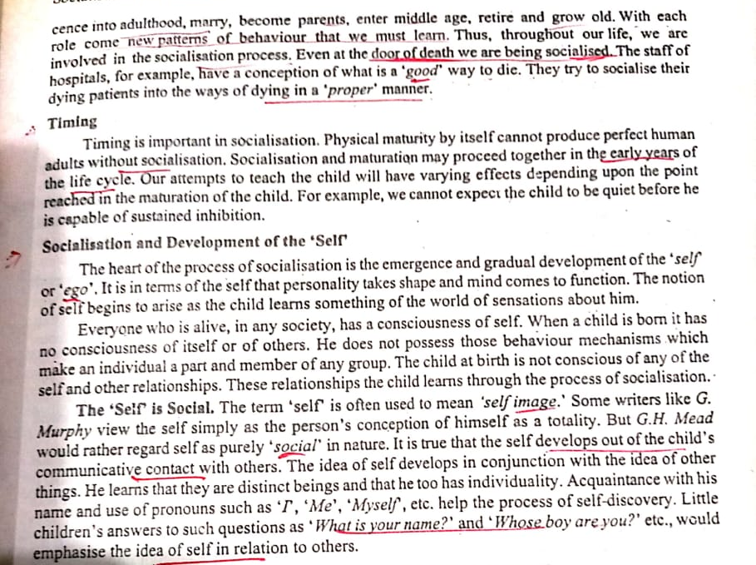

Slide 7
Features of socialization may be discussed as under:
1. Inculcates basic discipline:
Socialization inculcates basic discipline. A person learns to control his impulses. He may show a disciplined behavior to gain social approval.
2. Helps to control human behavior:
It helps to control human behavior. An individual from birth to death undergoes training and his, behavior is controlled by numerous ways. In order to maintain the social order, there are definite procedures or mechanism in society. Through socialization, society intends to control the behavior of its-members unconsciously.
3. Socialization is rapid if there is more humanity among the- agencies of socialization:
Socialization takes place rapidly if the agencies’ of socialization are more unanimous in their ideas and skills. When there is conflict between the ideas, examples and skills transmitted in home and those transmitted by school or peer, socialization of the individual tends to be slower and ineffective.

Slide 8
4. Socialization takes place formally and informally:
Formal socialization takes through direct instruction and education in schools and colleges.
Family is, however, the primary and the most influential source of education. Children learn their language, customs, norms and values in the family.
5. Socialization is continuous process:
Socialization is a life-long process. It does not cease when a child becomes an adult. As socialization does not cease when a child becomes an adult, internalization of culture continues from generation to generation.
Society perpetuates itself through the internalization of culture. Its members transmit culture to the next generation and society continues to exist.

Slide 9
Types of Socialization:
Although socialization occurs during childhood and adolescence, it also continues in middle and adult age. Orville F. Brim (Jr) described socialization as a life-long process. He maintains that socialization of adults differ from childhood socialization. In this context it can be said that there are various types of socialization.
1. Primary Socialization:
Primary socialization refers to socialization of the infant in the primary or earliest years of his life. It is a process by which the infant learns language and cognitive skills, internalizes norms and values.
The infant learns the ways of a given grouping and is moulded into an effective social participant of that group.

Slide 10
The norms of society become part of the personality of the individual. The child does not have a sense of wrong and right. By direct and indirect observation and experience, he gradually learns the norms relating to wrong and right things. The primary socialization takes place in the family.
2. Secondary Socialization:
The process can be seen at work outside the immediate family, in the ‘peer group’. The growing child learns very important lessons in social conduct from his peers. He also learns lessons in the school. Hence, socialization continues beyond and outside the family environment. Secondary socialization generally refers to the social training received by the child in institutional or formal settings and continues throughout the rest of his life.
3. Adult Socialization:
In the adult socialization, actors enter roles (for example, becoming an employee, a husband or wife) for which primary and secondary socialization may not have prepared them fully. Adult socialization teaches people to take on new duties.

Slide 11
The aim of adult socialization is to bring change in the views of the individual. Adult socialization is more likely to change overt behavior, whereas child socialization moulds basic values.
5. Re-socialization:
Re-Socialization refers to the process of discarding former behavior patterns and accepting new ones as part of a transition in one’s life. Such re-socialization takes place mostly when a social role is radically changed. It involves abandonment of one way of life for another which is not only different from the former but incompatible with it. For example, when a criminal is rehabilitated, he has to change his role radically.

Slide 16
Thank You

