Slide 1
Software Testing & Quality Engineering
Chapter 10
-Software Verification and Validation
-Product Evaluation
Linda Westfall Quality Press

Slide 2
Objectives
Software Verification Method
Inspection
Demonstration
Test
Analysis
Software Validation Method
Black box testing
System testing
User Acceptance testing
Alpha testing
Beta Testing
White box testing
Unit Tetsting
Integaration Testing
Unit testing
Integration testing
Software Product Evaluation
Approaches to software evaluation
Evaluation Process

Slide 3
Software Verification Method: Software verification is a discipline of software engineering whose goal is to assure that software fully satisfies all the expected requirements. It is the static process of checking that a software system meets specifications and that it fulfills its intended purpose. It may also be referred to as software quality control.

Slide 4
Verification in Software Testing is a process of checking documents, design, code, and program in order to check if the software has been built according to the requirements or not. The main goal of verification process is to ensure quality of software application, design, architecture etc. The verification process involves activities like reviews, walk-throughs and inspection.

Slide 5
METHODS OF VERIFICATION: The four fundamental methods of verification are: 1- Inspection 2- Demonstration 3- Test 4- and Analysis. These four methods are somewhat hierarchical in nature, as each verifies requirements of a product or system with increasing rigor.

Slide 6
The four fundamental methods of verification are Inspection, Demonstration, Test, and Analysis. These four methods are: 1- Inspection is the nondestructive examination of a product or system using one or more of the five senses (visual, auditory, olfactory, tactile, taste). It may include simple physical manipulation and measurements.

Slide 7
2- Demonstration is the manipulation of the product or system as it is intended to be used to verify that the results are as planned or expected. 3- Test is the verification of a product or system using a controlled and predefined series of inputs, data, or stimuli to ensure that the product or system will produce a very specific and predefined output as specified by the requirements. 4- Analysis is the verification of a product or system using models, calculations and testing equipment. It is often used to predict the breaking point or failure of a product or system by using nondestructive tests to extrapolate the failure point.

Slide 8
Software Validation Method
Validation is the process of checking whether the software product is up to the mark or in other words software meets the requirements and expectations of a customer. It is the process of checking the validation of product i.e. It checks what we are developing is the right product. With the involvement of testing team validation is executed on software code. Validation is the dynamic testing.

Slide 9
Methods:
Activities involved in validation are:
Black box testing
White box testing
Unit testing
Integration testing

Slide 10
Black box Testing :
It is also called behavioral or/Specification based input/output testing. It is a software testing method in which the functionality of software are validated without having knowledge of internal code structure, implementation details and internal paths.
Black Box Testing mainly focuses on input and output of software applications and it is entirely based on software requirements and specifications in SRS document. It can be applied to every level of software testing like unit, integration, system and acceptance testing. It is further categorized.

Slide 11
System Testing:
System testing is performed by the testers team. It is defined as testing of a complete and fully integrated software product that is obtained after the code integration. The purpose of this test is to evaluate the system's compliance with the specified requirements.
User Acceptance Testing :
User Acceptance Testing (UAT) is a type of testing performed by the end user or the client to verify/accept the software system before moving the software application to the production environment. It ensures if the software meets the user’s requirement and performs as per the user experience. There are two types of UAT Testing that are alpha testing and beta testing.

Slide 12
Alpha Testing
Alpha testing performed to identify bugs before releasing the software product to the real users. The main objective of alpha testing is to refine the software product by finding and fixing the bugs that were not discovered through previous tests. It is performed at developer’s end.

Slide 13
Beta Testing
In beta testing, the product is made available to a specific set of users. Doing so will get the remaining defects detection and correction before the final release of the application. Feedbacks provided in this testing are noted down and later used to enhance the user experience. The end user record the problems and reports to the developer.

Slide 14
White Box Testing:
White box testing focuses on internal structure and coding. This testing technique is based on the internal working of application with predefined programming skills required to improve design, usability and security. Using this, a set of pre-defined inputs are validated against expected outputs. It requires a skillful tester with high programming skills.
It is further divided into unit testing and integration testing.

Slide 15
Unit Testing
In Unit testing, each module is validated irrespective of their integration with another module. Unit testing eliminates the module based bugs up to an extent but not effective as System integration testing. Each part of a program is validated to ensure that there is no gap in the application functionality. Everything hereon is validated against what is specified according to the requirements.
Integration Testing
When a module has passed the unit test, it enters into Integration testing. In Integration, all the unit based modules are linked to each other forming a flow of the actual application. Integration testing focuses on validating the overall functionality of the application ensuring its stability in Test Environment, so it behaves the same way in Production testing. This testing is applicable to distributed and client-server based systems.

Slide 16
Software product evaluation

Slide 17
Software product evaluation
Software product evaluation addresses software product quality.
It is defined as assessment of software product characteristics according to specified procedures.
Evaluation of same product to the same evaluation specification by different evaluators should produce result that can be accepted as identical and repeatable.
Evaluation of software product must be objective-based on observation, not opinions.

Slide 18
Software product evaluation:
During software product evaluation the fit between software product and the needs of products are determined.
By on the one hand examining the needed level of product quality, and on the other hand examining whether a product meets that level of quality, fitness for use is evaluated.
Software evaluation can help you to improve your software.it can assess the general usability, and can identify technical or development issues, as well as any barrier to sustainability.

Slide 19
Approaches to software evaluation
Feature Analysis:
List main attributes that product needs, weighing the different attributes based on priority.
Select multiple processes/products which could serve as solution.
Rate each of the product for each of criterion.
Add up all the scores and find the highest scoring product/process.

Slide 20
Feature Analysis:

Slide 21
Surveys:
This methodology documents what has happened or what is the existing solution.
Capture a wide range of information from user perspective.
Record real world data.

Slide 22
Surveys:
This methodology includes:
Listing a set of attributes of interest.
Posing those attributes as form of questions that are easily answerable.
Collect and tabulate the answers.
e.g.(are u satisfied with ease of usability of this software.)
Analyze the data.
Open ended questions, Suggestions to improve software.

Slide 23
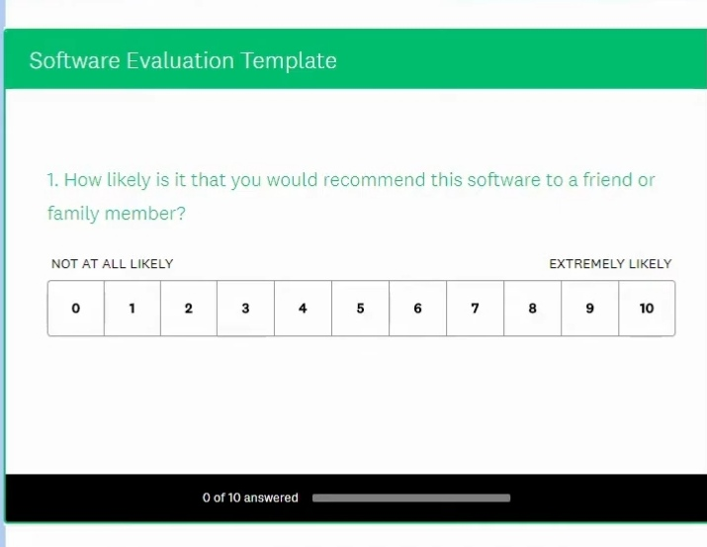
Surveys:

Slide 24
Case study:
Case studies are very much like academic reports
The idea of case study is to determine all the factors that could have influenced, affect a certain outcomes.
Consider the sequence of :conception, hypothesis setting, design, preparation, execution, dissemination, and decision making.
Describing what the product was created to do.

Slide 25
Ways of doing case study:
Sister projects:
Finding two products that have very similar variables and comparing these two against one another.
Baseline:
Comparing product against the organizational or industrial norm for what the product should do.
Random selection:
Allow us to break our product into parts and look at each of them individually.

Slide 26
Formal Experiments:
Like scientific method.
We have a research question or a goal we have a hypothesis or what we expect to happen.
Listing of variables that could influence what your outcome is and you determine if they need to be controlled or if they need to be altered in order to change the outcome.
They are repeatable(to increase accuracy).

Slide 27
Formal experiments(example):
Does multithreading increase speed of sorting.
Hypothesis: the more threads used in a Merge sort, the faster the sort
Variables:
Independent-number of threads.
Dependent-time to sort
Controlled: data to sort, system specs(number of cores, speed of processor, etc.)other processes using memory etc.
Sample result:
Multithreading increases merge sort speed by a factor of 1.92*(# of thread-1)on average, until number of core is exceeded.

Slide 28
Evaluation process
The attribute related to quality of software have been grouped differently by different models.
Boehm
ISO 9126
Dromey’s build your own “Quality” model technique

Slide 29
Using multi-layered categories to organize different desirable software attributes Essentially breakdown into
Portability
As-is-Utility
Maintainability

Slide 32
Dromey’s Criticism of “Quality” Model 1996
Believes that: “A software products tangible internal characteristics or properties determines its external quality attributes”
Two main issues in tackling the issue of linking “tangible”(and measurable internal ) properties with “intangible” (higher level external) properties:
Many properties seem to influence the “quality” of software
There is little evidence that indicates which lower level property affect the higher level quality properties.

Slide 33
Dromey's Technique of building Quality Model
1. Pick the software component (e.g. code, requirements. etc.)
2. Identify a set of "high" level quality properties (e.g. from ISO 9126 as a starter).
3. Identify the product component (e.g. for code — data variables, assignment statements. etc. )
4. Identify "quality carrying" properties associated with this component (e.g. what properties affect the quality of a data variable? — "is it correctly defined" property is tangible for data variable)
5. Link the lower tangible property to the higher level quality property. (e.g. "correct definition" may linked to a higher level quality property of "reliability" or "maintainability")
6. Refine and improve the model

Slide 34
Software Quality characteristics
• Functionality - the capability of the software to provide functions which meet stated and implied needs when the software is used under specified conditions.
• Suitability -the capability of the software to provide an appropriate set of functions for specified task: and user objectives.
• Accuracy - the capability of the software to provide right or agreed results or effects.
• Interoperability - the capability of the software to interact with one or more specified systems.
• Security - the capability of the software to prevent unintended access and resist deliberate attacks intended to gain unauthorized access to confidential information, or to make unauthorized modifications to information or to the program so as to provide the attacker with some advantage or so as to deny service to legitimate users.

Slide 35
Evaluation Technique

Slide 36
Conclusion
Software Verification and Validation methods are also referred to as software Quality control.
Software Product Evaluation is an instrument that supports in controlling actual implementation of investment proposals i.e. translating investment proposal into quality profile, on the bases of which actual product can be created.

