Slide 1
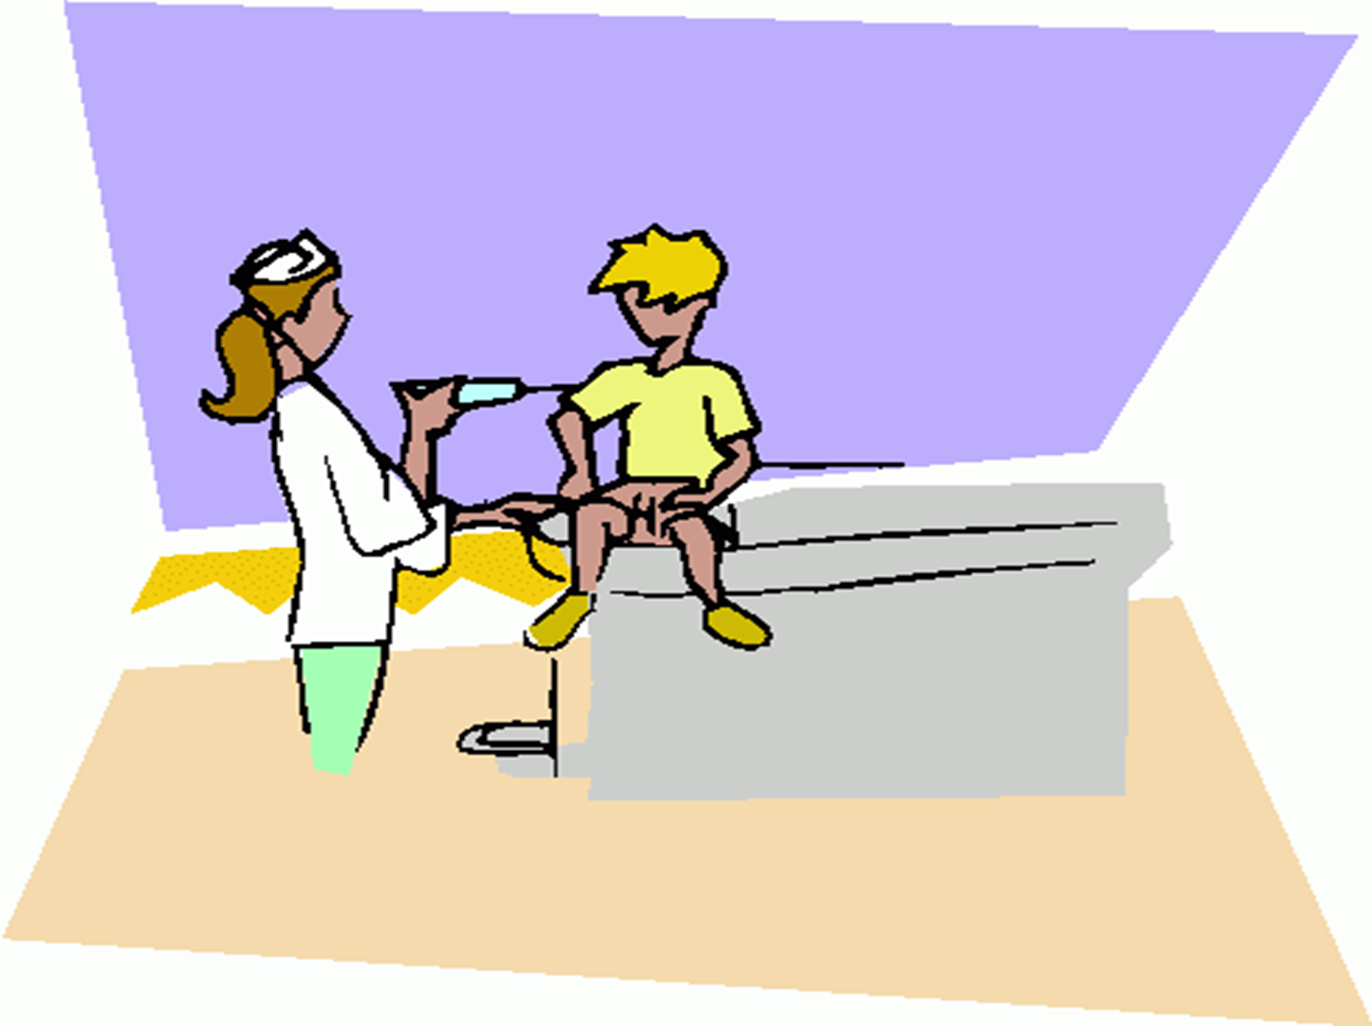
Expended Program of immunization(EPI)

Slide 2
The Expanded Programme on Immunization (EPI) is a disease prevention activity aiming at reducing illness, disability and mortality from childhood diseases preventable by immunization.
These diseases are referred as 8 EPI target diseases and cause millions of ailments, disabilities & deaths each year

Slide 3
Poliomyelitis
Neonatal Tetanus
Measles
Diphtheria
Pertussis (Whooping Cough)
Hepatitis-B
Hib Pneumonia & Meningitis
Childhood Tuberculosis

Slide 4
The objectives of EPI:
1. To achieve 100% coverage with all EPI vaccines.
Example:
The coverage rate for measles vaccine by the year 2002 in a city Y=
The No. of the infants received measles vaccine in the year 2002 in city Y X100
The total No. of the targeted infants during the same year & locality

Slide 5
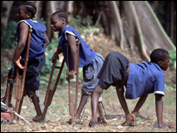
2. Eradication of polio to maintain polio free status.

Slide 6
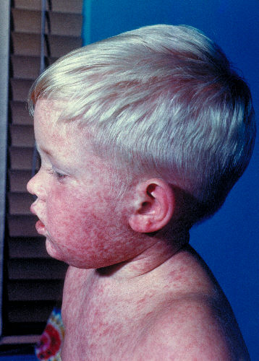
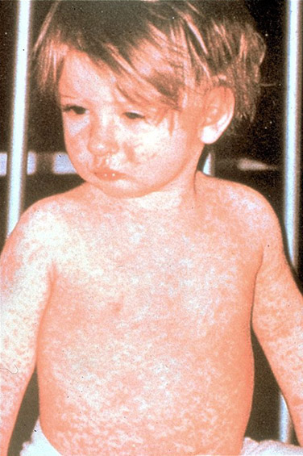
3. Elimination of measles.

Slide 7
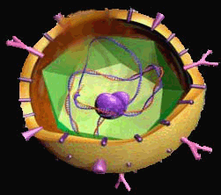
4. Reduce
seroprevalence of
(HBsAg)to <1%
among under five.
HBV

Slide 8
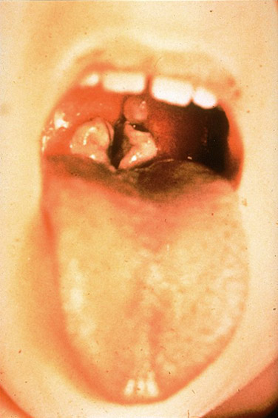
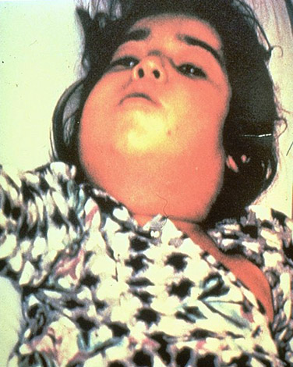
6. To maintain zero level of diphtheria.

Slide 9
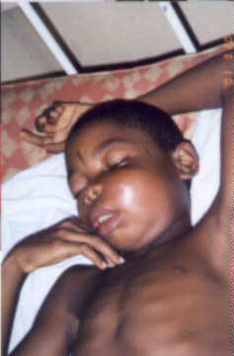
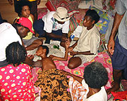
7.Prevention of severe forms of TB ( TB meningitis &miliary TB).
12 year old girl with TB meningitis

Slide 10
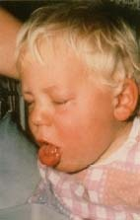
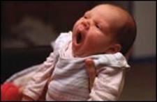
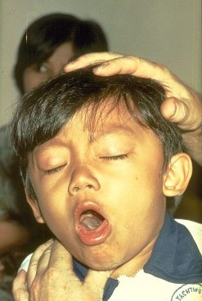
8. To reduce the incidence of whooping cough
.

Slide 11
9.Reduce the incidence of Bacterial Meningitis due to haemophelus influenza
10. To maintain immunization safety.
11.To prepare for introduction of new vaccines

Slide 12
Components of EPI
Routine Immunization
Children 0-23 months – immunization with 8 EPI antigens
Pregnant ladies by TT.
Supplemental Immunization Activities
Routine immunization does not ensure 100% coverage of the mobile population i.e. nomads, NAs, hard to reach areas / missed areas. So SIAs(supplimentry immunizaion activities) are scheduled to ensure coverage of this population / areas.
NIDs / SNIDs: children < 5 years receive polio drops (3-days campaign)
Disease Surveillance
To detect every case of target diseases, the suspected cases of seven VPDs are reported by health facilities to the district health authorities for immediate launching of the control measures.
Mopping up
Special campaigns 5-8 km around the infected locality to localize the disease and stop its transmission.

Slide 13
The Schedule of Compulsory Vaccination

Slide 14
At birth
 | Diseases | Type of vaccine | Dose | Rout of administration
1-BCG 2-HBV | TB Hepatitis B | Live attenuated, variant Recombinant, yeast derived HBs antigen | 0.01ml 0.5 ml | ID injection in left deltoid IM thigh
Notes:
Bacillus Calmette–Guérin (historically Vaccin Bilié de Calmette et Guérin commonly referred to as Bacille de Calmette et Guérin or BCG) is avaccine against tuberculosis that is prepared from a strain of the attenuated (weakened) live bovine tuberculosis bacillus

Slide 15
2nd month
Rout of administration | Dose | Type of vaccine | Diseases
oral | 2 drops | Live attenuated | Polio | 1-OPV
IM thigh | 0.5 ml | polysaccharide conjugate | Hib disease | 2-HiB
IM thigh | 0.5 ml | Recombinant, yeast derived HBs antigen | Hepatitis B | 3-HBV
IM thigh | 0.5 ml | Toxoid (D) Toxoid (T) Killed pertussis (P) | Diphtheria Tetanus Whooping cough | 4-DPT

Slide 16
4th month
Rout of administration | Dose | Type of vaccine | Diseases
oral | 2 drops | Live attenuated | Polio | 1-OPV
IM thigh | 0.5 ml | polysaccharide conjugate | Hib disease | 2-HiB
IM thigh | 0.5 ml | Toxoid (D) Toxoid (T) Killed pertussis (P) | Diphtheria Tetanus Whooping cough | 3-DPT

Slide 17
6th month
Rout of administration | Dose | Type of vaccine | Diseases
oral | 2 drops | Live attenuated | Polio | 1-OPV
IM thigh | 0.5 ml | polysaccharide conjugate | Hib disease | 2-HiB
IM thigh | 0.5 ml | Recombinant, yeast derived HBs antigen | Hepatitis B | 3-HBV
IM thigh | 0.5 ml | Toxoid (D) Toxoid (T) Killed pertussis (P) | Diphtheria Tetanus Whooping cough | 4-DPT

Slide 18
12th month
Mode of administration | Dose | Type of the vaccine | The disease
Subcutaneous | 0.5 ml | All Live attenuated | Measles, Mumps German Measles | 1-MMR

Slide 19
18th month
Rout of administration | Dose | Type of vaccine | Diseases
oral | 2 drops | Live attenuated | Polio | 1-OPV
IM thigh | 0.5 ml | polysaccharide conjugate | Hib disease | 2-HiB
IM thigh | 0.5 ml | Toxoid (D) Toxoid (T) Killed pertussis (P) | Diphtheria Tetanus Whooping cough | 3-DPT

