Slide 1
Professional Practice
Structure of Organizations

Slide 2
Limited Liability Company (LLC)
The LLC is a relatively new type of hybrid business structure. It is designed to provide limited liability features of a corporation and the tax efficiencies and operational flexibility of a partnership
LLC can get a tax identification number, open a bank account and do business, all under its own name.
Tax Advantages of an LLC. ...
Ownership Flexibility. ...
Management Flexibility. ...
Flexible Profit Distributions.
Notes:
Limited liability is where a person's financial liability is limited to a fixed sum, most commonly the value of a person's investment in a company or partnership. If a company with limited liability is sued, then the claimants are suing the company, not its owners or investors. A shareholder in a limited company is not personally liable for any of the debts of the company.The same is true for the members of a limited liability partnership and the limited partners in a limited partnership.^{[1]} By contrast, sole proprietors and partners in general partnerships are each liable for all the debts of the business (unlimited liability).

Slide 3
Companies
A company is a legal entity made up of an association of people.
•Companymembersshareacommonpurpose,anduniteinordertofocustheirvarioustalentsandorganizetheircollectivelyavailableskillsorresourcestoachievespecific,declaredgoals.

Slide 4
Companies
The essence of a company is that it enjoys an independent existence as a legal person.
• Ownership of the company is divided into a number of shares.
• An individual or another company may own one or more shares.
• Individuals who own shares in a company are known as the shareholders or members of the company

Slide 5
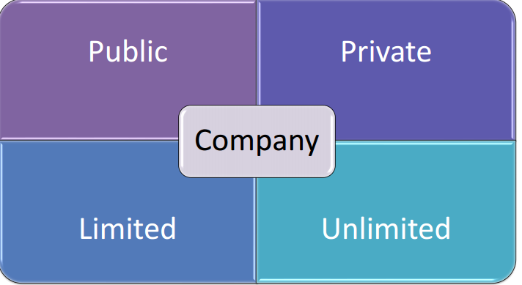
Types of Companies
Public
Private
Limited
Unlimited

Slide 6
Public Company
Public companies are allowed to offer their share to the public and their names must end with the word “Public limited company”.
• A public company has a minimum paid up capital of Rs. 5 lacs.
• Minimum 7 shareholder maximum no limit for the number of members/shareholder.
Suitable for large business.
Notes:
Public companies are publicly traded within the open market, and a variety of investors buy the shares. Most public companies were once private companies that, after meeting all regulatory requirements, opted to become public to raise capital. Examples of public companies include Chevron Corporation, F5 Networks, Inc., Google LLC, and Proctor & Gamble Company.

Slide 7
Public Company
Paid-up capital is the amount of money a company has received from shareholders in exchange for shares of stock. Paid-up capital is created when a company sells its shares on the primary market directly to investors.
Examples of Public companies in Pakistan:
ITTEHAD CHEMICALS LTD. Lahore
SITARA CHEMICAL INDUSTRIES LIMITED. Karachi

Slide 8
Private Company
A private company is a firm held under private ownership. Private companies may issue stock and have shareholders, but their shares do not trade on public exchanges and are not issued through an initial public offering (IPO)
A private company cannot offer its shares to the public and its name must end with the word “limited”. • It has a minimum paid up capital of Rs. 1 lakh. • It prohibits any invitation from public for subscription to shares and any acceptance of deposits from persons other than members or directors.
Minimum 2 and maximum 200 shareholder.

Slide 9
Examples
Khalil Private Limited. ...
Ayan Citrus Private Ltd
Xpert Solutions

Slide 10
Unlimited Company

Slide 11
Unlimited Company
In an unlimited company, the shareholders are personally liable for all the company’s debts.
• The shareholders (or members) of this type of company have unlimited liability.

Slide 12
Limited Company

Slide 13
Company limited by Guarantee:
Commonly used where companies are formed for non-commercial purposes, such as professional bodies or charities.
– The members guarantee the payment of certain fixed, usually small amount towards the company’s debts if the company wound up
– otherwise they have no economic rights in relation to the company

Slide 14
Limited by share
It is the most common form of company used for business ventures(risky investment : high success/failure)
– Specifically, a limited company is a company in which the liability of each shareholder is limited to the amount individually invested
– Corporations are the most common example of a limited company

Slide 16
“Computer Contracts”
A contract is an agreement between two or more persons creating rights & duties and which is enforceable by law.
• A contract is a promise or set of promises that are legally enforceable and, if violated, allow the injured party access to legal remedies.
• An agreement between persons which obliges each party to do or not to do a certain thing.

Slide 17
Contract
Should be set out in a clear and logical manner
– should be complete and consistent
– Should have no ambiguity
– Should be free of doubts regarding the rights and duties of concerned parties

Slide 18
Contract
There are four types of contractual arrangement which are widely used in connection with the provision of software services.
– Contract hire
– Time and materials
– Consultancy
– Fixed price
Notes:
Provision : the action of providing or supplying something for use

Slide 19
Contracts for the Supply of Custom-built Software at a Fixed Price
Structure of the Contract
• A short introductory section • A set of standard terms and conditions • A set of appendix or annexes
Notes:
An appendix contains data that cannot be placed in the main document and has references in the original copy or file. An annex, on the other hand, is usually a standalone document that offers additional information than contained in the main document.

Slide 20
The Introductory Section
The introductory section states that it is an agreement between the parties whose names and registered addresses are given.
• It is dated and signed by the authorized representatives of the parties.

Slide 21
What is to be Produced
Contract must state what is to be produced.
• Two level references is normally used.
Notes:
Two parties sign.

Slide 22
What Is to be Delivered
Producing software is not simply handing over the text of program. • Some other possibilities are – Source code – Command files for building the executable code from the source and installing it. – Documentation of the design and code. – Different manuals – Test data and test results

Slide 23
Ownership of Rights
Contract should state what legal rights are being passed by the software house the client under the contract.

Slide 24
Confidentiality
Confidentiality is the protection of personal information. Confidentiality means keeping a client's information between you and the client, and not telling others including coworkers, friends, family, etc.
• It should be highly considered while writing a contract

Slide 25
Payment Terms
Standard terms and conditions will specify the payment conditions like “payment shall become due within thirty days of the date of issue of an invoice.
If payment is delayed by more than thirty days from due date, the company shall have the right to terminate the contract or to apply a surcharge at an interest rate of 2 per cent.

Slide 26
Penalty Clauses
Delays caused by suppliers are handled by penalty clauses.

Slide 27
Some other sections of a contract
Standards and Methods of Working • Progress meetings • Project managers • Acceptance procedure • Warranty and maintenance • Indemnity • Termination of the contract • Arbitration(Arbitration, a form of alternative dispute resolution, is a way to resolve disputes outside the courts) • Inflation • Applicable law
Notes:
Indemnity :security or protection against a loss or other financial burden.
Inflation: When advising on long-term services contracts, it is therefore vital to ensure an inflationary mechanism is included

Slide 28
General Info.
Applicable Law means all applicable provisions of constitutions, laws, statutes, ordinances, rules, treaties, regulations, permits, licenses, approvals, interpretations and orders of courts or Governmental Authorities and all orders and decrees of all courts and arbitrators.
Stamp paper : way of collecting revenue for govt.

